Slide 1
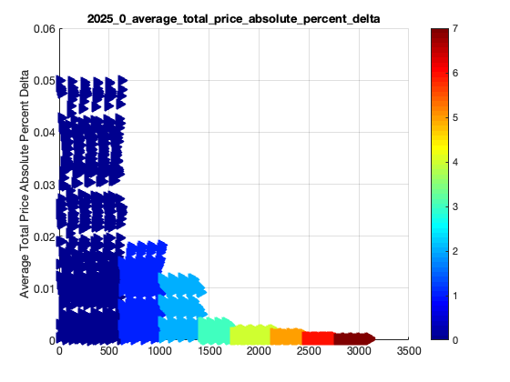
Notes:
2025_0_average_total_price_absolute_percent_delta.png

Slide 2
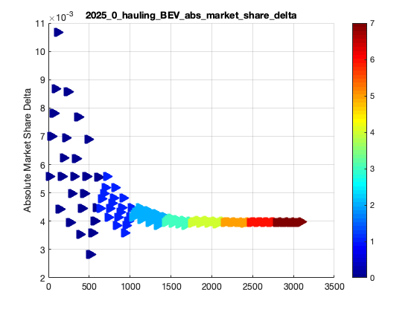
Notes:
2025_0_hauling_BEV_abs_market_share_delta.png

Slide 3
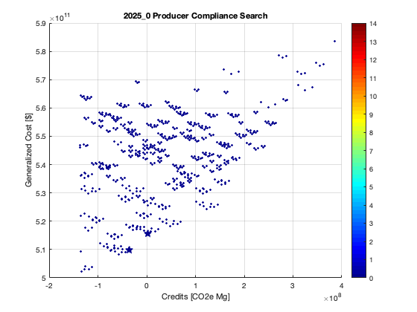
Notes:
2025_0_producer_compliance_search.png

Slide 4
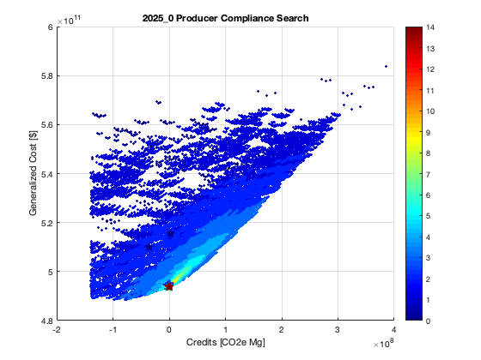
Notes:
2025_0_producer_compliance_search_colored.png

Slide 5
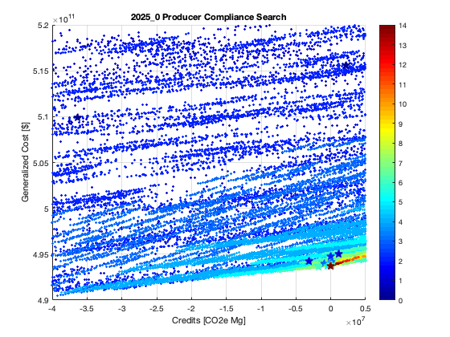
Notes:
2025_0_producer_compliance_search_colored_zoomed.png

Slide 6
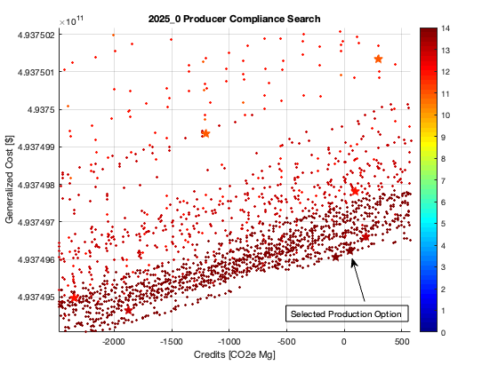
Notes:
2025_0_producer_compliance_search_final.png

Slide 7
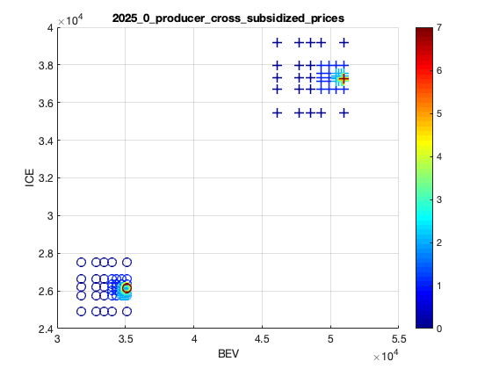
Notes:
2025_0_producer_cross_subsidized_prices.png

Slide 8
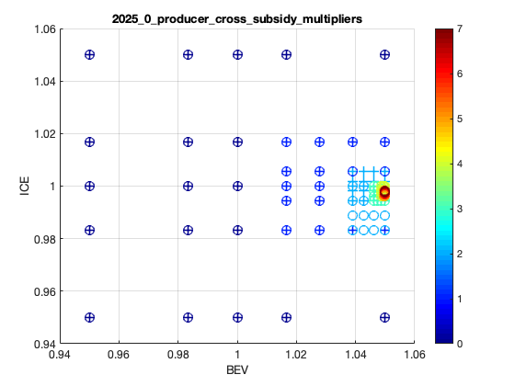
Notes:
2025_0_producer_cross_subsidy_multipliers.png

Slide 9
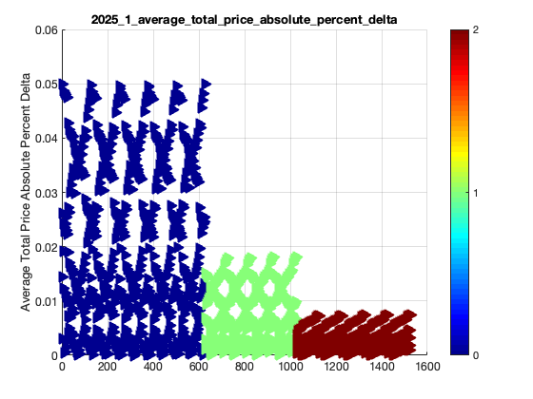
Notes:
2025_1_average_total_price_absolute_percent_delta.png

Slide 10
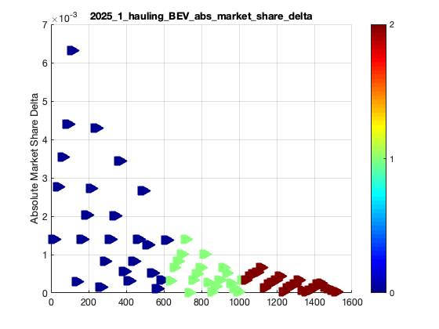
Notes:
2025_1_hauling_BEV_abs_market_share_delta.png

Slide 11
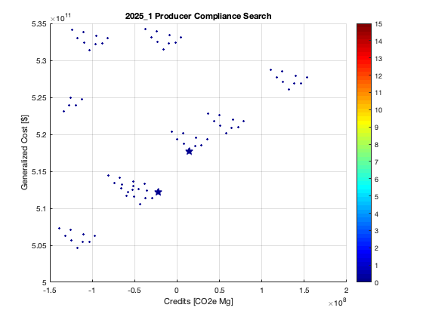
Notes:
2025_1_producer_compliance_search.png

Slide 12
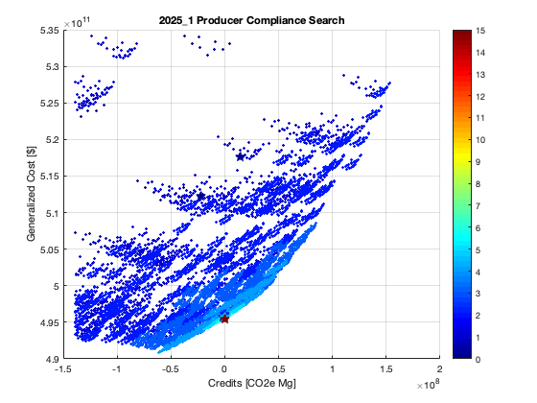
Notes:
2025_1_producer_compliance_search_colored.png

Slide 13
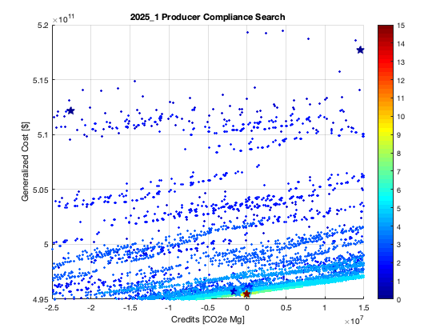
Notes:
2025_1_producer_compliance_search_colored_zoomed.png

Slide 14
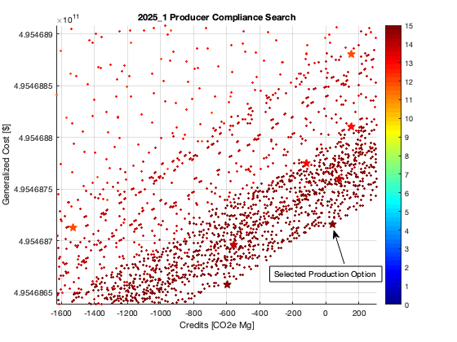
Notes:
2025_1_producer_compliance_search_final.png

Slide 15
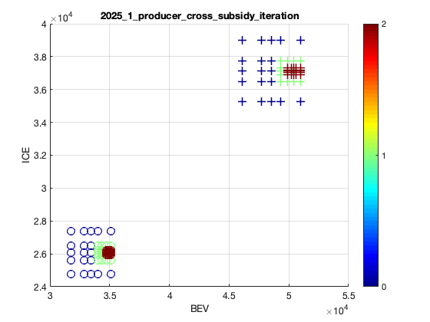
Notes:
2025_1_producer_cross_subsidized_prices.png

Slide 16
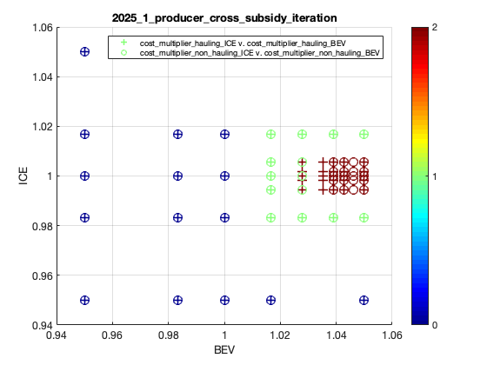
Notes:
2025_1_producer_cross_subsidy_multipliers.png

