Slide 1
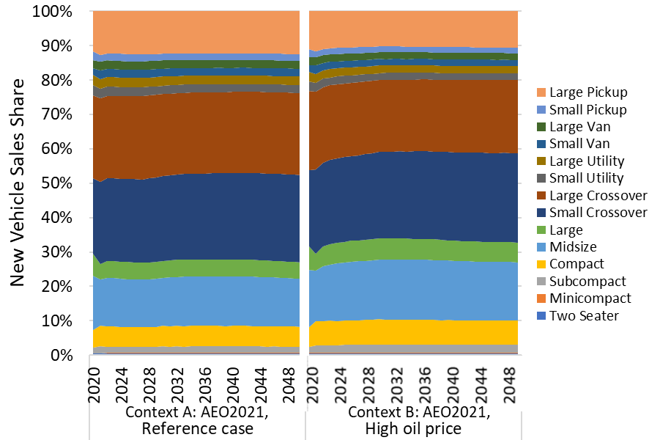

Slide 2
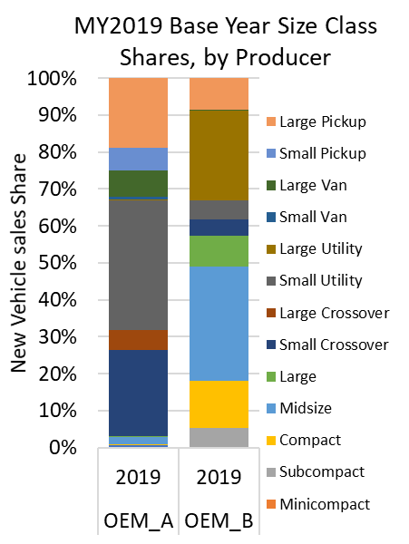
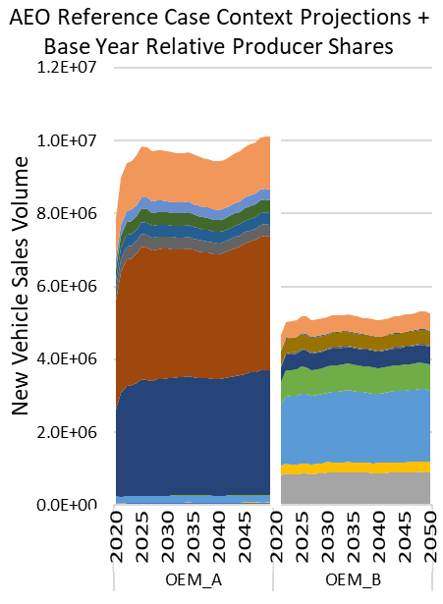

Slide 3
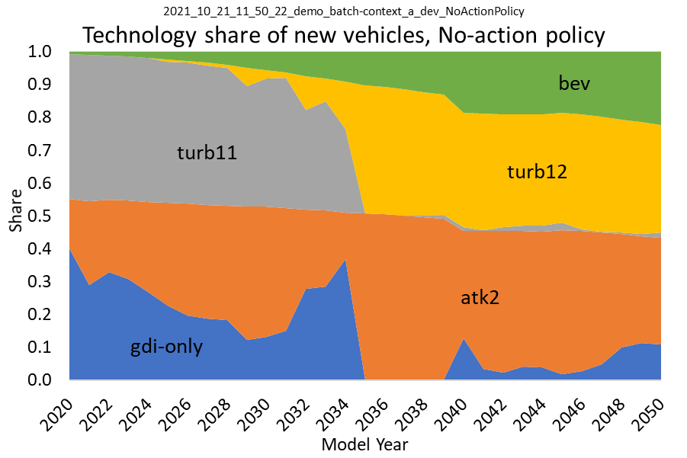

Slide 4
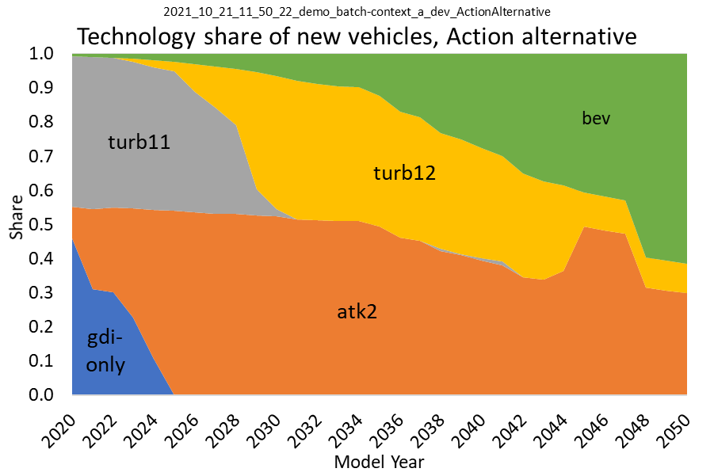

Slide 5
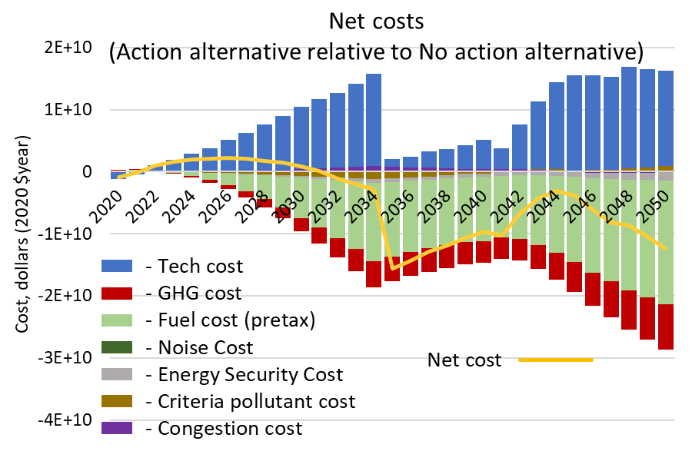

Slide 6
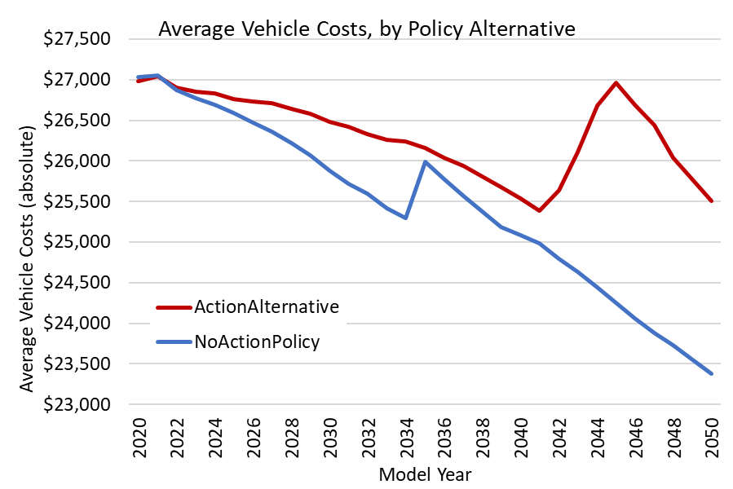
2042: start higher year-over-year target stringency
2046: first year where targets are not met
(alt1)
(alt0)
2035: start upstream accounting

Slide 7
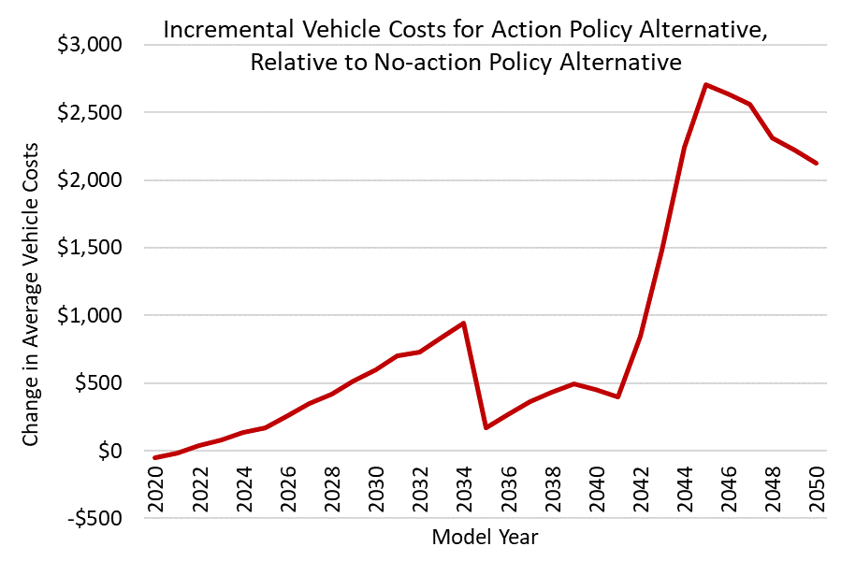
2046: first year where targets are not met
2042: start higher year-over-year target stringency
2035: start upstream accounting

Slide 8
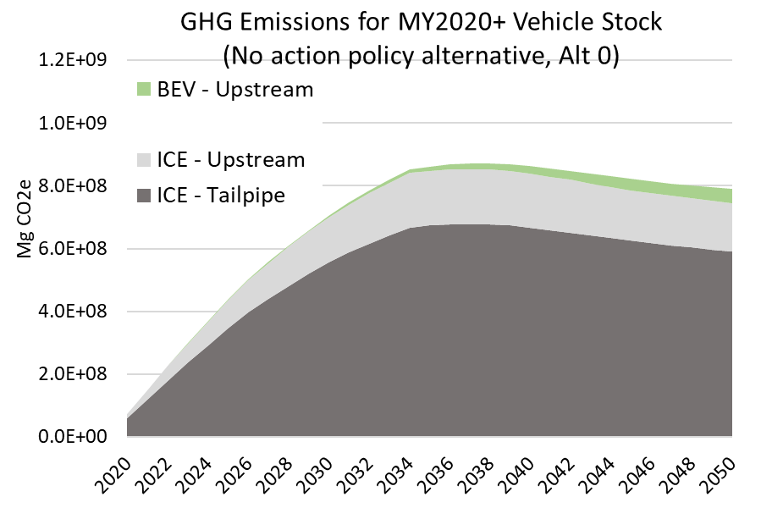

Slide 9
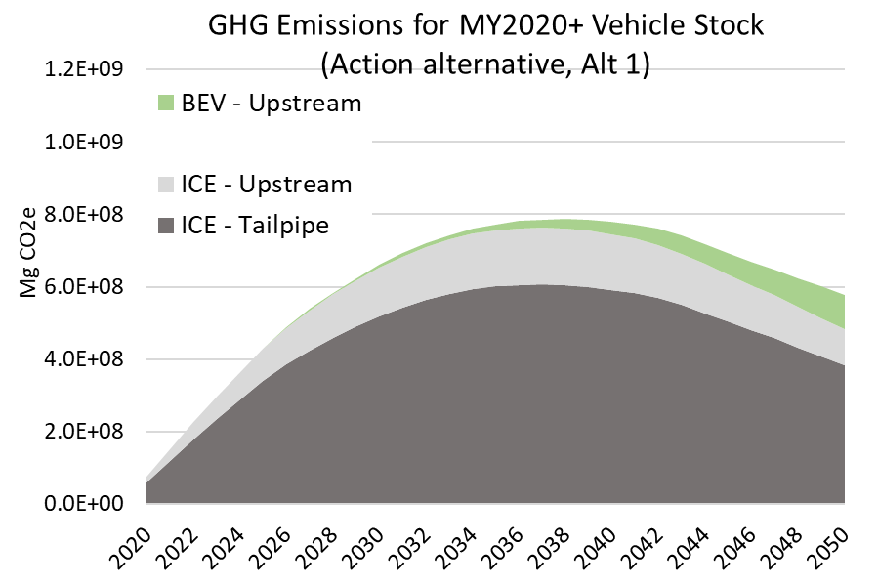

Slide 10
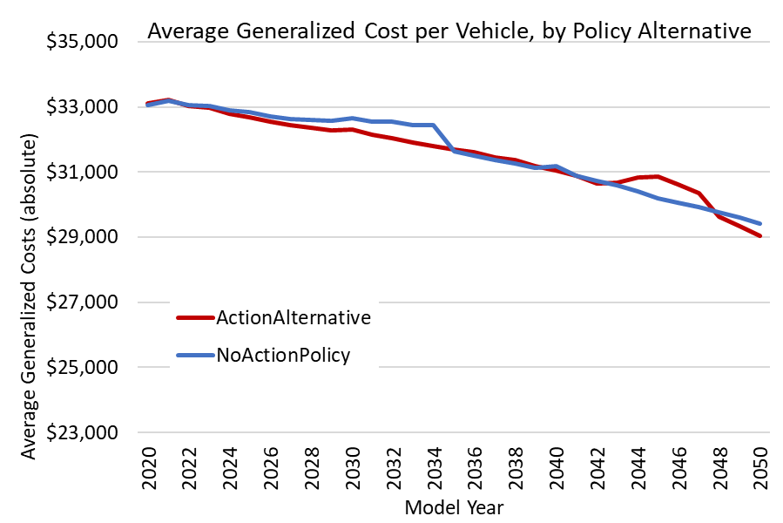
(alt1)
(alt0)

Slide 11
