Slide 1
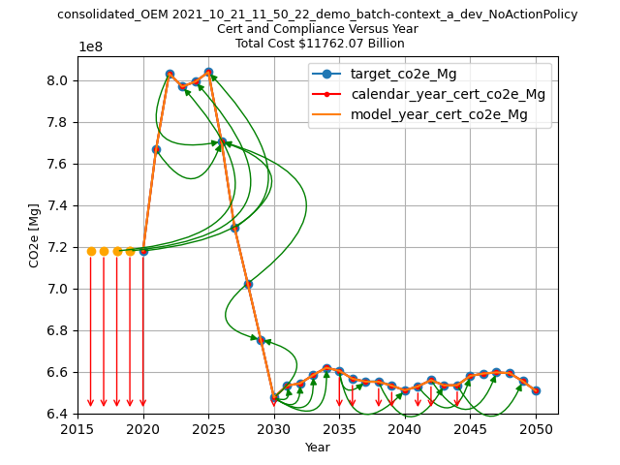
Increases through 2025 are due to increases in projected sales
Decreases through 2030 are due to decreasing vehicle emissions targets

Slide 2
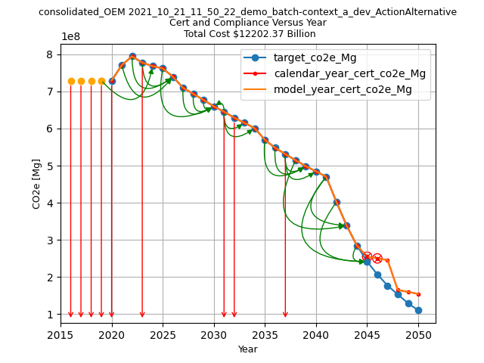
Non-compliance in 2045 and 2046 due to lack of available credits
Emissions targets decrease at an accelerated rate after 2041

Slide 3
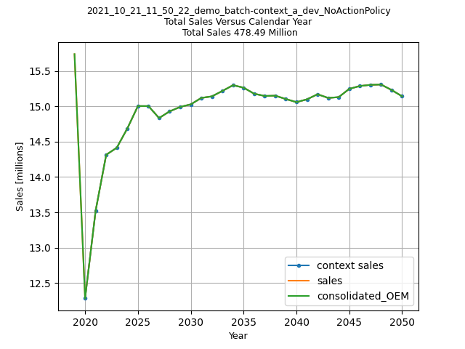
The no-action policy is the same as the context policy. Therefore, Alt 0 sales are calibrated to be the same as the analysis context sales projections.
note: this demo example was run using the ‘Consolidate Manufacturers=TRUE’ option. When OMEGA is run for individual producers, this chart will show sales for each, as well as the total (orange line.)

Slide 4
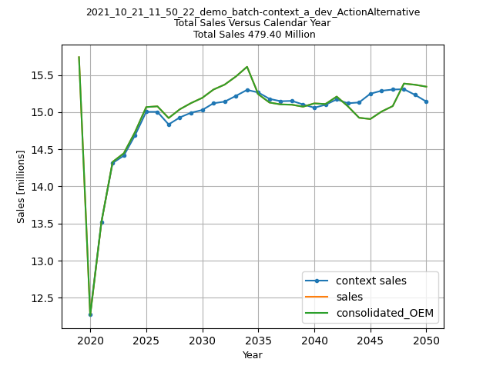
Deviations from the analysis context projected sales are the result of the assumed price elasticity of demand for new vehicles, and differences in the generalized costs between Alt 0 and Alt 1.

Slide 5
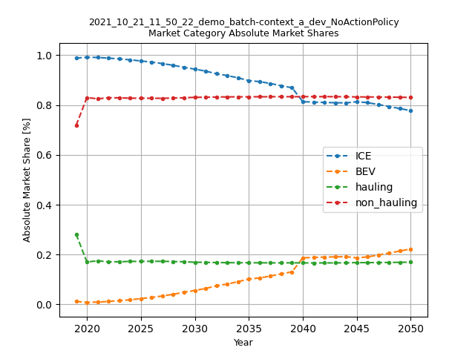

Slide 6
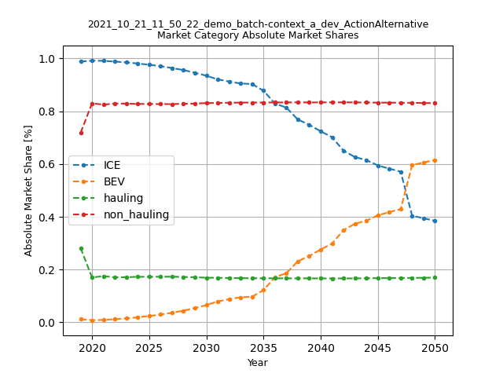

Slide 7
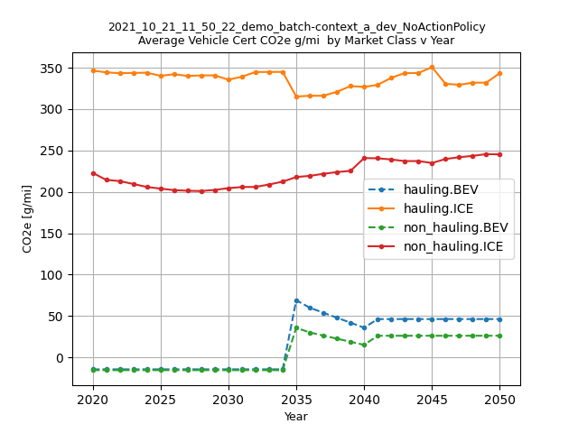
ICE cert values decrease as producer applies technology to compensate for accounting of BEV upstream
BEV cert values increase in 2035 with introduction of upstream emissions accounting in policy
BEV cert values start off at less than zero, due to ‘ac leakage’ off-cycle credit in policy

Slide 8
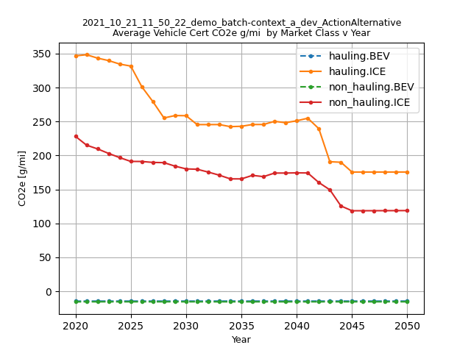
ICE technology is eventually exhausted as emissions targets decrease and producers apply increasingly more technology
Without accounting for upstream emissions, BEV cert values remain at less than zero, due to ‘ac leakage’ off-cycle credit

Slide 9
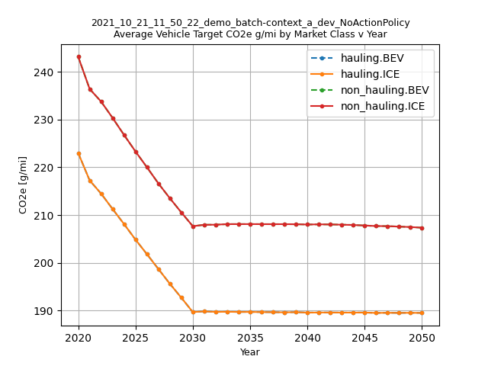

Slide 10
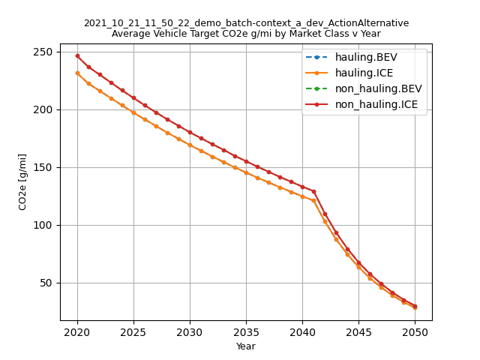

Slide 11
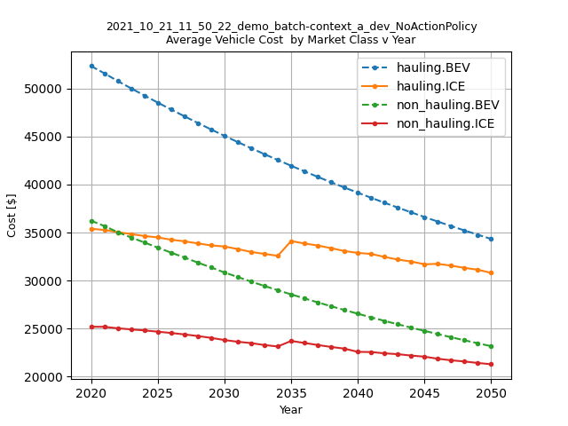
BEV cost learning at a faster rate than ICE learning
Increase in ICE cost as producers add technology to compensate for upstream emissions accounting.

Slide 12
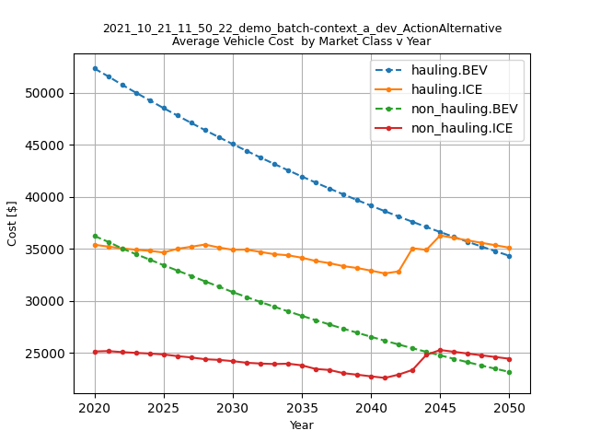
Additional ICE technology, combined with ongoing BEV cost learning results in BEV-ICE cost parity in latter years

Slide 13
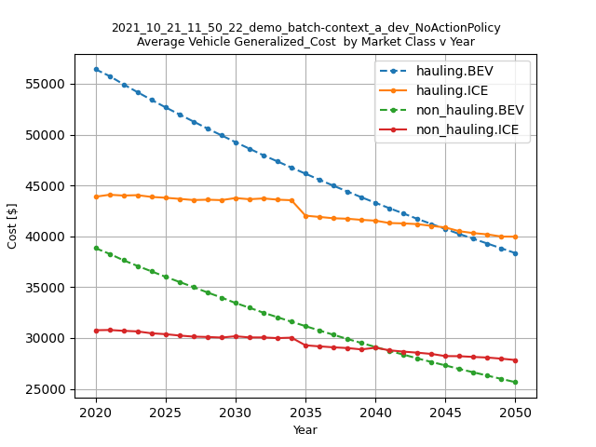
With 5 years of fuel costs included, ICE generalized costs decrease with more technology
BEV-ICE parity in generalized costs occurs earlier compared to vehicle production costs

Slide 14
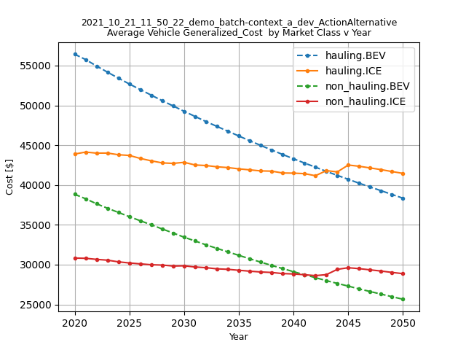
With 5 years of fuel costs included,
BEV-ICE parity in generalized costs occurs earlier than for vehicle production costs

Slide 15
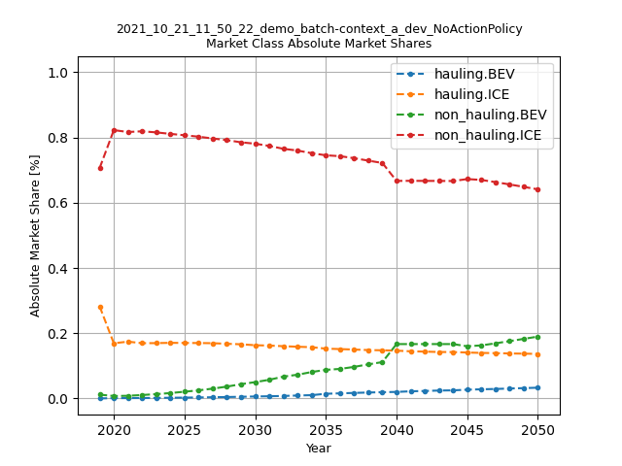
Temporary step-up in nonhauling BEVs due to minimum required share inputs.
Specified levels of minimum required share for nonhauling BEVs specified in Alt 0 policy inputs

Slide 16
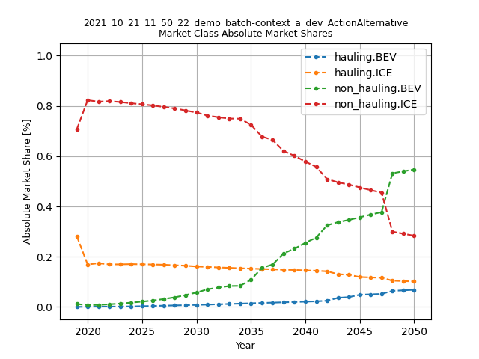
Significant increase in BEV shares as producer tries to avoid non-compliance state.
Generally, ramp up of BEV shares is greater than the less-stringent, no-action policy (Alt 0)

Slide 17
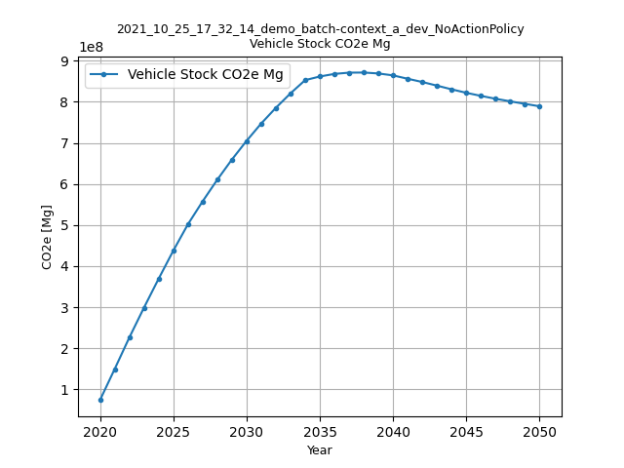

Slide 18
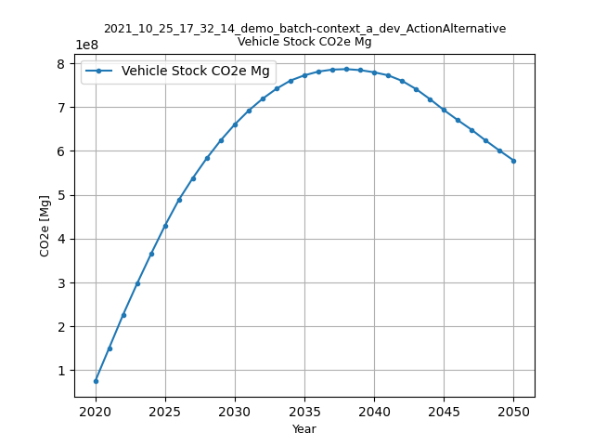

Slide 19
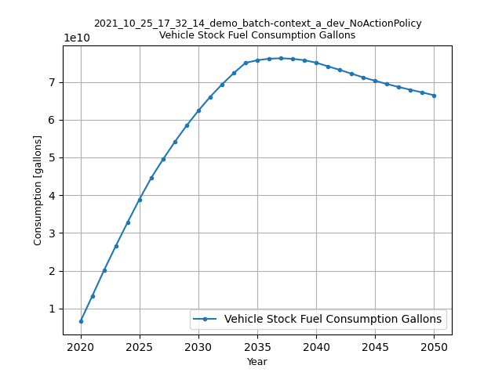

Slide 20
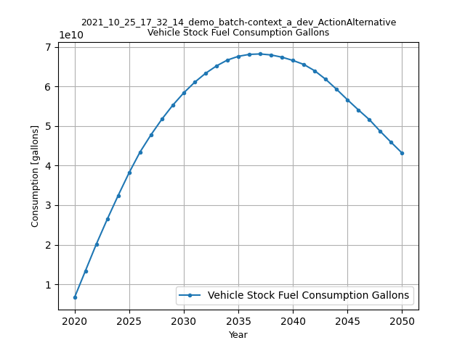

Slide 21
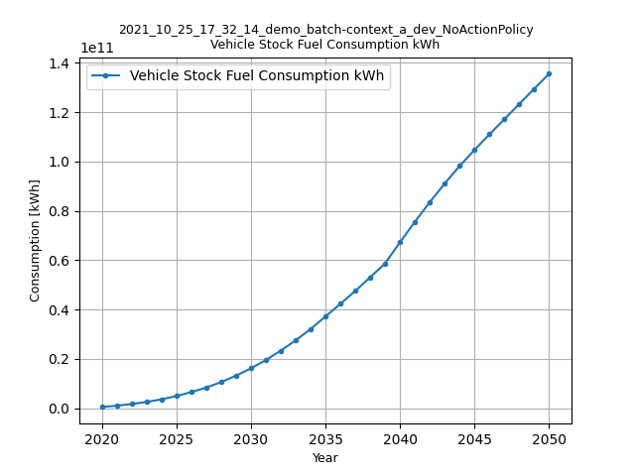

Slide 22
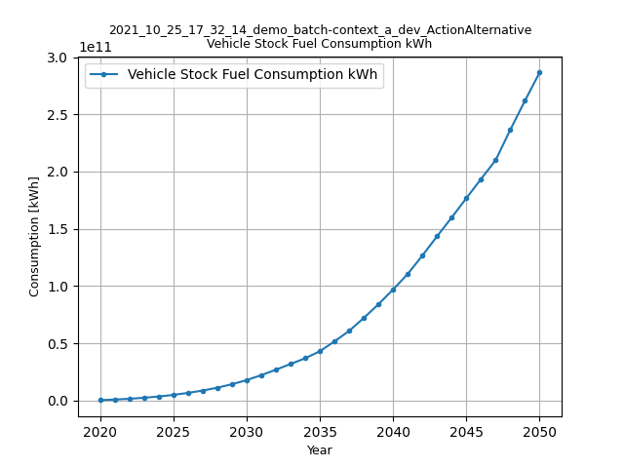

Slide 23
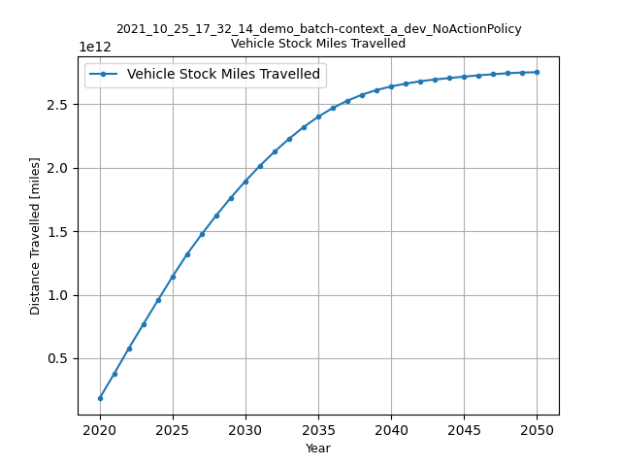

Slide 24


Slide 25
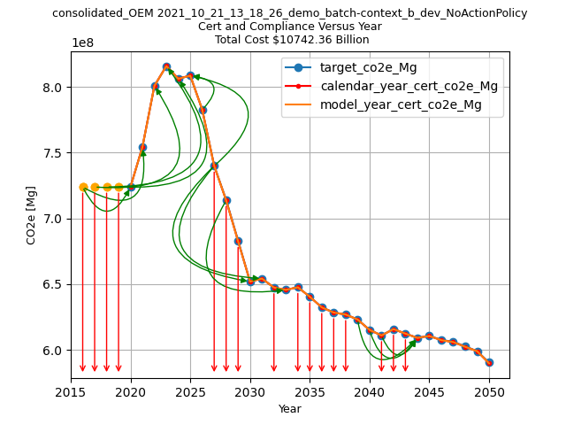

Slide 26
