Slide 1
Overview
Information Flow Diagram
Description of StEPP
Description of PPMS/PEARLS
Actions Required to Merge StEPP & PPMS
Demo of New Software ...
CenCITT 1999/2000 Proposal
“Establishing Automated Linkages Between Existing P2-Related Software Design Tools”

Slide 2
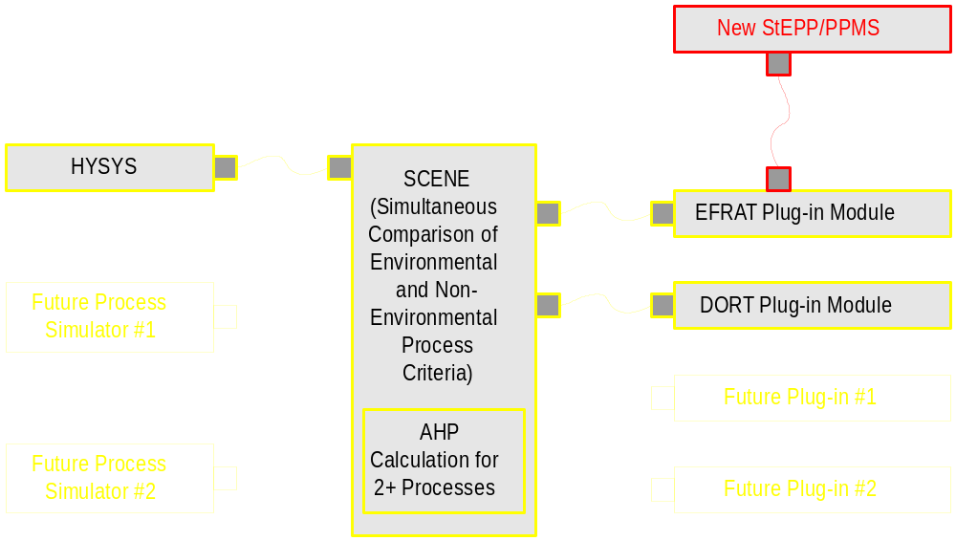
Information Flow Diagram

Slide 3
Overview
Information Flow Diagram
Description of StEPP
Description of PPMS/PEARLS
Actions Required to Merge StEPP & PPMS
Demo of New Software ...
CenCITT 1999/2000 Proposal
“Establishing Automated Linkages Between Existing P2-Related Software Design Tools”

Slide 4
Description of StEPP
Deficiencies:
  Not flexible enough to add new properties
  Cannot easily be converted to ActiveX DLL
Positive Traits:
  UNIFAC calculation system
  Well-tested and verified

Slide 5
Overview
Information Flow Diagram
Description of StEPP
Description of PPMS/PEARLS
Actions Required to Merge StEPP & PPMS
Demo of New Software ...
CenCITT 1999/2000 Proposal
“Establishing Automated Linkages Between Existing P2-Related Software Design Tools”

Slide 6
Description of PPMS/PEARLS
Deficiencies:
  Not flexible enough to add new properties
  Cannot easily be converted to ActiveX DLL
  Many calculation errors, e.g.:
    Toluene density = 104 g/cm³
    Water density = -8.73e+04 kmol/m³
    Toluene density = -8.50e+07 kg/m³
Positive Traits:
  Very large databases (DIPPR801/911)
  Good prototype of new program

Slide 7
Overview
Information Flow Diagram
Description of StEPP
Description of PPMS/PEARLS
Actions Required to Merge StEPP & PPMS
Demo of New Software ...
CenCITT 1999/2000 Proposal
“Establishing Automated Linkages Between Existing P2-Related Software Design Tools”

Slide 8
Actions Required to Merge StEPP and PPMS
Phase One:
  Finalize StEPP/PPMS agreement (today)
  Add additional units and estimation techniques
Phase Two:
  Add printing, exporting, searching
  Add UNIFAC calculations
  Link with EFRAT and SCENE
Phase Three:
  Develop SMILES-based estimation methods
  Link with Jane’s model

Slide 9
Overview
Information Flow Diagram
Description of StEPP
Description of PPMS/PEARLS
Actions Required to Merge StEPP & PPMS
Demo of New Software ...
CenCITT 1999/2000 Proposal
“Establishing Automated Linkages Between Existing P2-Related Software Design Tools”

Slide 10
Demo ...

