Slide 1
Overview
Information Flow Diagram
Main Objectives
Additional Objectives
Development Status
CenCITT 1999/2000 Proposal
“Establishing Automated Linkages between Existing P2-Related Software Design Tools”

Slide 2
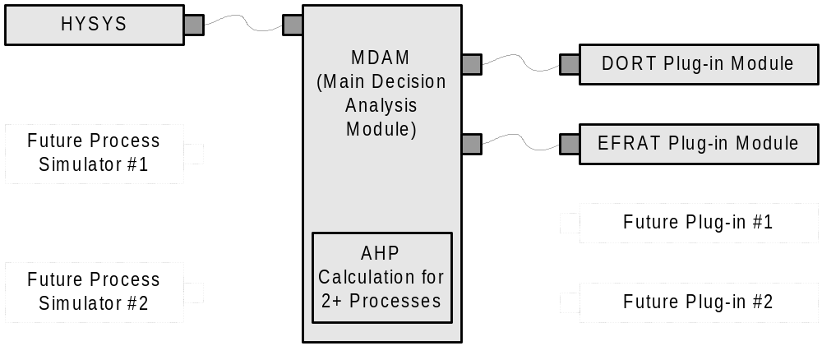
Information Flow Diagram

Slide 3
Main Objectives
Minimize the required user input to CPAS-enable a HYSYS process flow diagram (PFD)
Calculate cost and environmental risk factors for a CPAS-enabled PFD
Calculate AHP values for 2+ CPAS-enabled PFDs
Provide simple navigation/visualization of all data within the AHP tree
Construct linking standards for future plug-in DORT-like and EFRAT-like modules to maximize the future use of the design comparison features of CPAS

Slide 4
Additional Objectives
Minimize initial user input to CPAS-enable the PFD
Make data requiring entry easy to find
For CPAS-enabled PFDs:
  Minor changes in HYSYS should require only that the user click the “Synchronize” button
  Major changes in HYSYS should result in only small data entry (new unit operations, new streams, etc.)
AHP output for 2+ CPAS-enabled PFDs by one button
User must have large control over any default values suggested by the software (physical properties, emission factors, cost factors, etc.)

Slide 5
Development Status
HYSYS-to-MDAM Link: 10% Complete
MDAM Software: 30% Complete
DORT Conversion: 10% Complete
EFRAT Conversion: 10% Complete

