Slide 1
Design Options Ranking Tool (DORT)
Eric J. Oman
6/98

Slide 2
Overview
Simple Case Study
  Introduction
  Demonstration using DORT Software
Demo of New Databases
Feedback / Questions

Slide 3
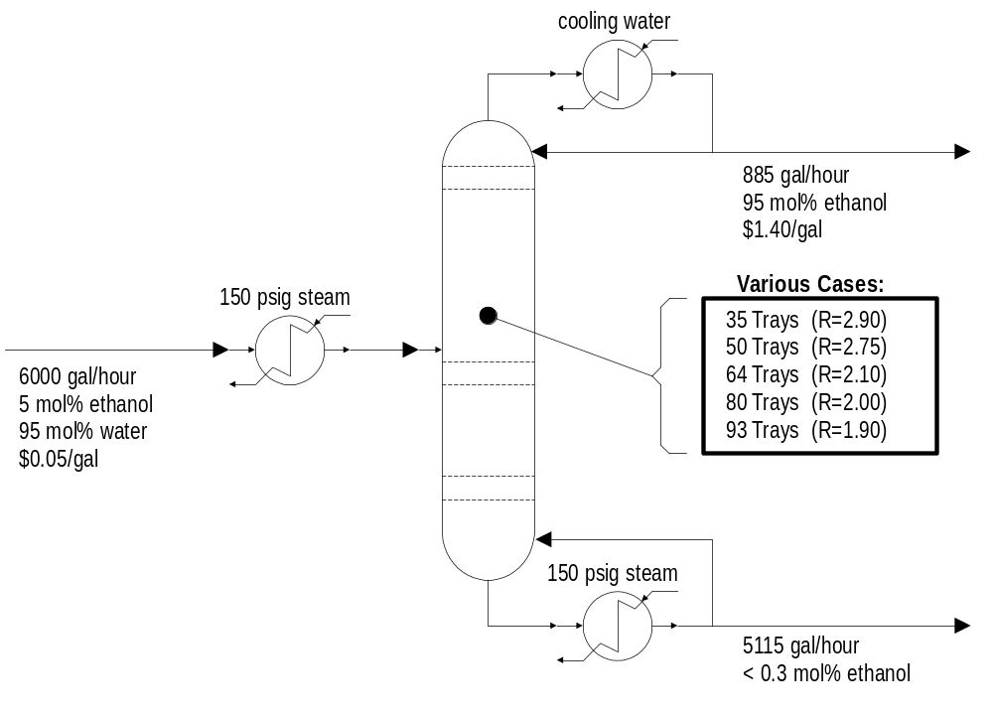
Simple Case Study: Reflux Ratio Optimization

Slide 4
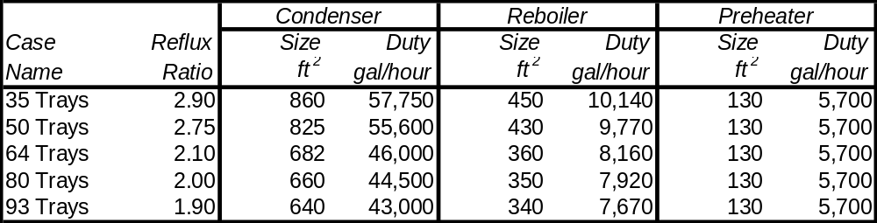
Design Specifications for Case Study
Only 4 pieces of equipment
Nonetheless, the optimal reflux ratio is not immediately obvious

Slide 5
Demonstration ...

Slide 6
Recommended Future Work
Add support for “plant areas”
Add printing of cost factors
Perform extra error trapping
Perform extra testing of database UI
Release to unsuspecting plant design students
Code AHP logic into DORT

