Slide 1
Overview
Objectives
  Short-Term
  Long-Term
Status Report
DORT-Centric AHP Demo
Other AHP Capabilities
Feedback / Questions
CenCITT 1999/2000 Proposal
“Establishing Automated Linkages Between Existing P2-Related Software Design Tools”

Slide 2
Short-Term Objectives
Combine DORT, EFRAT, and DEAR
Combine above with HYSYS
Maximize ability to add future plug-in modules (via ActiveX)
Version 1.0 ETA: 1-March-1999

Slide 3
Long-Term Objectives
Main Interface:
  Incorporate OPPT modules
  Incorporate WAR and TRACI algorithms (?)
  Incorporate other CPAS tools
  Commercialize as HYSYS extension
Remainder of Project (Now - July 2000):
  Work with Dr. Shonnard’s group
  Construct/commercialize other CPAS tools
  Improve on existing tools

Slide 4
Overview
Objectives
  Short-Term
  Long-Term
Status Report
DORT-Centric AHP Demo
Other AHP Capabilities
Feedback / Questions
CenCITT 1999/2000 Proposal
“Establishing Automated Linkages Between Existing P2-Related Software Design Tools”

Slide 5
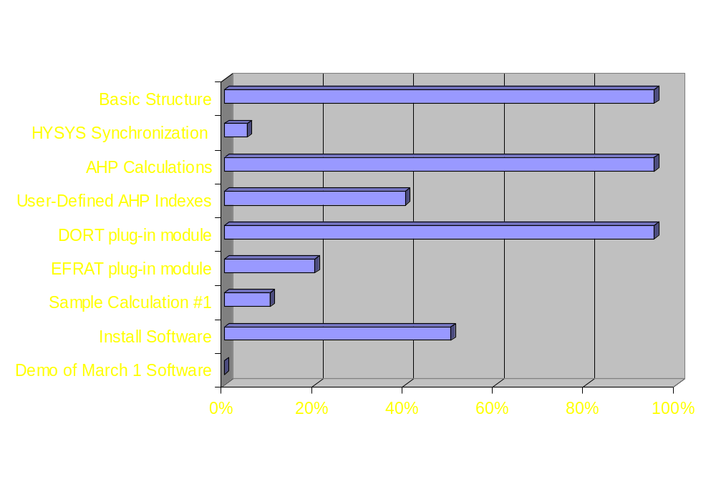
Status Report

Slide 6
Overview
Objectives
  Short-Term
  Long-Term
Status Report
DORT-Centric AHP Demo
Other AHP Capabilities
Feedback / Questions
CenCITT 1999/2000 Proposal
“Establishing Automated Linkages Between Existing P2-Related Software Design Tools”

Slide 7
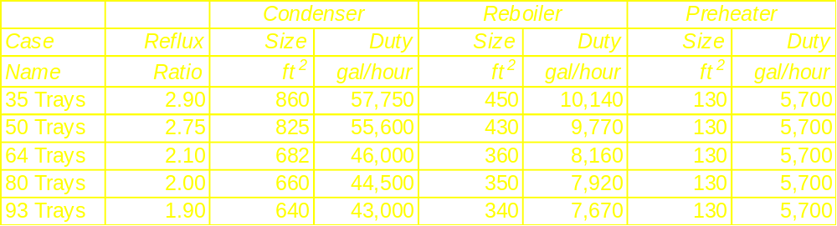
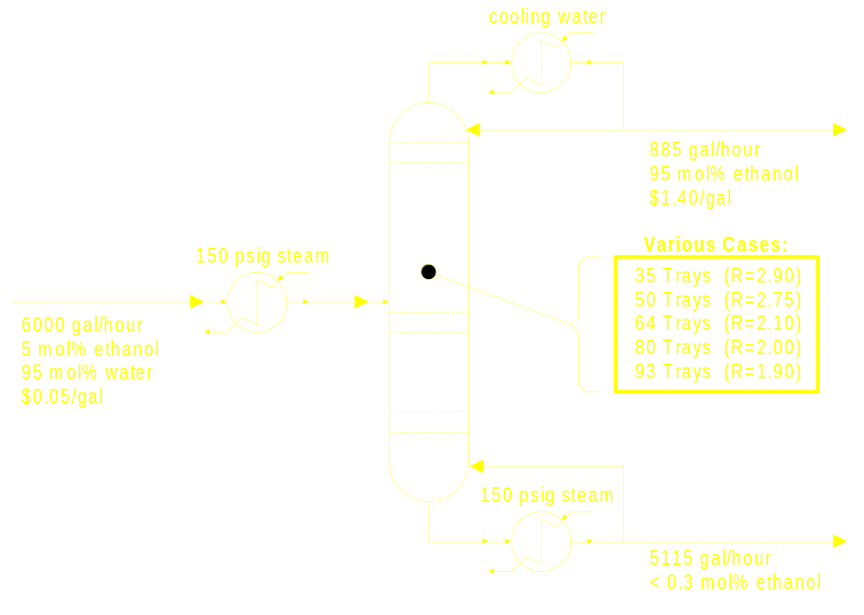
DORT-Centric AHP Demo

Slide 8
Demo ...

Slide 9
Overview
Objectives
  Short-Term
  Long-Term
Status Report
DORT-Centric AHP Demo
Other AHP Capabilities
Feedback / Questions
CenCITT 1999/2000 Proposal
“Establishing Automated Linkages Between Existing P2-Related Software Design Tools”

