Slide 1
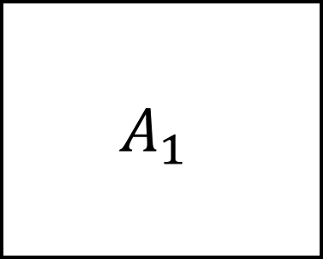
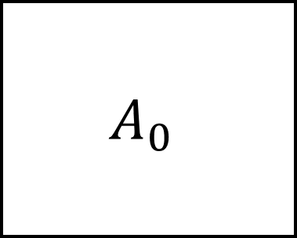


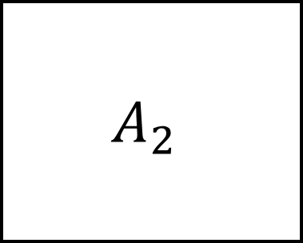
$$A_{0}$$
$$A_{1}$$
$$A_{2}$$
$$k_{01}$$
$$k_{12}$$
Exposure Compartment
Central Compartment
Cleared Compartment

