Slide 1
Using Python for information retrieval with machine learning
Risa Sayre, ORISE at EPA/ORD/NCCT
Python CoP webinar: 18 Mar 2019
Mentor for this project: Chris Grulke Current mentor: John Wambaugh
This presentation does not necessarily reflect U.S. EPA policy

Slide 2
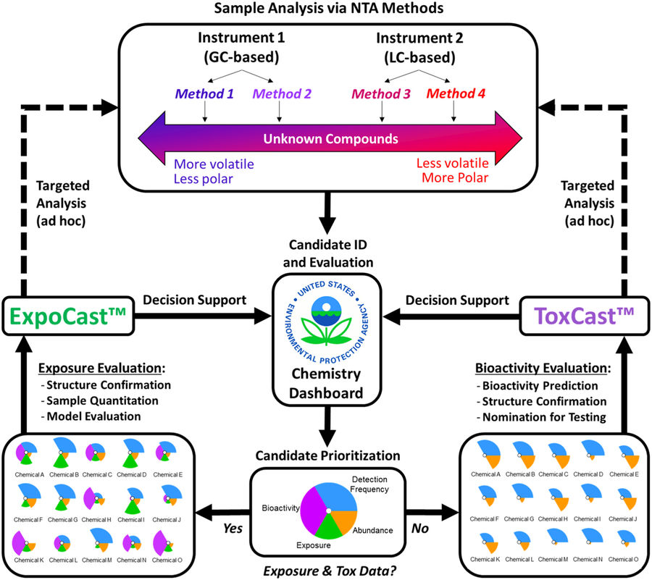
Why do we need a metabolite database?
Toxicity: “Linking agents to pathway perturbations” Nat. Acad., Using 21st Century Science...
Toxicokinetics: Improve external dose estimates based on biomonitoring data/other measurements
Exposure: Validating exposure pathway predictions
Sobus 2017
Notes:
not the technical definition of metabolite –
differentiate between endogenous and exogenous
can’t get this data from animals easily - https://www.ncbi.nlm.nih.gov/pubmed/8406924

Slide 3
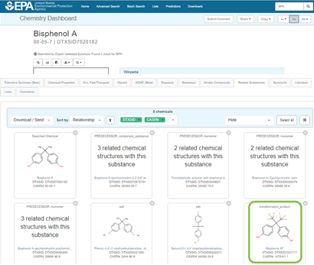
Implementation idea
Objective: Help people identify substances that may form within the body as a result of chemical exposure
Plan: Add mappings between substances to DSSTox
Data need: Evidence of relationships, metadata describing observation context
Data storage and delivery: MySQL sandbox → DSSTox; available on dashboard
Notes:
my initial interest came from my internship at CDC in the Health Studies Branch, the folks that implement NHANES. groundwater modeling to estimate exposure to pesticides in drinking wells from agricultural applications. modeling okay, but needed metab data, not only enviro, but what they could add to nhanes
came here, worked on pbpk model db, familiar with httk, cleared, okay; but what is formed?
original objective was not to create a definitive resource, but a method to create a resource
metab predication tools have a lot of fp, potentially fn

Slide 4
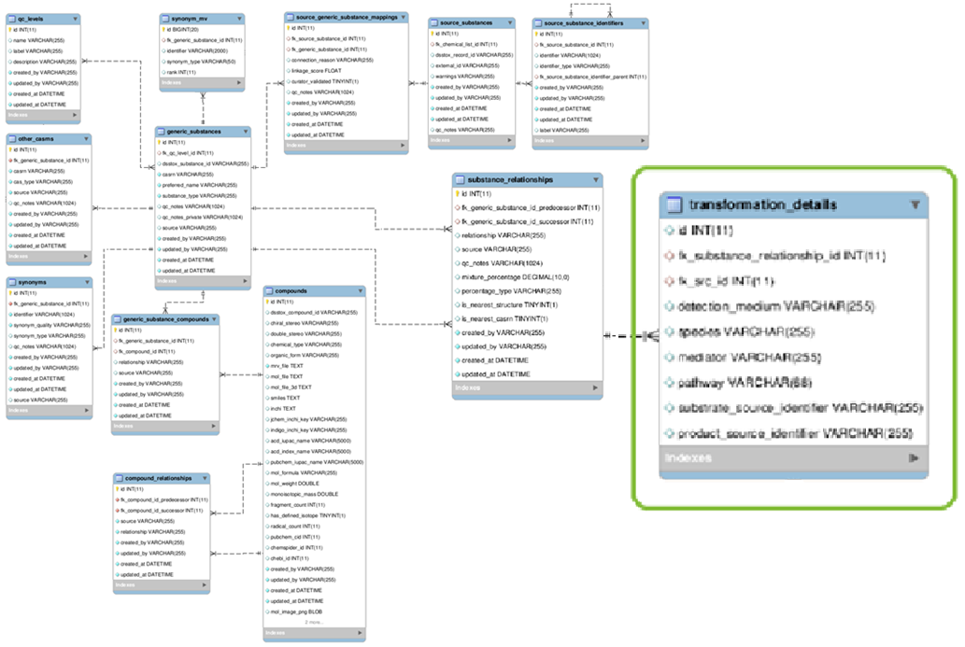
substance_relationships
transformation_details
id
fk_substance_relationship_id
fk_src_id
other_src
detection_medium
species
mediator
pathway
substrate_source_identifier
product_source_identifier
↖ Existing DSSTox structure
Proposed addition for storing metabolite metadata ↗
Notes:
obligatory eer
any suggestions?
thanks josh smith

Slide 5
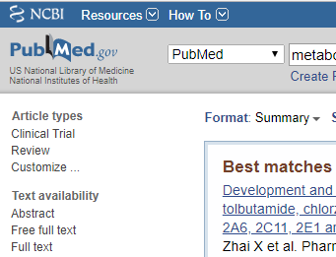
Benchmark study for PubMed source identification
Case study: Suspect screening analysis of pooled human blood samples;
1685 (out of 4284) GC-identified substances given with names, but 280 not in PubMed
Experiment zero: Abstract search for “metabolite of” AND 30 of the substance names
Results: 8371 abstracts → 11 mappings, 5 ambiguous
High FP:
PubMed search engine
False substance identification through ambiguous MeSH
Substance was not the studied compound
Low TP: < 1%
Slow: Would take over a year of full-time work to get all mappings for the set this way
Notes:
“metabolite of” 113827
again, there are a lot we still need
(spell check mapped seractide to selective)
(internal standard, etc)

Slide 6
Experiment 1: Computer-identified keywords for data source identification
Notes:
108641 results with “metabolite of” – will take a whole year even if i did nothing else
hypothesis: will identify abstracts better
ranked retrieval

Slide 7
Experiment 1: Method
Build positive set by manual curation
Training: 362 abstracts for human plasma/serum/blood metabolites
Validation: 220 abstracts
Build negative set from random abstracts
Build consensus predictions (10-fold cross validation)
Compare performance of prediction
Notes:
python 3, sklearn
informativeness, not just features

Slide 8
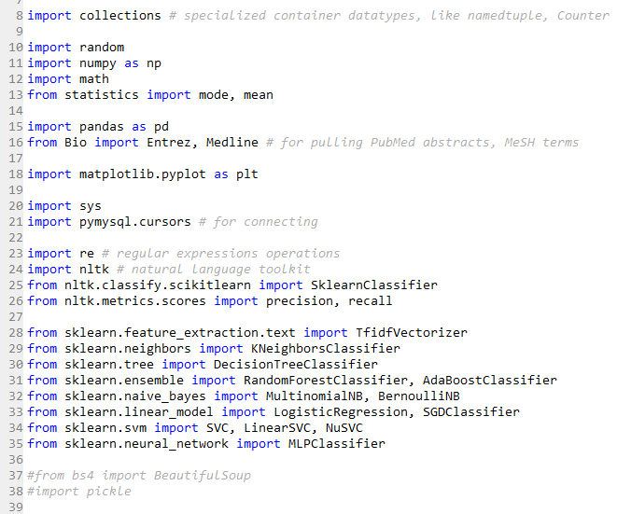
Experiment 1: Code
Packages used

Slide 9
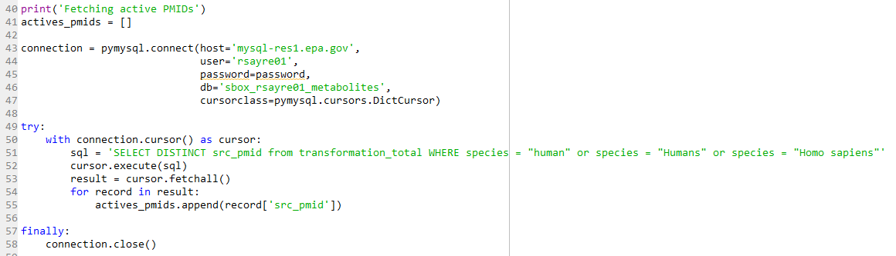
Retrieve PMIDs of positive articles from database

Slide 10
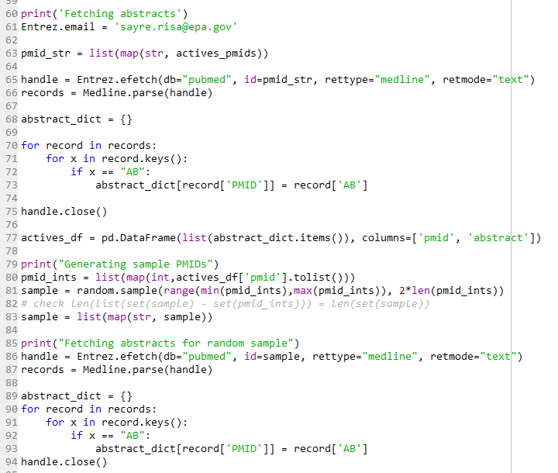
Fetch abstracts of positive articles from PubMed
Randomly generate PMIDs to serve as a negative set, fetch negative abstracts

Slide 11
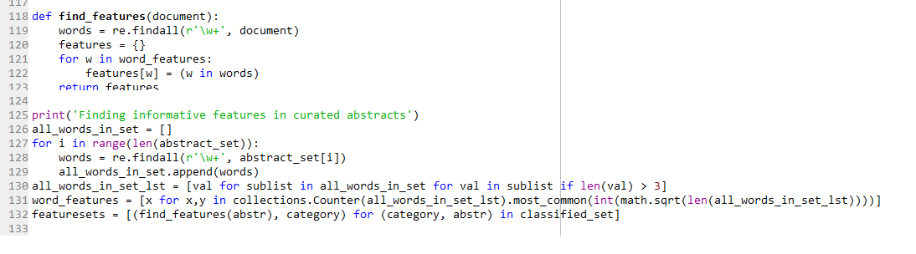
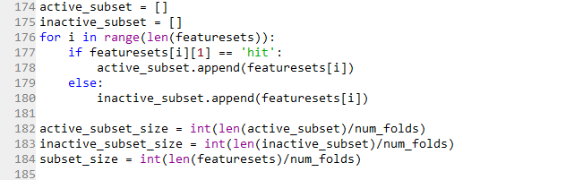
Split abstracts into words
Identify most popular words
Classify words as belonging to positive or negative abstracts

Slide 12
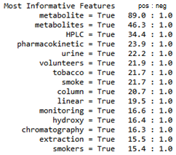
value ratios for informative features in training set with Naive Bayes classifer

Slide 13
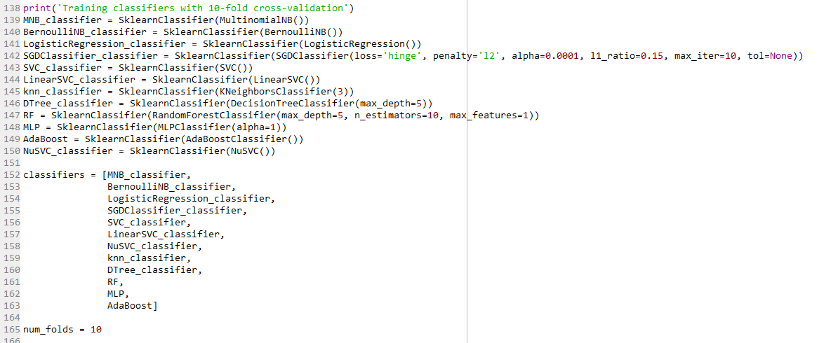
List of classifiers

Slide 14
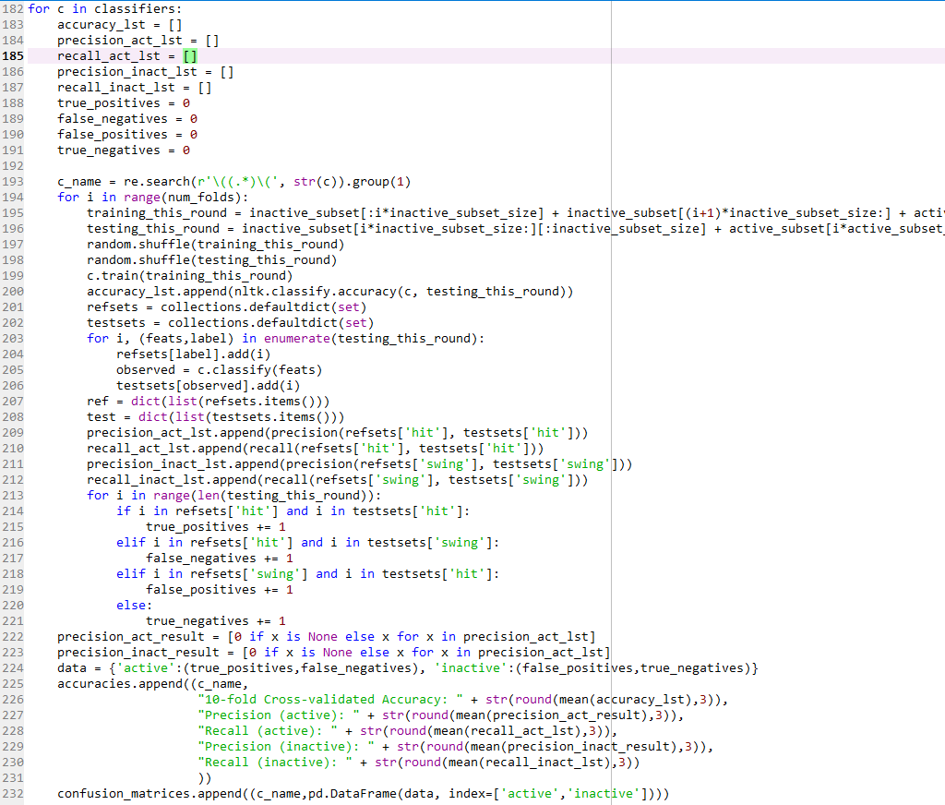
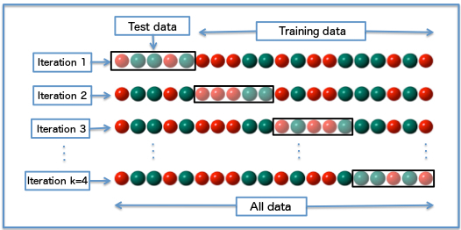
Train each classifier
Plot results
K-fold cross-validation
(By Fabian Flöck - Own work, CC BY-SA 3.0, https://commons.wikimedia.org/w/index.php?curid=51562781)

Slide 15
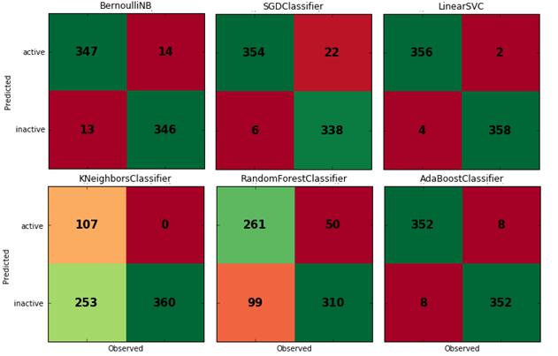
Experiment 1: Results
For 90% consensus:
Validation set (220):
TP 195, FN 4
Random set (664):
FP 4
33 contained “metabolite”, 3 contained “pharmacokinetic” and were correctly listed as negative
Reduced case study hits from to 1688808 to 14502; often found answer in top hit, but still FP
Notes:
(>70% 210/220)
(>70% 6/220)
(>70% 8/664)
this still has the problem of FP and a few FN (2)
less than 2 min train
urine, not plasma
just wrong
not human
not named
used as internal standard
endo metab
progesterone
were the assays conducted at reasonable levels to imply formation in circulation?
did it form due to heat? ph?
1685 (out of 4284) substances given with names yielded 1688808 abstracts

Slide 16
Glucuronidation of codeine was detected and compared with that of morphine in microsomes from human livers and kidneys. Vmax values for codeine-6-glucuronide (C6G) were 0.54 +/- 0.24 and 0.74 +/- 0.35 nmol/mg/min. in the livers and 0.10 and 0.13 nmol/mg/min. in the kidney, respectively, when codeine and UDP-glucuronic acid (UDPGA) were incubated with microsomal preparation. The corresponding Km values were 2.21 +/- 0.68 and 1.41 +/- 0.36 mM in the livers and 6.69 and 4.12 mM in the kidney. The average codeine glucuronyltransferase (GT) activity was 14-fold lower in the six kidneys than in the 11 livers. Higher GT activities were observed in liver microsomes from patients who had been exposed to enzyme inducers. Rates of glucuronide formation from morphine correlated significantly with those from codeine in both human liver and kidney microsomes. Morphine, amitriptyline, diazepam, probenecid and chloramphenicol inhibited codeine glucuronidation with Ki values of 3.6, 0.13, 0.18, 1.7 and 0.27 mM, respectively.
Notes:
example of positive abstract that does not contain the word metabolite
works best on in vivo vs in vitro, which reduces sample size

Slide 17
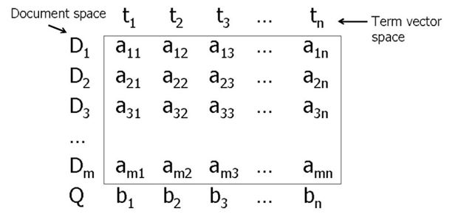


Experiment 1.1: TF-IDF, LSA
Determine set membership: TF-IDF
weights the information present in a term
tf = number of times the term appears in this document
nd = total number of documents in set
df(d,t) = number of times the term appears in all documents
Term frequency – inverse document frequency
auburnbigdata.blogspot.com/2013/03/vector-creating-from-document-set.html
Notes:
108641 results with “metabolite of” – will take a whole year even if i did nothing else
hypothesis: will identify abstracts better
ranked retrieval

Slide 18

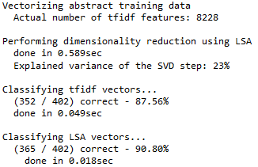
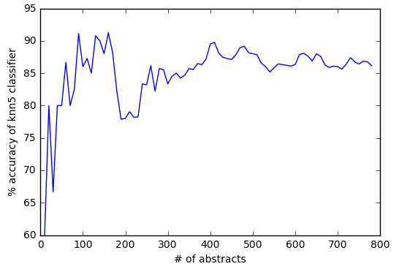

Experiment 1.1: TF-IDF, LSA
Latent semantic analysis finds a low rank approximation to the term document matrix
http://topicmodels.west.uni-koblenz.de/ckling/tmt/svd_ap.html
Experiment on how many abstracts needed to get a good result with this method
Notes:
reduce dim from 8228 to 100
works better, runs faster

Slide 19
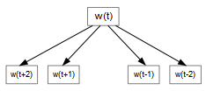
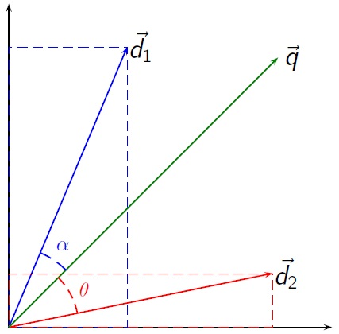
Experiment 2: Identifying data sources & content
Can I use vectors find my abstracts and extract the information I want?
Define each word’s contexts: Skip-gram
defines target words from source context words
Define each skip-gram’s semantic context: Word2vec
cosine difference in high-dimensional space
Determine each embedding’s significance in set membership: TF-IDF
Compare performance
https://en.wikipedia.org/wiki/Vector_space_model
Notes:
created word2vec in tensorflow

Slide 20
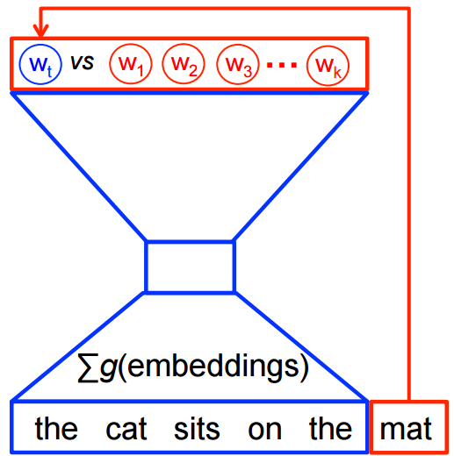
Experiment 2: Method
Build embeddings with neural network
925,066 (of 17,160,946 total) abstracts
164,784,788 words (1,585,942 unique), removed any words that occurred >1 million times
Compute maximum likelihood to predict next word given previous words
Noise-contrastive estimation (NCE) turns multinomial classification into binary given a true pair and 64 random pairs
Update NCE loss according to optimizer (SGD) at learning rate of 0.0001
Noise-contrastive estimation (NCE)
https://www.tensorflow.org/tutorials/word2vec

Slide 21
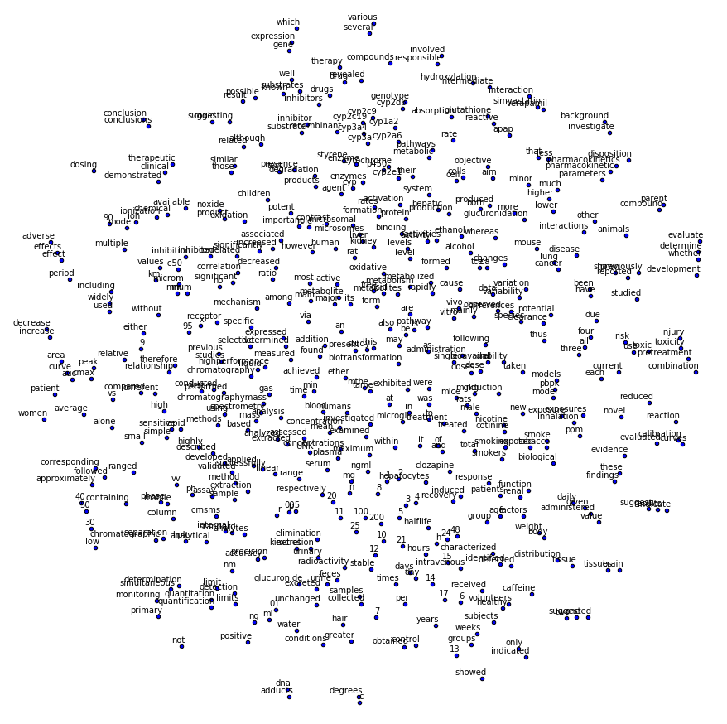
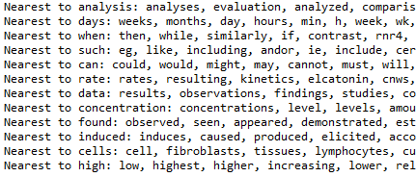
Experiment 2: Results/Conclusion
Could not reliably cluster terms in a way that improved retrieval, even though the vectors look informative
Could not complete TF-IDF on high-dimensional data without overflowing or crashing
Further dimensionality reduction possible
tSNE (PCA , n=2) vectors for 500 most common words in metabolite abstracts
Notes:
final loss was 4.79
might work better if normalize abstract len (avg 1251, max 19936)
122 of 128 explained 95% of variance
want to guess most common substance? sodium water glucose calcium
cumulative explained variation
t-Distributed stochastic neighbor embedding (t-SNE) minimizes the divergence between two distributions: a distribution that measures pairwise similarities of the input objects and a distribution that measures pairwise similarities of the corresponding low-dimensional points in the embedding”
id threshold of meaningfulness in embeddings
two word names (clustering)

Slide 22
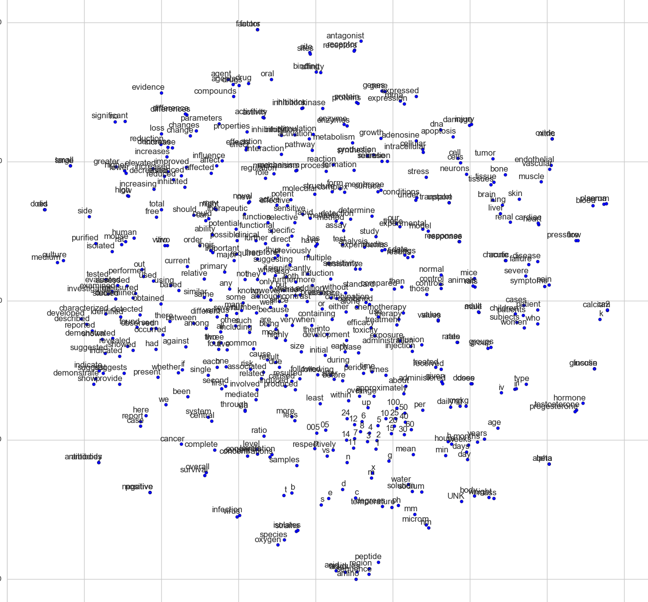

Slide 23
Experiment 3: Simpler information retrieval
Methods
Identify metabolite name identification context
Query for most prevalent phrases: “metabolite of”, “its metabolite”, etc.
Identify parent and metabolite compounds
Find MeSH RN term in abstract text within identified context
Identify media type from MeSH terms
Organ, cell type, assay names
Identify mediators from MeSH
CYP, MFO, etc.
Results
Validation set (220) performance
Mappings:
found 23% of manual mappings
missed additional metabolites
Media: pretty good
Species: pretty good, but some FP
Mediator: low retrieval
Notes:
Same training and evaluation sets as before

Slide 24
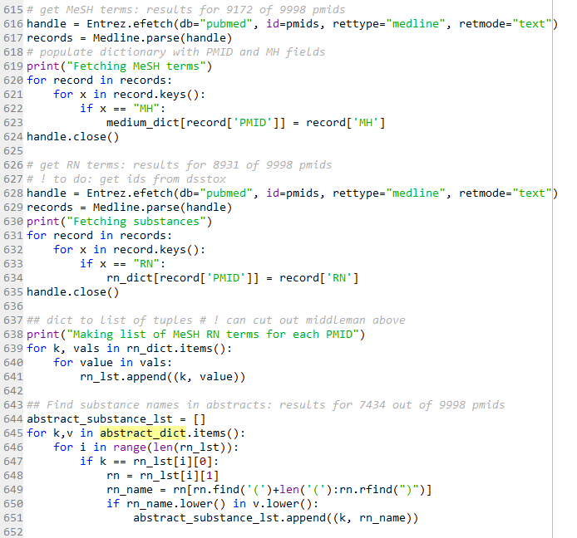
Experiment 3: Code
Get MeSH chemical names and related terms for each abstract
Find location of terms in abstract
Notes:
Same training and evaluation sets as before

Slide 25
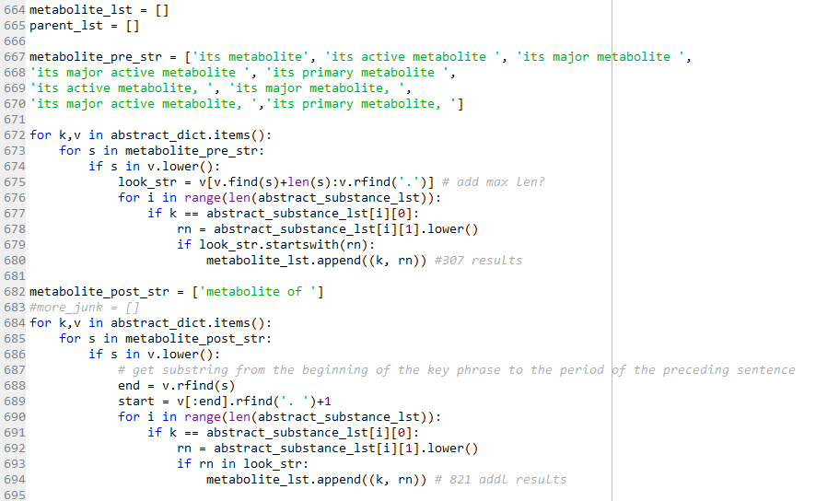
Find metabolite names from context
Notes:
Same training and evaluation sets as before

Slide 26
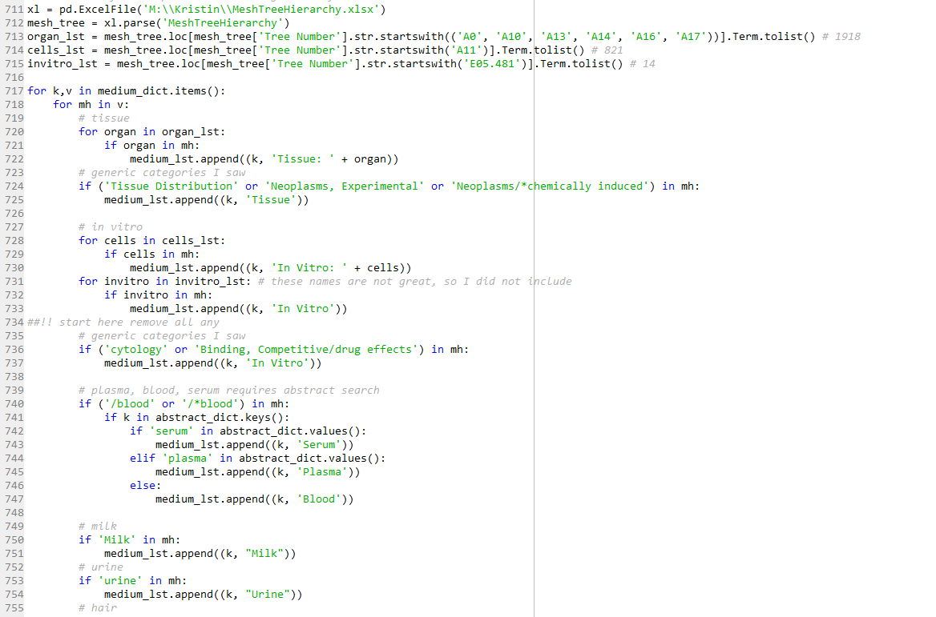
Find medium, species using MeSH terms
Notes:
Same training and evaluation sets as before

Slide 27
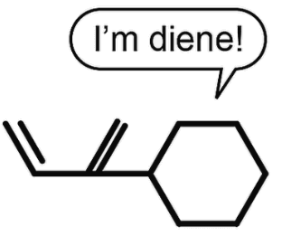
Summary
Case study findings
46.5% of substances had at least one verified metabolite mapping in an abstract
25.2% of metabolite names were uninformative
49.6% of names that seemed reasonable were found in DSSTox
Database status
Tables have been added to DSSTox (thanks, Josh!)
4747 mapped entries, 1822 unique parents
Not under active development, but available on request
Database with abstracts flagged for observed and predicted inclusion in metabolite and CvT set
Info will be available at http://confluence.zn.epa.gov/display/PKDAT/Metabolites
Notes:
800,000 really just the tip of the iceberg of relevant chemicals
also have a sandbox where i label all pubmed abstracts: already extracted, no metab, expected metab
still requires manual curation – just because an abstract asserts that a metabolite is formed doesn’t mean they demonstrate it, also endo
dose related?

Slide 28
Experiment conclusions
PubMed abstracts are a rich, easily accessible source of data
Relevant abstracts can be identified by machine learning with a relatively small training set of only actives
Simple machine learning yields fewer false positives than keyword searching
A limited amount of information is easily machine retrievable
More algorithmically sophisticated and computationally intensive methods seem likely to yield more thorough results, but require better skills/hardware
Any automated method will still require human curation as a final step, but the time saved is still quite significant
There are a lot of chemicals relevant to our work that are not yet in DSSTox (need more chemical curation!)

Slide 29
Discussion: possible future uses
Of database
Helping us better understand significance of in vitro data (is toxicity driven by formed metabolites?)
Metabolite read-across (Grace’s team)
ID markers of exposure (Jon Sobus’s team)
Add formed metabolites to httk (John Wambaugh’s team)
Add to SEEM model (John Wambaugh’s team)
CERAPP type project to build a great predictor
Of methods
Identification of similar abstracts
New entity recognition method for substances, but right now only very frequent names are well mapped
Possible improvements
More chemicals in DSSTox
Ecological and endogenous transformation products
Part-of-speech tagging using already collected entities
Identify compounds with several metabolites, build paths
Notes:
just focused on getting mappings
funny serendipity
when they say css, I assume plasma

Slide 30
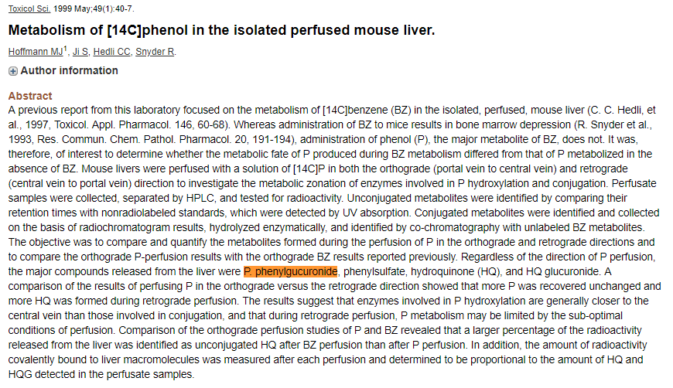
A cautionary tale

