Slide 1

Python 101
I learned with:
Sharon D. Kenny
EPA Region 3
215-814-3417
kenny,sharon@epa.gov

Slide 2
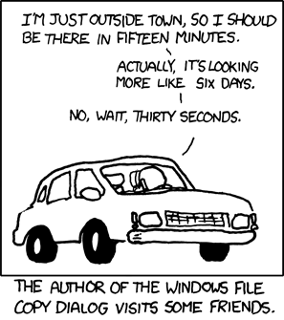
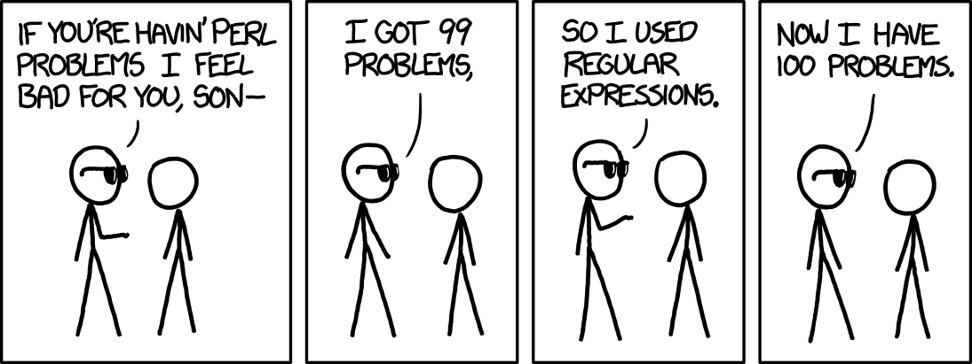
Outline

Slide 3
“I CAN do THE SAME WITH R”
<-
Wow, that’s a good point. Let me think for a bit…
Oh, wait, my mistake. That is [NOT a good point].
Tim Minchin
Assignment operator is not an =
Apache Spark (big data)
Connect with Hadoop > 1 billion records
ArcGIS R Bridge

Slide 4
Things I can do with Python
Look inside a geodatabase:
import arcpy
arcpy.env.workspace = "C:\\Users\\Skenny02\\Desktop\\Region3.gdb"
fc1 = arcpy.ListDatasets()
print (fc1)

Slide 5
Things I can do with Python
Download from a website a document that is updated on a regular basis:
import urllib.request, urllib.parse, urllib.error
import time
rr = time.strftime("%Y%m%d")
print (rr)
#rr.replace(".", '/')
url = 'https://www3.epa.gov/airquality/greenbook/downld/greenbook_exportdoc.pdf'
path = r"C:\Users\Skenny02\Desktop"
suffix = '.pdf'
output_file = path + "\\" + "rdocument" + rr + suffix
urllib.request.urlretrieve(url, output_file)

Slide 6
Things I can do with Python
Manage directories
import os
print(f"The files in the {os.getcwd()} directory are Python scripts:")
print("")
for hh in os.listdir ('.'):
if (hh.endswith('.py')):
print (hh)

Slide 7
Things I can do with Python
Find a string (e.g., email address) in all the text files within the current directory
import os, re
for file in os.listdir('.'):
if file.endswith('.txt'):
fileR = open(file, 'r')
text = fileR.read()
line = text.rstrip()
match = re.findall(r'[\w\.-]+@[\w\.-]+', line)
print (f'{file}:', match)

Slide 8
Finding Python
For teaching and assigning homeworks: repl.it
For "seeing" the scripts "live" I use PythonTutor.com
For collaborating on Jupyter Notebooks:
Google’s Colaboratory (https://colab.research.google.com/)
EPA Analytics Pilot run by David Smith (EPA)
For coding, I use the "real thing“ @ python.org

Slide 9
The Basics
Object-oriented
Everything is a "thing" that belongs to a type
Case sensitive
Variables assign a name to a value
EPA == epa will give a FALSE value
Types of values
Strings, numbers, Booleans, lists, tuples, dictionaries, etc.

Slide 10
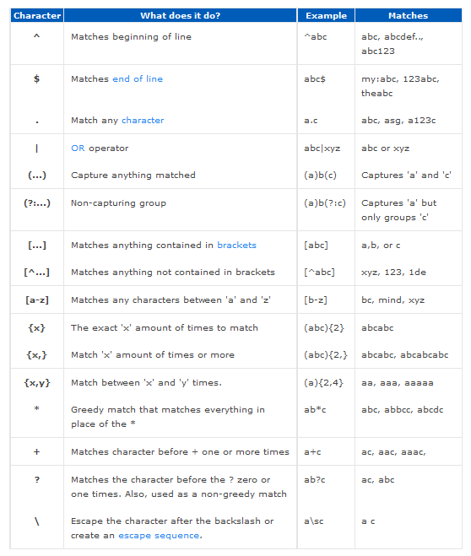
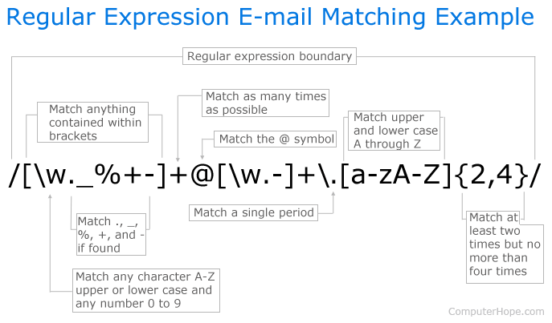
ADVANCED

Slide 11
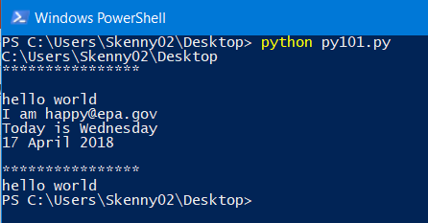
Let’s code
Open a notepad and type the contents in the py101.py file under SECTION 1
Save the document as python1.py within your Desktop directory (a.k.a. folder)
Select a command prompt to work with:
Use the Python Command Prompt under Start > Programs > ArcGIS if you have ArcGIS Pro installed; or
Use the Windows Powershell if you have Python already installed; or
Use the Anaconda prompt if you have Conda installed
Navigate to your Desktop directory by typing: cd Desktop
Run your script by typing: python python1.py
Repeat for SECTION 2 and 3
Compare your output to the image to the right
Congratulations on running your first script
with regular expressions

Slide 12
Questions?
Sharon D. Kenny, PMP, M.S.Eng.
EPA Region 3
Mobile: 215-814-3417
Email: kenny,sharon@epa.gov
GitHub: sharondenisse

