Slide 1
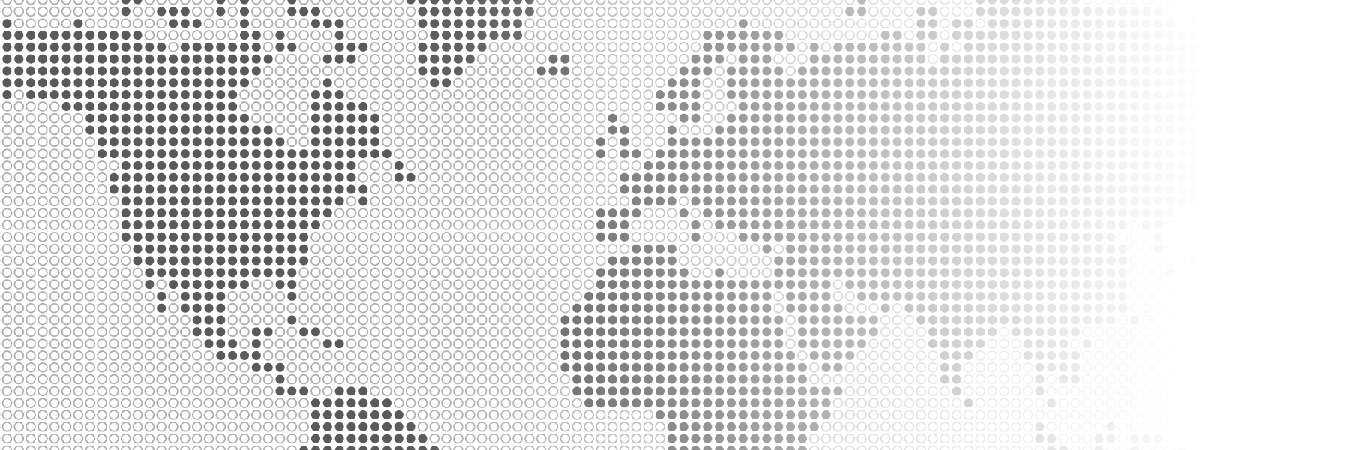

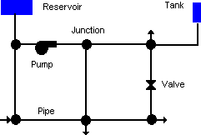


Water Network Resilience Software
Data Requirements for the
Water Network Tool for Resilience
The Water Network Tool for Resilience (WNTR) requires a model of the water distribution system. That model can be obtained from the water utility (in EPANET INP or related file format) or be generated from data. The basic features of the model are shown in Figure 1 and briefly described in Table 1. Some information can be approximated from publicly available data sources, as outlined in the table. Models should be calibrated to replicate system operations.
For more information on water distribution system models, see the EPANET 2.2 online user manual, EPA’s website on Small System Challenges and Solutions, and WNTR documentation on water network models.
Demand point
Figure 1: Physical Components in a Water Distribution System (from EPANET documentation)
Table 1: Water distribution system model data requirements
Component | Definition | Requirement | Attributes | Approximations
Junctions | Junctions are nodes that connect links (pipes, pumps, and valves). | Required to connect components | Location* * Location for all components includes the X and Y position along with elevation. X and Y can be in any coordinate system. WNTR uses SI units for all other attributes. | The location of junctions can be inferred from link start and end location. Elevation (for all components) can be determined using digital elevation maps.
Demand points | Demand points are junctions that also include water withdrawal over time. Demand points can represent an individual household / building, a neighborhood, a zip code, or a census block. | Required for hydraulic simulation | Location Base demand rate (volume per time) Demand pattern Demand patterns define how water is used throughout the day. Different patterns can be defined for summer and winter. | Demand location and base value can be approximated in several ways, for example from open-source data on building footprints. General demand patterns can be used (i.e., peak mid-day for commercial use or peak morning and evening for residential use).
Reservoir | Reservoirs are nodes that define the water source, generally the water treatment plant. | All models must contain at least one source | Location Hydraulic head (elevation + water pressure) | Location is generally known or can be estimated using online maps of the region. Hydraulic head can be estimated if needed.
Tanks | Tanks are nodes with storage capacity. | Not required | Location Min and max water level Diameter | Tank location and size can sometimes be approximated from satellite images.
Pipes | Pipes are links that connect nodes (junctions, reservoirs, and tanks). | Required to connect components | Start and end location Diameter Material or roughness | Since pipes generally follow streets, the location of pipes can be approximated using open-source street data. Attributes like diameter and roughness can be estimated if needed.
Pumps | Pumps are links that raise the hydraulic head. | Not required if the system is gravity fed | Location and direction Operational settings (pump curve or constant power) Controls (pump schedule) | Pump attributes are difficult to approximate without guidance from the utility.
Valves | Valves are links that limit the pressure or flow. | While most systems include valves, they are not always included in the model | Location and direction Type (pressure reducing valve, flow control valve, etc.) Operational setting (pressure or flow) Status (open or closed) Controls (schedule to change setting/status) | Valve attributes are difficult to approximate without guidance from the utility.
Sandia National Laboratories is a multi-mission laboratory managed and operated by National Technology & Engineering Solutions of Sandia, LLC (NTESS), a wholly owned subsidiary of Honeywell International Inc., for the U.S. Department of Energy’s National Nuclear Security Administration (DOE/NNSA) under contract DE-NA0003525.

