Slide 1
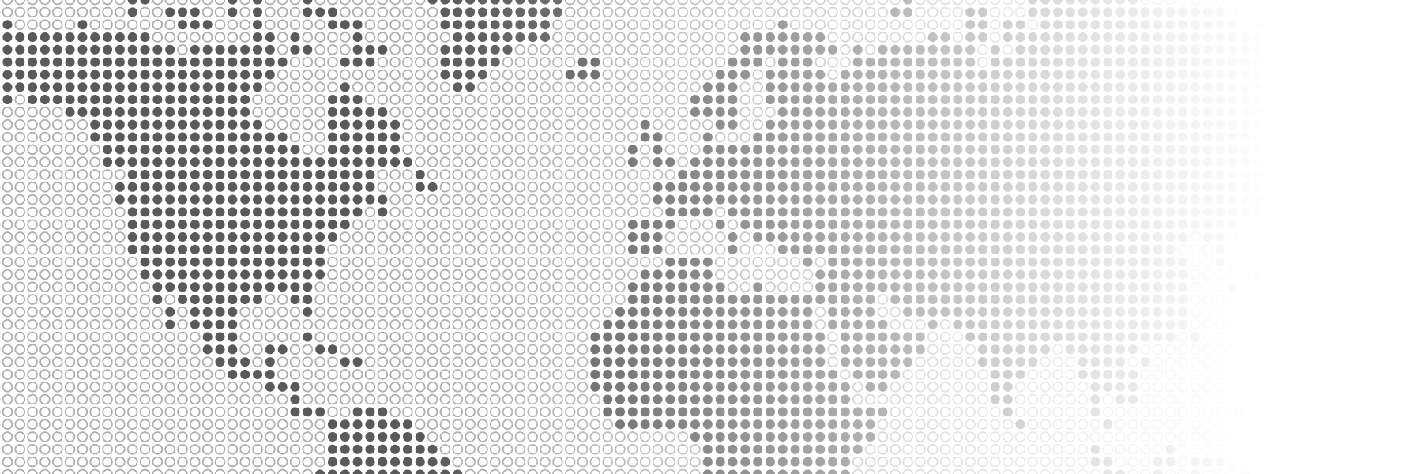
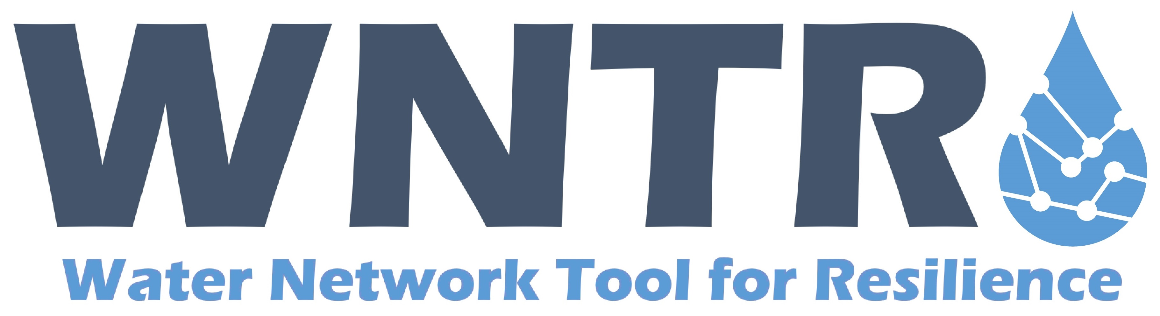
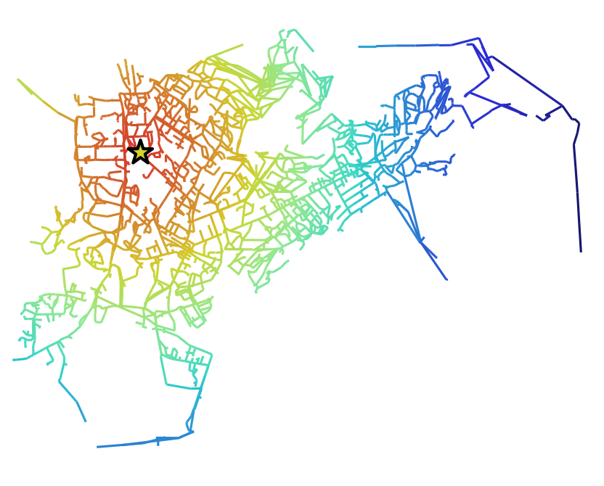
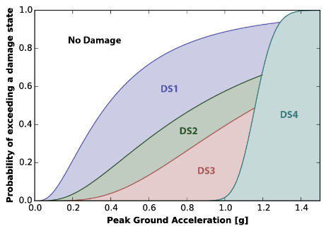
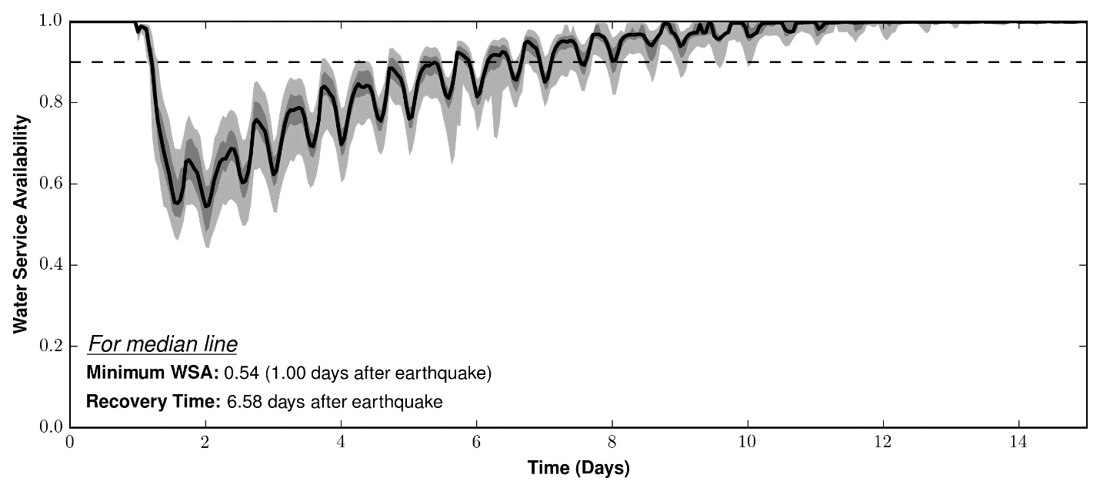

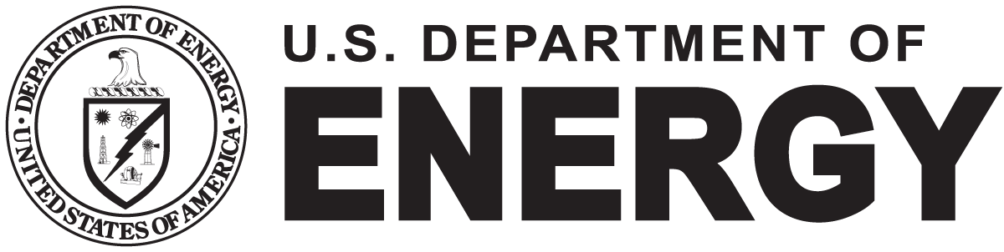
Water Network Resilience Software
Water Infrastructure Resilience Evaluation using WNTR
Drinking water distribution systems face multiple challenges, including aging infrastructure, water quality concerns, pipe breaks, uncertainty in supply and demand, natural disasters, environmental emergencies, and targeted attacks. All of these have the potential to disrupt a large portion of a water network. Increasing resilience to these types of hazards is essential to improving water security. Simulation and analysis can help water utilities predict how their system will respond to both expected and unexpected incidents and help inform decisions to make water distribution networks more resilient over time.
The Water Network Tool for Resilience (WNTR) is an open source Python package designed to simulate and analyze resilience of water distribution systems. The United States Environmental Protection Agency, in partnership with Sandia National Laboratories, developed WNTR to integrate multiple critical aspects of resilience modeling for water distribution systems into a single software framework.
The software includes capability to:
Build water network models
Integrate GIS data into models and analysis
Modify network structure and operations
Assign fragility and survival curves to network components
Model disruptive events such as power outages, earthquakes, fires, pipe breaks, and contamination incidents
Model response and repair strategies
Simulate hydraulics and water quality
Evaluate resilience using a wide range of metrics
Integrate dependency with other critical infrastructure and supply chains
Analyze results and generate graphics
WNTR can be used to estimate infrastructure damage, evaluate preparedness strategies, prioritize response actions, and identify worst case scenarios and best practices for maintenance and operations. WNTR can be installed through the United States Environmental Protection Agency GitHub site at https://github.com/USEPA/WNTR. Documentation is available at https://usepa.github.io/WNTR/.
For more information or to conduct a case study, contact:
Katherine Klise, kaklise@sandia.gov
Terra Haxton, Haxton.Terra@epa.gov
WNTR can simulate diverse hazards to analyze water distribution system resilience
Aging Infrastructure / Asset Management
Power Outage and Black Sky Hazards
Earthquakes
Drought / Wildfires
Water Contamination
Flood / Hurricane
Cyber Threats to
Critical Sectors
Example application: System resilience following an earthquake
Simulated peak ground acceleration from an earthquake
Epicenter
Fragility curves for tank damage
Statistical prediction of water service availability
Sandia National Laboratories is a multimission laboratory managed and operated by National Technology and Engineering Solutions of Sandia LLC, a wholly owned subsidiary of Honeywell International Inc. for the U.S. Department of Energy’s National Nuclear Security Administration under contract DE-NA0003525. SAND2017-13459

