Slide 1
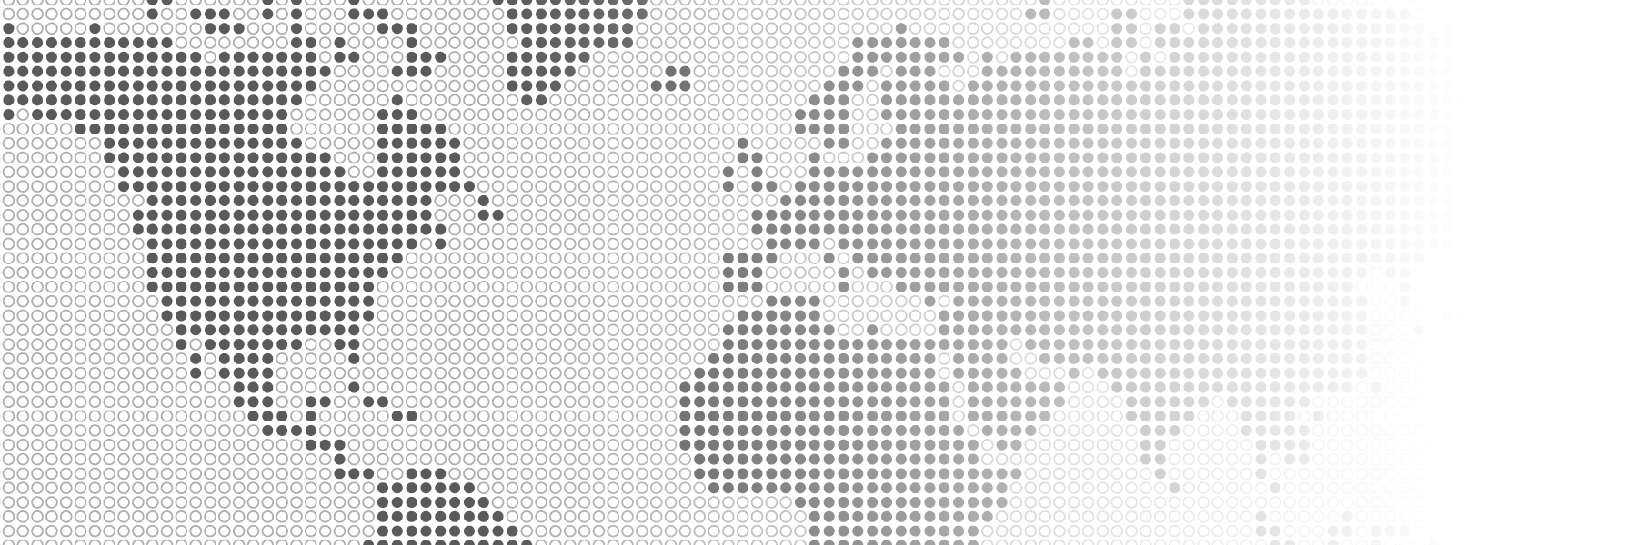
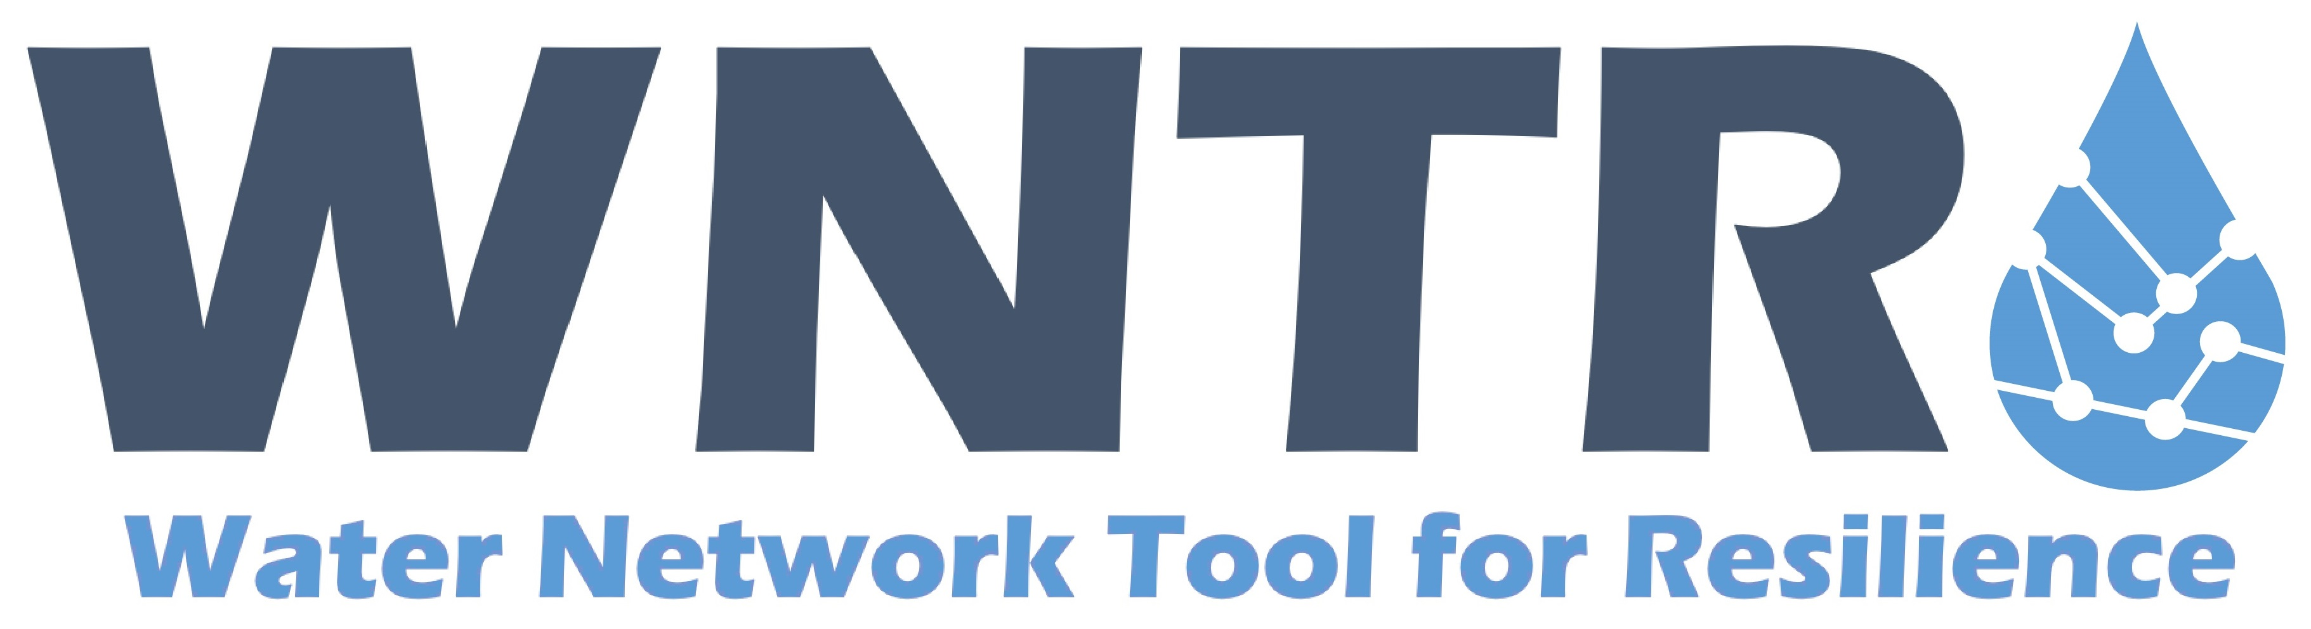
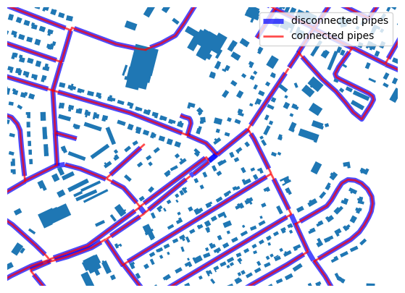
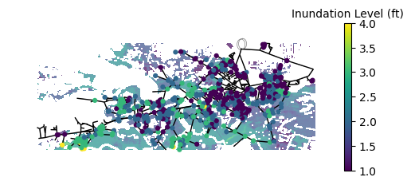
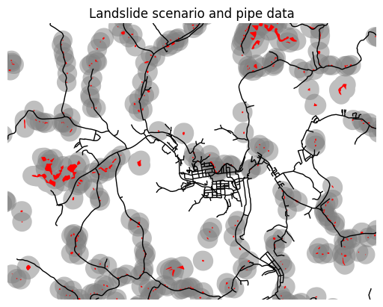

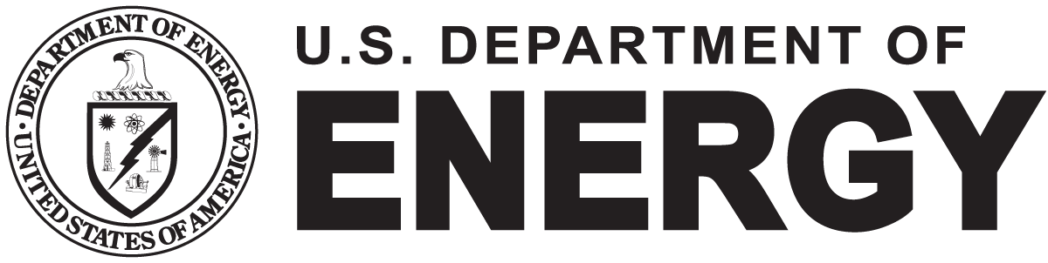
Water Network Resilience Software
Water Network Tool for Resilience Tutorials
The Water Network Tool for Resilience (WNTR) is an open-source Python package designed to simulate and analyze resilience of water distribution systems. The United States Environmental Protection Agency, in partnership with Sandia National Laboratories, developed WNTR to integrate multiple critical aspects of resilience modeling for water distribution systems into a single software framework. WNTR can be used to estimate infrastructure damage, evaluate preparedness strategies, prioritize response actions, and identify worse case scenarios and best practices for maintenance and operations.
WNTR comes with Jupyter notebook tutorials which illustrate basic usage of the software and how to execute a variety of analyses. Instructions for setting up Jupyter are available in the WNTR documentation. The tutorials cover the following capabilities:
Getting started: Create a water network model from an EPANET INP file, simulate hydraulics, and plot simulation results
WNTR basics: Learn how to use additional WNTR capabilities to compute resilience metrics, define fragility curves, skeletonize water network models, and integrate GIS data
Model development: Create a water network model from limited geospatial data
Pipe break analysis: Run multiple hydraulic simulations to compute the impact of pipe breaks/closures on network pressure
Fire flow analysis: Run multiple hydraulic simulations with and without fire fighting flow demand to multiple fire hydrant nodes
Earthquake analysis: Compute water service availability and population impacted by low pressure conditions from earthquake damage
Landslide analysis: Use landslide inventory data to quantify potential water service disruptions from pipes damaged in a landslide
Salt water intrusion: Use storm surge data to estimate salt intrusion to a system after a hurricane
Multispecies quality analysis: Run a chlorine decay quality analysis using advanced MSX features
The model development tutorial helps small utilities build models for resilience analysis
Landslide and salt water intrusion tutorials use geospatial hazard maps to define disruption scenarios
Figure 2: Storm surge data layers are intersected with the junctions of a model to develop salt water intrusion scenarios.
Figure 3: Landslide data is used to identify potential regions of disruption which are intersected with nearby pipes to determine system damage for each scenario.
Figure 1: Water distribution system pipe databases often lack the connectivity necessary to easily create a model (blue lines). WNTR provides functions creating connected networks from imperfect pipe data (red lines).
For more information visit https://usepa.github.io/WNTR/
Sandia National Laboratories is a multi-mission laboratory managed and operated by National Technology & Engineering Solutions of Sandia, LLC (NTESS), a wholly owned subsidiary of Honeywell International Inc., for the U.S. Department of Energy’s National Nuclear Security Administration (DOE/NNSA) under contract DE-NA0003525.

Slide 2
