Slide 1
Introduction to EMF Server Communication and Cases
Beta Testing
November 4, 2009

Slide 2
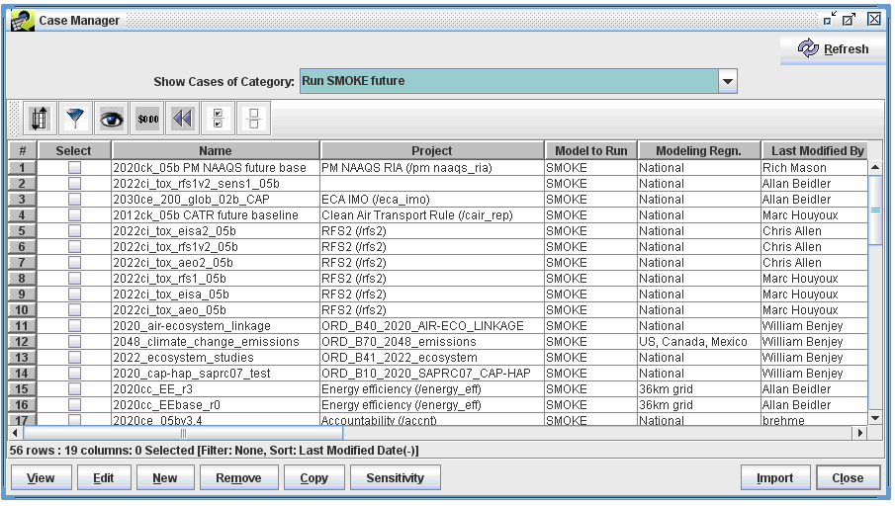
EMF Case Manager
The Case Manager uses SMOKE programs to create emissions modeling outputs.
Case: Set of Jobs, Inputs, and Parameters that fully describe a SMOKE or other model run

Slide 3
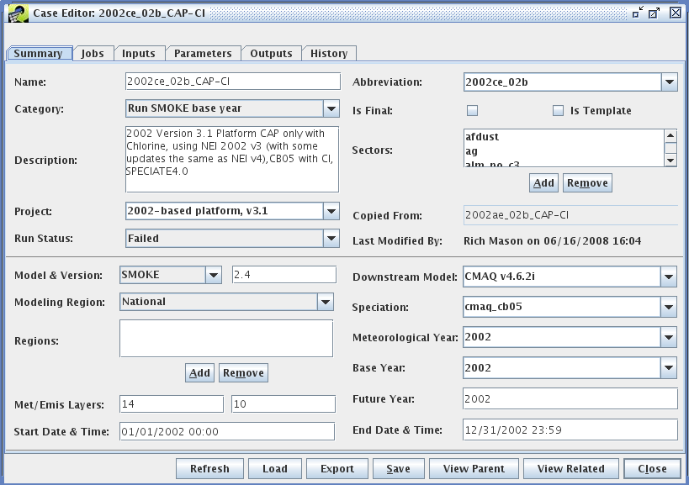
EMF Cases – Summary tab
Sector: Emissions modeling sector(e.g., ptipm, ptnonipm)

Slide 4
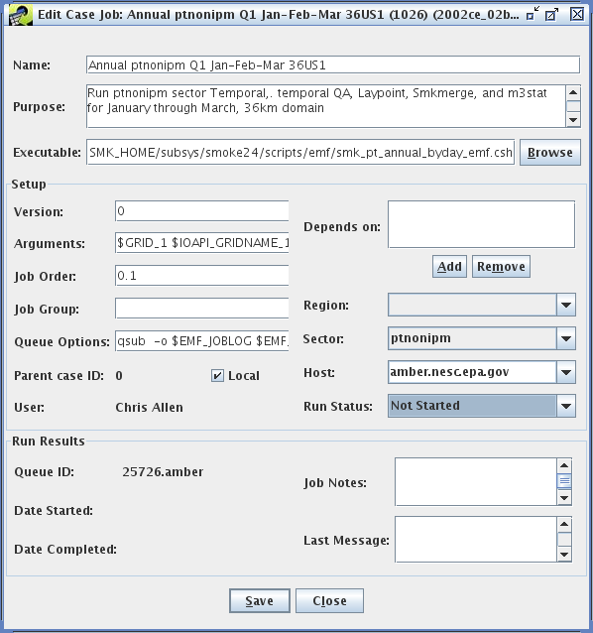
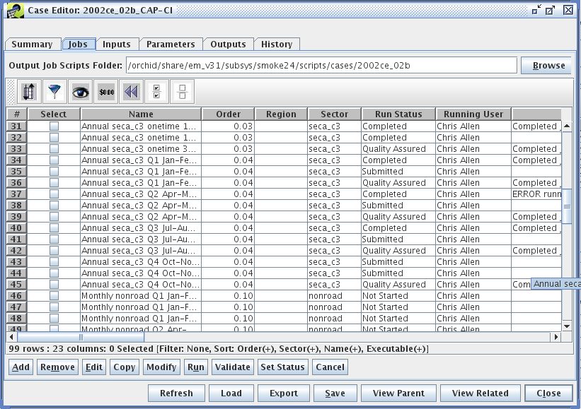
EMF Cases – Jobs tab
Job: Program or script with settings and arguments needed to run a script

Slide 5
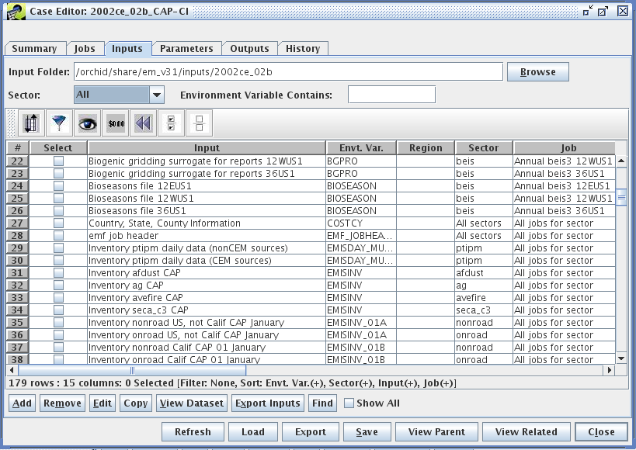
EMF Cases – Inputs tab
Input: Dataset used by one or more Jobs

Slide 6
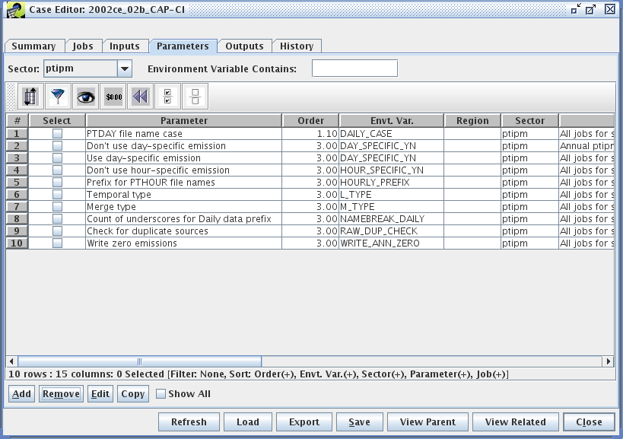
EMF Cases – Parameters tab
Parameter: Setting, usually an environment variable, used by one or more Jobs

Slide 7
Key EMF Definitions
Case: Set of Jobs, Inputs, and Parameters that fully describe a SMOKE run
Job: Program or script with settings and arguments needed to run a script
Input: Dataset used by one or more Jobs
Parameter: Setting, usually an environment variable, used by one or more Jobs

Slide 8
Case Management Overview
Dataset Manager
SMOKE datasets
in PostgreSQL
Tell Dataset Manager
to export Inputs as
ASCII SMOKE files
Run
Case Manager
Case
Generate wrapper scripts
with Inputs and Parameters
defined as Environment
Variables
Jobs: Run scripts
Inputs: Datasets
to use for runs
Run scripts
Parameters: SMOKE
and script settings
Submit Job to a run queue
on a UNIX/Linux computer
SMOKE
EMF utility
to register
outputs
Outputs: List of results
(e.g., AQ model inputs)
History: Who, when,
what run & status
Completed

Slide 9
Running a Job in EMF
User selects job(s) and clicks run (EMF client)
EMF exports inputs (EMF server)
EMF writes a job wrapper script (EMF server)
  EMF wrapper scripts are specific for a CASE and JOB and specific run (date-stamped)
  Include all inputs and parameters needed by that job
  EMF wrapper scripts call model specific scripts (e.g., SMOKE sector specific script)

Slide 10
Running a Job in EMF (2)
EMF submits job to the SMOKE server
  After exports are completed and dependencies are satisfied
Job executable runs (SMOKE server)
  SMOKE scripts and ASSIGNS file have been modified to be more generic
  SMOKE scripts communicate status, message and imports files via EMF command-line client

Slide 11

Communication between Servers
EMF to SMOKE server:
  EMF uses ssh-keys to start running programs on SMOKE server and for authentication
  On EMF server the Linux user “emf” ssh into SMOKE server as the SMOKE user and starts the EMF wrapper script
SMOKE to EMF server:
  SMOKE scripts call EMF command-line client
  Communicate changes in status, messages, or imports outputs generated by SMOKE
ssh <wrapper script>
EMF cmd-line client
EMF Server
SMOKE Server

Slide 12
Delivered Cases
Test messages and imports
Spatial Surrogate
2005 SMOKE platform
Each delivery will include:
  Case to import into EMF
  Executable scripts
  Potentially one or more datasets to import into EMF

