Slide 1
R: Innovating at the Bureau of Labor Statistics
Arcenis Rojas
Economist
Division of Consumer Expenditure Surveys
EPA R Users’ Group Workshop
Monday, September 11, 2017

Slide 2
Overview
Automation (International Prices)
Quality control (Industrial Prices)
Data Visualization (Consumer Expenditures)
Maps (Survey Methods – OES)
R package development (Survey Methods)
Other applications and programs
Education

Slide 3
International Prices sample refinement
International Prices Program
Receive data from Census and Customs
Must verify Establishment ID (EIN), name, and address to provide to field economists
1700 export collections units per sample
2400 import collection units per sample
6 IPP sample team members
16 copies, 20 pastes, and 46 clicks per unit
Notes:
Developed by Ara Khatchadourian, Mike Murphy, and Rob Sutton

Slide 4
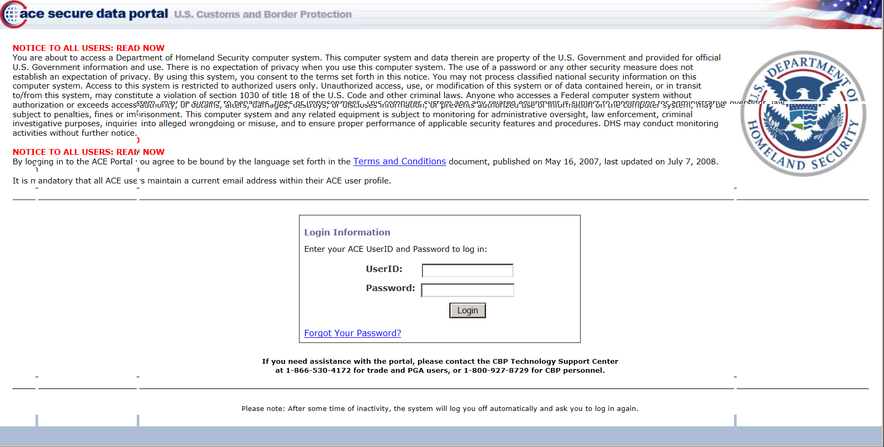
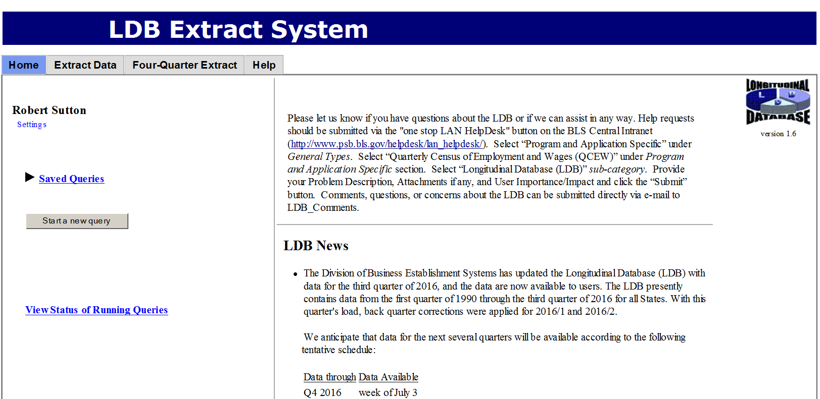
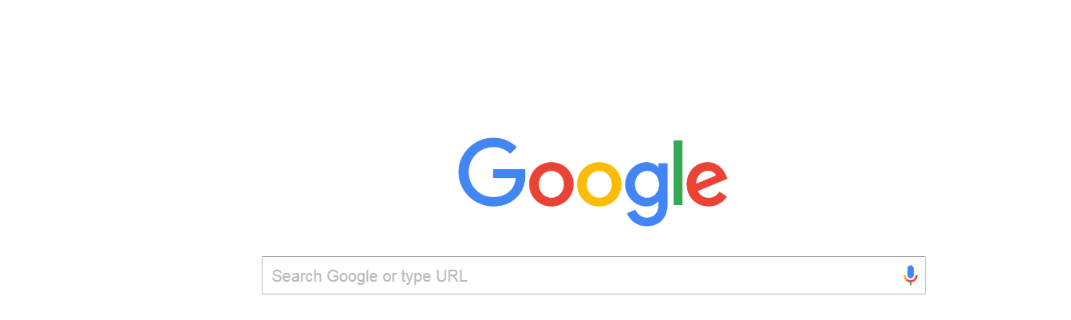
Data sources
Notes:
Upper left - ACE is the Automated Commercial Environment. This is the portal where exporters and importers enter all of their mandatory customs documentation
Right - Longintudinal Database (LDB) used to verify EIN after getting it from ACE
Lower left – Google is used to verify establishment name and address.
If name and address could not be verified on Google, would have to use the Secretary of State website for the firm’s respective state
… repeat the process hundreds of times

Slide 5
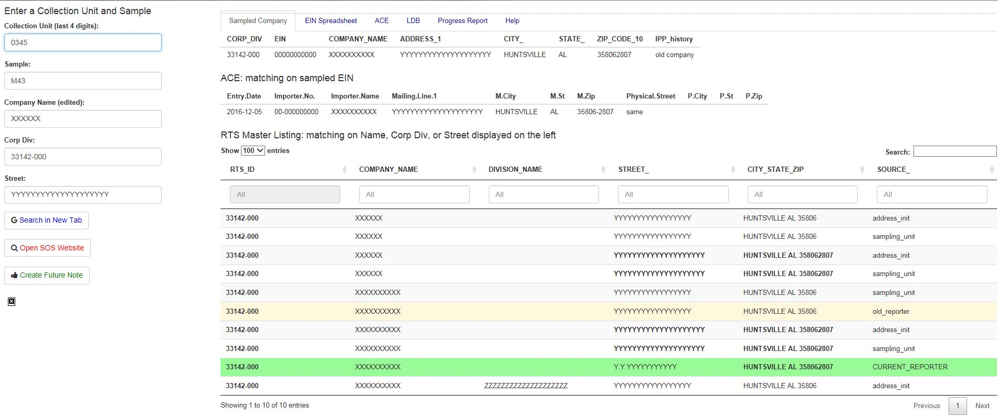
Automating Sample Refinement
Notes:
Now you just have to…
Enter the collection unit identifier.
The program populates the company name and address. The user can change the company name and street to update the search of the master list in real time.
The program queries a data dump from ACE verifying the EIN. If the EIN mailing or physical address do not match, the program highlights them. This prompts the sampling team member to investigate further and note it in processing comments.
The program checks by name, and separately by address the RTS master list. The user can search within these fields as well to narrow down the results. The program highlights current reporters in green, and highlights old reporter addresses. Seeing a current reporter quickly allows us to verify the sampled address.
By clicking “Search on SOS website” the program will open a web browser tab with the correct State SOS page opened. By clicking create future note the program will create an appropriate future note on the clipboard that can be pasted into the sampling system

Slide 6
Benefits of automation
80-100 hours per sample of time savings
Much less clicking
Better and more thorough sample review
More time to review more problematic collection units
Notes:
Other scripts have been created to improve efficiency.

Slide 7
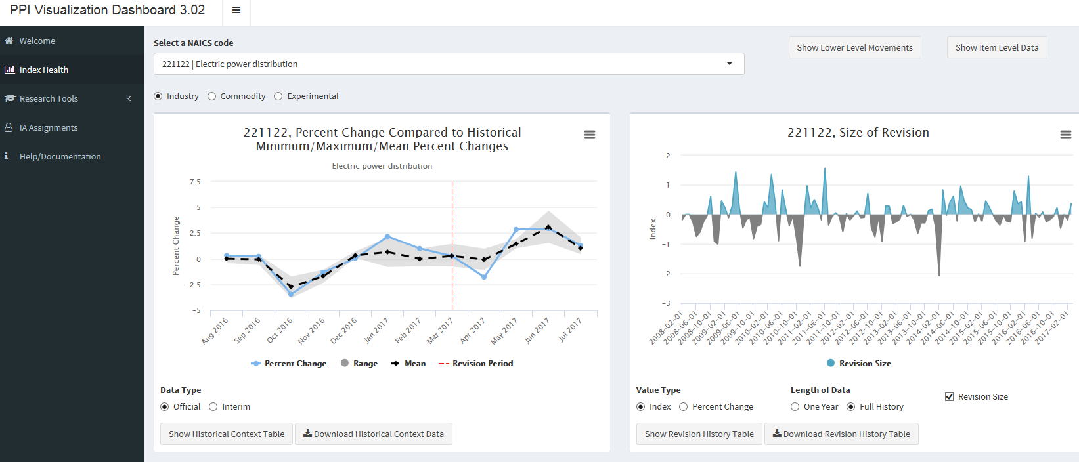
Industrial Prices Visualization Dashboard
Notes:
Developed by Steven York and Neil Wagner

Slide 8
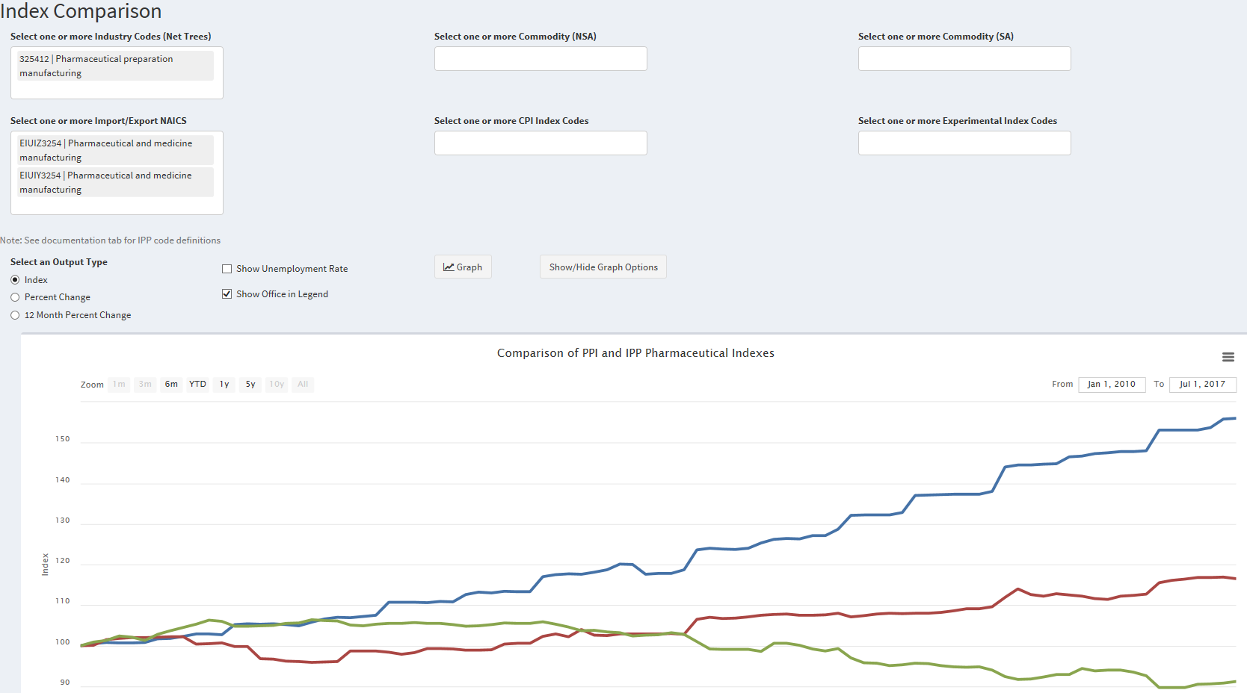
Index comparisons
Notes:
* Simulated data used due to confidentiality.

Slide 9
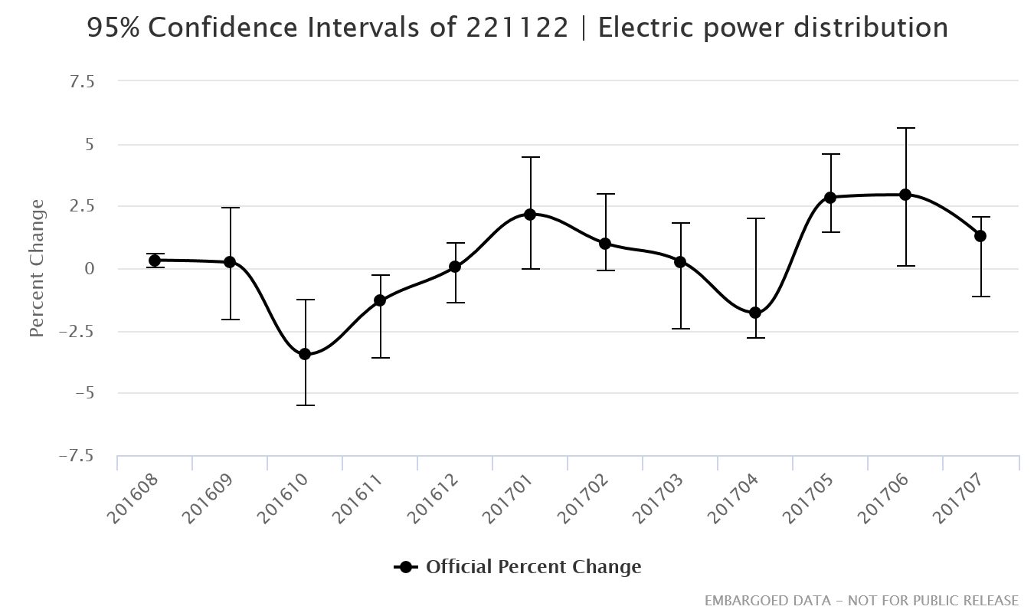
Index review and revision

Slide 10

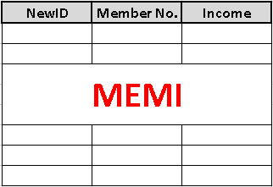
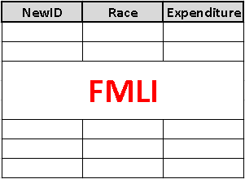

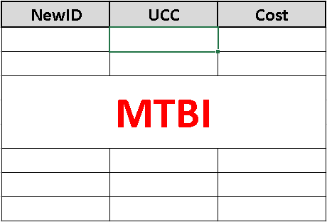
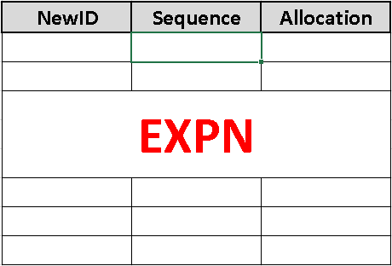

Consumer Expenditure Survey (CE)
Notes:
Developed by Arcenis Rojas
Interview Survey is a 3-month recall interview focusing on large expenditures and consists of 4 interviews per Consumer Unit (CU)
Diary Survey is a record of smaller-scale expenditures that are more difficult to recall and consists of up to 2 weeks of expenditure records per CU
We collect data on family and member characteristics, expenditures, income, taxes, assets, and liabilities.

Slide 11
CE Public-Use Microdata (PUMD)
PUMD = Public-Use Microdata
Family-level characteristics
Expenditures by Universal Classification Code (UCC)
Member-level characteristics
Expenditures and their characteristics by type of expenditure (EXPN… > 50 files each year!)
And more!
Notes:
CE PUMD provides all this cell-level data as a package of many spreadsheets. Some files are quarterly and others annual. The 2015 Microdata Release contained 95 files of 2015 data.

Slide 12
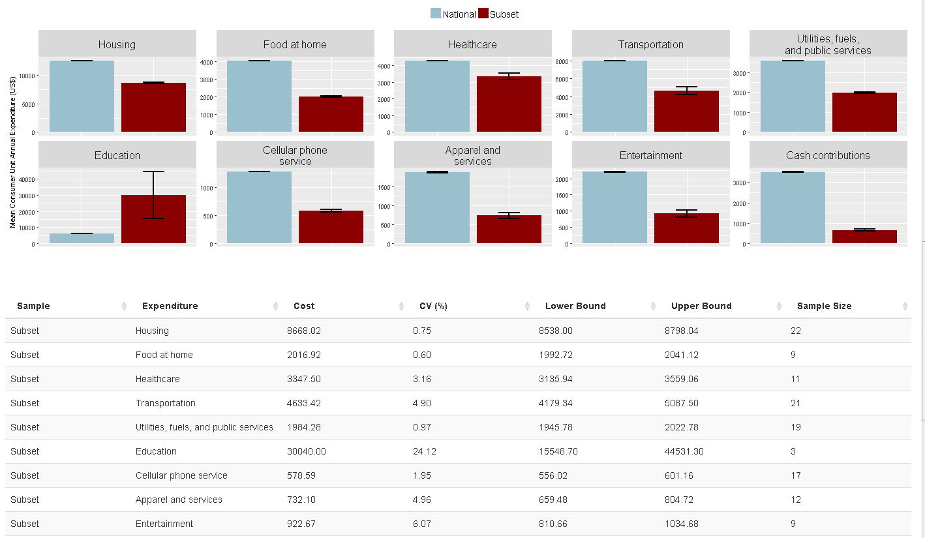
Interactive CE Visualization Tool

Slide 13
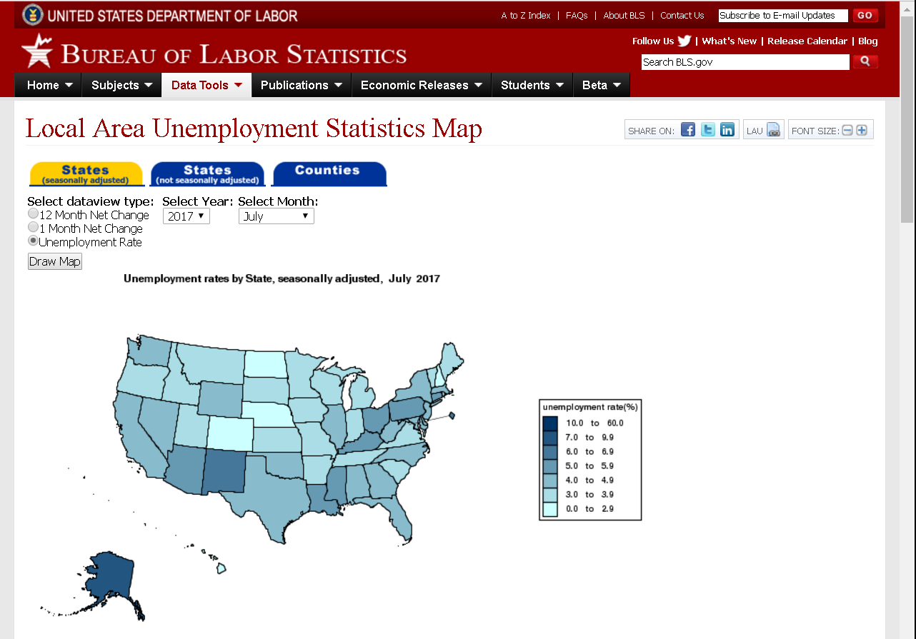
Mapping unemployment data
Notes:
OEUS JavaScript map.
Uses pre-made tables to generate maps.

Slide 14
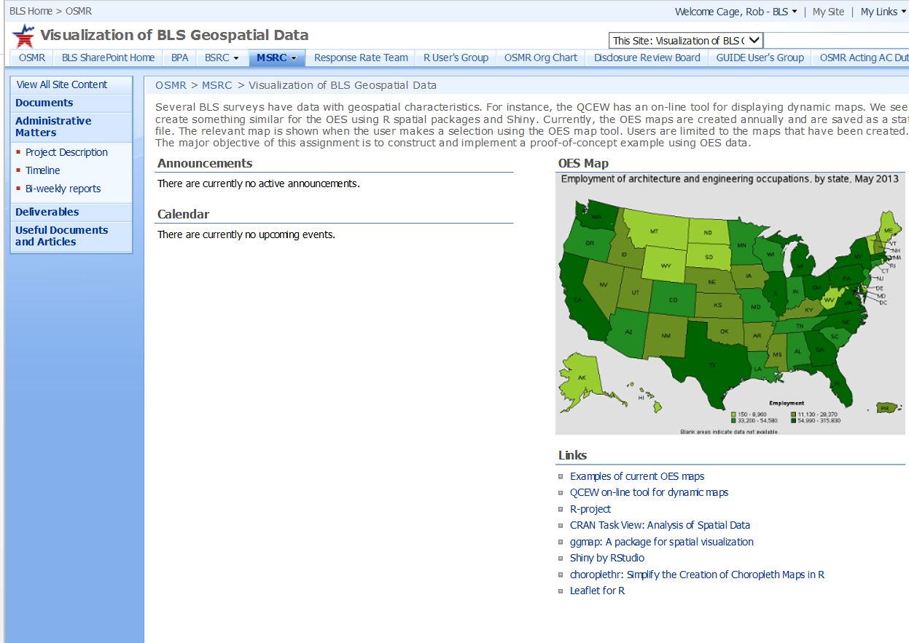
Mapping unemployment data
Notes:
OSMR working on generating R Choropleth maps which would allow more dynamic map generation.
CPI also working on generating ArcGIS maps for their own data.

Slide 15
Other apps and programs
EIA Analyzer (Industrial Prices)
Text analysis Shiny App (Survey Methods)
rpms: Recursive Partitioning for Modeling Survey Datapackage (Survey Methods)
growfunctions: Bayesian Non-Parametric Dependent Models for Time-Indexed Functional Data package (Survey Methods)
Notes:
EIA Analyzer - Shiny app that takes webscraped (also via R) data from EIA’s Weekly Petroleum Status Report and allows user to visualize the data and easily calculate percent changes between any two data points. Developped by Stephen York and Neil Wagner
Text analysis Shiny app is general app. Developed by Brandon Kopp, Randall Powers, and Wendy Martinez

Slide 16
Challenges
Data confidentiality
Need for an R server to make apps/programs public
Can only put Shiny apps on a webpage via iFrames or setting up an account on a cloud server (i.e., Digital Ocean)

Slide 17
Arcenis Rojas
Economist
Division of Consumer Expenditure Surveys
www.bls.gov/cex
202-691-6884
rojas.arcenis@bls.gov

