Slide 1
EPA-R: Open Software, Big Data, and Modern Statistical Modeling
Joel Schwartz
Harvard TH Chan School of Public Health

Slide 2
Confessions of a Former SAS User
I used to use R for data analysis, because it would take SAS about 20 years after R to implement modern statistical analysis approaches (GAM, Frailty terms in survival analysis, Gradient boosting, etc)
BUT
I would do a lot of data management in SAS, because for many things it was easier. If it was simple to do as a matrix manipulation, it was great in R, but otherwise SAS was more straightforward to program
Thanks to Hadley Wickham, this is no longer the case

Slide 3
New R data manipulation packages
Are Simpler than SAS, and MUCH FASTER
They include spatial packages that are INFINITELY FASTER than ARCGIS
Dplyr, data.table, magrittr, rgeos,tidyr, raster, broom etc
Examples
Left_join is faster than merge in SAS
look<-left_join(mortpol,pbl,all.x=T,by=c("citycode","date"))
This is particularly important for large data sets

Slide 4
Big Data plays several key roles in Environmental Studies
Developing Exposure/Exposome metrics
High resolution estimates of PM2.5, O3, NO2, Temperature, Green Space, Social Status, Crime Rates, etc
Understanding Mechanisms of Their Health Impacts
Epigenomics, metabalomics, p > n problems
Exposomics
Analyzing many exposures
Modeling exposure with Big Data
Big n to allow for better exploration of
Susceptibility
Dose Response

Slide 5
Compute NDVI for France from Landsat
library(magrittr)
library(XML)
library(raster)
library(rgdal)
dirs = list.files()[file.info(list.files())$isdir]
for(i in dirs[c(21:131)]) {
red = list.files(i, pattern = "_sr_band4\\.tif$", full.names = TRUE) %>% raster
nir = list.files(i, pattern = "_sr_band5\\.tif$", full.names = TRUE) %>% raster
ndvi = (nir - red) / (nir + red)
cfmask = list.files(i, pattern = "_cfmask.tif$", full.names = TRUE) %>% raster
ndvi[cfmask != 0] = NA # Remove non-'clear' pixels
writeRaster( ndvi, paste0(i, "_ndvi.tif"), format = "GTiff", overwrite = TRUE
)
removeTmpFiles(h=0)
}

Slide 6
Where did the Landsat Data come from?
library(magrittr)
library(XML)
url = "view-source_espa.cr.usgs.gov_ordering_status_yourname101603063006_.html"
dat = htmlParse(url)
files = dat["//a"] %>% sapply(xmlValue)
files = files[grepl("\\.tar.gz$", files)]
files_names = strsplit(files, "/", fixed = TRUE) %>% sapply("[", 6)
for(i in 90:length(files)) {
download.file(
files[i],
# paste0("/media/Elements/landsat_ny/", files_names[i]),
paste0("~/Pictures/", files_names[i]),
method = "wget",
quiet = TRUE
)
}

Slide 7
There are R functions that download
MODIS satellite retrieval data (AOD, NDVI, surface radiance)
National Land Cover Data
National Elevation Data
There are other fuctions that allow you to rasterize those, and easily merge them together, along with Census Data, etc.

Slide 8
Deal with duplicate monitors at same site
library(data.table)
library(dplyr)
pm$stn_id=paste(round(pm$lat.stn,4),round(pm$long.stn,4))
pm_new2<- pm %>%
dplyr::group_by(day,stn_id) %>%
dplyr::summarise_each(funs(mean))

Slide 9
R can easily allow us to write code to analyzed large numbers of datasets quickly
For example, I wanted to fit a propensity score model to look at air pollution. A propensity score estimates the probability of getting the exposure you got, given the covariates. If you weight a sample by the inverse of that probability, then in the weighted sample, the exposure of interest is independent of the covariates.
For example, suppose obese people have higher exposures on average.
Obesity is a confounder. But if I give more weight to obese people with low exposure, and to skinny people with higher exposure—
Then in the weighted sample exposure is independent of obesity

Slide 10
But I want to do this separately in 135 US cities and then combine the results
dfpmno2=test %>% group_by(citycode) %>% do(fitcitycode=lm(pm2501~as.factor(month):yearcat+ns(TEMP,df=3)+ns(TEMP1,df=3)+ns(no201,df=3)+as.factor(dow),data=.))
dfno2res =augment(dfpmno2,fitcitycode)
test$pm25res<-as.numeric(unlist(dfno2res[,".resid"]))
test$sigma<-as.numeric(unlist(dfno2res[,".sigma"]))
gps<-(1/sqrt(2*pi*test$sigma^2))*exp(-(test$pm25res)^2/(2*test$sigma^2))
dfnum=test %>% group_by(citycode) %>% do(fitcitycode=lm(pm2501~1,data=.))
test$wt<-test$gpsnum/test$gps

Slide 11
R has much more up to date Statistical Methods
R had penalized splines and frailty terms in survival analysis decades before SAS
R/S had generalized additive models, robust regression, Bayesian methods, etc earlier than most other programs
Many statisticians post R code for new methods when they develop them
Bioconductor and most genomic/epigenomic processing tools are in R
R has excellent machine learning tools

Slide 12
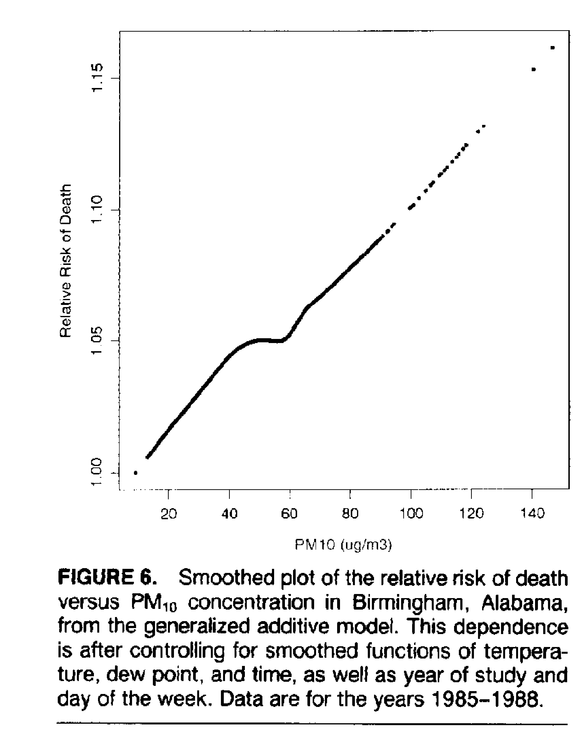
American Journal of Epidemiology, 1993

Slide 13
Exposomics
Exposomics adds large numbers of Exposures to the Mix
How can we realistically model such large numbers of predictors?
Standard variable selection methods (stepwise, etc) perform poorly
What about high level interactions?

Slide 14
The Lasso and Elastic Net
The lasso shrinks coefficients of predictors toward zero based on a penalty proportional to the sum of the absolute values of the coefficients
The adaptive lasso weights those penalties down for variables whose standardized coefficients are larger in an initial analysis
The Elastic Net adds another weight proportional to the square of the coefficients

Slide 15
The Lasso is Consistent
If the correlation among predictors is not large
This is a problematic assumption for Environmental Studies
The adaptive lasso and elastic net are consistent even with high correlation, which is usually the case
Glmnet and other functions in R fit these for glm’s, others fit it for Cox regression, etc
Dai and coworkers looked at particle components as predictors of blood pressure in a cohort study in Boston, an used the adaptive lasso to identify components that were more (or less) toxic than average
cvfit = cv.glmnet(x = as.matrix(InputData1[,2:N]), y = as.matrix(InputData1[,1]),alpha=0.5)

Slide 16
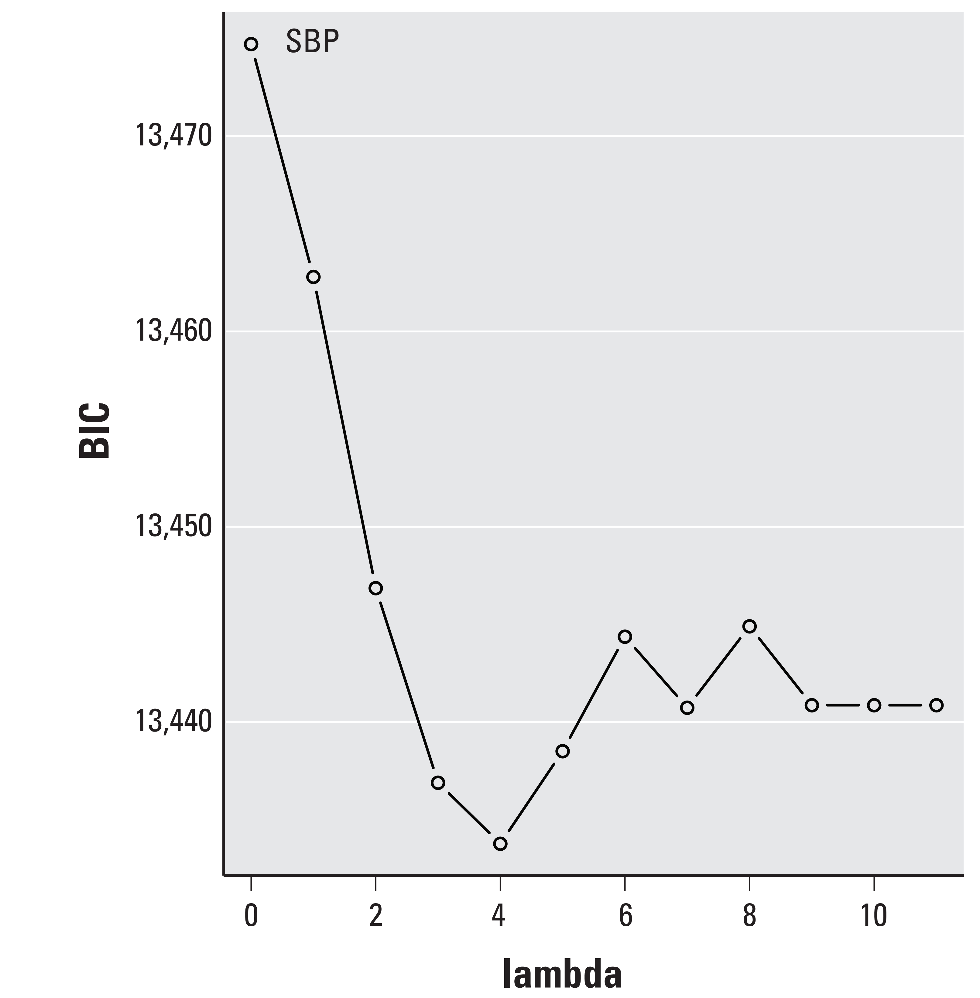
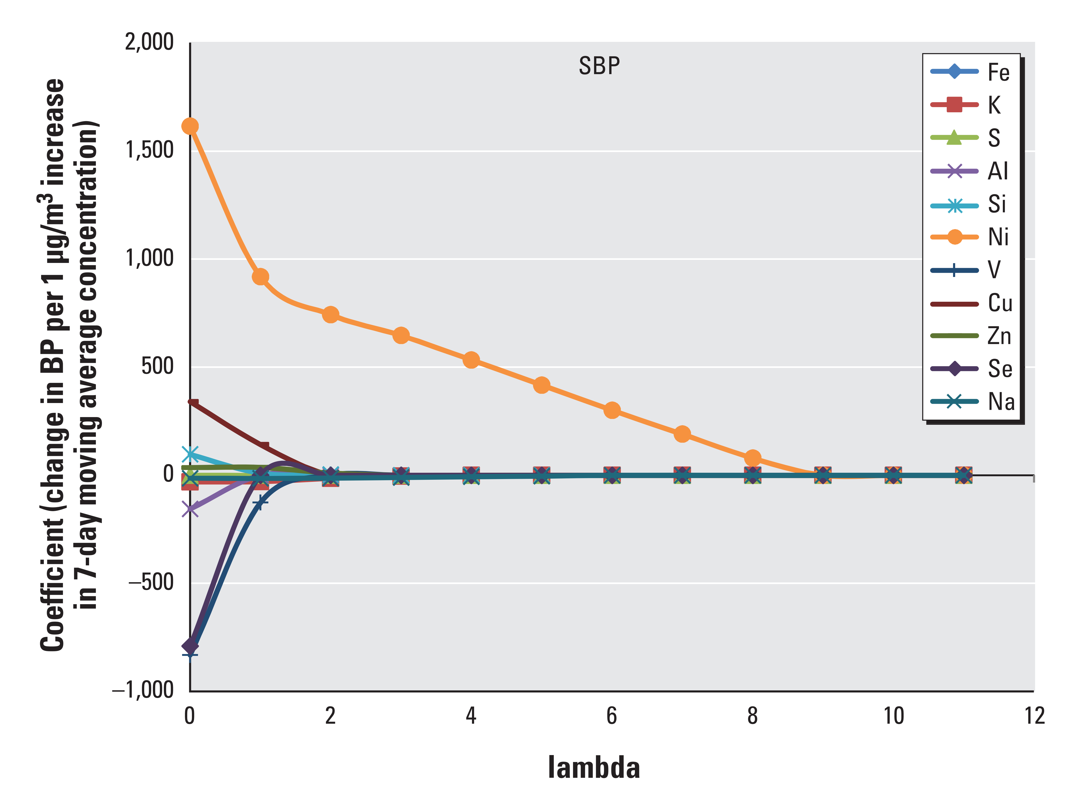

Slide 17
Difference in DNAm-age for IQR Increase in Particle Components
PM2.5 + Individual Components | Difference in Horvath DNAm-age for IQR (95% CI) | P | Difference in Hannum DNAm-age for IQR (95% CI) | P | N
EC | 0.27 (-0.25, 0.80) | 0.30 | -0.09 (-0.48, 0.29) | 0.64 | 940
OC | 0.93 (0.37, 1.50) | 0.001 | 0.35 (-0.05, 0.77) | 0.09 | 940
Sulfate | 0.59 (0.37, 0.81) | <0.0001 | 0.08 (-0.09, 0.25) | 0.36 | 940
Nitrate | 0.58 (0.11, 1.04) | 0.01 | 0.30 (-0.04, 0.65) | 0.08 | 940
Ammonium | 0.59 (0.26, 0.92) | 0.0004 | 0.06 (-0.18, 0.30) | 0.63 | 940
PM2.5 plus Adaptive Lasso
PM_{2.5} | 0.18 (-0.30, 0.66) | 0.45 | - | - | 940
Sulfate | 0.51 (0.28, 0.74) | <0.0001 | - | - | 940
Ammonium | 0.36 (0.02, 0.70) | 0.04 | - | - | 940

Slide 18
Other Newer Approaches in R
Bayesian Variable Selection Methods
Random Forests and Gradient Boosting combined with variable importance scores
, Support Vector Machines, Neural Networks, Additive Survival Models, gamlss, etc

Slide 19
Better Exposure Estimates
We want them to be Address Specific
We want them to be Time Specific
We need to study many people for long periods of time
We want to study people who do not live in big cities
Approaches include time varying land use regression (e.g. Yanoski 2008)
Satellite Remote Sensing (e.g. Kloog 2014)
Chemical Transport Models (e.g. CMAQ)

Slide 20
Critical Issues in Modeling/Fusion
Missing Data
Surrogates for emissions (e.g. traffic density) have time varying impacts
Aerosol Optical Depth has a time varying relationship to ground level particle concentrations
Nonlinearities
Many factors have multiplicative impacts on particle concentrations: High order interactions
Most models have significant errors, and these are for different reasons

Slide 21
Machine Learning was made for This Problem
Support Vector Regression includes high order nonlinearities and interactions (R: e1071 kernlab)
Gradient boosting does as well, and averages across models to get higher accuracy (R: xgboost)
Deep Neural Networks include high order interactions and nonlinearities more flexibly than SVR (R:h2o, neuralnet)

Slide 22
Let’s take a look
We used SVMs to fit a land use regression to BC data in MA, RI, and Southern NH. We had data from 2000-2012.
Worked much better than a generalized additive model
We added a gam to fit the residuals because gam is somewhat better at nonlinearities
Abu Abad et al, 2017, in press

Slide 23
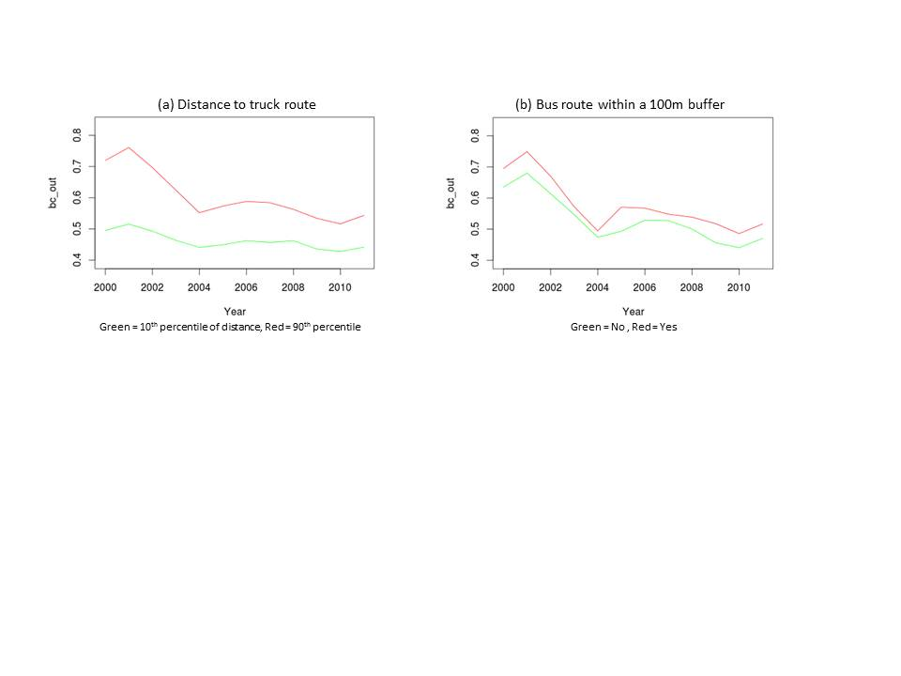
Land Use Terms have Different Impacts on Concentrations over Time

Slide 24
mod = tune.svm(BC~ as.factor(Month) + as.factor(Year) + std_invcoast + std_wdsp_sp + std_bc_pred + I(1/std_cm) + std_TEMP + std_TEMP2 + std_invpbl + std_elev_m + std_pm25_pred + std_invrail + std_ldrta + bus_100 + std_pctdvlofs12 + std_Z_intxn + Longitude + Latitude + as.factor(winddir_sp) + Surface + as.factor(pctdvhi_cat) + std_Z_land + as.factor(pctimp_cat) + dow + std_Z_time + std_pctoil + std_pctelect_solar + Ref1 + EC1 + std_adtlxth100m + std_disttotrkrte + I(1/std_dista3rd) + I(1/std_dista2rd) + I(1/std_ldistmjrd) + I(1/std_dista1rd) + 1/std_disttge10k) + std_pctwood + std_pctgas + std_RH + std_slp + std_dewp + std_ge10k + std_pctw10k + std_pctw2k ,
data = InputData,
gamma = seq(0.1,0.3,0.01),
cost = 1, nu = seq(0.1,0.2,0.001))

Slide 25
Estimating PM2.5 using Fusion of Satellite Remote Sensing, GEOS-Chem, and other Parameters
Goal: Estimate Daily PM2.5 concentrations for every 1km² in North America, Europe, and Asia
The U.S. is 11 million km², so this is big data
Inputs: Daily measurements everywhere using satellite remote sensing, meteorology, GIS data, Chemical Transport Models, etc.

Slide 26
Neural Network for Daily PM2.5 and Ozone: Out of Sample R2
0.85 for PM2.5
0.76 for Ozone
Daily predictions for each of 11 million 1km cells in the Continental US for each day Jan 1 2000-Dec 31 2012.
Di 2016, 2017

Slide 27
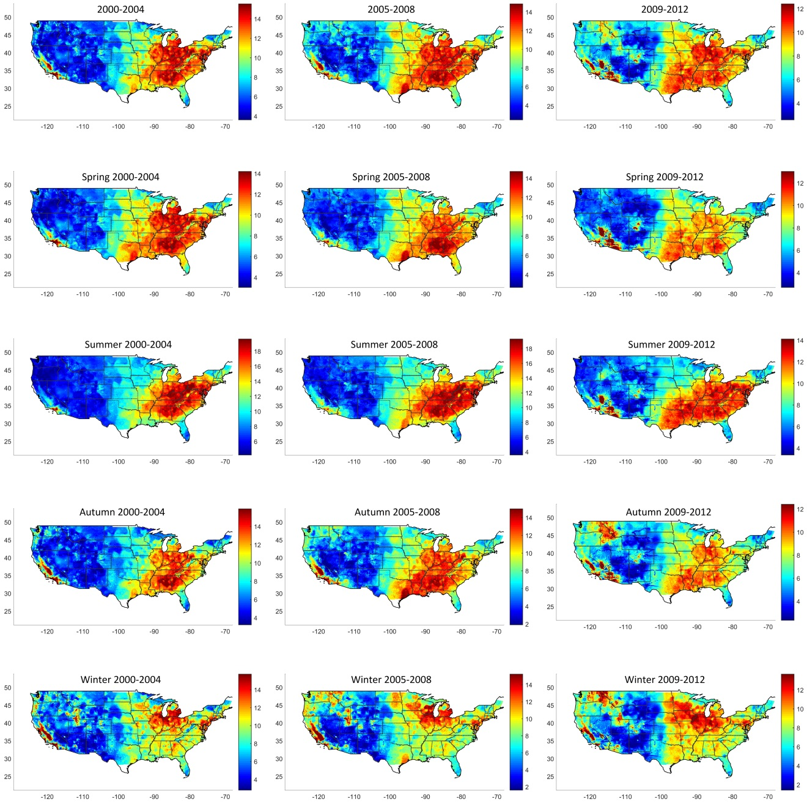

Slide 28
Large Administrative Datasets
For Example, Medicare provides medical insurance for everyone in the US over age 65 who is not still employed
We followed 61 million Medicare Enrollees, with 460 million person-years of follow-up
We had postal codes, and merged each year in each address with the average PM2.5 and Ozone from our National Model

Slide 29
Method
ZIP code-level and county-level covariates
U.S. censuses
% of Hispanic people, % of black, median household income, median value of owner occupied housing, % of population above age 65 living below the poverty level, % with less than high school education (above age of 65), % of owner occupied housing units, and population density.
Behavioral Risk Factor Surveillance System (BRFSS) of the Centers for Disease Control and Prevention (CDC)
Ever smoking rate, BMI
The Dartmouth atlas of health care
% of Medicare enrollees having a blood lipid (LDL-C) test, a hemoglobin A1c test, and at least one ambulatory visit to a primary care clinician
Notes:
Besides that, we got extra covariates…

Slide 30
Exposure assessment results:
Cross-validated correlation: R²=0.84 for PM_{2.5}; R²=0.76 for ozone on held out monitors
Di, Q., Kloog, I., Koutrakis, P., Lyapustin, A., Wang, Y. and Schwartz, J., 2016. Assessing PM2. 5 Exposures with High Spatiotemporal Resolution across the Continental United States. Environmental science & technology,50(9), pp.4712-4721.
Di, Q., Rowland, S., Koutrakis, P. and Schwartz, J., 2016. A Hybrid Model for Spatially and Temporally Resolved Ozone Exposures in the Continental United States. Journal of the Air & Waste Management Association, (just-accepted).
Notes:
Since we are taking daily average at ZIP code levels, the correlation should be higher…

Slide 31
We had enough power to
Look at people living in smaller cities and towns, and rural areas
Look at groups separately by Race, Sex, and poverty
Look at low exposure dose response (over 200 million person years at concentrations less than 12 µg/m³)
And of course, R will let you fit penalized splines in a survival analysis

Slide 32
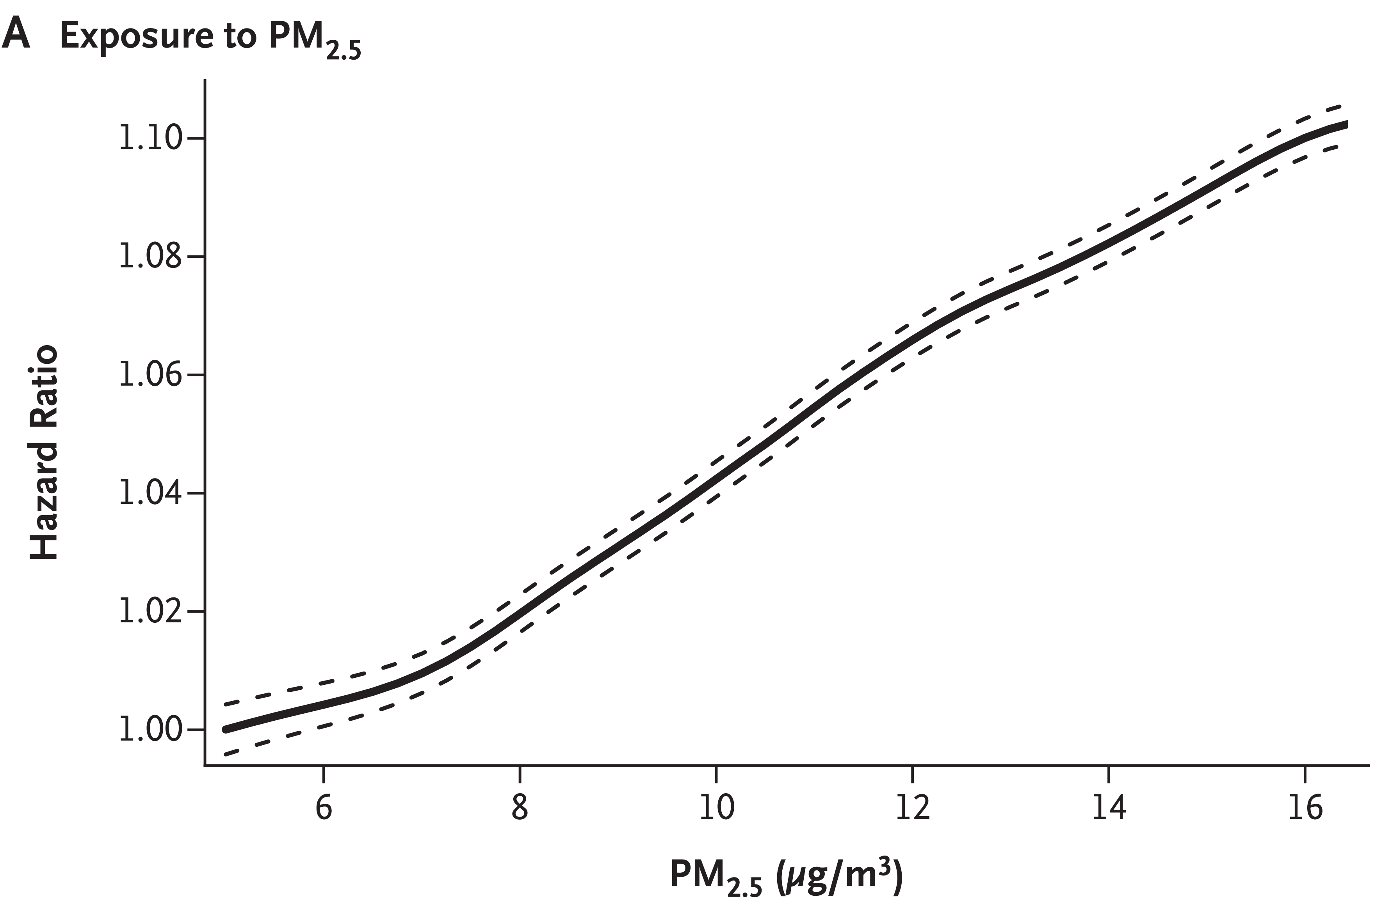
Dose-Response Curve

Slide 33
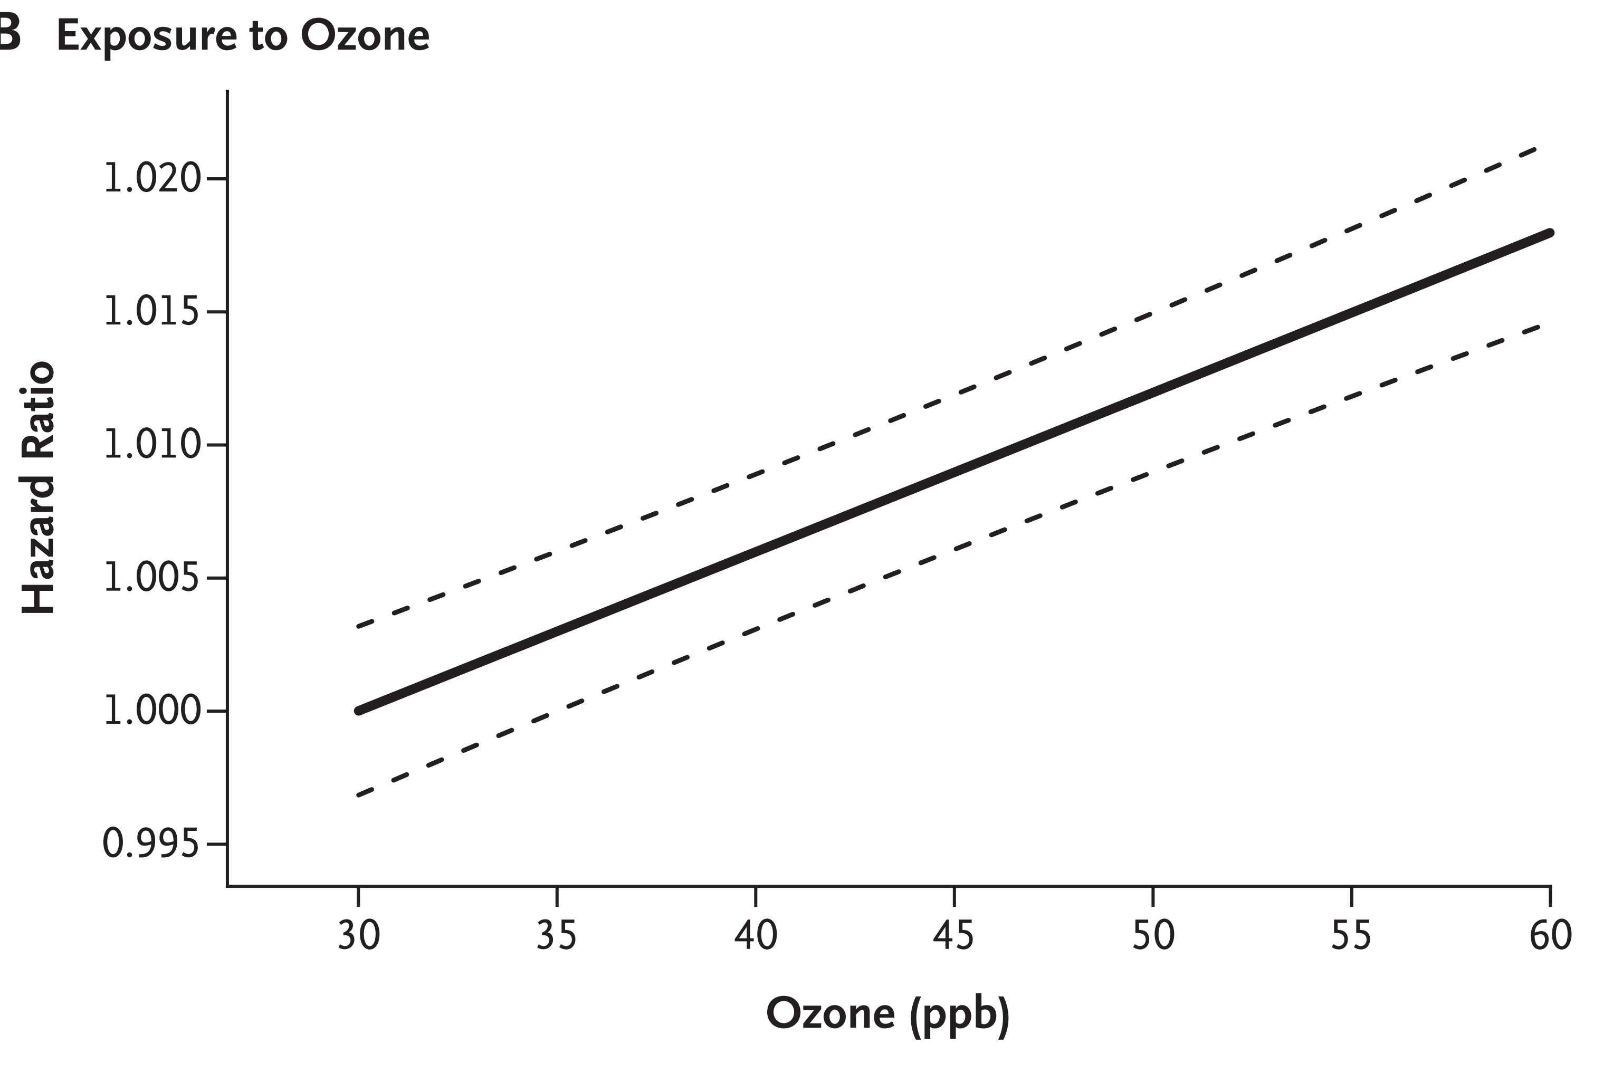

Slide 34
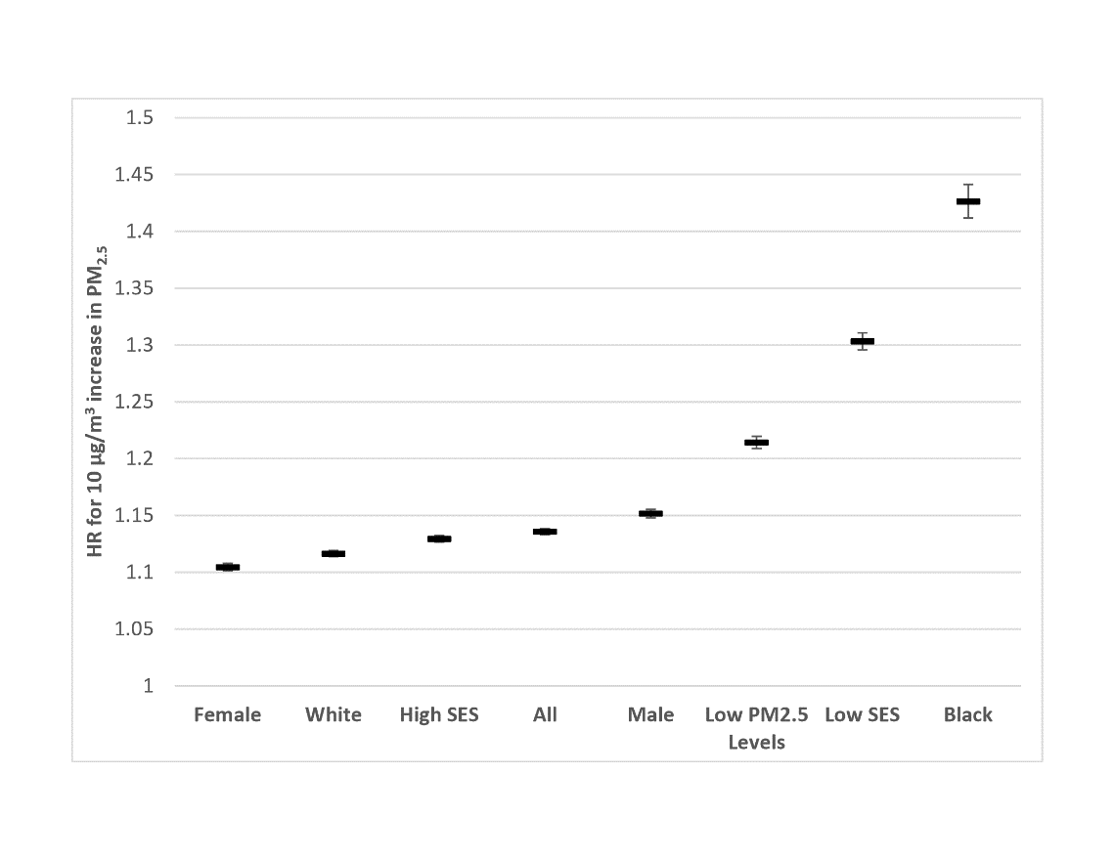
Mortality Risk by Subgroup

Slide 35
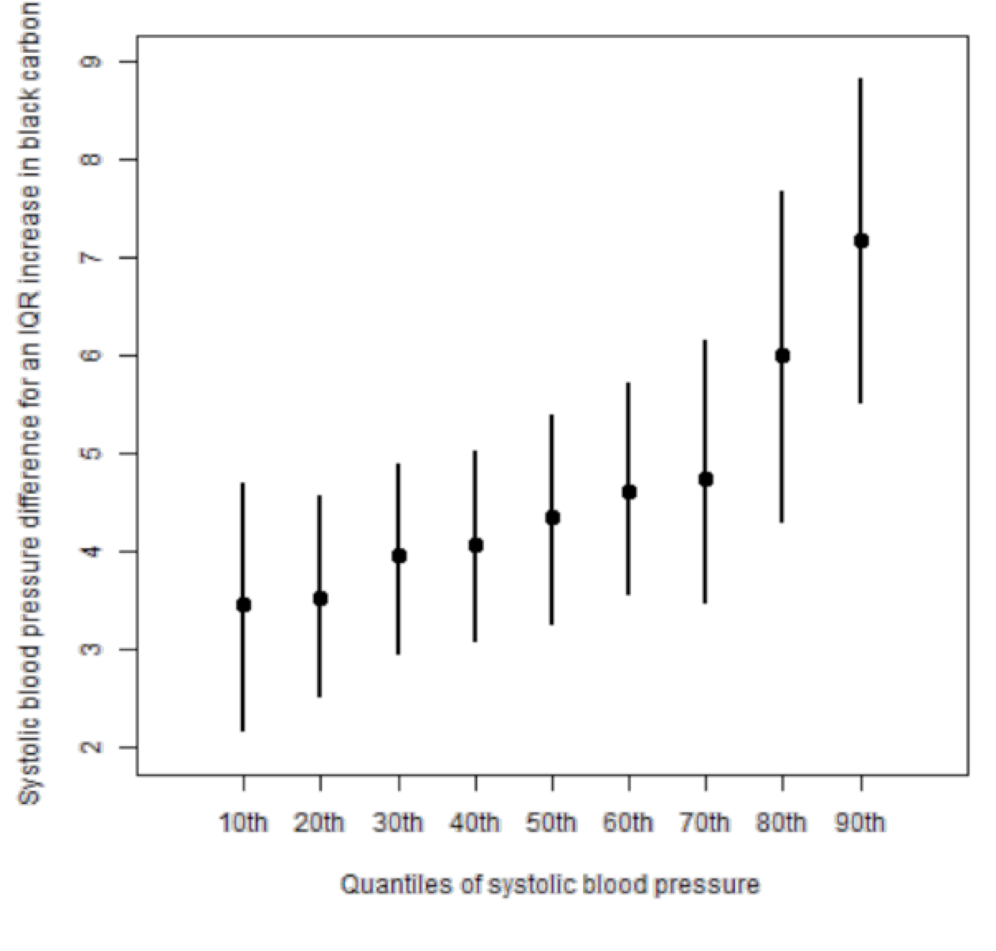
Quantile
Regression!
Bind 2016

Slide 36
We can also write our own functions: PM_{2.5} and Survival in Older Adults in the Southeast
13 million Medicare participants in the Southeastern US
Followed for 12 years
Matched to air pollution by Zip code
We wrote code to fit an additive risk model instead of a relative risk model
We used propensity scores, which give causal estimates if the propensity model is correct
We developed a doubly robust model which gives causal estimates if either the propensity model, or the model predicting the outcome is correct

Slide 37
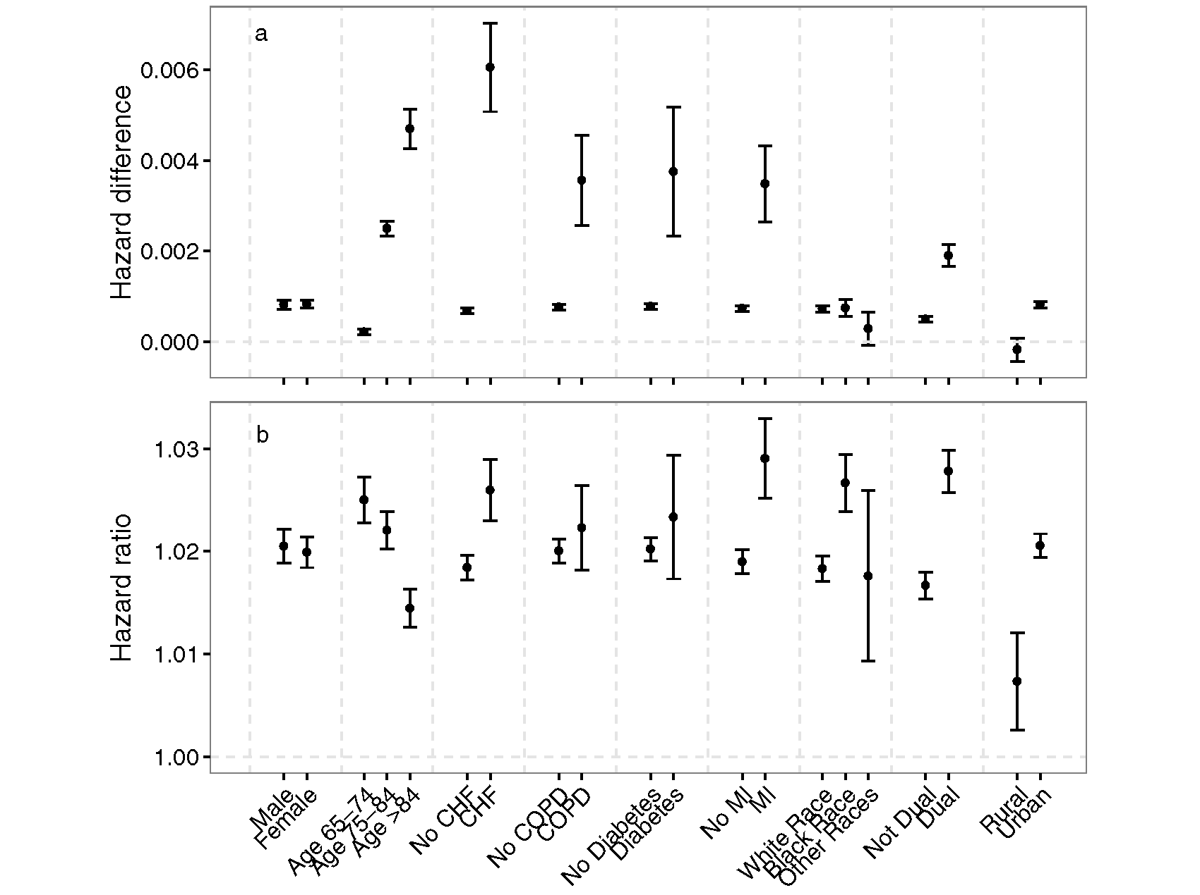

Additive
Approach 1
Prevent 5000 premature deaths for each 1 μg m⁻³ reduction in PM_{2.5}
Multiplicative Cox Model

Slide 38
Parallel Processing
library(doParallel)
registerDoParallel(cores=7)
library(foreach)
predy<-foreach(i=1:7, .combine='rbind',.packages="gamlss") %dopar% {
test <-subset(analysis,followup==i)
try=gamlss(outcome~pm,sigma.formula=~pm, nu.formula=~pm, data=test,family=BEINF0)

Slide 39
And Finally
It is open Source, free, and has good support groups

