Slide 1
Water Quality Portal Data Tools
Britt L. Dean
Laura Shumway
Dwane Young
US EPA- OWOW-WRAPD
Water Data Integration Branch

Slide 2
Outline
State Water Assessment Process
Identified Gaps and Purpose of the Tools
Data Discovery Tool Capabilities
Data Analysis Tool Capabilities
Future of Tools

Slide 3
State Water Assessment Process
= WQP Tools
Identify Target Area
Find “All Relevant Data”
Screen All Data for Quality
Compare Data against citeria
Determine if water is impaired
List water and develop restoration plan
TMDL development
Restoration
Monitoring to Measure effectiveness
Develop Monitoring Plan
Collect Data
Share Data through WQX/WQP

Slide 4
State Identified Gap and Purpose of the tools
Many states accomplish assessment in a piecemeal fashion
States can have thousands of Assessment Units and Monitoring Locations
WQX and ATTAINS- solutions to aid state process
ATTAINS Redesign
System that houses water quality assessment decisions
Workgroup 4 “Improved Assessment Methods”
Need to automate process of finding monitoring data and comparing it against state water quality criteria to assess waters

Slide 5
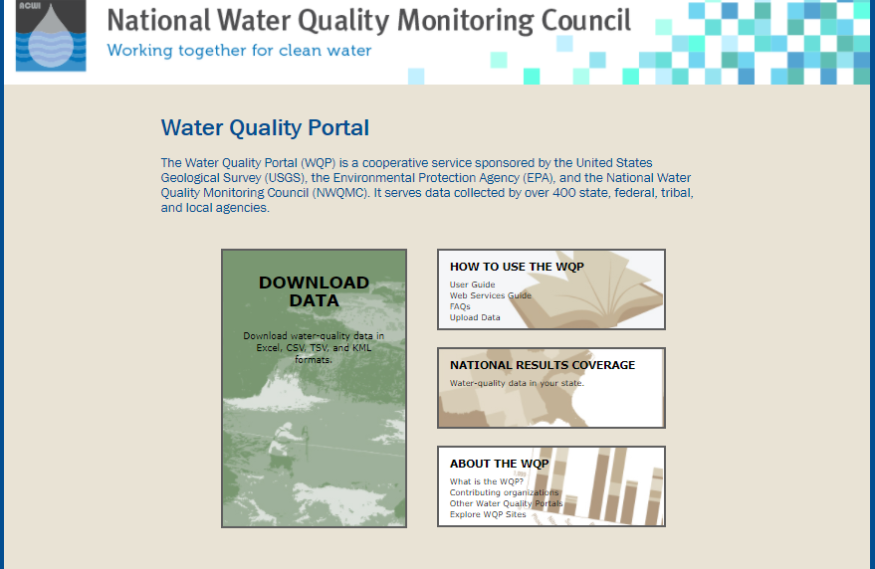
The Water Quality Portal Tools
What do the tools do for our state users?
Data Discovery-find a dataset of interest, QA checks and process out ‘bad data’, and deal with non-detects
Data Analysis- assess water quality monitoring data against water quality criteria, including Acute/Chronic thresholds, calculating exceedances, Trend analysis, and Metals criteria calculations
Keys to Success in Development:
R-portable:
Solution for R versioning issues and lack of admin privileges on EPA machines
Downside: updates of packages
Deciphering and parsing the many to many relationships in the input data
Web services
USGS dataretrieval package
Notes:
R-portable: these tools are for the states and regions, so we ran up against versioning issues

Slide 6
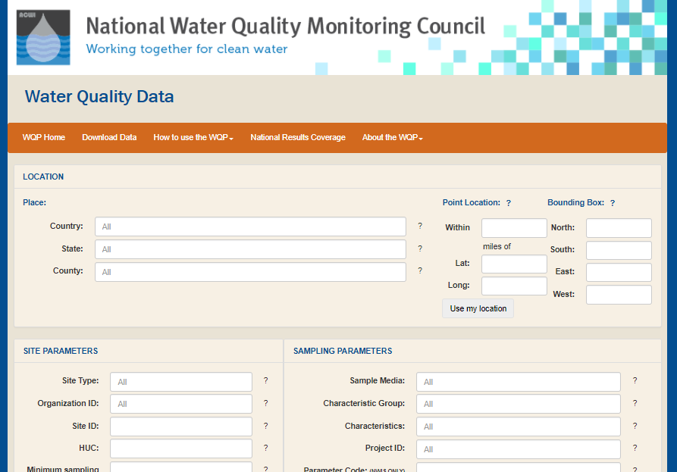
The Water Quality Portal Tools
Tools built using Water Quality Portal offerings via web services
Data sources- USGS, EPA, USDA
Users expressed difficulty accessing data outside of their organization

Slide 7
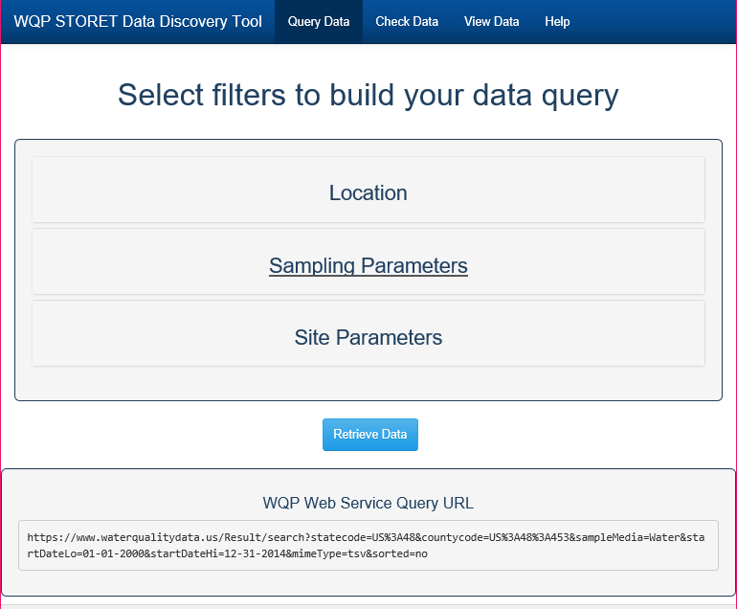
Data Discovery Tool Capabilities: Finding Data
Dynamic Data Source
Data Retrieval Package enables live querying, packaging, and delivery of data from Portal
Set up original query to portal- data is then imported into tool

Slide 8
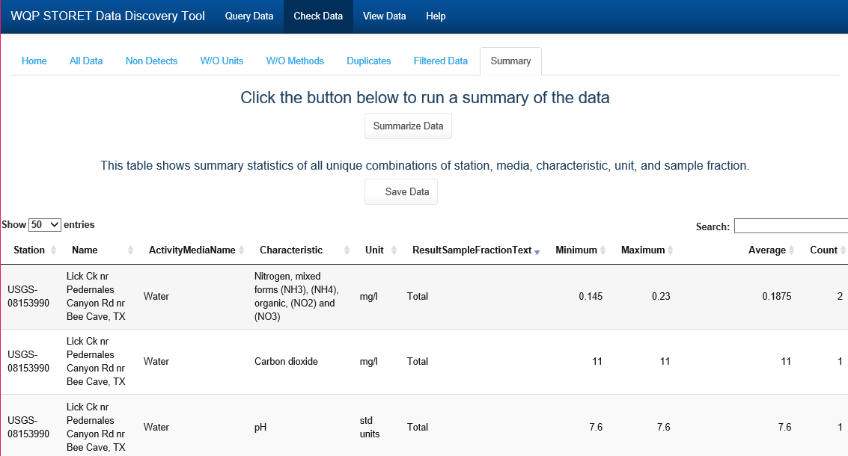
Data Discovery Tool Capabilities: Processing out unwanted Data

Slide 9
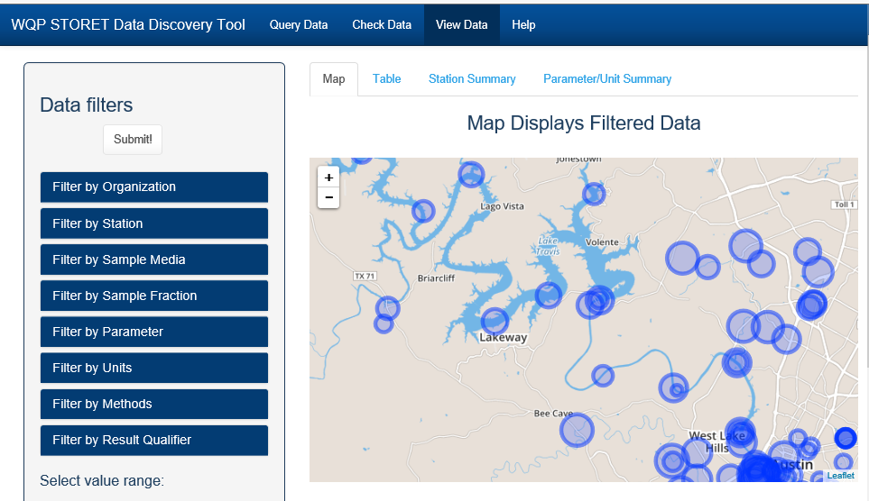
Data Discovery Tool Capabilities: Exploring the dataset
Notes:
Once you have filtered out the data you cannot use because of missing metadata, you can move to the view data area which allows you to search your dataset and further filter for the specific parameters, units, methods, ranges of data, etc. etc. Using this tab, you can explore the dataset in depth to ensure you are getting only the specific data you need.

Slide 10
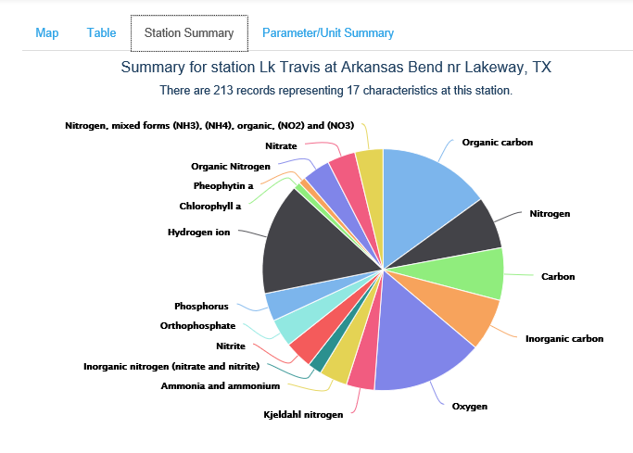
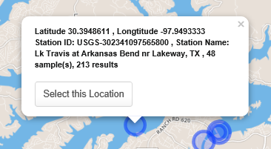
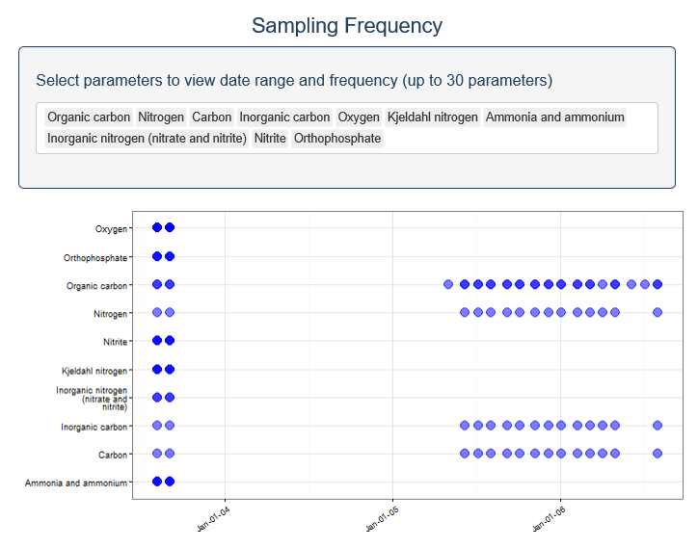
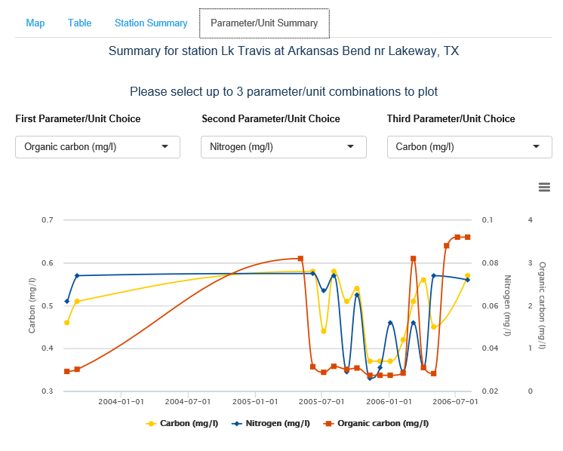
Data Discovery Tool Capabilities: Exploring the Data set
Notes:
Tool allows you to sift through the data available at each station, without having to leave the tool, or go through each station file separately. Visualizes the data to check for the correct parameters in the correct frequency for the statistic you wish to run and show you the actual data so you can check the quality of the data.

Slide 11
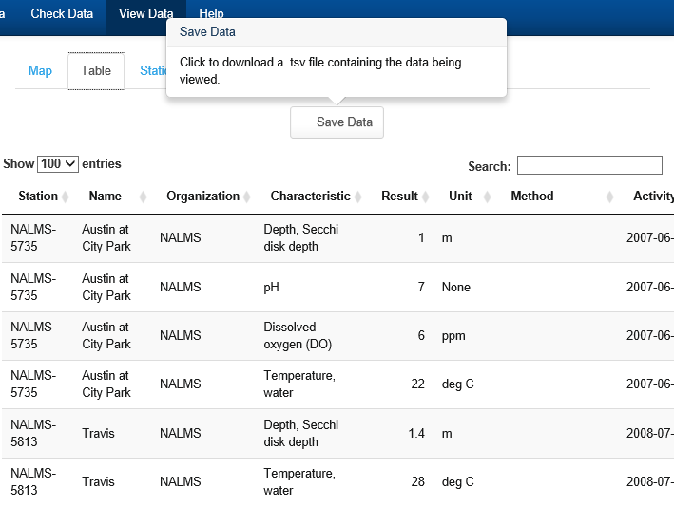
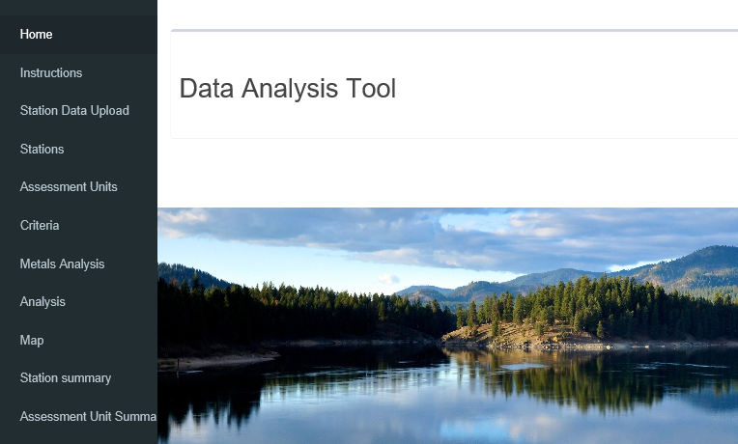
Output of Data Discovery Tool
Input for Data Analysis Tool
Notes:
Export of saved data from Discovery tool is data import for Analysis Tool

Slide 12
Data Analysis Tool: Development Considerations
Assessment Unit
Variance between states:
statistics used and way they are applied
tool has to be flexible in the areas that vary, but not so flexible as to be complicated to use
How to input many to many relationships:
User interface for inputting parameters for statistical tests OR Batch upload of a flat file with criteria enumerated
Some tests lend themselves more to a UI and some in flat files
Param
Monitoring Location A
Use 1
Param
Monitoring Location B
Use 2
Param
Param
Use 3
Param
Param
Param
Param
Param
Param
Notes:
so you will see both in this tool, and we can talk more about that later in future enhancements (editable tables; UI for metals)

Slide 13
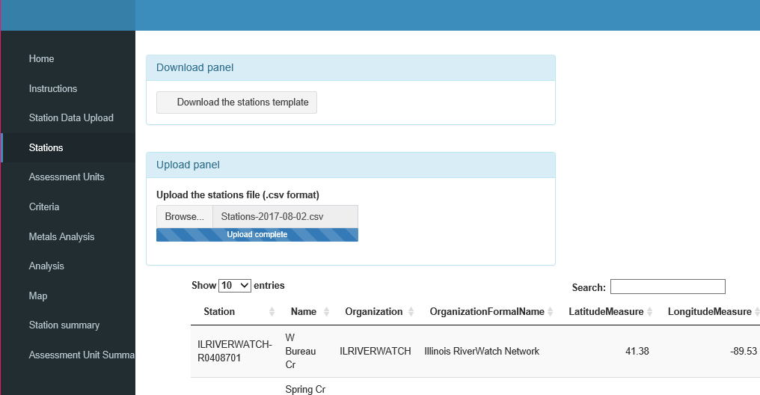
Data Analysis Tool Capabilities: Inputting Data and Criteria
Series of flat files relating stations, to assessment units, to designated uses, and water quality criteria
Notes:
Can download template and populate. Once files are set up for station assessment unit and criteria, these would stay the same for every subsequent analysis of a data tool

Slide 14
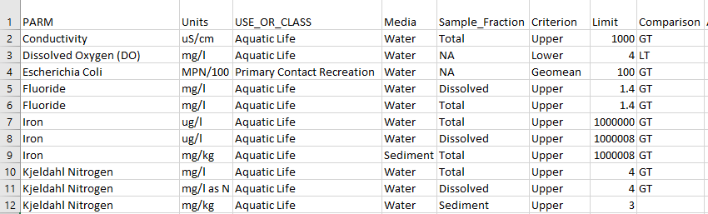
Data Analysis Tool Capabilities: Assessing against criteria
Notes:
Additional elements for criteria include: min # of samples, season start and end date (as criteria change values by seasons)
ACUTE AND CHRONIC

Slide 15
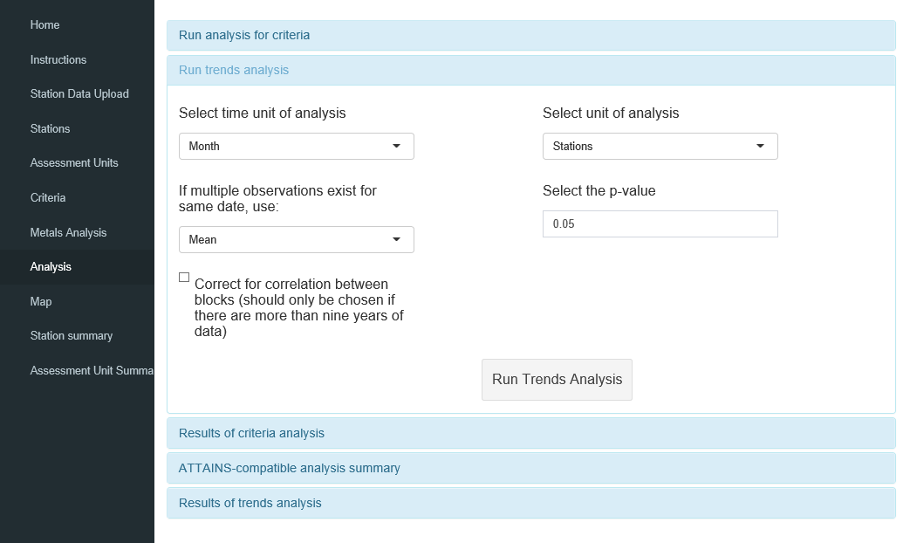
Data Analysis Tool Capabilities: Detecting Trends
Detects trends in long term data sets with seasonality- Seasonal Mann Kendall Trend Test
Considerations for setting parameters of test:
Length of data
Frequency of data
#Seasonal Bins
P-value to denote significance
Test output in different format than other criteria (i.e exceedance y/n vs reported tau, p-value, trend y/n, significance y/n)
Notes:
Seasonal Mann Kendall Trend Test: detects trend in long term datasets with seasonalityif present, provides statistical outputs denoting significance of trend if present

Slide 16
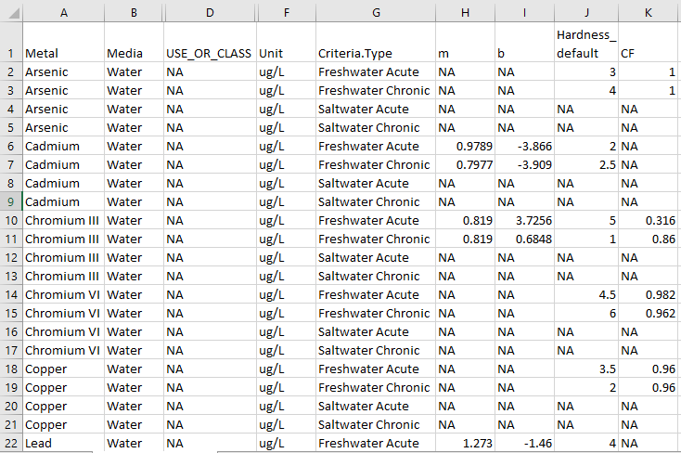
Data Analysis Tool Capabilities: Calculating metals criteria (beta)
Metals criteria for Aquatic Life, to compare WQ data against is hardness dependent
Bioavailability of metal dependent on hardness of water
User sets default hardness for now
Future enhancements to include sweep of dataset for all hardness related characteristics (i.e. ph, Calcium, Magnesium, Hardness, etc.)
Notes:
Metals criteria are usually dependent on hardness of the water, take into account those values in calculating the acute and chronic exposure of aquatic life. Future enhancement to include searching the dataset for hardness values (need to do some harmonizing of characteristics in WQX before proceeding to this step. Metals group)

Slide 17
Future Improvements
WQX Metals workgroup-
Hardness calculations for criteria
QAQC enhancement for Data Discovery Tool-
currently in development
Data Screening Rules and Harmonization of characteristics across datasets
Open Source Community
To share tools, code, and expertise collaboratively
Expressed need of Workgroup 4
With final release of DAT will disseminate tool to states

Slide 18
Questions?
Github link: https://github.com/USEPA/Water-Quality-Data-Discovery-Tool
Web Link: https://www.epa.gov/waterdata/water-quality-portal-data-discovery-tool
Dwane Young
202-566-0616
Young.dwane@epa.gv
Laura Shumway
202-564-2514
Shumway.laura@epa.gov
Britt Dean
202-566-1020
Dean.britt@epa.gov

