Slide 1
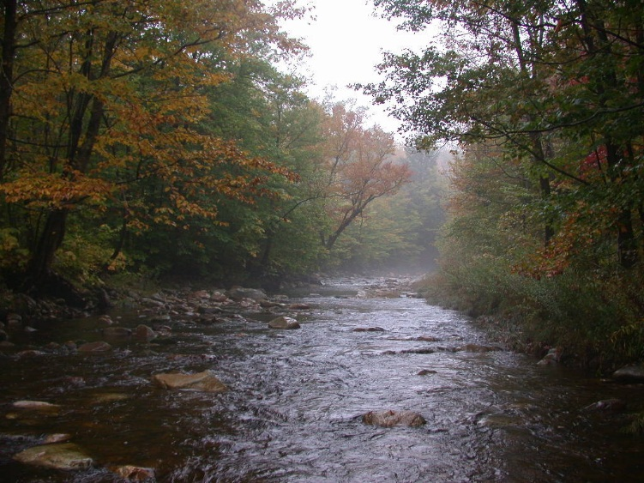
A (prototype) Shiny app for QCing continuous stream sensor data
David Gibbs (EPA ORISE fellow)
Jen Stamp & Erik Leppo (Tetra Tech)
EPA R User Group Meeting
Washington, D.C.
September 13, 2017
Office of Research and Development
National Center for Environmental Assessment
The views expressed in this presentation are those of the author and do not necessarily reflect the views or policies of the U.S. EPA.

Slide 2
The problem
How to detect climate change effects in streams?
Climate change occurs on top of natural variation
Detecting climate change effects in streams takes years, if not decades
Effects on stream invertebrate communities can be complex

Slide 3
Regional Monitoring Networks (RMNs)
Voluntary participation by states, tribes, EPA regions, and river basin commissions
Capitalizes on existing monitoring locations and programs, USGS gages
Started in 2012 in Northeast

Slide 4
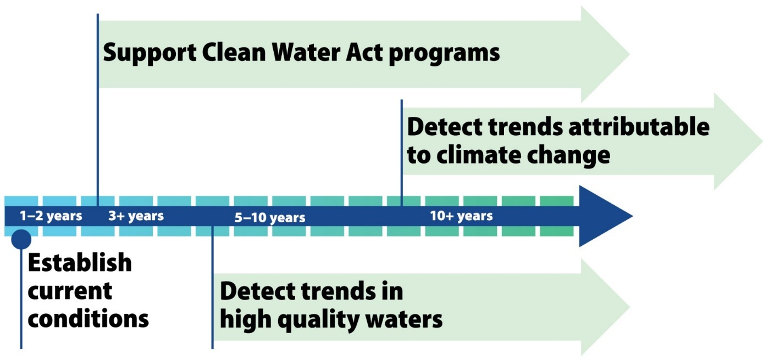
The RMN goal
Detect potentially small, climate-related temperature and hydrological trends at a regional scale, in a decision-relevant timeframe, in the context of routine biomonitoring

Slide 5
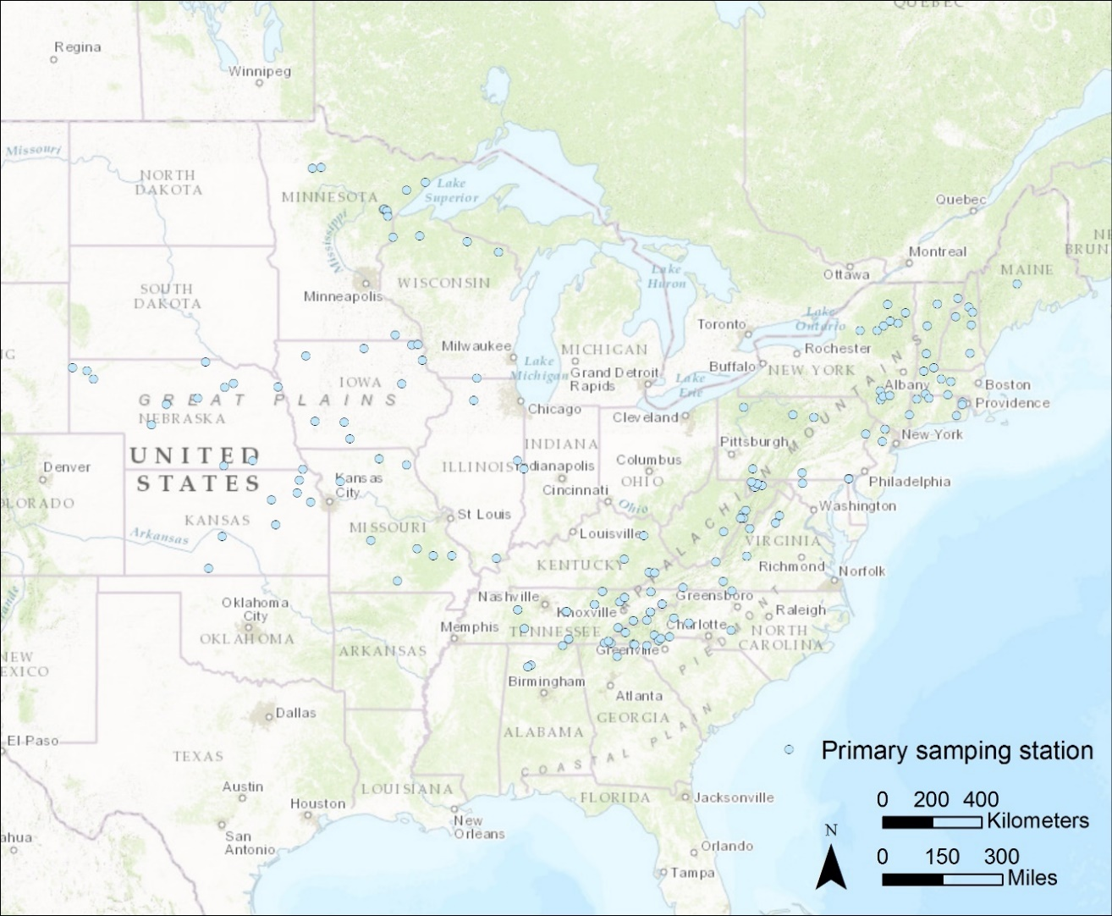
The RMN approach
Long-term monitoring of reference sites (minimal disturbance)
Wadeable streams, medium-to-high gradient, <100 km² watersheds, cold water taxa (higher hydrologic and biologic sensitivity) (for the eastern US)
Standardized measurement protocols
Continuous stream temperature and water level, annual macroinvertebrate sampling
Data regionally pooled to increase statistical power and shorten time for trend detection
Site map does not reflect most recent changes to site locations.

Slide 6
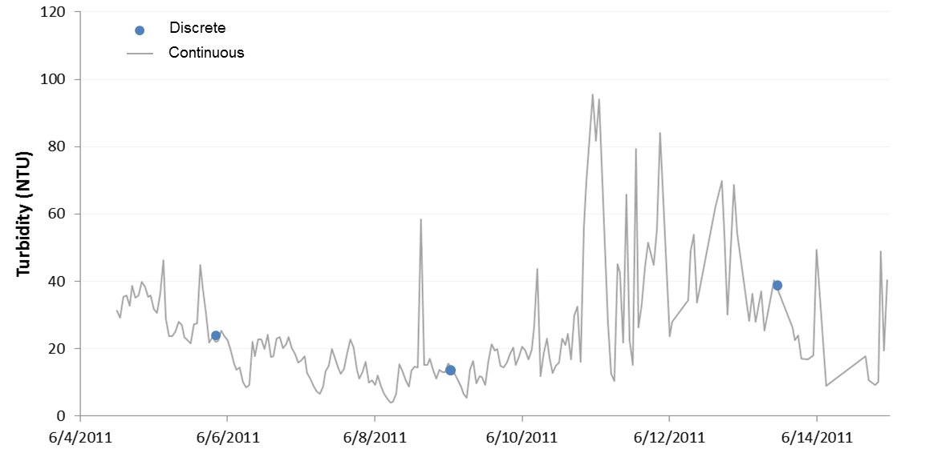
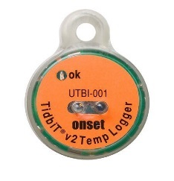
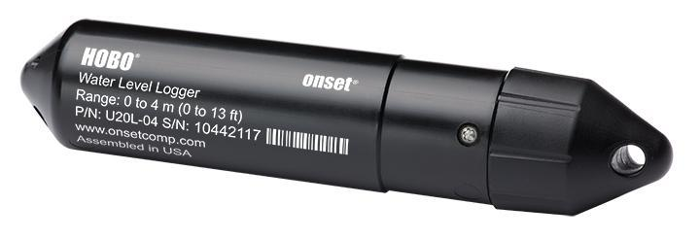
Continuous stream measurements
Continuous stream and air temperature and water level sensors take measurements every 30 minutes
3-4 months between data retrieval at each site
Continuous sensors record episodic or flash events
Many states are new to continuous monitoring
Temperature (C)

Slide 7
How to QC all these RMN data?
One sensor taking one measurement every 30 minutes will record over 17,000 measurements in one year
It’s a lot to handle– too much to check manually
Automated QC scripts can help
Checks for: unreasonable values, rapid changes, and flat values
Consistency across partners, users, years
RMNs are using an R-based QC process
Currently using Tetra Tech’s R script partners run on their computer
Moving to web interface using R Shiny

Slide 8
Prototype Shiny app demonstration

Slide 9
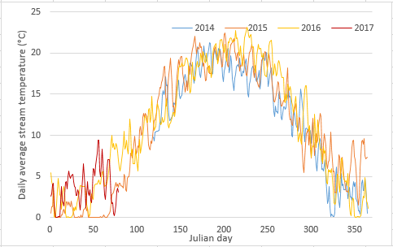
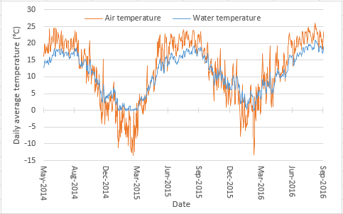
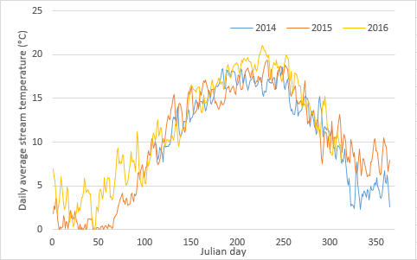
Continuous water temperature example sites
Water temperature across years
Dunnfield Creek, NJ
Water and air temperature
Dunnfield Creek, NJ
Spring invertebrate sampling
Summer invertebrate sampling
Over many years, trends should emerge in these plots
Data from New Jersey Department of Environmental Protection

Slide 10
Next steps
Get app to work online (issue with downloading output files)
Make app available online to monitoring partners
Improve QC tool functionality: input file format checking, error messages, etc.
Add other tools: macroinvertebrate metrics, water metrics 90 days before macroinvertebrate sampling date, etc.
Do you have any ideas, suggestions, best practices, etc.?
Contact: gibbs.david@epa.gov

Slide 11
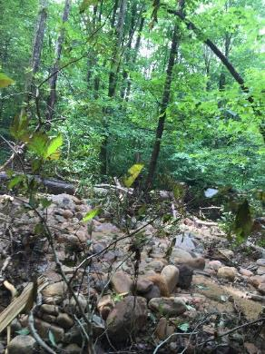
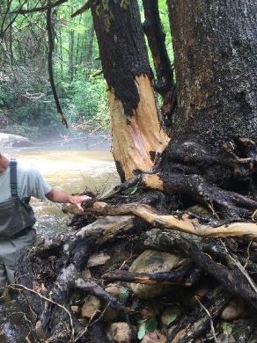
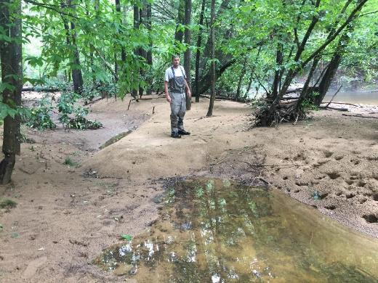
Acknowledgements
Britta Bierwagen (EPA Office of Research & Development
Regional Monitoring Network partners
For more information, e-mail:
gibbs.david@epa.gov
jen.stamp@tetratech.com
bierwagen.Britta.@epa.gov
Photos from West Virginia DEP

