Slide 1
Expose your R functions and data with an API
Tom Purucker

Slide 2
Web APIs
Programs interact with APIs, not people
Machine friendly data formats (usually JSON), but can also render images, HTML widgets
Accessible from all current programming languages and platforms
Including R with the httr package
Web browsers, apps
Any modern programming language

Slide 3
Our goal is to accomplish 2 things:
Access other web APIs using R (using the httr package)
Express our data/algorithms via a web API so that others can use it (using the plumber package)

Slide 4
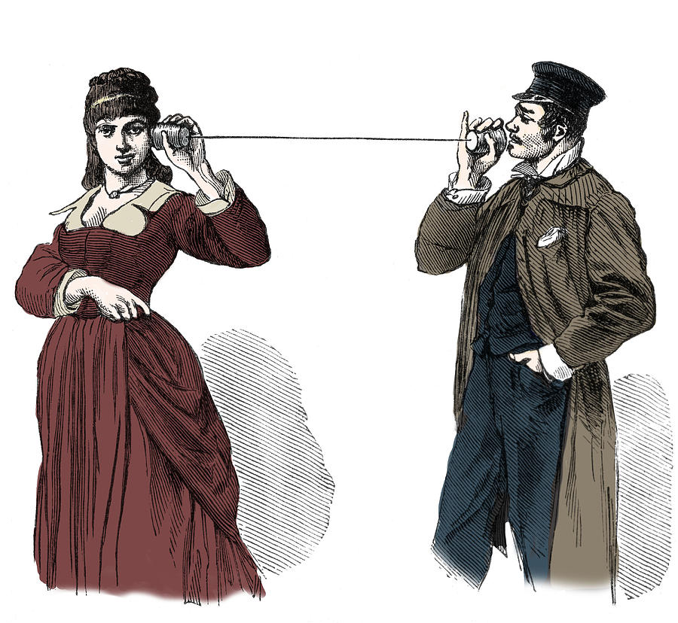
Client
Server

Slide 5

Client
Server
The Client (e.g., a browser or phone app) makes a GET request for the Google home page
The Server (hosted at Google) receives the request and returns HTML
The Client renders the HTML in her web browser

Slide 6

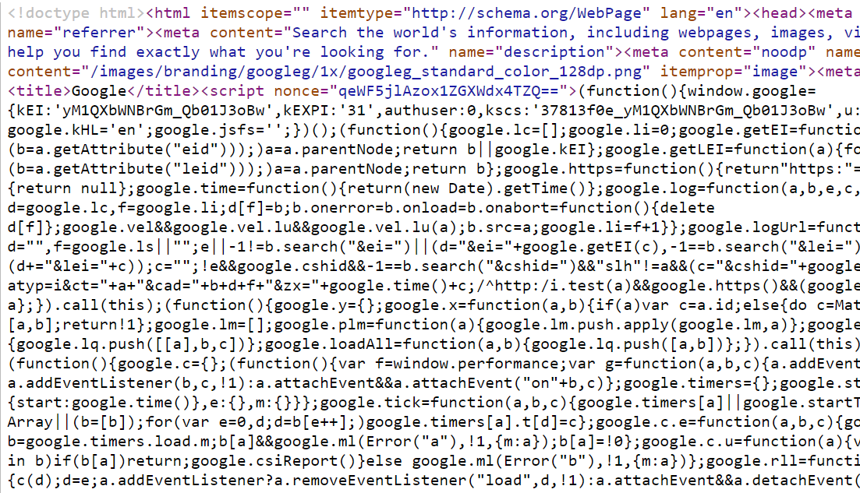
Client-Server Communication: GET Request
Client Request
Client
Server
Server Response

Slide 7
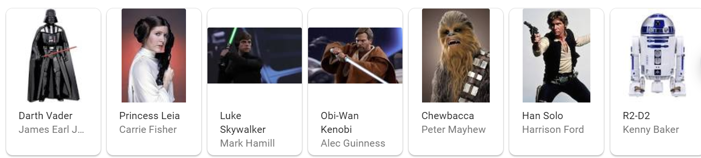
Client
Server
The Client makes a POST request to Google for links about “Star Wars characters”
The Server receives the POST request
Creates a second POST request to its own API for the relevant info/links
Then returns HTML with the API results embedded
The Client renders the HTML in her web browser

Slide 8


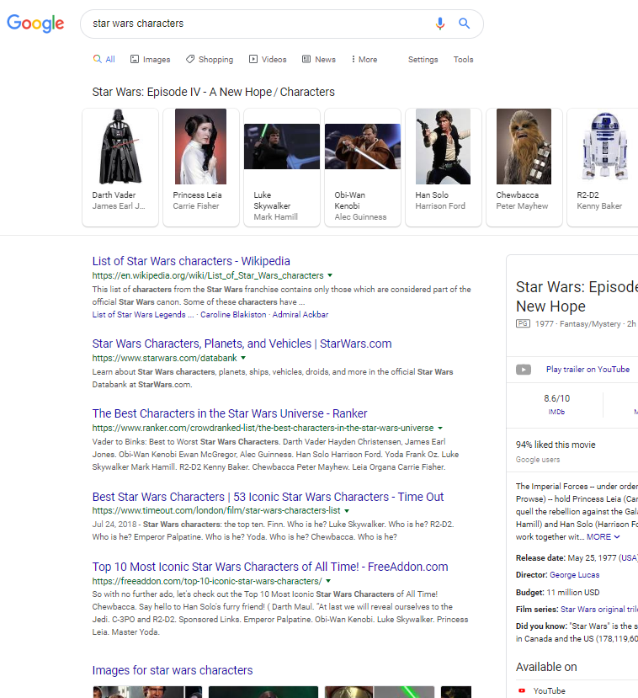
Client-Server Communication: POST Request
Client Request
Client
Server
Server Response

Slide 9
Client-Server Communication: POST Request (API)
Client API Request
Client
Server
Server Response

Slide 10
Our goal is to accomplish 2 things:
Access other web APIs using R (using the httr package)
Express our data/algorithms via a web API so that others can use it (using the plumber package)

Slide 11


Access other Web APIs Using R
Us
Client API Request
Client
Server
Server Response
Them

Slide 12
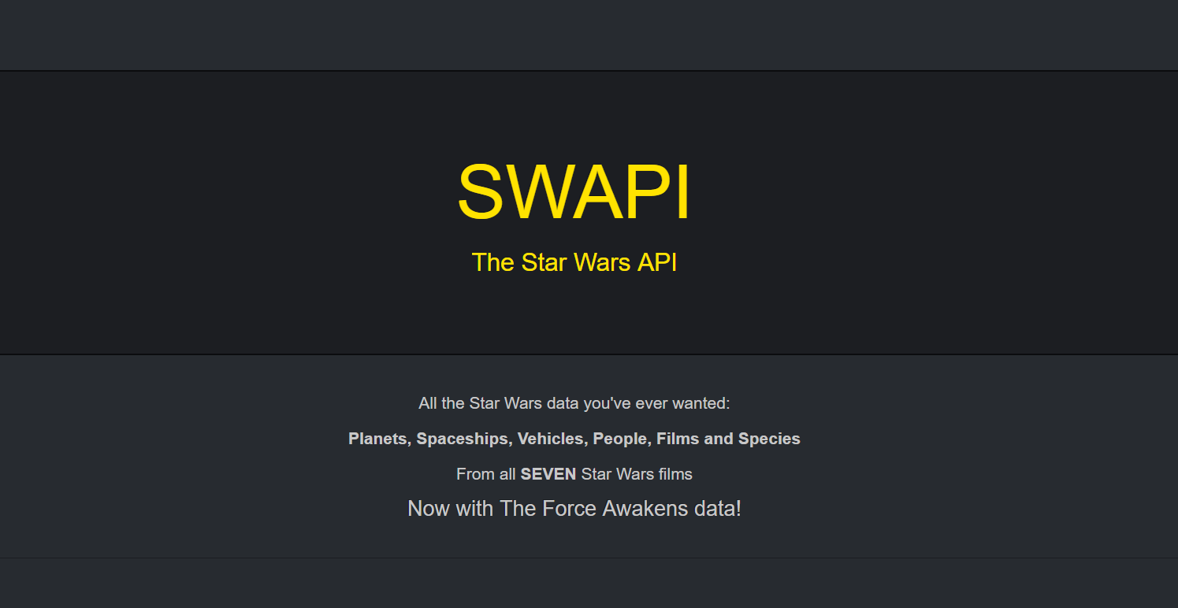

Slide 13
Accessing web APIs from R
aws.s3, acs, RGoogleAnalytics
httr (hitter) for making requests– uses HTTP verbs ( GET POST, being the most common)
jsonlite, xml2 for parsing the response
Tidyverse packages (dplyr, tidyr, lubridate, stingr, etc) for going from json back to dataframes or other R objects

Slide 14



httr

Slide 15
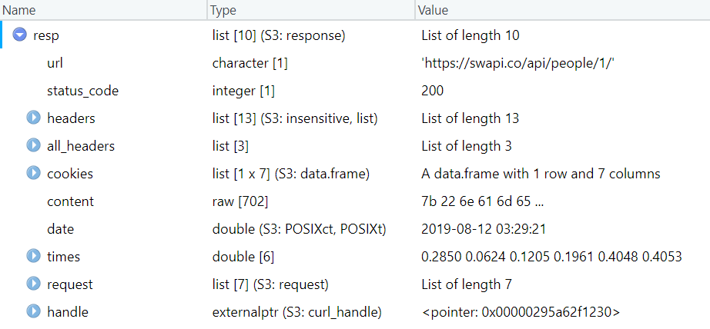
Response objects

Slide 16
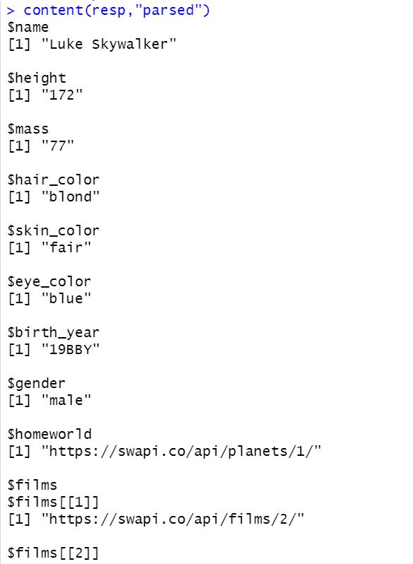
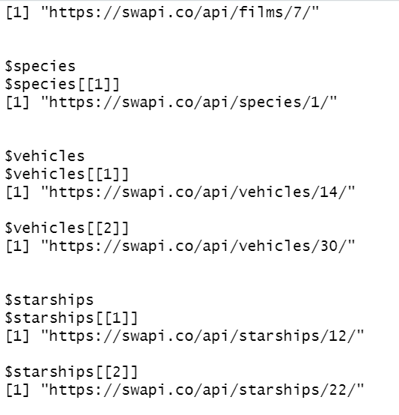
Decoding the response content

Slide 17
Our goal is to accomplish 2 things:
Access other web APIs using R (using the httr package)
Express our data/algorithms via a web API so that others can use it (using the plumber package)

Slide 18
Express our data/algorithms with an API
Client API Request
Client
Server
Server Response

Slide 19
Web API
Shiny bundles the web application and the API together
Plumber is a minimalist way to expose your data and functions as an API
Converts your existing R code into web APIs using decorator comments on your functions
The serializer included in the decorator specifies the type of output to return as part of the request (json, html, plaintext, image, etc.)

Slide 20
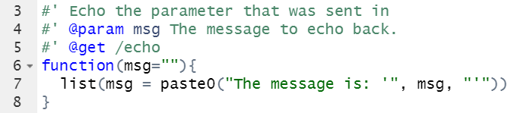
Decorator comments on functions
This plumber decorator turns the function into a service endpoint when plumber is run
The decorator specifies the function argument (@param) and the use of the http GET verb (@get) when the /echo endpoint is requested.

Slide 21
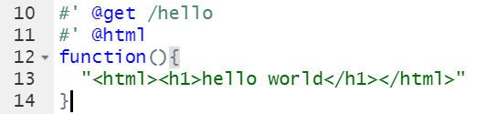
Serializers specify output types
The serializer included in the decorator specifies the type of output to return as part of the request (json, html, plaintext, image, etc)

Slide 22
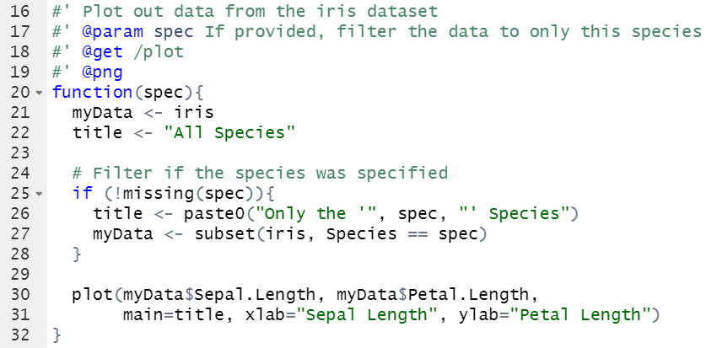
Example with argument and serializer

Slide 23
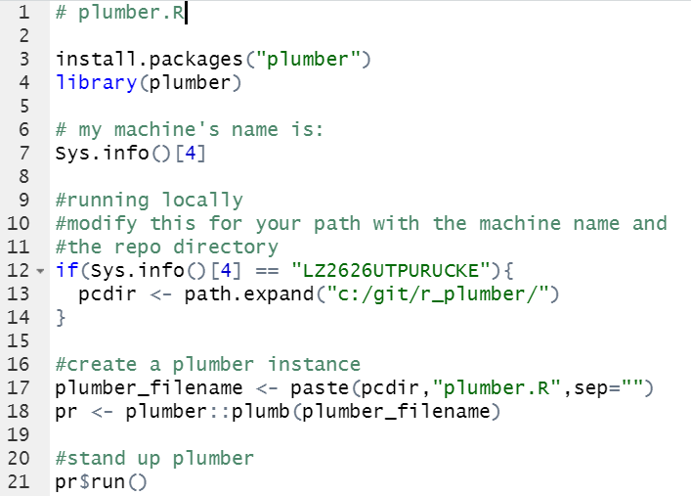
Standing up plumber

Slide 24
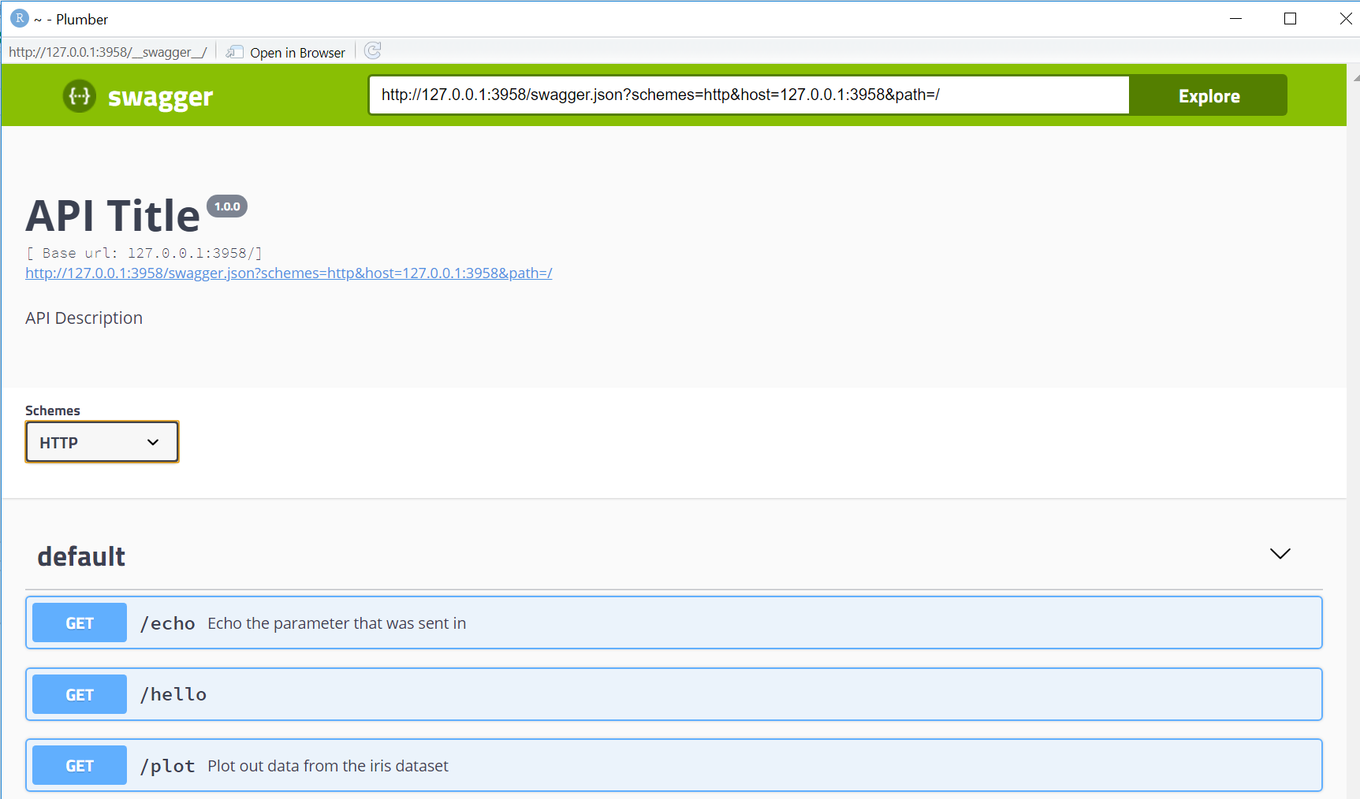

Slide 25
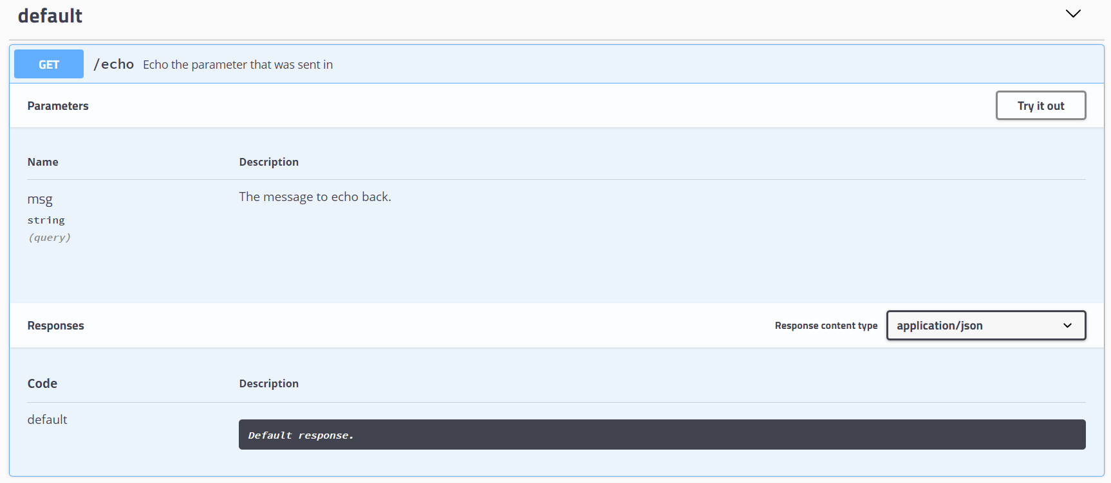

Slide 26
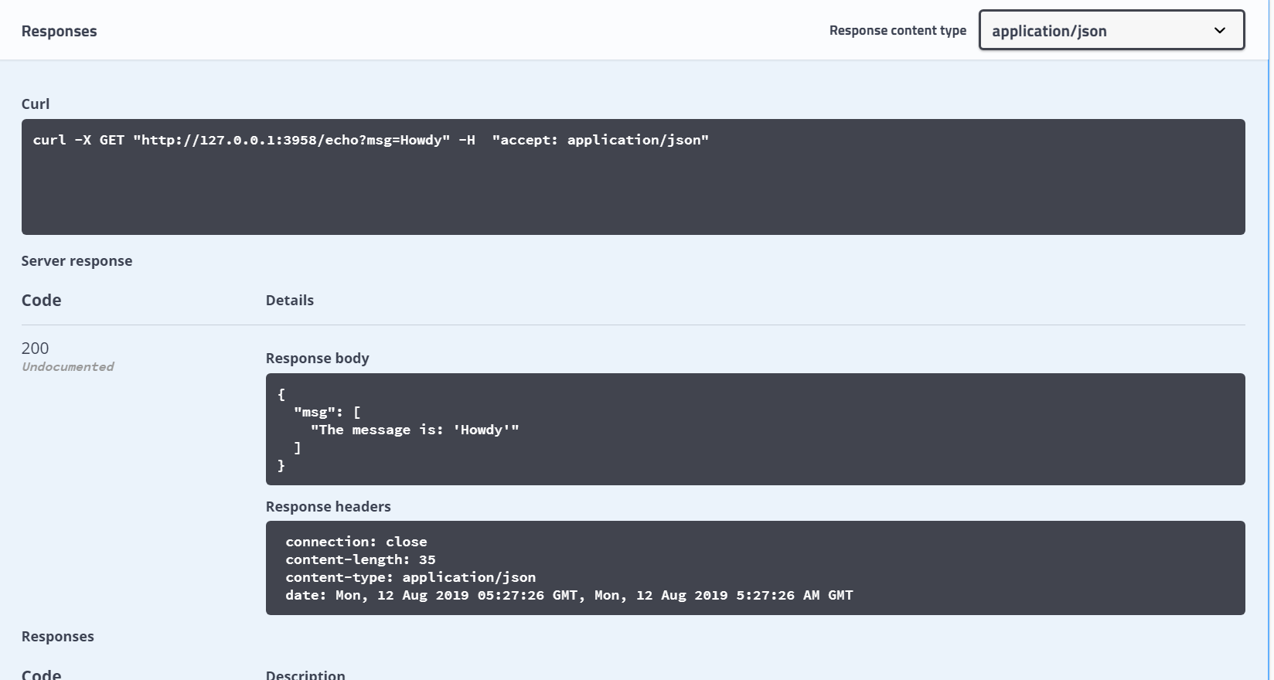

Slide 27
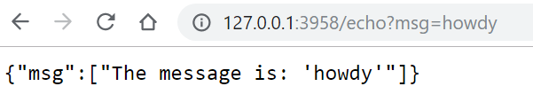
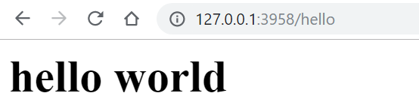

Slide 28
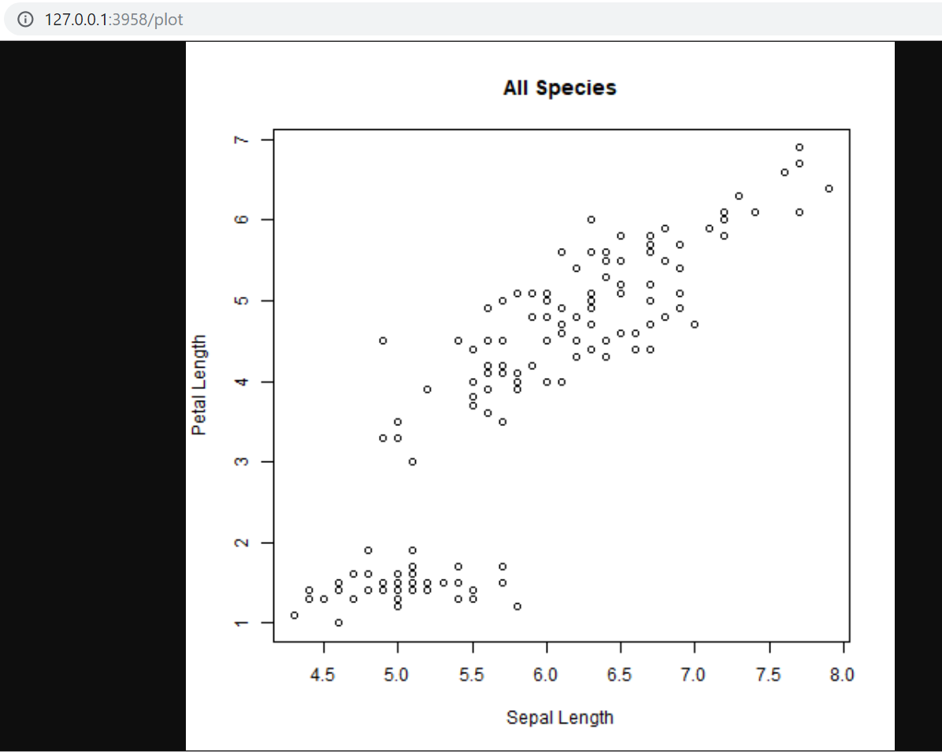
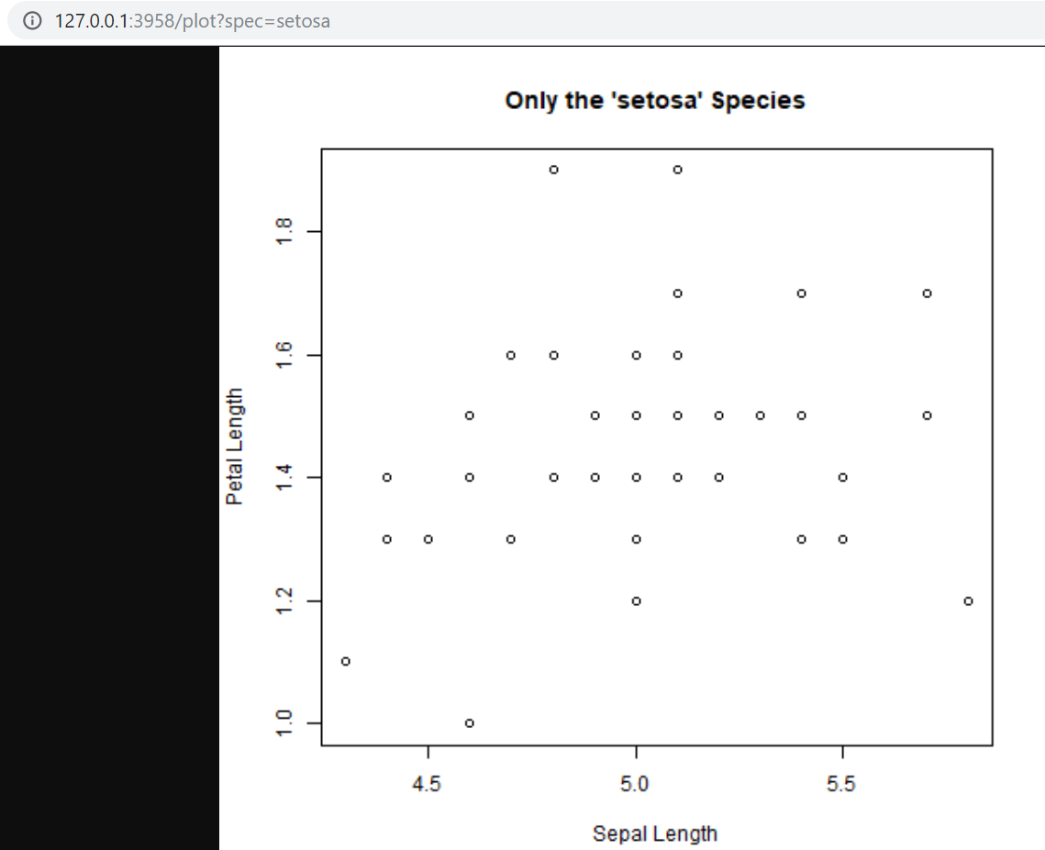

Slide 29
Advantages of APIs for Developers
These API endpoints are available from the command line (curl), from browsers, and from within language IDEs
Allows other programmers/scientists to write programs to consume your data without scraping (json)
Other front end developers can create web applications/phone apps that integrate these R functions into their workflows
Other back end developers can use your algorithms/data outside of R (python, java, c, etc.) and integrate into scientific workflows
Allows for scaling of computations (high throughput) in concert with capable servers
I’ll talk Wednesday about deploying via docker
https://github.com/puruckertom/r_plumber

