Slide 1
Bart
Beneficiary Assessment and Review Tool

Slide 2
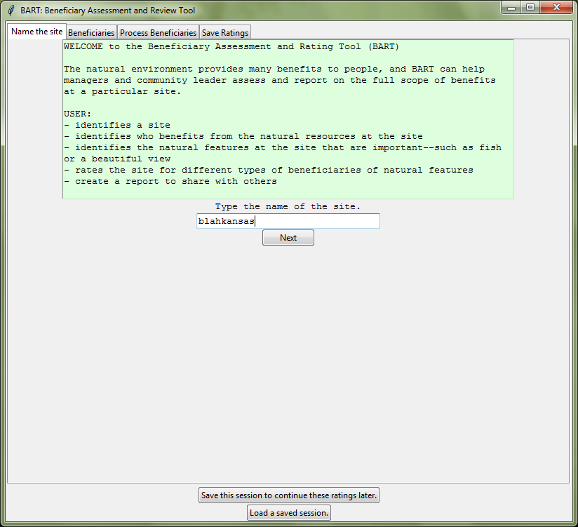
Name the Site
Users can save or load a ratings-session from any step of the process using the buttons on the bottom.
Press the “Next”-button when done with a page to advance.
Previous pages are selected by their tabs.

Slide 3
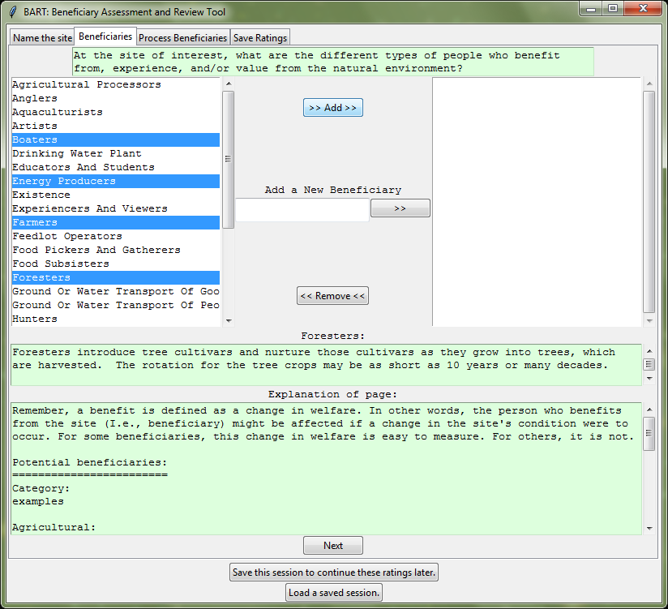
Select Beneficiaries of the Site
Beneficiaries are selected in the listbox on the left.

Slide 4
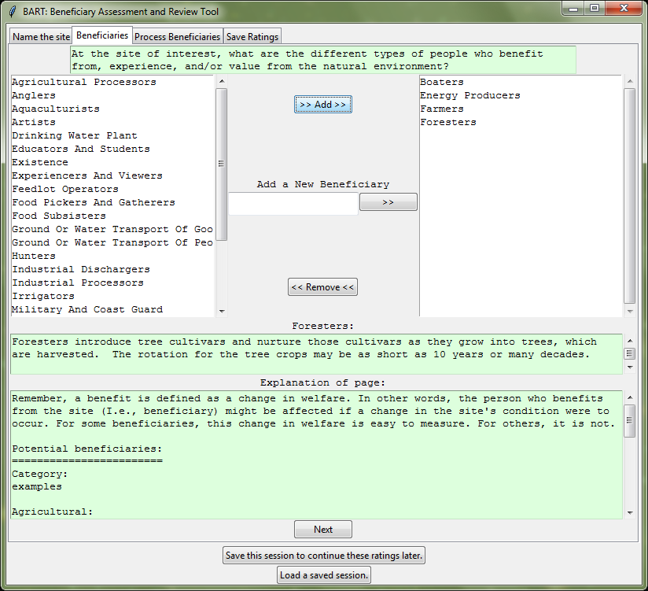
Beneficiaries have been Added
The “>> Add >>”-button was pressed.

Slide 5
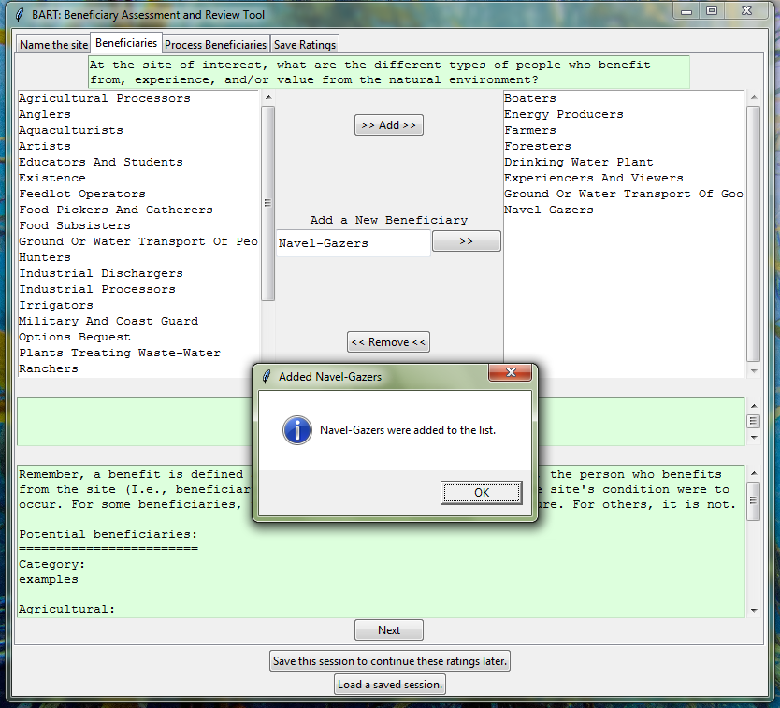
Create a New Beneficiary
Users have the option of adding a beneficiary if it is not listed or a colloquial name is preferred to a listed beneficiary.

Slide 6
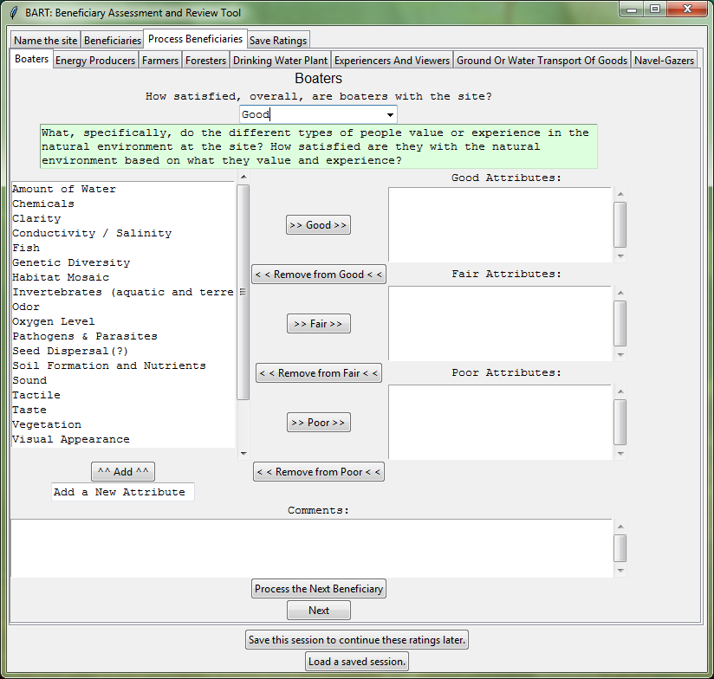
Rate the Entire Site for a Beneficiary
A tab is programmatically created for each beneficiary.

Slide 7
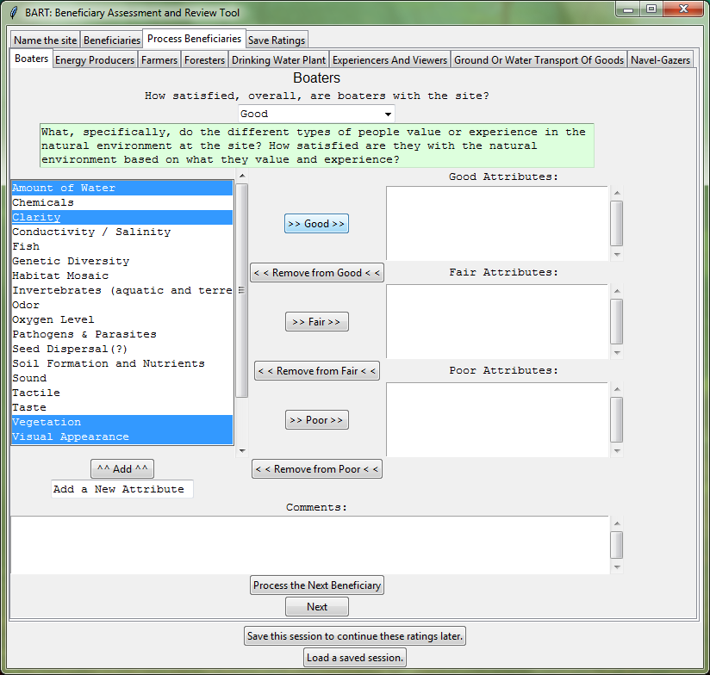
Choose Attributes to Rate
The selected beneficiaries will be rated good.

Slide 8
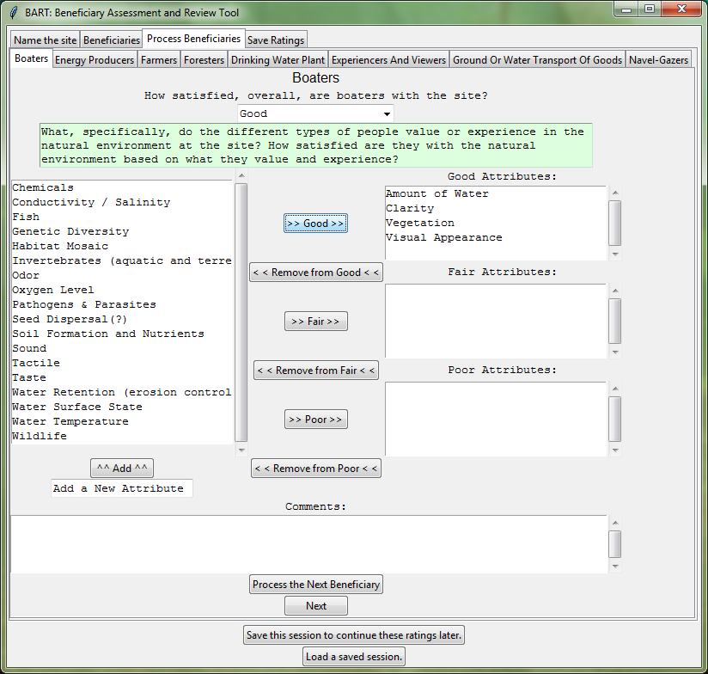
Move Selected Attributes to a List to Rate Them
The selected attributes from the last slide are rated good here.
The “>> Good >>”-button moved these attributes, effectively rating them.

Slide 9
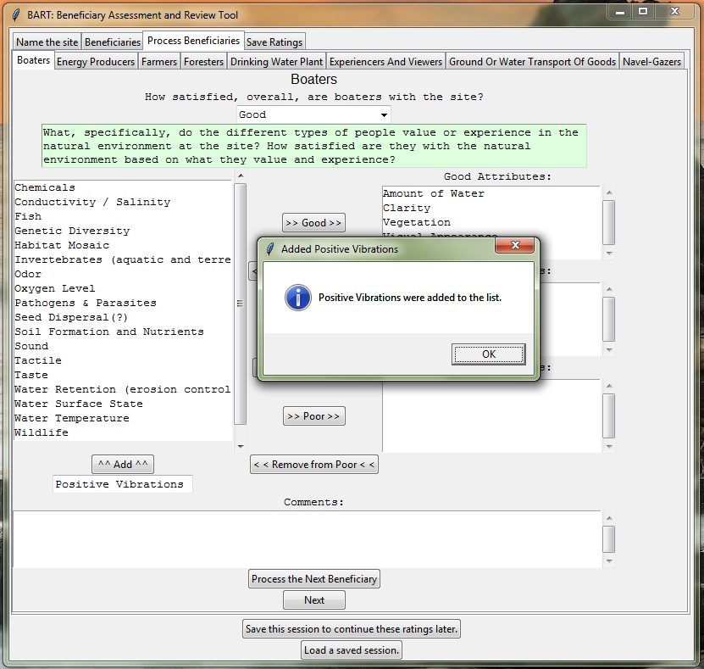
Create a New Attribute
Users can create unlisted attributes.

Slide 10
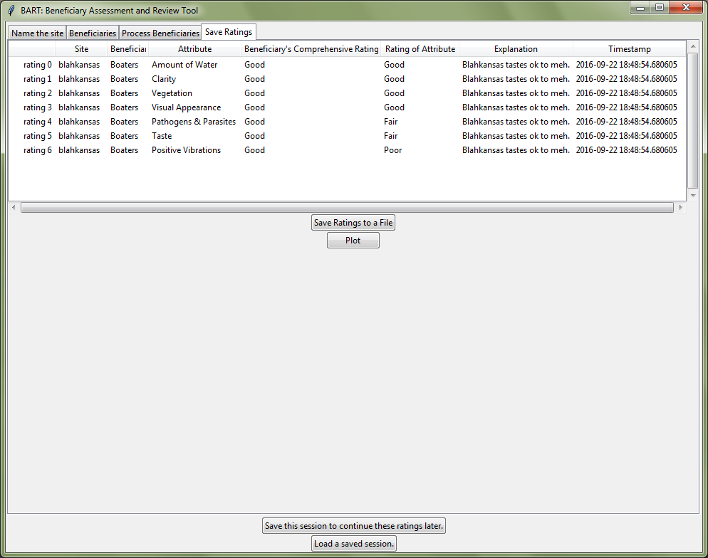
Review the Ratings

Slide 11
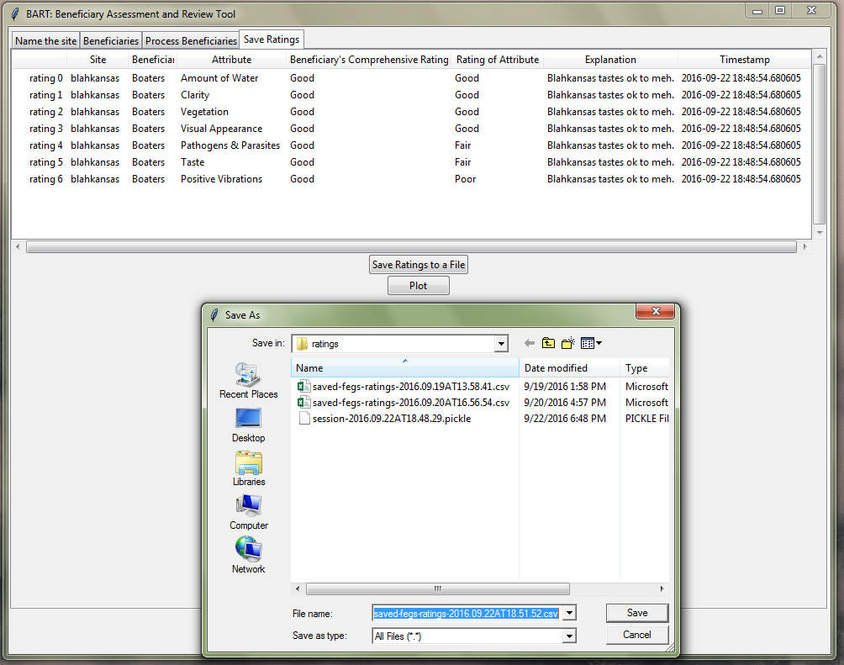
Save the Ratings to a CSV

Slide 12
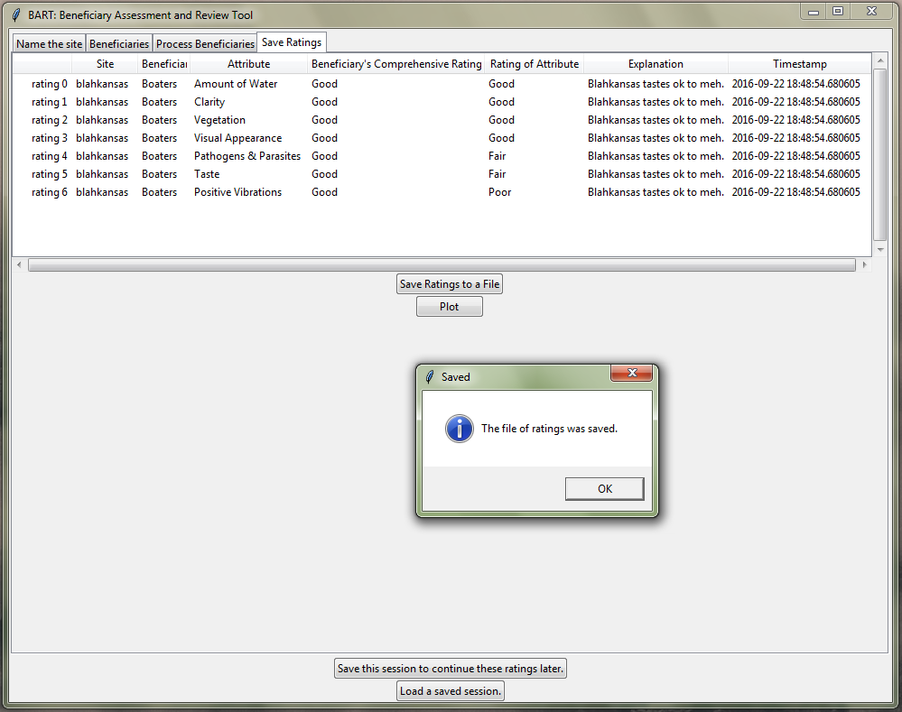
Let’s Plot the Ratings in the Browser

Slide 13
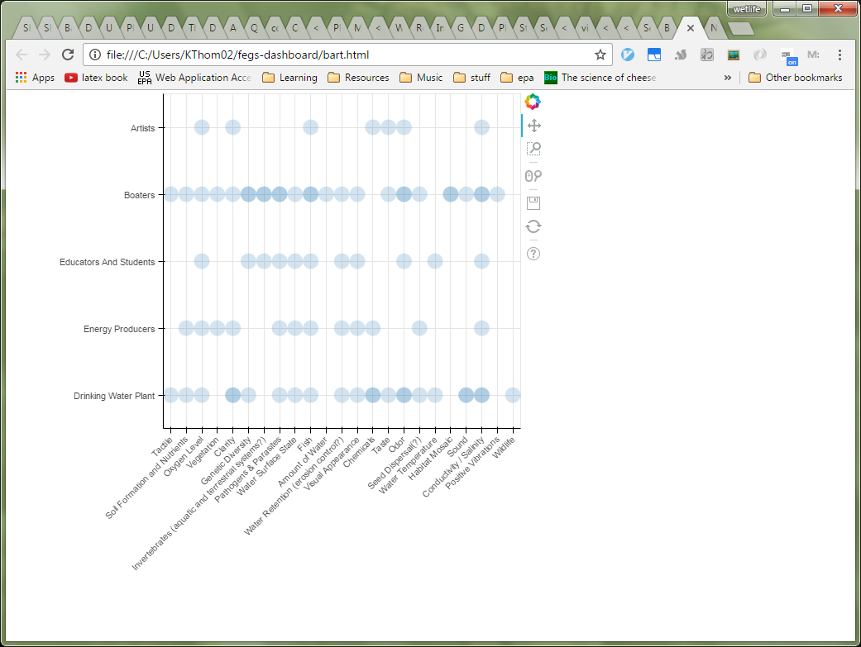
Ratings are Plotted in the Browser
Circles are drawn darker over FEGs with more ratings.
A circle’s colors will later indicate the mean rating of that FEG.
Size of a circle will later indicate the count of ratings for that FEG.

