Slide 1

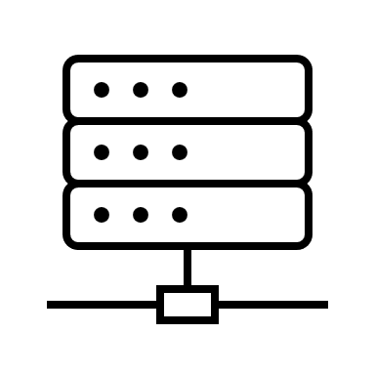
LabLAN Network
LabLAN Network Folder
\\AA\ORD\RTP\Data\Lab\ORDLIMS
Data files
Instrument 1
Data files
Pull data files
Instrument 2
LIMS Server
H26267OHTH502.aa.ad.epa.gov
Push universal template files
Data files
Pull universal template files
GoAnywhere Server
Instrument N
Production Network

Slide 2
GoAnywhere
Folder Monitor
Source:\\AA\ORD\RTP\Data\Lab\ORDLIMS
Recursive
Schedule
Trigger
\\AA\ORD\RTP\Data\Lab\ORDLIMS
Schedule

