Slide 1











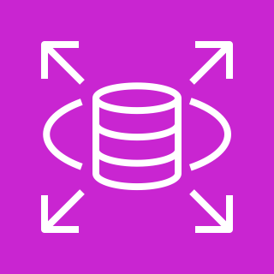

AWS Cloud
AWS Secrets Manager
S3 Model Output Storage
Elastic Container Registry
Virtual private cloud (VPC)
Private subnets (divided by usage – some for RDS, some for Beanstalk, etc.)
Public subnet
Application Users
Classic Load Balancer (part of Beanstalk Environment)
AWS Step Functions
AWS Elastic Beanstalk
Web Tier
EC2 Bastion/Jumpbox
Developers Accessing Databases, Servers, etc.
RDS (Postgres)
ECS Docker Task

