Slide 1
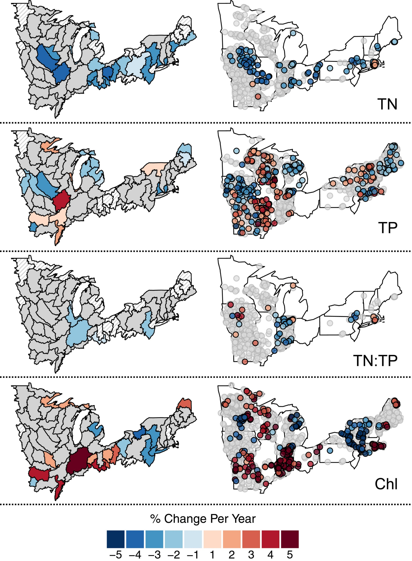
Unexpected stasis in a changing world: Lake nutrient and chlorophyll trends since 1990
Global Change Biology, Volume: 23, Issue: 12, Pages: 5455-5467, First published: 23 August 2017, DOI: (10.1111/gcb.13810)
Notes:
Region (left panel) and lake‐specific (right panel) rates of change for total nitrogen (TN), total phosphorus (TP), TN:TP or Chl estimated by the mixed model. Rates of change are only shown for regions or lakes with trend estimates with 90% confidence intervals that did not overlap with zero. Gray regions or lakes are locations that did not have significant trends, and regions with no nutrient or chlorophyll data are white with gray hatching
IF THIS IMAGE HAS BEEN PROVIDED BY OR IS OWNED BY A THIRD PARTY, AS INDICATED IN THE CAPTION LINE, THEN FURTHER PERMISSION MAY BE NEEDED BEFORE ANY FURTHER USE. PLEASE CONTACT WILEY'S PERMISSIONS DEPARTMENT ON PERMISSIONS@WILEY.COM OR USE THE RIGHTSLINK SERVICE BY CLICKING ON THE 'REQUEST PERMISSIONS' LINK ACCOMPANYING THIS ARTICLE. WILEY OR AUTHOR OWNED IMAGES MAY BE USED FOR NON-COMMERCIAL PURPOSES, SUBJECT TO PROPER CITATION OF THE ARTICLE, AUTHOR, AND PUBLISHER.

Slide 2


