Slide 1
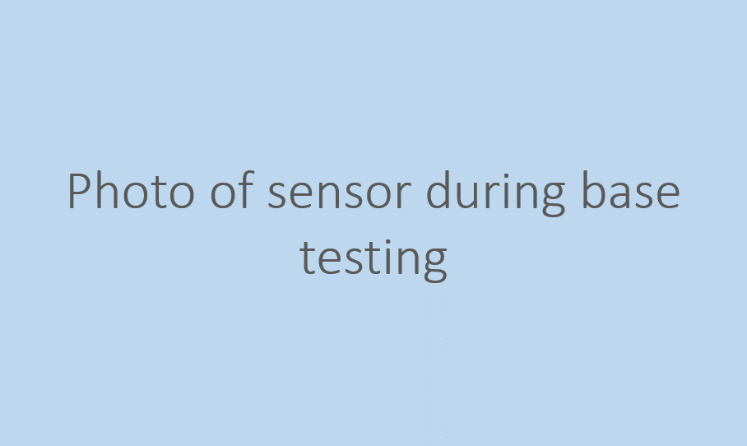
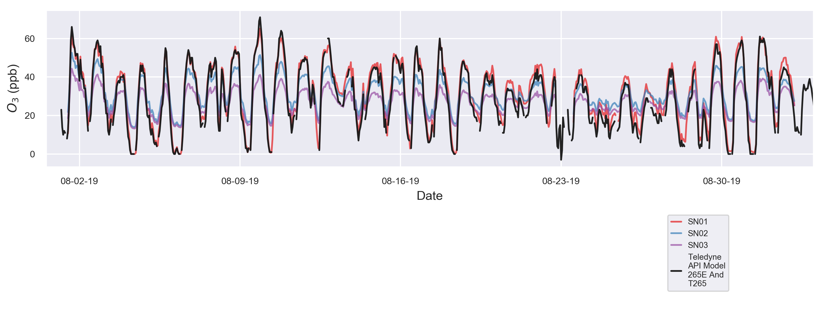
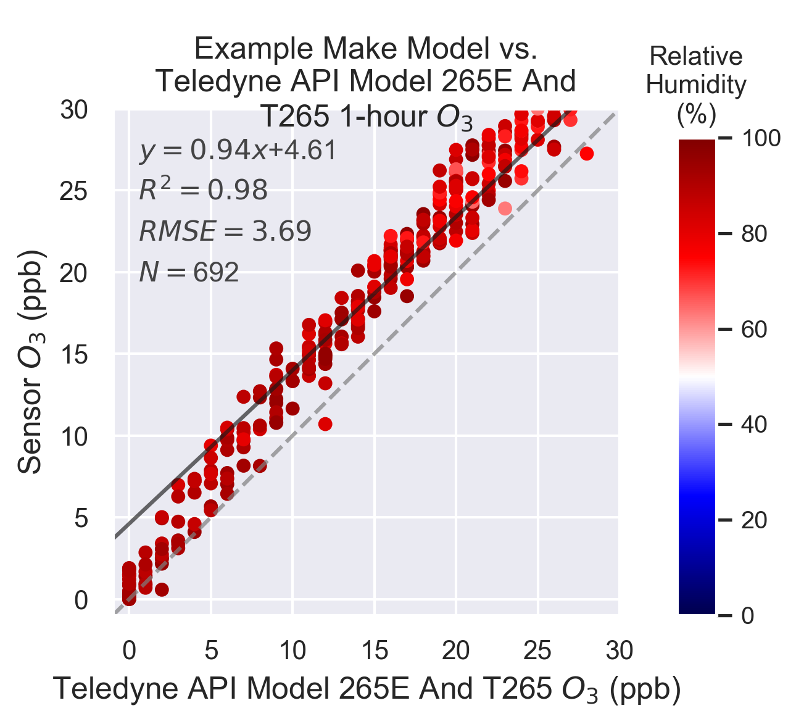
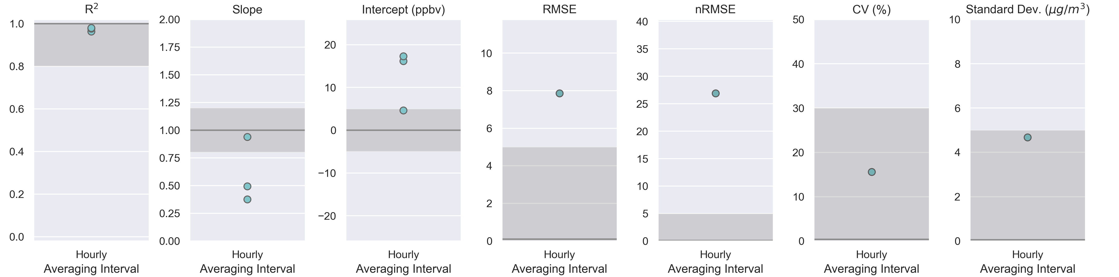
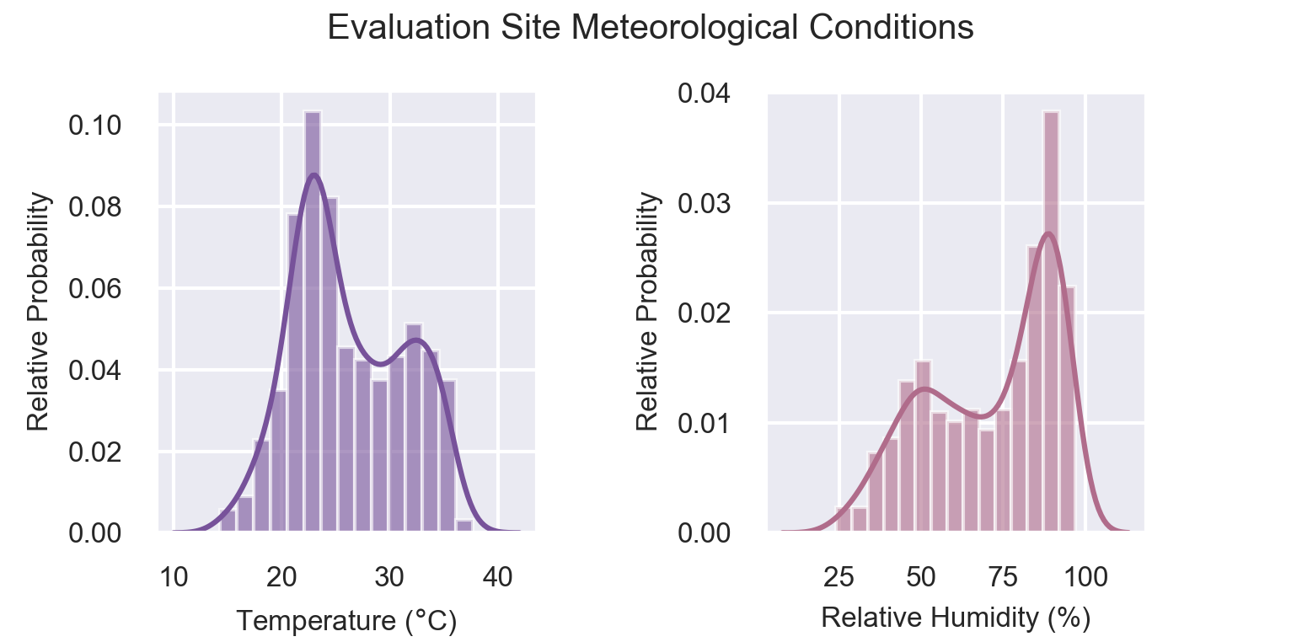
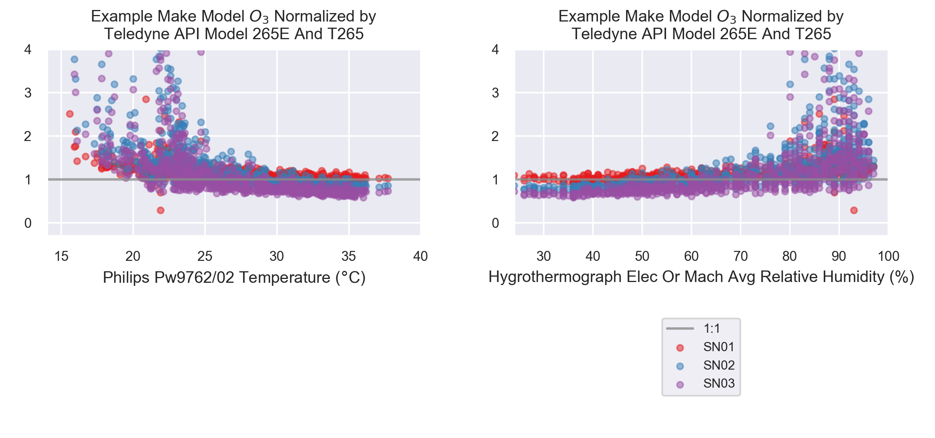
Deployment #1
U.S. Environmental Protection Agency
Office of Research and Development
PI: Clements.Andrea@epa.gov
919-541-1364
May 2021
Testing Report - O3 Base Testing
Example Make Model
Testing Organization and Site Information
Testing organization (Name, Organization Type, Contact website / phone number / email) | U.S. Environmental Protection Agency - Office of Research and Development https://www.epa.gov/air-sensor-toolbox/evaluation-emerging-air-sensor-performance PI: Clements.Andrea@epa.gov 919-541-1364
Testing location (City, State; Latitude & Longitude) | (AIRS) Ambient Monitoring Innovative Research Station 111 TW Alexander Dr. RTP, NC 27713 35.889510N, -78.874572W
AQS site ID | 37 – 063 – 0099
Sampling timeframe (UTC) | Group 1: 2019-08-01 12:11:00 - 2019-09-02 04:59:00
Deployment Details
Reference Monitor Information
Manufacturer, model | Teledyne API Model 265E And T265
Measurement recording interval
Date of calibration
Date of one-point QC check
Description, date(s) of maintenance activities
Sensor Information
Manufacturer, model | Example Make Model
Device firmware version
Measurement recording interval | 1 minute
Sensor serial numbers | Group 1 SN01 |  | Group 1 SN02 | Group 1 SN03
Issues encountered during deployment? | ◻ | Group 1: No Issues
Time Series Plot: 1-hour Average O₃
Scatter Plot: Comparison to Reference Monitor
Range of reference monitor concentrations over duration of base test (ppbv) | Group 1: -3.0-71.0 (1-hr), 18.4-40.4 (24-hr)
Number 1-hr periods in reference monitor measurements outside concentration value target criteria | Group 1: 10
Sensor-Reference Accuracy
Performance Metrics
Sensor-Sensor Precision
Hourly Meteorological Conditions During Deployment
Hourly Meteorological Influence
Number of 24-hr periods outside temperature target criteria | Group 1: 0
Number of 24-hr periods outside relative humidity target criteria | Group 1: 0
Number of paired, normalized concentration and temperature values | Group 1: 757.0
Number of paired, normalized concentration and relative humidity values | Group 1: 757.0
For evaluations with greater than three sensors, grouping individual sensor metrics into boxplots is recommended for displaying results. Note that this recommendation does not apply to metrics computed as a single value for all sensors over the whole evaluation group, such as RMSE, NRMSE, CV, and standard deviation.
1

Slide 2
Deployment #1
U.S. Environmental Protection Agency
Office of Research and Development
PI: Clements.Andrea@epa.gov
919-541-1364
May 2021
Testing Report - O3 Base Testing
Example Make Model
Supplemental Information
Optionally, additional documentation may be attached or linked to digital versions alongside this report. Such documentation may include field reports and observations during the evaluation period, maintenance logs kept on sensors and reference instruments, standard operating procedures, and other documentation relevant to this evaluation report.
Supplemental Documentation | Attached | Description & URL or file path to documentation
Field Observations | ◻
Maintenance Logs | ◻
Standard Operating Procedure | ◻
Photos from Evaluation | ◻
Product Specifications Sheet | ◻
Product Manual | ◻
Deployment Issues | ◻
Data storage, transmission method narrative | ◻
Data correction method narrative | ◻
Air Monitoring Station QAPP | ◻
Other | ◻

Slide 3
Deployment #1
U.S. Environmental Protection Agency
Office of Research and Development
PI: Clements.Andrea@epa.gov
919-541-1364
May 2021
Testing Report - O3 Base Testing
Example Make Model
Tabular Statistics - Group 1
Sensor-Reference Correlation
 | Bias and Linearity |  |  | Data Quality
 | R^2 | Slope | Intercept (ppbv) | Uptime (%) | Number of paired sensor and reference concentration pairs
 | 1-Hour 3 out of 3 meet target | 1-Hour 1 out of 3 meet target | 1-Hour 1 out of 3 meet target | 1-Hour 3 out of 3 meet target | 1-Hour
Metric Target Range | ≥ 0.80 | 1.0 ± 0.20 | -5 ≤ b ≤ 5 | 75%* | -
Sensor SN01 | 0.98 | 0.94 | 4.61 | 97.37 | 692.00
Sensor SN02 | 0.98 | 0.49 | 17.27 | 97.64 | 693.00
Sensor SN03 | 0.96 | 0.38 | 16.14 | 97.64 | 693.00
Mean | 0.97 | 0.60 | 12.67 | 97.55 | 692.67
 | Error
 | RMSE (ppbv) | nRMSE (%)
 | 1-Hour Metric target not met | 1-Hour Metric target met
Metric Target Range | ≤ 7 | ≤ 30
Deployment Value | 7.86 | 26.91
Sensor-Sensor Precision
 | Precision (between collocated sensors) |  | Data Quality
 | CV (%) | Standard Deviation (ppbv) | Uptime (%) | Number of paired sensor and reference concentration pairs
 | 1-Hour Metric target met | 1-Hour Metric target met | 1-Hour Metric target met | 1-Hour
Metric Target Range | ≤ 30 | ≤ 5 | 75%* | -
Deployment Value | 15.601 | 4.683 | 97.55 | 736

