Slide 1
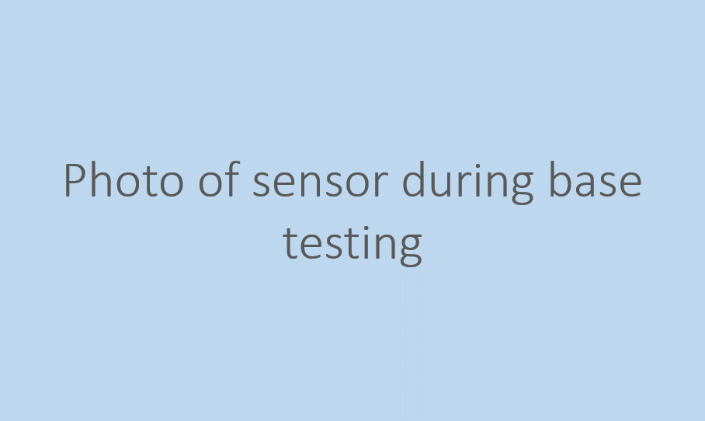
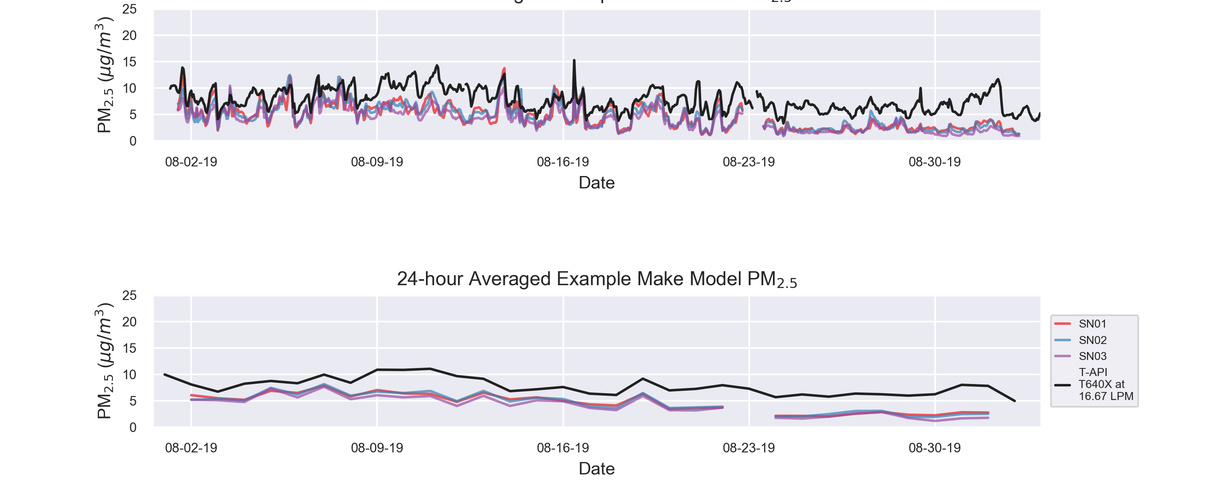
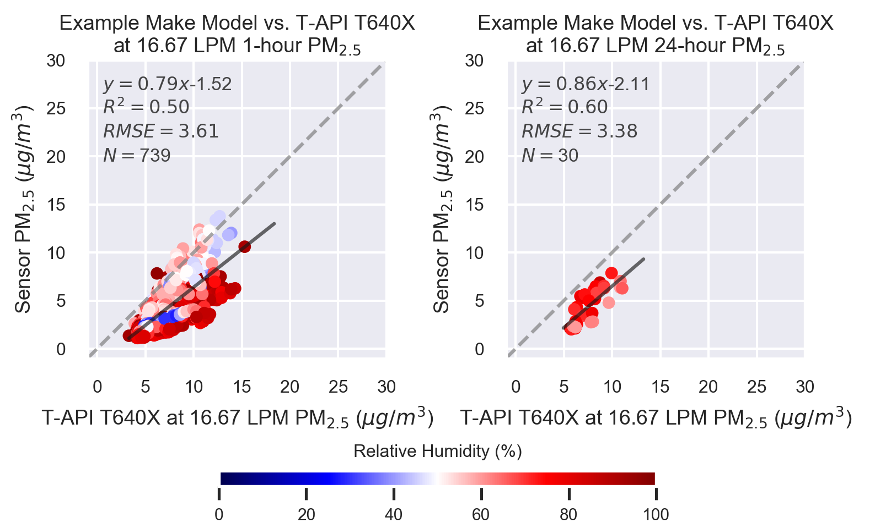
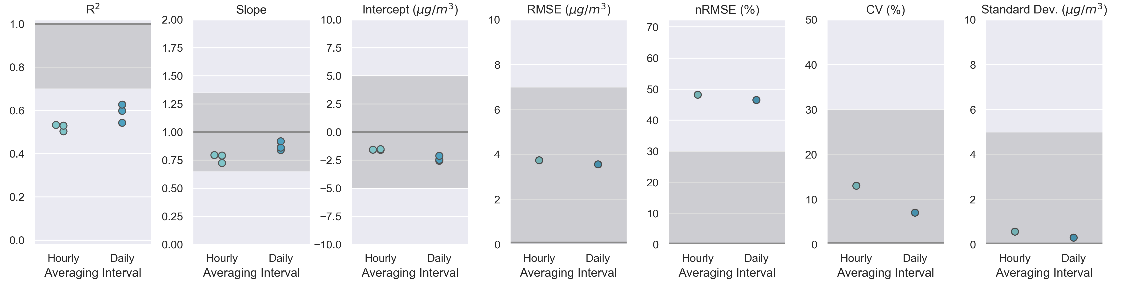
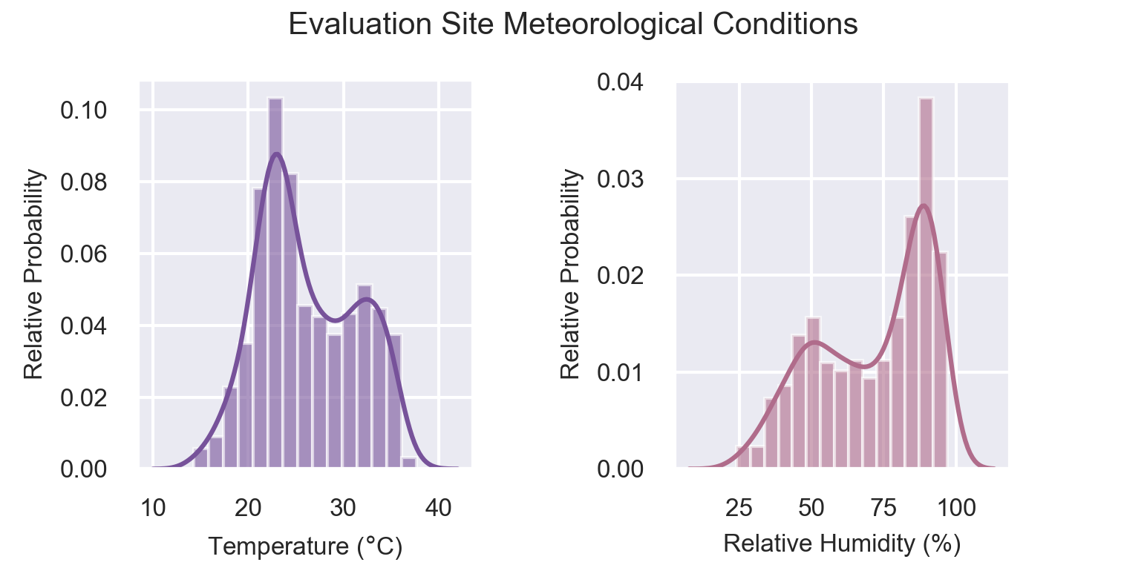
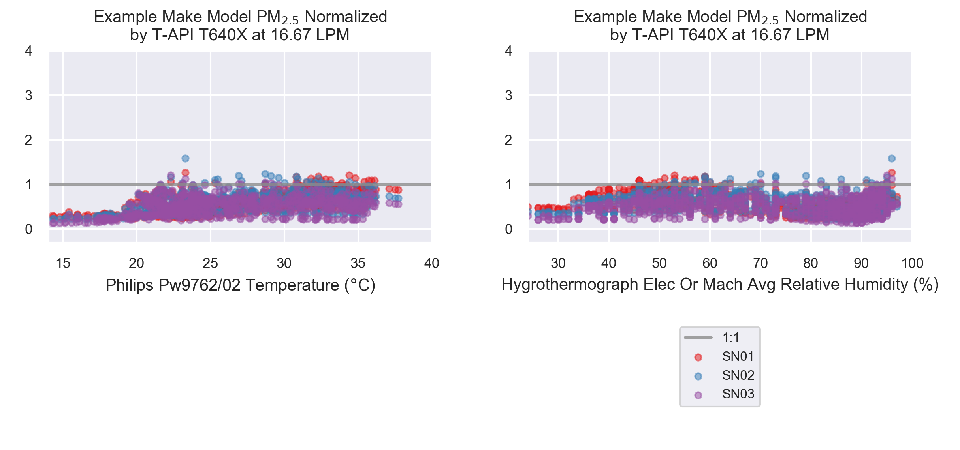
Deployment #1
U.S. Environmental Protection Agency
Office of Research and Development
PI: Clements.Andrea@epa.gov
919-541-1364
May 2021
Testing Report - PM25 Base Testing
Example Make Model
Testing Organization and Site Information
Testing organization (Name, Organization Type, Contact website / phone number / email) | U.S. Environmental Protection Agency - Office of Research and Development https://www.epa.gov/air-sensor-toolbox/evaluation-emerging-air-sensor-performance PI: Clements.Andrea@epa.gov 919-541-1364
Testing location (City, State; Latitude & Longitude) | (AIRS) Ambient Monitoring Innovative Research Station 111 TW Alexander Dr. RTP, NC 27713 35.889510N, -78.874572W
AQS site ID | 37 – 063 – 0099
Sampling timeframe | Group 1: 2019-08-01 12:11:00 - 2019-09-02 04:59:00
Deployment Details
Sensor Information
Manufacturer, model | Example Make Model
Device firmware version
Sampling time interval | 1 minute
Sensor serial numbers | Group 1 SN01 |  | Group 1 SN02 | Group 1 SN03
Issues encountered during deployment? | ◻ | Group 1: No Issues
FRM/FEM Information
Manufacturer, model | T-API T640X at 16.67 LPM
Sampling time interval
Date of calibration
Date of flowrate verification check
Description, date(s) of maintenance activities
Time Series Plots
Scatter Plots: Comparison to FRM/FEM
Range of FRM/FEM concentrations over duration of base test (μg/m³) | Group 1: 3.3-15.3 (1-hr), 4.9-11.0 (24-hr)
Number 24-hr periods in FRM/FEM monitor measurements with a goal concentration of 25 μg/m³ | Group 1: 0
Sensor-FRM/FEM Accuracy
Performance Metrics
Sensor-Sensor Precision
Meteorological Conditions During Deployment
Meteorological Influence
Number of 24-hr periods outside manufacture-listed temperature target criteria | Group 1: 0
Number of 24-hr periods outside manufacture-listed relative humidity target criteria | Group 1: 0
Mean number of paired, normalized concentration and temperature values | Group 1: 757.0
M number of paired, normalized concentration and relative humidity values | Group 1: 757.0
For evaluations with greater than three sensors, grouping individual sensor metrics into boxplots is recommended for displaying results. Note that this recommendation does not apply to metrics computed as a single value for all sensors over the whole evaluation group, such as RMSE, NRMSE, CV, and standard deviation.
1

Slide 2
Deployment #1
U.S. Environmental Protection Agency
Office of Research and Development
PI: Clements.Andrea@epa.gov
919-541-1364
May 2021
Testing Report - PM25 Base Testing
Example Make Model
Supplemental Information
Additional documentation may be attached or linked to digital versions alongside this report. Such documentation may include field reports and observations during the testing period, maintenance logs for sensors and FRM/FEM monitors, standard operating procedures, and other documentation relevant to this testing report (see below for examples).
Supplemental Documentation | Attached | Description & URL or file path to documentation
Field observations | ◻
Maintenance logs | ◻
Standard operating procedure(s) | ◻
Photos of equipment setup and testing | ◻
Product specifications sheet(s) | ◻
Product manual(s) | ◻
Deployment issues | ◻
Data storage and transmission method | ◻
Data correction approach | ◻
Data analysis/correction scripts and version | ◻
Air Monitoring Station QAPP | ◻
Summary of FRM/FEM monitor QC checks | ◻
Other documents | ◻

Slide 3
Deployment #1
U.S. Environmental Protection Agency
Office of Research and Development
PI: Clements.Andrea@epa.gov
919-541-1364
May 2021
Testing Report - PM25 Base Testing
Example Make Model
Tabular Statistics - Group 1
Sensor-Reference Correlation
 | Bias and Linearity |  |  |  |  |  | Data Quality
 | R^2 |  | Slope |  | Intercept (μg/m^3) |  | Uptime (%) |  | Number of paired sensor and FRM/FEM concentration pairs
 | 1-Hour 0 out of 3 meet target | 24-Hour 0 out of 3 meet target | 1-Hour 3 out of 3 meet target | 24-Hour 3 out of 3 meet target | 1-Hour 3 out of 3 meet target | 24-Hour 3 out of 3 meet target | 1-Hour 3 out of 3 meet target | 24-Hour 3 out of 3 meet target | 1-Hour | 24-Hour
Metric Target Range | ≥ 0.70 | ≥ 0.70 | 1.0 ± 0.35 | 1.0 ± 0.35 | -5 ≤ b ≤ 5 | -5 ≤ b ≤ 5 | 75%* | 75%* | - | -
Sensor SN01 | 0.50 | 0.60 | 0.79 | 0.86 | -1.52 | -2.11 | 97.37 | 93.75 | 739.00 | 30.00
Sensor SN02 | 0.53 | 0.63 | 0.80 | 0.92 | -1.59 | -2.56 | 97.64 | 93.75 | 741.00 | 30.00
Sensor SN03 | 0.53 | 0.54 | 0.72 | 0.84 | -1.57 | -2.46 | 97.64 | 93.75 | 741.00 | 30.00
Mean | 0.52 | 0.59 | 0.77 | 0.87 | -1.56 | -2.38 | 97.55 | 93.75 | 740.33 | 30.00
 | Error
 | RMSE (μg/m^3) |  | nRMSE (%)
 | 1-Hour Metric target met | 24-Hour Metric target met | 1-Hour Metric target not met | 24-Hour Metric target not met
Metric Target Range | ≤ 7 | ≤ 7 | ≤ 30 | ≤ 30
Deployment Value | 3.75 | 3.57 | 48.23 | 46.50
Sensor-Sensor Precision
 | Precision (between collocated sensors) |  |  |  | Data Quality
 | CV (%) |  | Standard Deviation (μg/m^3) |  | Uptime (%) |  | Number of paired sensor and reference concentration pairs
 | 1-Hour Metric target met | 24-Hour Metric target met | 1-Hour Metric target met | 24-Hour Metric target met | 1-Hour Metric target met | 24-Hour Metric target met | 1-Hour | 24-Hour
Metric Target Range | ≤ 30 | ≤ 30 | ≤ 5 | ≤ 5 | 75%* | 75%* | - | -
Deployment Value | 13.09 | 7.09 | 0.58 | 0.31 | 97.55 | 93.75 | 736 | 30

