Slide 1

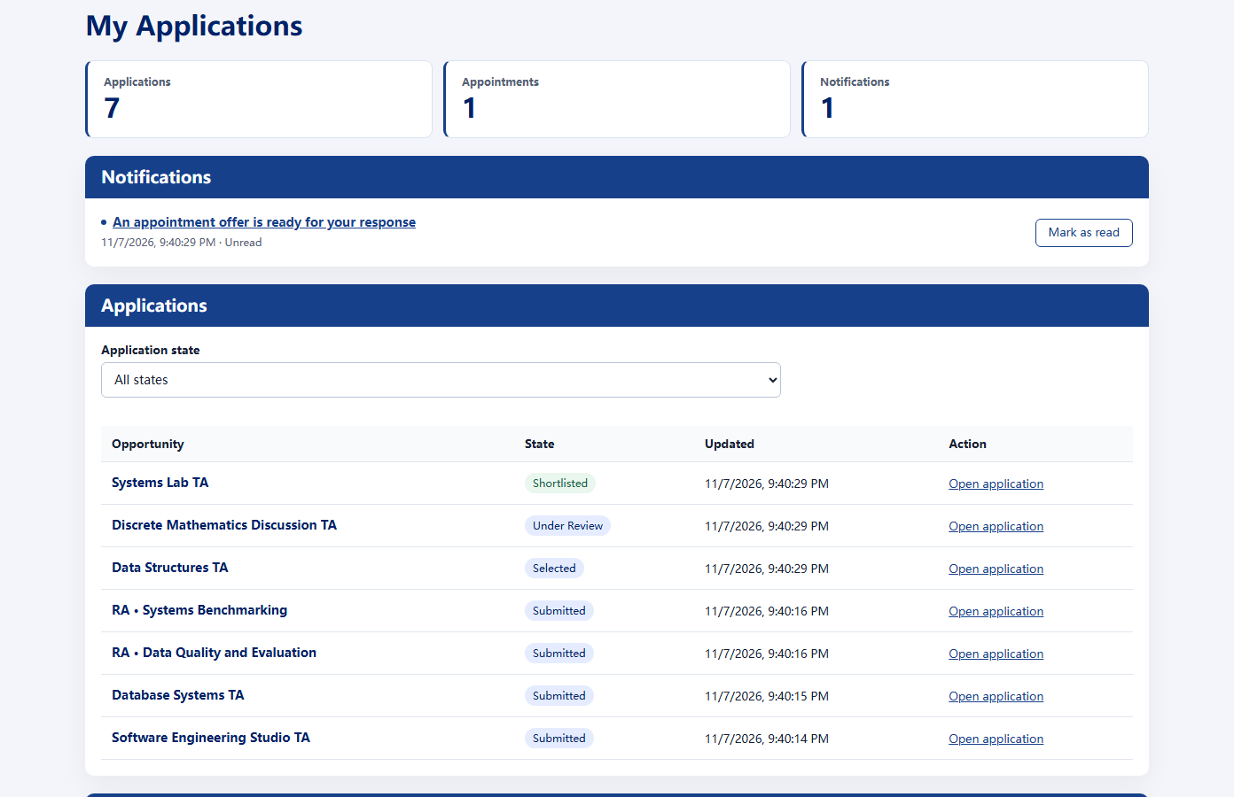
CampusWorks
TA/RA hiring and
course support
For departments, faculty,
assistants and students
Independent project · synthetic demonstration
1 / 8
Notes:
Target time: 20 seconds.
CampusWorks connects the people who recruit teaching assistants with the people who deliver course support. It follows one student from application to appointment, into the help queue, and through the evidence a department can use for its next teaching cycle.
Sources: docs/submission/PROJECT_STORY.md; genuine applicant workspace screenshot. This is an independent project, not an institutional service or an adoption claim.
References: docs/submission/PROJECT_STORY.md
docs/PRODUCT_POLICY.md
All product records are synthetic. Product images are genuine local captures. Commercial proposals and pilot measures are hypotheses, not established adoption or results.

Slide 2
A fragmented hiring workflow
One application. Three places to coordinate.
Application
Course duties
Follow-ups
Microsoft Forms
Excel
Email
Who owns the next handoff?
Match applicants · Avoid conflicting offers · Activate course access
Observed example: supplied recruitment email, application form and duties spreadsheet
2 / 8
Notes:
Target time: 35 seconds.
The supplied CS recruitment example starts with Microsoft Forms, sends course requirements in Excel, and follows up by email. Those tools collect information, but people still connect the pieces. Faculty need to know which requirements apply and whether a candidate remains available. Applicants need a clear status. Administrators need the accepted appointment before enabling course authority. Our opportunity is to connect these handoffs, rather than claim that universities have never built a queue.
Source: user-supplied June 2026 recruitment email, Excel duties sheet and Microsoft Forms application screenshots. This is one observed example, not a claim that all CS departments or all Duke course queues are manual. The workflow diagram is an editable summary, not a fabricated screenshot. Existing queues already exist: https://courses.cs.duke.edu/fall25/compsci101/consult.php and https://queue.cs.stanford.edu/ .
References: Owner-provided screenshot: Fall 2026 TA application emails
Owner-provided screenshot: TARecruitingNeeds.xlsx
Owner-provided screenshot: Microsoft Forms application
https://courses.cs.duke.edu/fall25/compsci101/consult.php
All product records are synthetic. Product images are genuine local captures. Commercial proposals and pilot measures are hypotheses, not established adoption or results.

Slide 3
A connected assistant lifecycle
Publish
Apply
Offer
Faculty
Student
Faculty
Next cycle
Review
Course support
Accept + clear
Faculty + department
TA + students
Student + administrator
TA access: accepted + cleared + within dates
RA uses applications and appointments; TA appointments additionally enable course queues
3 / 8
Notes:
Target time: 40 seconds.
An instructor publishes duties, skills and screening questions. A student applies, and faculty review the submitted evidence. An offer reserves both the opening and the candidate, so another course cannot make an overlapping selection. Acceptance alone is not course authority: administrative clearance and valid appointment dates are also required. Only then does that same account gain the relevant TA queue access. Ending the appointment removes that access while preserving history. RA recruitment shares the application and appointment stages, without becoming a research workspace.
Sources: docs/PRODUCT_POLICY.md; docs/STAFFING_OPERATIONS.md; server/utils/staffing-appointments.ts. Selection alone does not grant TA authority. Acceptance, administrative clearance and date validity are required. Expiry or ending revokes appointment-derived course access. RA does not receive TA queues or a research-project workspace. All six lifecycle stages, role labels and connectors are native editable slide objects.
References: docs/PRODUCT_POLICY.md
docs/submission/PROJECT_STORY.md
docs/STAFFING_OPERATIONS.md
All product records are synthetic. Product images are genuine local captures. Commercial proposals and pilot measures are hypotheses, not established adoption or results.

Slide 4
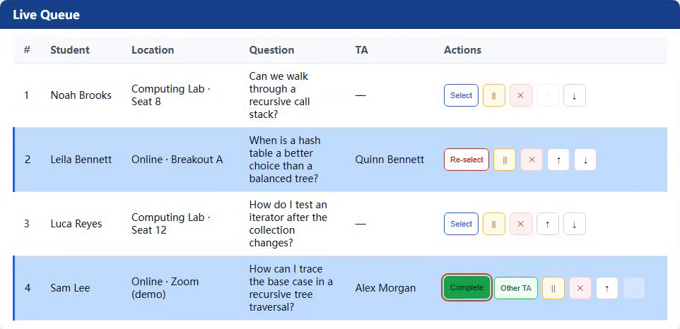
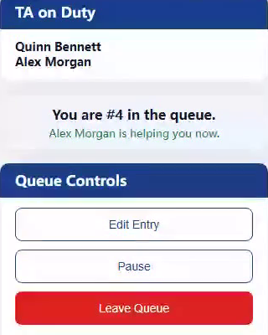
Deadline night: one shared queue
Course-specific questions still need course staff.
TA view
Student view
Visible order
Shared ownership
Clear helper status
Genuine paired views · synthetic CS201 session · on-duty TAs can hand off or reorder
4 / 8
Notes:
Target time: 45 seconds.
Picture the evening before an assignment deadline. Several students need help, and several TAs are moving between tables or online rooms. A shared queue makes arrival order and request status visible. One TA claims a request; another sees that it is already being handled. A handoff or completion updates that shared state. Students see their position and helper, rather than repeatedly asking who comes next. The current product does not promise exact remaining minutes. And even with AI available, course staff still provide assignment context, interpretation and feedback that students need.
Sources: app/pages/courses/[id]/student.vue; app/pages/courses/[id]/ta.vue; server/api/queue/claim.post.ts; server/utils/queue-mutations.ts. Arrivals append in order, while authorized staff can reorder, pause and hand off. This is not immutable FIFO. The product displays position, state and assigned helper; it does not currently predict minutes remaining. Official deadline-demand context: https://courses.cs.duke.edu/fall26/compsci210d/syllabus.html . This scenario is illustrative. Zoom is a labeled external announcement link, not built-in conferencing.
References: app/pages/courses/[id]/student.vue
app/pages/courses/[id]/ta.vue
https://courses.cs.duke.edu/fall26/compsci210d/syllabus.html
https://www.cs.cornell.edu/courses/cs1110/2022fa/info/officehours/
All product records are synthetic. Product images are genuine local captures. Commercial proposals and pilot measures are hypotheses, not established adoption or results.

Slide 5
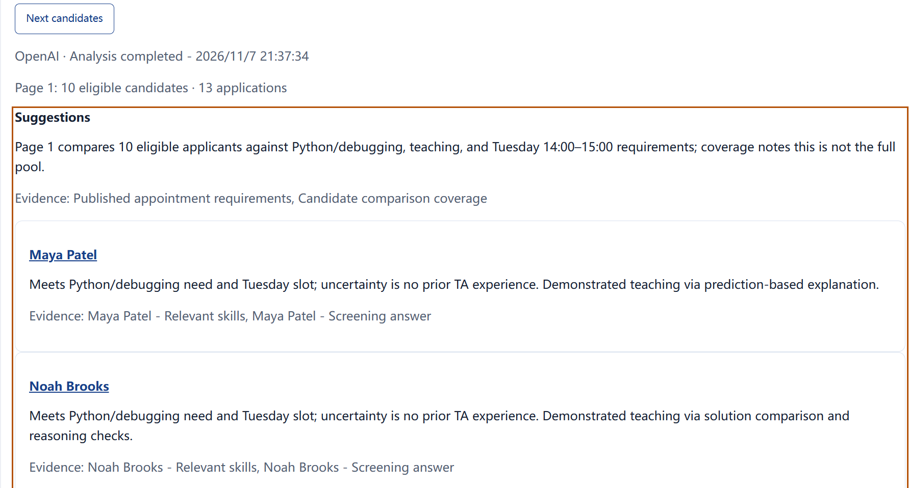
AI supports the hiring decision
Four advisory steps. Human decisions.
Available candidates · recorded example
Draft requirements
Summarize qualifications
Compare candidates
Suggest course changes
People choose and approve.
Saved real OpenAI outputs on synthetic evidence · no automatic hiring · uploaded CV bytes are not parsed
5 / 8
Notes:
Target time: 45 seconds.
AI works at four points: improving position requirements, summarizing submitted qualifications, comparing currently eligible candidates, and preparing course advice. These are real recorded OpenAI outputs using synthetic evidence. The analysis draws on typed qualifications and screening answers; uploaded CV file bytes are not parsed. When another course reserves a candidate, availability changes and the full application schedules updated comparisons. Reviewers can inspect the evidence and its gaps. Faculty still choose the candidate, students still respond to offers, and administrators still approve clearance. AI does not make those decisions.
Sources: docs/AI_OPERATIONS.md; docs/verification/staffing-live-ai-proof.json; the original AI capture files. Four implemented advisory types are requirement drafts, typed qualification summaries, eligible-candidate-page comparisons, and course advice. Candidate comparisons cover a supplied page in supplied order, not a global best-to-worst ranking. Availability changes invalidate and requeue scoped advice. Humans select, accept offers and approve clearance. These are saved genuine provider outputs, not live calls from a slide or the GitHub browser demo.
References: docs/AI_WORKFLOWS.md
docs/PRODUCT_POLICY.md
docs/verification/staffing-live-ai-proof.json
docs/demo/screenshots/showcase-ai-summary-desktop.png
docs/demo/screenshots/showcase-ai-candidates-desktop.png
All product records are synthetic. Product images are genuine local captures. Commercial proposals and pilot measures are hypotheses, not established adoption or results.

Slide 6
Customers and beneficiaries
Proposed first buyer
Department | See staffing and support demand
Faculty | Recruit and coordinate the team
TA | Know who needs help next
RA | Track application and offer status
Students | See their position and helper
CS department
Champions
Program staff
+ course lead
Also benefits: remote students, commuters and teaching coordinators
Buyer and commercial path are proposals for validation; institutional adoption is not established
6 / 8
Notes:
Target time: 45 seconds.
Our first customer hypothesis is a CS department or graduate program office. A program coordinator and course lead are plausible champions; leadership and institutional IT would evaluate a pilot. The department gains a shared staffing and demand picture. Faculty review current candidate evidence. TAs coordinate help through one queue. RA applicants gain clear duties and appointment status, without a new operational workspace. Students gain a visible place in line. Remote and commuting students may especially value joining the same workflow. These are proposed benefits to validate, not claims of existing customers or measured savings.
Source for the professor/coordinator workflow: https://cs.duke.edu/graduate/ms/financial . Product roles and values: docs/submission/PROJECT_STORY.md. A department or graduate-program office is a proposed first buyer, not an identified customer. A faculty lead and coordinator are potential champions; department leadership and IT/privacy may evaluate deployment. Actual purchasing authority varies. RA receives application/appointment tracking, not TA course queues. Benefits for remote and commuter students are plausible workflow benefits, not measured retention or equity outcomes.
References: https://cs.duke.edu/graduate/ms/financial
docs/PRODUCT_POLICY.md
docs/COURSE_INSIGHTS.md
Commercial buyer and benefit hypotheses; no customer validation claimed
All product records are synthetic. Product images are genuine local captures. Commercial proposals and pilot measures are hypotheses, not established adoption or results.

Slide 7
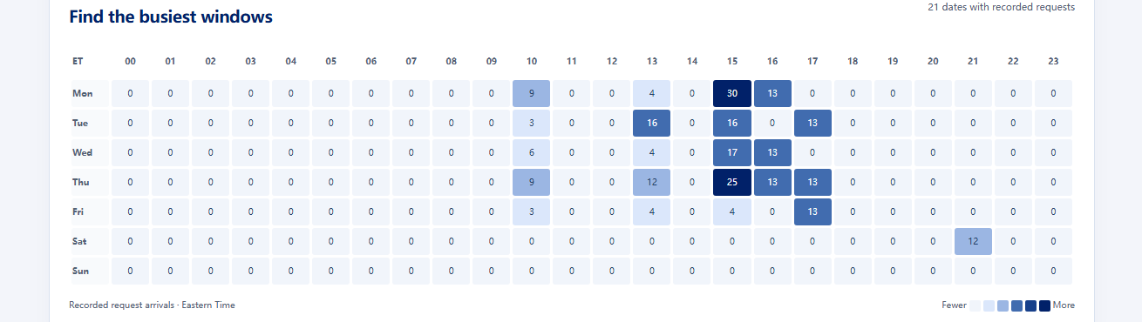
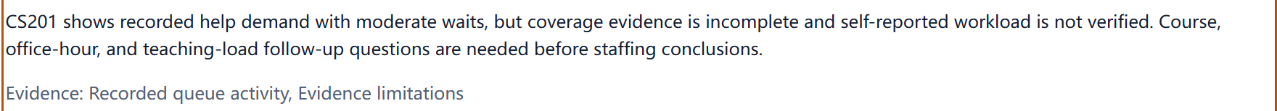
Evidence for the next teaching cycle
When students need help
Course advice, with evidence limits
Saved real OpenAI output · synthetic observations · demand alone does not establish required TA headcount
7 / 8
Notes:
Target time: 40 seconds.
At the end of a cycle, the department can examine when requests arrived, which planned positions remain unfilled, what work TAs reported, and what feedback students actually attributed to a helper. The heatmap supports conversations about busy support windows. Counts and sample sizes stay visible. One five-star response does not establish that a TA is excellent, and queue traffic alone does not establish required headcount. Course advice helps faculty frame follow-up questions, while grading, labs and other teaching duties remain part of the staffing conversation.
Sources: docs/COURSE_INSIGHTS.md; server/utils/course-insights.ts; docs/verification/staffing-live-ai-proof.json. Request arrival heatmaps, observed helpers, reported workload and helper-scoped feedback remain separate evidence. Individual feedback retains reviewer and sample counts. High raw throughput or a single rating is not a reliable ranking of TA quality. Queue demand alone cannot determine exact TA headcount because grading, labs, attendance and other duties may be missing. Saved real course advice informs a human conversation for the next cycle.
References: docs/COURSE_INSIGHTS.md
docs/demo/screenshots/showcase-department-insights-desktop.png
docs/demo/screenshots/showcase-ai-course-review-desktop.png
All product records are synthetic. Product images are genuine local captures. Commercial proposals and pilot measures are hypotheses, not established adoption or results.

Slide 8
Start with one department
One cycle.
A few busy courses.
Pilot measures
Proposed model
Hiring handoffs
Peak-night service
Student clarity
Annual department subscription
+ onboarding
Expand: engineering · math/statistics · learning centers
Next: SSO · reliable wait-time ranges
userzeroa.github.io/campusworks-demo
8 / 8
Notes:
Target time: 30 seconds.
The next step is one department, one recruitment cycle and a few busy courses. We would measure coordination effort, time until a TA is ready, unfinished requests and student clarity. An annual department subscription with onboarding is a business model to test, not an agreed price. Later targets include other teaching departments and learning centers. Institutional SSO and bounded wait estimates are future pilot targets. The public link lets anyone explore the four-role browser experience today.
Sources: current implementation and the verified public demo URL https://userzeroa.github.io/campusworks-demo/ . This is a proposed pilot and business model, not a purchase agreement, priced offer, existing customer or validated return. Expansion beyond teaching departments needs adaptation. Institutional SSO and bounded wait estimates are future targets, not shipped capabilities. The public URL runs a browser-local synthetic experience with labeled saved real AI examples; fresh calls require the full application and a private server-side Key.
References: docs/submission/API_AND_HOSTING.md
docs/submission/PROJECT_STORY.md
Proposed pilot and commercial model; not an agreed customer contract or implemented SSO/ETA
https://userzeroa.github.io/campusworks-demo/
All product records are synthetic. Product images are genuine local captures. Commercial proposals and pilot measures are hypotheses, not established adoption or results.

