Slide 1
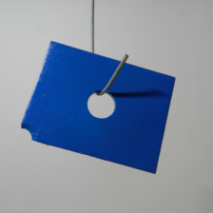



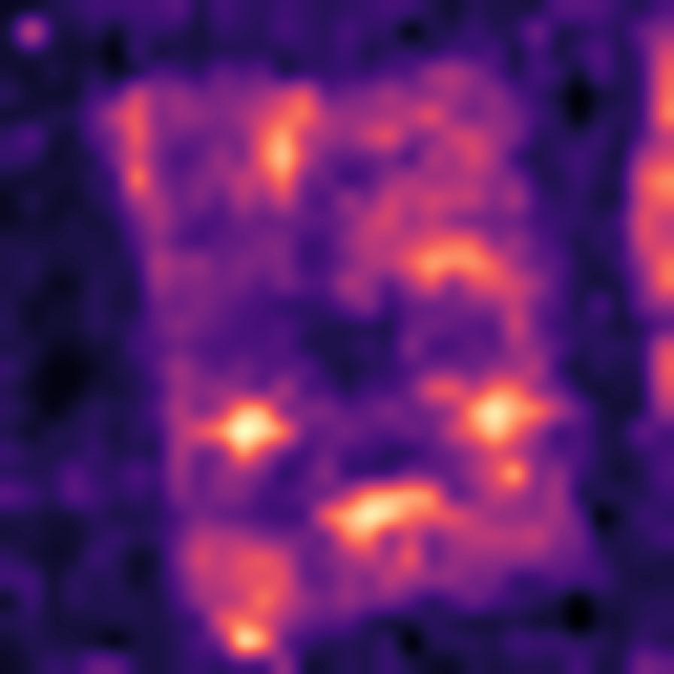
a
Build the fixed reference bank
Frozen branches
Common grid
Fixed reference bank
B DINOv2-B
…
C AnomalyCLIP
S or D extra slot
shared reference row r
K normal images
of one category
frozen;
no branch is trained
align, then
ℓ2 normalize
the query never writes
to the bank
b
Localize anomalies in a query image
read only
Same branches
Common
grid
Matching rule
B DINOv2-B
J = min_r Σ_B w_B d_B(q,r)
C AnomalyCLIP
L = Σ_B w_B min_r d_B(q,r)
score
map
contour
S or D extra slot
query
image
same modules
as (a)
align +
ℓ2 unit
J: one shared row
L: per-branch rows
same query
(threshold)
Controlled factors: fixed weights · DUP vs TRI · shared vs independent matching
patch score → 448 resize → Gaussian σ = 4 → anomaly map; image score = spatial max
The extra branch is an experimental construction, not a runtime switch.
DUP does not train a new model; the bank is fixed and read only.
Notes:
Figure 1. Shared detection framework. (a) K normal images of one category pass through the frozen visual branches, are aligned to B's canvas grid and unit-normalised per branch, and build one fixed reference bank whose rows keep a shared (support image, grid position) identity. (b) A separate query image passes through the same modules and is scored by the matching rule under study; the bank is read only and is never updated by the query. The score map and the contour are the same query: the map is replayed from submission_repro_20260827/predictions_compact/maps/mpdd/s0_k1/metal_plate.npz through the repository's own frozen post-processing, and the contour is the Otsu-thresholded display of that same map, not a ground-truth mask. B = DINOv2-B, C = AnomalyCLIP visual, S or D = the controlled extra branch. The extra branch is an experimental construction: it is not added or removed at inference time, and DUP does not train a new model. Dotted lines are structural schematics, not measured activations.

Slide 2
a
One query patch and the candidate rows
branch B
ordering only;
no measured
value
branch C
query
patch
weighted sum
candidate reference rows r = 1 … 8
b
The two rules over the same fixed bank
J: one shared reference row
L: branch-specific rows
J(q) = min_r Σ_B w_B d_B(q, r)
L = Σ_B w_B min_r d_B(q, r)
one row for
both branches
its own row
per branch
c
Constraint difference
G(q) = J(q) − L(q) ≥ 0
Both rules search the same candidate rows with the
same non-negative weights, so the shared-row minimum
is never below the sum of the per-branch minima.
G is a score difference, not a localization loss: what matters for AP is whether the gap changes the ranking of normal and anomalous patches.
Notes:
Figure 2. The two matching rules at one query patch. (a) the query patch against the candidate reference rows; the cell shading only indicates ordering and no cell carries a measured value. (b) J minimises the weighted sum over one shared row, so both branches are scored at that same row; L lets every branch keep its own nearest row and sums the weighted minima. (c) G(q) = J(q) - L(q) is non-negative because both rules search the same candidate set with the same non-negative weights. G is a score difference and not a localization loss: a large gap does not by itself reduce AP.

Slide 3
a
Four constructions with fixed weights
A1
DUP
TRI
BAL
two-branch anchor
duplicate B
real encoder in the slot
family weight kept
B DINOv2-B
1/2
B DINOv2-B
1/3
B DINOv2-B
1/3
B DINOv2-B
1/4
C AnomalyCLIP
1/2
Bcopy same B
1/3
X extra encoder
1/3
X extra encoder
1/4
C AnomalyCLIP
1/3
C AnomalyCLIP
1/3
C AnomalyCLIP
1/2
the existing anchor:
two equal branches
no new information;
B reaches 2/3
a real encoder in the
slot, same weight
the family totals
stay equal
b
What each step isolates
A1 → DUP
duplicate a branch
DUP → TRI
replace the copy
A1 → BAL
keep family weights
A1 → DUP varies only the effective weight of B. DUP → TRI varies the representation at a fixed slot weight. A1 → BAL keeps the DINO-family and C totals equal.
c
Contrasts estimated in this paper
TRI_J − DUP_J
TRI_L − DUP_L
BAL_J − A1_J
BAL_L − A1_L
shared matching
independent matching
family control
family control
TRI − A1 moves both factors and is never attributed to the added encoder alone.
X slot encoders: S DINOv2-S 384-D and D WideResNet50-2 1536-D were pre-specified;
E1 deiT-small/8 384-D, E2 ConvNeXt-Tiny 576-D, E3 Swin-Tiny 576-D were added later;
E1, E2 and E3 are exploratory transfer checks, never confirmatory results.
Notes:
Figure 3. The four controlled constructions, their fixed weight vectors and the five encoders that can instantiate the extra slot. A1 = (B 1/2, C 1/2); DUP = (B 1/3, Bcopy 1/3, C 1/3); TRI = (B 1/3, X 1/3, C 1/3); BAL = (B 1/4, X 1/4, C 1/2) with X in {S, D, E1, E2, E3}. A1 -> DUP changes only B's effective weight; DUP -> TRI changes only the representation at a fixed slot weight; A1 -> BAL keeps the DINO-family and C totals equal. TRI - A1 moves both factors and is therefore never attributed to the added encoder alone. DUP_BAL is numerically identical to A1 and DUP_EXPECTED to DUP; these are implementation equivalences, not additional algorithms. X = S was pre-specified; D was pre-specified after the S result; E1, E2 and E3 were chosen after the S and D results and are reported as exploratory transfer checks. Every construction is evaluated under both J and L.

Slide 4
a
Representation swap
-0.02
0
+0.02
+0.04
+0.06
E = P(new) − P(control) · 95% paired bootstrap intervals · S = DINOv2-S, 12 MPDD / 8 BTAD conditions · D = WideResNet50-2, 4 conditions
S
D
MPDD TRI J
MPDD TRI L
MPDD BAL J
MPDD BAL L
BTAD TRI J
BTAD TRI L
BTAD BAL J
BTAD BAL L
b
Direct interaction
-0.005
0
+0.005
+0.010
+0.015
+0.020
I = E_L − E_J · S and D pre-specified; E1, E2, E3 added later and exploratory · MVTec/VisA rows appear once interaction_generalization.csv exists (TODO)
S
D
E1
E2
E3
MPDD I TRI
MPDD I BAL
BTAD I TRI
BTAD I BAL
MVTec I TRI
MVTec I BAL
VisA I TRI
VisA I BAL
Notes:
Figure 4. (a) the direct interaction I = E_L - E_J for every encoder instance of the extra slot, together with the 95% interval each source file carries; MVTec and VisA cells are reserved and empty because the four-dataset aggregation has not produced a table yet. (b) representation-swap effects E = P(new) - P(control) for the pre-specified S and D branches. (c) the interaction of the two matching rules per seed for seeds 0-7; seeds 3-7 share one query resampling block and are therefore not independent replicates of the query stream. Sources: 05_extra_encoders/encoder_comparison_three.csv (S, D, E1, E2, E3), 02_interaction/representation_effects.csv (S), 04_new_encoder/representation_effects_new_encoder.csv (D) and seeds_extension_20260917/interaction_by_seed.csv (8 seeds). Bars and points are point estimates; S and D intervals are the unadjusted 95% paired bootstrap intervals of the source files, the E1/E2/E3 intervals are that file's 95% level (its 98.75% level is the family-adjusted one), and the eight-seed panel has no interval because one run per seed exists. S uses 12 MPDD conditions and 8 BTAD conditions, D and the E branches use 4 conditions (seed {0,1} x K {1,4}), so the rows are not on identical grids and this is stated rather than hidden. BTAD uses the corrected geometry revision. The dashed guide marks 0.005 macro pixel AP, a project-internal practical scale, not an industrial standard.

Slide 5
a
Interaction against K
seed-averaged over seeds 0–2 · K1–K8 are nested support sets, not independent samples
MPDD I_TRI
MPDD I_BAL
BTAD I_TRI
BTAD I_BAL
K = 1
K = 2
K = 4
K = 8
b
Per category
-0.02
-0.01
0
+0.01
+0.02
+0.03
+0.04
I_TRI · MPDD study revision, BTAD corrected revision
MPDD bracket_black
MPDD bracket_brown
MPDD bracket_white
MPDD connector
MPDD metal_plate
MPDD tubes
BTAD 01
BTAD 02
BTAD 03
c
Per seed
I = E_L − E_J · seeds 0-2 use their own query block (solid); seeds 3-7 share one resampling block (hollow), so they measure support-set variation only
MPDD I_TRI
MPDD I_BAL
BTAD I_TRI
BTAD I_BAL
seed 0
seed 1
seed 2
seed 3
seed 4
seed 5
seed 6
seed 7
Notes:
Figure 5. (a) the interaction against the reference budget K, seed-averaged over seeds 0-2 (03_robustness/interaction_K_curve.csv, seed = -1). (b) the interaction per category for I_TRI (03_robustness/interaction_per_category.csv; MPDD study revision, BTAD corrected revision). (c) the same interaction per seed for seeds 0-7 (seeds_extension_20260917/interaction_by_seed.csv); the original three seeds are drawn solid and the five added seeds are drawn hollow because seeds 3-7 reuse one shared query resampling block, so the wider seed set measures support-set variation and not five extra independent query draws. K1, K2, K4 and K8 are nested support sets, so the points are not independent samples and no trend is claimed as a monotone law. BTAD is negative at K4 and K8 and positive at K1, which is why the dataset-level statement is conditioned on K.

Slide 6
a
Peak GPU memory
per unit, in MB
AnomalyDINO MPDD
111.6 MB
AnomalyDINO BTAD
118.8 MB
controlled + D branch
417.7 MB
PatchCore 224
not measurable on this machine
nvidia-smi returns N/A here, so the PatchCore row stays empty.
b
Peak process RAM
per unit, in MB · controlled A1 has no recorded field
AnomalyDINO MPDD
0.97 GB
AnomalyDINO BTAD
1.75 GB
PatchCore 224 MPDD
6.28 GB
PatchCore 224 BTAD
8.29 GB
c
Stage time per unit
one unit = one dataset × seed × K · PatchCore reports a single total
AnomalyDINO MPDD
40.3
49.7 s
AnomalyDINO BTAD
45.3
62.1 s
PatchCore 224 MPDD
142.4
142.4 s
PatchCore 224 BTAD
154.2
154.2 s
Notes:
Figure 8. Measured cost on one machine (RTX 3060 Laptop, 6 GB). Source: 05_baselines/resource_comparison_v2.csv. (a) peak GPU memory; the PatchCore row stays empty because nvidia-smi --query-compute-apps returns N/A on this machine, so the value is reported as not measurable rather than estimated. (b) peak process RAM, where PatchCore reaches about 6.3 GB (MPDD) and 8.3 GB (BTAD) against about 1.0-1.7 GB for AnomalyDINO; the controlled matrix has no recorded memory field. (c) stage time per unit, where one unit is one dataset x seed x K over all categories and all test images. AnomalyDINO is split into bank, retrieval and evaluation; PatchCore reports a single total without a stage split. Published numbers from other hardware are not comparable and are not used here.

Slide 7
a
The four branches and their native geometry
B
DINOv2-B
C
AnomalyCLIP visual
S
DINOv2-S
D
WideResNet50-2
ViT-B/14, frozen
ViT-L/14, frozen
ViT-S/14, frozen
ImageNet, frozen
448 canvas, cropped
518 × 518 input
448 canvas, as B
layer2 + layer3
32 × 32 patch tokens
37 × 37 patch tokens
32 × 32 patch tokens
bilinear to B's grid
768-D, ℓ2 unit
projected to 768-D
384-D, ℓ2 unit
1536-D, ℓ2 unit
already on the grid
resampled to B's grid
already on the grid
resampled to B's grid
b
Alignment and the distance actually used
Every branch is mapped to B's canvas grid by a bilinear resample with align_corners = False, then unit-normalised per position.
The distance is 1 − cosine for every branch, including D; no branch uses a scaled squared Euclidean norm.
The BTAD-03 canvas is 32 × 42 rather than square, so that unit uses the coordinate-correct C re-grid.
c
What is frozen, and how wide the fused vector is
No target-domain training, no PCA, no coreset, no foreground selection
Fused width: A1 1536 · DUP 2304 · TRI with S 1920 · D 3072 · E1 1920 · E2/E3 2112
Weights are fixed by the protocol and are never searched
Exploratory extra branches: E1 deiT-small/8, E2 ConvNeXt-Tiny, E3 Swin-Tiny
Notes:
Figure S1. The visual branches, their native geometry and the alignment actually used. B = DINOv2-B ViT-B/14 (768-D), C = AnomalyCLIP visual ViT-L/14 (37x37 native grid projected to 768-D), S = DINOv2-S ViT-S/14 (384-D), D = torchvision WideResNet50-2 ImageNet weights with layer2 and layer3 concatenated (1536-D); the exploratory extra branches are E1 = DINO deiT-small/8 (384-D), E2 = ConvNeXt-Tiny stages 1+2 (576-D) and E3 = Swin-Tiny stages 1+2 (576-D). All branches are resampled to B's canvas grid by bilinear interpolation with align_corners=False and unit-normalised per position; the distance is 1 - cosine for every branch. The BTAD-03 canvas is 32x42 rather than square, so that unit uses the coordinate-correct C re-grid and the study revision is kept only as a sensitivity check. Encoders are frozen: no target-domain training, no PCA, no coreset and no foreground selection, and no branch weight is searched.

