Slide 1
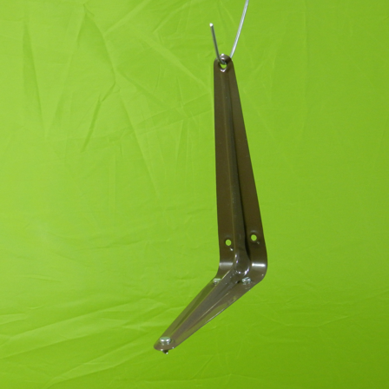
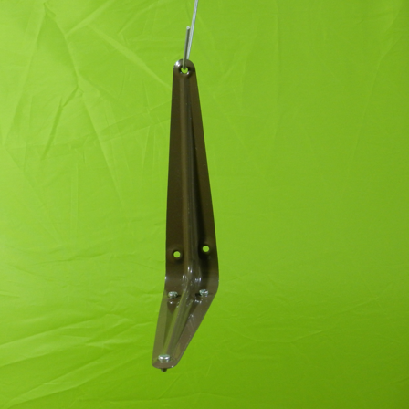
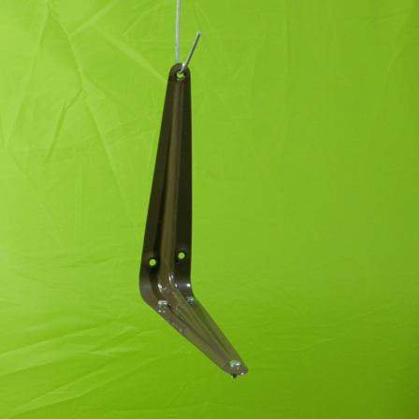
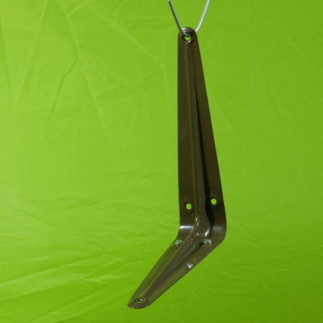
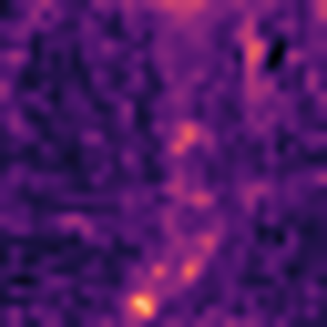

(a) Normal support bank
Frozen visual branches
Aligned patch bank
B DINOv2-B
Spatial align
and L2 normalize
C AnomalyCLIP visual
S or D controlled extra branch
indices aligned
fixed after build
read only
K normal images
same category
per branch
fixed bank
(b) Query with the same frozen feature path
Frozen visual branches
Matching
B DINOv2-B
Spatial align
and L2 normalize
J shared support patch
weighted sum across branches
C AnomalyCLIP visual
L branch-specific patches
sum of weighted minima
S or D controlled extra branch
per branch
fixed distance weights
Query image
(c) Continuous scores and contour visualization
A1 example
from one query
Contour is
visualization only
Resize to canvas
Gaussian smoothing
Visualization threshold
Anomaly map
Contour overlay
Notes:
Simple current-theme diagram. Normal support thumbnail source paths are recorded in the source manifest. J and L are established operators for a controlled comparison. Support bank is fixed, all branch reference indices aligned. B DINOv2-B, C AnomalyCLIP visual; optional S DINOv2-S or D WideResNet50-2. Real example MPDD bracket_brown/test/parts_mismatch/007.png, seed0 K4, A1_L stored prediction. Continuous heatmap and contour use same score; shared J/L minmax normalization and 256-bin Otsu visualization threshold. Source and exact threshold recorded in .tmp_english_main_figure_20260914/real_example.json. No GT used for contour. Scientific equations and controls in manuscript Tables1–2.

