Slide 1
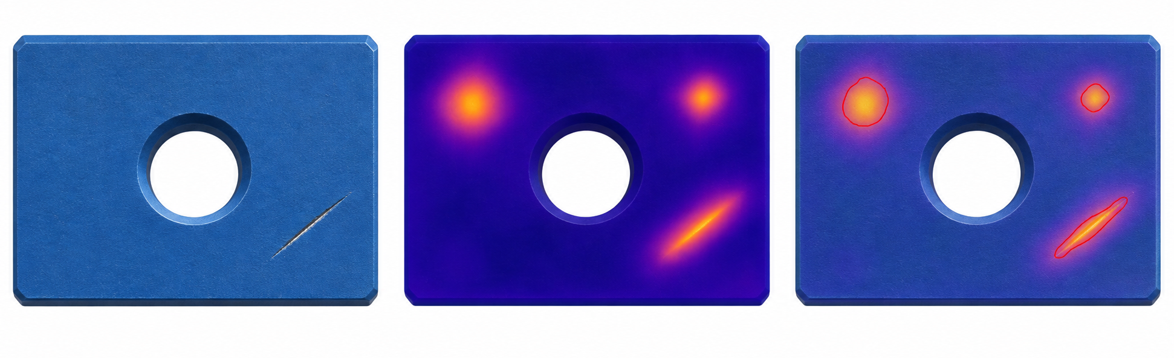
Frozen support matching for anomaly localization
Normal references from one category are aligned once and kept fixed during query scoring
Build the fixed reference bank
Frozen visual branches
Spatial align
and L2 normalize
Aligned patch bank
B DINOv2-B
C AnomalyCLIP visual
S or D controlled extra branch
indices aligned
fixed after build
read only
K normal images
same category
per branch
Query path and matching choice
Frozen visual branches
Spatial align
and L2 normalize
J / L matching
B DINOv2-B
J shared support patch
weighted sum across branches
C AnomalyCLIP visual
L branch-specific patches
sum of weighted minima
S or D controlled extra branch
per branch
separate query
stock choices for the control
All support patch indices stay aligned. The bank is read only after construction, with no online update.
Illustrative outputs from one query
Schematic query
Continuous score heatmap
Contour overlay
Illustrative outputs generated from one synthetic score field. Both views use that same score. Contour uses a visualization threshold; metrics use continuous scores.
Controlled configurations
A1: (B, C), weights (0.5, 0.5) DUP: (B, Bcopy, C), weights (1/3, 1/3, 1/3)
TRI: (B, S or D, C), weights (1/3, 1/3, 1/3) BAL: (B, S or D, C), weights (0.25, 0.25, 0.5)
Notes:
Schematic figure for the controlled representation-matching framework. The support set contains K normal images from one category and the reference bank is fixed after construction. B denotes DINOv2-B, C denotes the AnomalyCLIP visual branch, and S or D denotes the controlled extra branch. Each branch undergoes spatial alignment and L2 normalization before matching. J and L are stock matching choices for a controlled comparison: J chooses one shared support patch using a weighted sum across branches, while L chooses branch-specific support patches and sums the weighted minima. The triptych at the bottom is AI-generated illustrative content from one synthetic score field, not an experiment result. The continuous heatmap and contour overlay are intended as a matched pair, with the contour using a visualization threshold while metrics use continuous scores. No ground truth is shown or used as a prediction.

