Slide 1
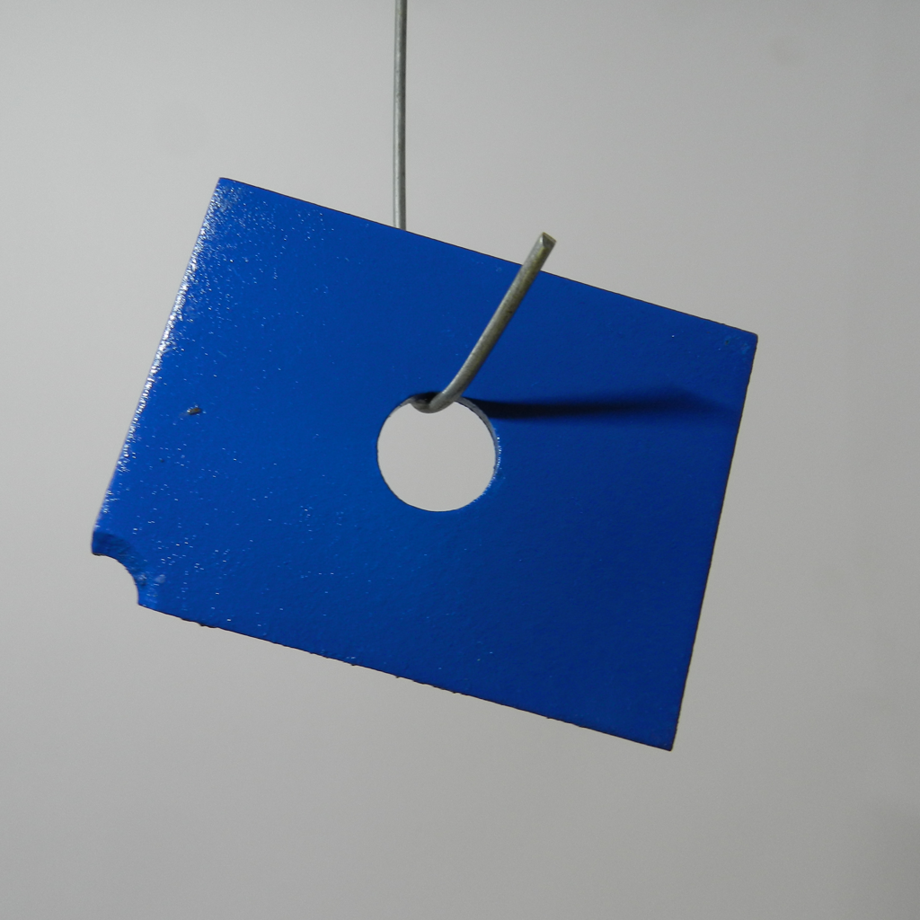



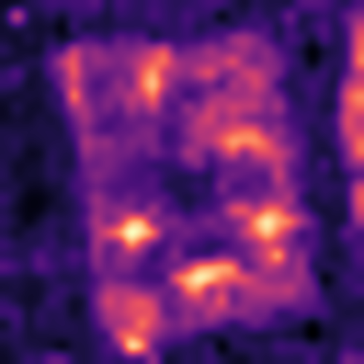
DCFnet
Dual-Encoder Calibrated Fusion Network
Normal-only few-shot industrial anomaly localization
(a) Build the normal reference memory
DINOv2
Align grids
Normalize and concatenate
Normal memory
All support patches
Fixed after construction
CLIP + DPAM
1536-D
R_{c} = {x^{c}₁, …, x^{c}_{K}}
Frozen visual encoders
Same feature pipeline as (b)
K ∈ {1, 2, 4}
M_{c}
(b) Localize anomalies in a query image
read only
Per patch
Bilinear resize
Gaussian σ = 4
DINOv2
ViT-B/14
ℓ₂ norm
Concat
h_{D} × w_{D}
Exact 1-NN
Fused space
Short side: 448
target grid
768-D
0.5 / 0.5
CLIP visual
ViT-L/14 + DPAM
Bilinear
grid alignment
ℓ₂ norm
a_{p}
x
Joint ℓ₂ norm
Input: 518 × 518
37 × 37
Anomaly map
768-D
S₄₄₈(x)
f_{A,p} ∈ ℝ¹⁵³⁶
448 × 448
a_{p} = ½ min_{m ∈ Mc} ‖f_{A,p}(x) − m‖₂²
s_{img}(x) = max_{u} S_{448,u}(x)
Notes:
Figure 1. DCFnet overview. (a) Verified normal support images construct a fixed category-specific memory. (b) The query passes through the same frozen encoders and deterministic fusion path. CLIP visual features are bilinearly resized to the DINO lattice; branch-wise L2 normalization, equal scaling, concatenation, and joint normalization yield 1536-dimensional descriptors. Exact nearest-neighbor scoring uses half the squared Euclidean distance in the joint space. Bilinear resizing and Gaussian smoothing (sigma = 4 pixels) produce the 448 x 448 anomaly map, whose spatial maximum is the image-level anomaly score. The query never updates the normal memory.
Blue and ochre grids/vector blocks are editable structural schematics, not measured activations, and their cell count is illustrative. The DINO grid is h_D x w_D, not universally 32 x 32. The CLIP grid is 37 x 37 and retains projected layer-24 patch descriptors with DPAM_layer = 20. The illustration uses MPDD metal_plate train/good/029.png and test/scratches/026.png. The map is the existing A1 inference panel from outputs/p1_b_figures/mpdd_s0_k1_metal_plate_success.png; it is not a ground-truth mask, and no output values were regenerated. The overlapping normal photographs denote the K-image support set, with illustrative examples 000, 001 and 029. They are not a claim that these three images form an evaluated support configuration. The displayed heatmap is the archived K=1 example, independent of the support-set schematic. Both encoders remain frozen, without target-domain parameter optimization or text-based inference. Norm formula assumes positive branch norms.
Method source: docs/manuscript_english_polished_20260906/English_content.md, sections 3.1–3.5, and DCFnet_Figure_Source_Polished_20260906_final.pptx. Design requirements: docs/lesson_notes_20260905/20260905_SCI论文辅导详细整理与修改清单.md, section 二, classroom 04:26–08:47 and 01:07:48–01:17:17.

Slide 2
Fig. 2 Spatial calibration and fixed feature fusion
Common spatial sampling, normalized branch magnitudes, and a joint descriptor
(a) Align the CLIP grid to the DINO lattice
DINO reference grid
CLIP grid
target size
Same grid location p
Bilinear
resizing
h_{D} × w_{D}
h_{D} × w_{D}
768-D per branch
37 × 37
align_corners = False
(b) Normalize, scale and concatenate each patch pair
f_{D,p}
g_{D,p}
ℓ₂ norm
× 0.5
f_{A,p}
Channel
concatenation
Joint
ℓ₂ norm
ℓ₂ norm
× 0.5
1536-D
f_{C→D,p}
g_{C,p}
f_{A,p} = Norm([0.5 g_{D,p}; 0.5 g_{C,p}]) = [g_{D,p}; g_{C,p}] / √2
Notes:
Figure 2. Deterministic calibration and fixed feature fusion. The CLIP lattice is bilinearly resized to the DINO grid with align_corners=False. At each location p, the aligned branch descriptors are independently L2-normalized, scaled by 0.5, concatenated, and jointly normalized. The DINO grid is unchanged. Matching grid dimensions does not guarantee receptive-field or semantic correspondence. Norm(v)=v/||v||2 assumes positive norms. The complete-metric implementation does not claim an epsilon guard.
Source: docs/manuscript_english_polished_20260906/English_content.md, sections 3.3–3.6. All grids, tokens and vector bars are editable structural schematics rather than measured activations. Cell counts are illustrative.

Slide 3
Fig. 3 Normal memory construction and exact anomaly scoring
Category-specific support patches define one fixed search space for every query patch
(a) Build the category-specific memory once
…
Shared frozen encoders
Align, normalize, fuse
Flatten and collect
1536-D unit vectors
x^{c}₁
x^{c}₂
x^{c}_{K}
K normal images of category c
All patch locations
from every support image
M_{c}: N_{c} × 1536
N_{c} = Σ_{i} h_{i}w_{i}
All patches retained; fixed after construction
(b) Retrieve one joint-space neighbor for each query patch
read fixed bank
Nearest squared ℓ₂
× ½
Bilinear resize
448 × 448
f_{A,p}(x)
Unit fused descriptor
a_{p}
Gaussian σ = 4
FAISS IndexFlatL2
Reshape to
DINO grid
Anomaly map
d_{pq} = ½ ‖g_{D,p} − g_{D,q}‖₂² + ½ ‖g_{C,p} − g_{C,q}‖₂²
a_{p} = ½ min_{q} d_{pq}
Both branches evaluate the same support candidate q
s_{img}(x) = max_{u} S_{448,u}(x)
Notes:
Every support image passes through the same frozen feature pipeline. Store every fused unit descriptor without coreset selection or PCA. N_c=sum_i h_i w_i, simplifying to K P only for common support grid size P. FAISS IndexFlatL2 returns exact squared Euclidean distances; divide the nearest distance by 2. The distance decomposition applies to the SAME support candidate q before minimization, so the branches do not independently choose neighbors. Reshape the patch scores, resize bilinearly to 448x448, then apply Gaussian sigma=4 output pixels. Spatial maximum gives the image score. Schematic support photos 000,001,029 represent the set, not an evaluated three-shot configuration. Output heatmap is the archived MPDD metal_plate seed0 K1 example; it is not a prediction regenerated from the illustrated support collection.
Source: docs/manuscript_english_polished_20260906/English_content.md, sections 3.3–3.6. All grids, tokens and vector bars are editable structural schematics rather than measured activations. Cell counts are illustrative.

Slide 4
Fig. S1 Frozen dual-encoder feature extraction
The same visual pipeline encodes every normal support image and each query image
(a) DINOv2 ViT-B/14
Short side 448
Patch-compatible crop
14 × 14 patches
Patch embedding
+ CLS token
12 transformer blocks
768-D, 12 heads
Final layer norm
Select patch tokens
P_{D} = h_{D}w_{D}
Frozen parameters
CLS excluded
Aspect ratio determines the grid; shorter grid dimension = 32
F_{D}: h_{D} × w_{D} × 768
(b) CLIP ViT-L/14 visual encoder with DPAM
Each image
One at a time
Requested block outputs
Resize
518 × 518
14 × 14 patches
1369 patches + CLS
Hidden width 1024
24 blocks, 16 heads
DPAM_layer = 20
6
12
18
24
Blocks 6–24
v–v attention
Layer 24 only
Layer norm + projection
1024 → 768
q ← v, k ← v
Exclude CLS
Reshape patch tokens
Only the final requested layer enters fusion
F_{C}: 37 × 37 × 768
Visual features only; encoders remain frozen for support construction and query inference
Notes:
DINOv2 ViT-B/14: short-side 448 and patch-compatible center crop, patch size14, transformer depth12, hidden/output width768. Use normalized patch tokens and reshape to the image grid, excluding CLS. CLIP ViT-L/14: input518 square, patch grid37x37, hidden width1024, depth24, DPAM_layer20. Requested layers6/12/18/24 are extracted, only the last (layer24) is retained downstream. Layer-normalized local features use the visual projection1024x768 and exclude CLS. DPAM_layer=20 replaces blocks6 through24 inclusive (19 blocks), not only block20. The v-v attention branch sets q and k to v; the retained patch path is x_DPAM. Code sources: scripts/export_anomalyclip_mpdd_features.py lines90-106; methods/AnomalyCLIP-main/AnomalyCLIP_lib/AnomalyCLIP.py lines71-94,284-296,344-387; methods/anomalydino/src/backbones.py lines90-118. Each photograph is processed per encoder call; the illustrated input is MPDD metal_plate test/scratches/026.png. No text encoder or text prompt enters this inference path. Grid counts are schematic.
Source: docs/manuscript_english_polished_20260906/English_content.md, sections 3.3–3.6. All grids, tokens and vector bars are editable structural schematics rather than measured activations. Cell counts are illustrative.

Slide 5
Fig. S2 Matched control for the added visual representation
Paired inputs and a common scorer isolate the effect of adding calibrated CLIP features
(a) DCFnet
Own bank: N꜀ × 1536
support
Common
post-processing
Same DINOv2
Align CLIP grid
Branch ℓ₂ norms
0.5 / 0.5 concat
Joint ℓ₂ norm
CLIP visual + DPAM
1536-D unit vector
Exact 1-NN
query
DCFnet map
(b) DINO-only
Own bank: N꜀ × 768
support
Common
post-processing
Same DINOv2
Patch-wise
ℓ₂ normalization
768-D patch features
768-D unit vector
Exact 1-NN
query
DINO-only map
(c) Fixed conditions in every paired run
Same input manifest
Same distance
Same output processing
Same evaluation
K = 1, 2, 4
Seeds = 0, 1, 2
Same support and query IDs
All normal support patches
FAISS IndexFlatL2
Nearest squared ℓ₂ / 2
Bilinear resize to 448 × 448
Gaussian σ = 4
Spatial max for image score
Same category and test split
Same metric implementation
Paired comparison per K / seed
Descriptor storage: DCFnet = 2 × DINO-only for the same number of stored patches
Maps: MPDD, seed 0, K = 1
Notes:
DCFnet and the DINO-only matched control share DINOv2 features, support image identities, query set, K in1/2/4, seed in0/1/2, exact nearest-neighbor distance convention, postprocessing and evaluation. They maintain separate normal banks with the same number N_c of descriptors; DCFnet stores1536 numbers per patch versus768 for DINO-only. This is2x descriptor storage, not a claim of2x measured total runtime. Exact retrieval is O(P N_c d). Existing paired maps are MPDD metal_plate seed0 K1 queryscratches026. No aggregate result is inferred from this single qualitative example.
Source: docs/manuscript_english_polished_20260906/English_content.md, sections 3.3–3.6. All grids, tokens and vector bars are editable structural schematics rather than measured activations. Cell counts are illustrative.

