Slide 1
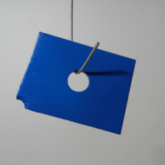



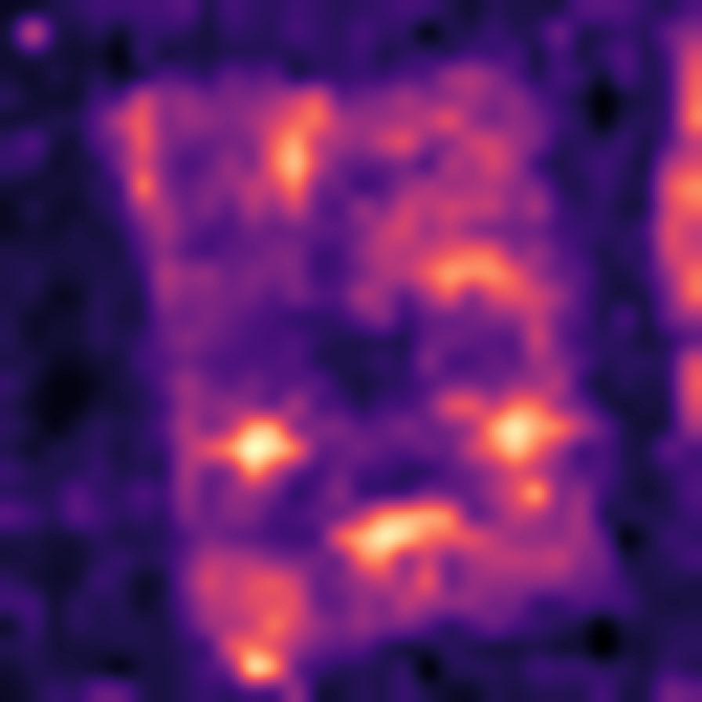
(a) Construct the normal reference bank
Frozen encoders
Align grids
Fixed reference bank
DINOv2-B/14
AnomalyCLIP visual
ℓ₂ unit
DINOv2-S/14 or
WideResNet50-2
x_{i}^{c}
K normal
support images
Replacement options
Unit descriptors
r ∈ ℛ_{c}
All patches
Read only
(b) Score the query using the fixed bank
Reference matching
Output and display
Same frozen
feature path
J(p) = min_{r} ∑_{b} w_{b} d_{b}(p,r)
L(p) = ∑_{b} w_{b} min_{r} d_{b}(p,r)
Query x
Align + normalize
Resize H × W Gaussian σ = 4
A_{t}
Contour
Joint: one shared row
Independent: separate rows
s_{img,t} = max_{u} A_{t,u}
Contour uses τ_{vis} for display only
(c) Representation effects and matching interactions
Dual-encoder
baseline
Duplicate-branch
control
Equal-weight
replacement
Balanced
replacement
Original encoder pair
Copy existing features
Replace the duplicate
Preserve group weights
E_{Equal,t} = P(Equal_{t}) − P(Duplicate_{t})
E_{Balanced,t} = P(Balanced_{t}) − P(Baseline_{t})
I_{Equal} = E_{Equal,L} − E_{Equal,J}
I_{Balanced} = E_{Balanced,L} − E_{Balanced,J}
Identical supports and query images within every paired comparison
Notes:
Scientific sources: scripts/manuscript_build_20260914 and docs/manuscript_polished_20260919. Real image assets: D:\STUDY\My_github\reference-matching-interaction-ad\scripts\figures_reference_matching_20260914\assets. MPDD metal_plate/test/scratches/026.png, A1 joint matching, seed 0 K=1. Score map follows stored resize and Gaussian sigma=4 processing. Red contour uses archived 256-bin Otsu polygons without loading a test mask. Three support thumbnails illustrate the general K-image input; they do not claim the output example used all three. The four constructions are the dual-encoder baseline, duplicate-branch control, equal-weight replacement, and balanced replacement. The frozen encoder names are DINOv2-B/14, AnomalyCLIP visual, and the replacement options DINOv2-S/14 or WideResNet50-2. p is query-patch index, b branch index, r normal-bank candidate. Native model outputs are the continuous anomaly map and its spatial maximum. Contour is display only. The replacement slot is a fixed construction, never a runtime switch. All diagrams and labels are editable native shapes, with real images embedded.

