Slide 1
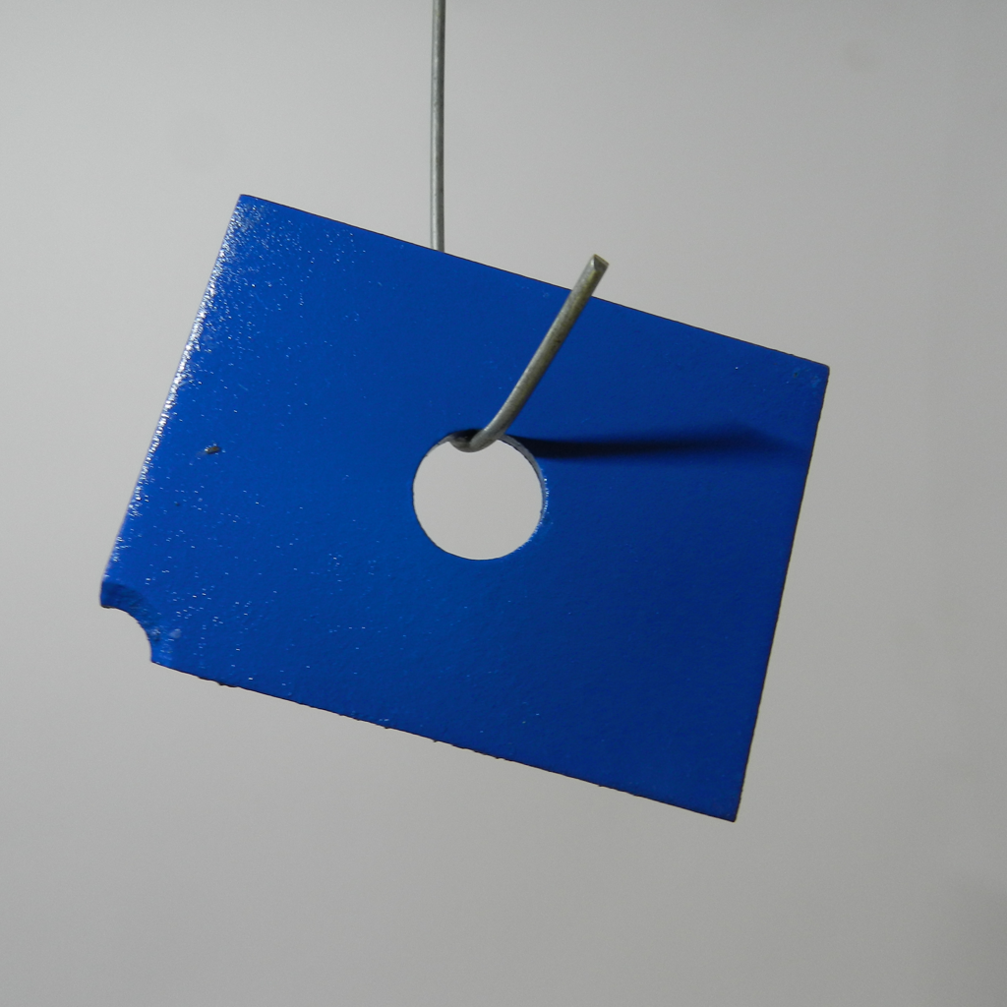



DCFnet
Dual-Encoder Calibrated Fusion Network
Normal-only few-shot industrial anomaly localization
(a) Build the normal reference memory
DINOv2
Align grids
Normalize and concatenate
Normal memory
All support patches
Fixed after construction
CLIP + DPAM
1536-D
R_{c} = {x^{c}₁, …, x^{c}_{K}}
Frozen visual encoders
Same feature pipeline as (b)
K ∈ {1, 2, 4}
M_{c}
(b) Localize anomalies in a query image
read only
Resize + Gaussian
σ = 4
Threshold + contour
Per patch
DINOv2
ViT-B/14
ℓ₂ norm
Concat
h_{D} × w_{D}
Exact 1-NN
Fused space
Short side: 448
target grid
768-D
0.5 / 0.5
CLIP visual
ViT-L/14 + DPAM
Bilinear
grid alignment
ℓ₂ norm
a_{p}(x)
x
Joint ℓ₂ norm
Input: 518 × 518
37 × 37
Predicted outline
768-D
f_{A,p} ∈ ℝ¹⁵³⁶
Illustrative threshold
448 × 448
a_{p}(x) = ½ min_{m ∈ Mc} ‖f_{A,p}(x) − m‖₂²
s_{img}(x) = max_{u} S_{448,u}(x)
Notes:
Prediction contour display. Source: submission_repro_20260827/predictions_compact/maps/mpdd/s0_k1/metal_plate.npz; sample metal_plate/test/scratches/026.png, seed0,K1. The contour is computed from the model score map, never from ground-truth masks. The 448x448 score maps are replayed from the archived float16 patch-score cache using the frozen bilinear resize and Gaussian sigma=4 pipeline. Each map is min-max quantized to 256 levels and automatically thresholded by Otsu for visualization only. This is not a calibrated deployment threshold or a binary-segmentation performance claim. No ground-truth masks or labels are loaded for contour extraction; no predicted component is suppressed. DCFnet and DINO use the same display rule, with independently computed per-image thresholds. The score map remains the numerical model output; threshold and contour extraction are visualization postprocessing. Image scores remain spatial maxima of the score map before thresholding. Source method and notation: docs/manuscript_english_polished_20260906/DCFnet_English_Polished_20260906.docx, Sections3.1–3.6. Support photographs are a schematic K-image set, not the exact supports of this archived example.

Slide 2
Fig. 2 Spatial calibration and fixed feature fusion
Common spatial sampling, normalized branch magnitudes, and a joint descriptor
(a) Align the CLIP grid to the DINO lattice
DINO reference grid
CLIP grid
target size
Same grid location p
Bilinear
resizing
h_{D} × w_{D}
h_{D} × w_{D}
768-D per branch
37 × 37
align_corners = False
(b) Normalize, scale and concatenate each patch pair
f_{D,p}
g_{D,p}
ℓ₂ norm
× 0.5
f_{A,p}
Channel
concatenation
Joint
ℓ₂ norm
ℓ₂ norm
× 0.5
1536-D
f_{C→D,p}
g_{C,p}
f_{A,p} = Norm([0.5 g_{D,p}; 0.5 g_{C,p}]) = [g_{D,p}; g_{C,p}] / √2
Notes:
Figure 2. Deterministic calibration and fixed feature fusion. The CLIP lattice is bilinearly resized to the DINO grid with align_corners=False. At each location p, the aligned branch descriptors are independently L2-normalized, scaled by 0.5, concatenated, and jointly normalized. The DINO grid is unchanged. Matching grid dimensions does not guarantee receptive-field or semantic correspondence. Norm(v)=v/||v||2 assumes positive norms. The complete-metric implementation does not claim an epsilon guard.
Source: docs/manuscript_english_polished_20260906/English_content.md, sections 3.3–3.6. All grids, tokens and vector bars are editable structural schematics rather than measured activations. Cell counts are illustrative.

Slide 3
Fig. 3 Normal memory construction and exact anomaly scoring
Category-specific support patches define one fixed search space for every query patch
(a) Build the category-specific memory once
…
Shared frozen encoders
Align, normalize, fuse
Flatten and collect
1536-D unit vectors
x^{c}₁
x^{c}₂
x^{c}_{K}
K normal images of category c
N_{c} = KP
All patch locations
from every support image
M_{c}: N_{c} × 1536
For a common patch grid
All patches retained; fixed after construction
(b) Retrieve one joint-space neighbor for each query patch
read fixed bank
Bilinear resize
448 × 448
Nearest distance
f_{A,p}(x)
Squared ℓ₂ / 2
Gaussian σ = 4
Unit fused descriptor
a_{p}(x)
FAISS IndexFlatL2
Reshape to
DINO grid
Threshold + contour
Defect outline
‖f_{A,p} − f_{A,q}‖₂² = ½ ‖g_{D,p} − g_{D,q}‖₂² + ½ ‖g_{C,p} − g_{C,q}‖₂²
The two branches use the same support candidate q
a_{p}(x) = ½ min_{m ∈ Mc} ‖f_{A,p}(x) − m‖₂²
s_{img}(x) = max_{u} S_{448,u}(x)
Notes:
Prediction contour display. Source: submission_repro_20260827/predictions_compact/maps/mpdd/s0_k1/metal_plate.npz; sample metal_plate/test/scratches/026.png, seed0,K1. The contour is computed from the model score map, never from ground-truth masks. The 448x448 score maps are replayed from the archived float16 patch-score cache using the frozen bilinear resize and Gaussian sigma=4 pipeline. Each map is min-max quantized to 256 levels and automatically thresholded by Otsu for visualization only. This is not a calibrated deployment threshold or a binary-segmentation performance claim. No ground-truth masks or labels are loaded for contour extraction; no predicted component is suppressed. DCFnet and DINO use the same display rule, with independently computed per-image thresholds. The score map remains the numerical model output; threshold and contour extraction are visualization postprocessing. Image scores remain spatial maxima of the score map before thresholding. Source method and notation: docs/manuscript_english_polished_20260906/DCFnet_English_Polished_20260906.docx, Sections3.1–3.6. Support photographs are a schematic K-image set, not the exact supports of this archived example.

Slide 4
Fig. S1 Frozen dual-encoder feature extraction
The same visual pipeline encodes every normal support image and each query image
(a) DINOv2 ViT-B/14
Short side 448
Patch-compatible crop
14 × 14 patches
Patch embedding
+ CLS token
12 transformer blocks
768-D, 12 heads
Final layer norm
Select patch tokens
P = h_{D}w_{D}
Frozen parameters
CLS excluded
Aspect ratio determines the grid; shorter grid dimension = 32
F_{D}: h_{D} × w_{D} × 768
(b) CLIP ViT-L/14 visual encoder with DPAM
Each image
One at a time
Requested block outputs
Resize
518 × 518
14 × 14 patches
1369 patches + CLS
Hidden width 1024
24 blocks, 16 heads
DPAM_layer = 20
6
12
18
24
Layer 24 only
Layer norm + projection
1024 → 768
Blocks 6–24
Value–value attention
Exclude CLS
Reshape patch tokens
Only the final requested layer enters fusion
F_{C}: 37 × 37 × 768
Visual features only; encoders remain frozen for support construction and query inference
Notes:
DINOv2 ViT-B/14: short-side 448 and patch-compatible center crop, patch size14, transformer depth12, hidden/output width768. Use normalized patch tokens and reshape to the image grid, excluding CLS. CLIP ViT-L/14: input518 square, patch grid37x37, hidden width1024, depth24, DPAM_layer20. Requested layers6/12/18/24 are extracted, only the last (layer24) is retained downstream. Layer-normalized local features use the visual projection1024x768 and exclude CLS. DPAM_layer=20 replaces blocks6 through24 inclusive (19 blocks), not only block20. The v-v attention branch sets q and k to v; the retained patch path is x_DPAM. Code sources: scripts/export_anomalyclip_mpdd_features.py lines90-106; methods/AnomalyCLIP-main/AnomalyCLIP_lib/AnomalyCLIP.py lines71-94,284-296,344-387; methods/anomalydino/src/backbones.py lines90-118. Each photograph is processed per encoder call; the illustrated input is MPDD metal_plate test/scratches/026.png. No text encoder or text prompt enters this inference path. Grid counts are schematic.
Source: docs/manuscript_english_polished_20260906/English_content.md, sections 3.3–3.6. All grids, tokens and vector bars are editable structural schematics rather than measured activations. Cell counts are illustrative.

Slide 5
Fig. S2 Matched control for the added visual representation
Paired inputs and a common scorer isolate the effect of adding calibrated CLIP features
(a) DCFnet
Own bank: N_{c} × 1536
support
Post-processing
Contour display
Same DINOv2
Align CLIP grid
Branch ℓ₂ norms
0.5 / 0.5 concat
Joint ℓ₂ norm
CLIP visual + DPAM
1536-D unit vector
Exact 1-NN
query
DCFnet outline
(b) DINO-only
Own bank: N_{c} × 768
support
Post-processing
Contour display
Same DINOv2
Patch-wise
ℓ₂ normalization
768-D patch features
768-D unit vector
Exact 1-NN
query
DINO-only outline
(c) Fixed conditions in every paired run
Same input manifest
Same distance
Same output processing
Same evaluation
K = 1, 2, 4
Seeds = 0, 1, 2
Same support and query IDs
All normal support patches
FAISS IndexFlatL2
Nearest squared ℓ₂ / 2
448 × 448 maps, Gaussian σ = 4
Image score = spatial max
Threshold + contour display
Same category and test split
Same metric implementation
Paired comparison per K / seed
Descriptor storage: DCFnet = 2 × DINO-only for the same number of stored patches
Illustrative contour threshold
Notes:
Prediction contour display. Source: submission_repro_20260827/predictions_compact/maps/mpdd/s0_k1/metal_plate.npz; sample metal_plate/test/scratches/026.png, seed0,K1. The contour is computed from the model score map, never from ground-truth masks. The 448x448 score maps are replayed from the archived float16 patch-score cache using the frozen bilinear resize and Gaussian sigma=4 pipeline. Each map is min-max quantized to 256 levels and automatically thresholded by Otsu for visualization only. This is not a calibrated deployment threshold or a binary-segmentation performance claim. No ground-truth masks or labels are loaded for contour extraction; no predicted component is suppressed. DCFnet and DINO use the same display rule, with independently computed per-image thresholds. The score map remains the numerical model output; threshold and contour extraction are visualization postprocessing. Image scores remain spatial maxima of the score map before thresholding. Source method and notation: docs/manuscript_english_polished_20260906/DCFnet_English_Polished_20260906.docx, Sections3.1–3.6. Support photographs are a schematic K-image set, not the exact supports of this archived example.

