Slide 1
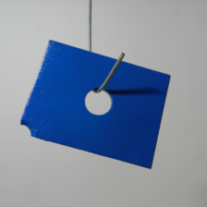



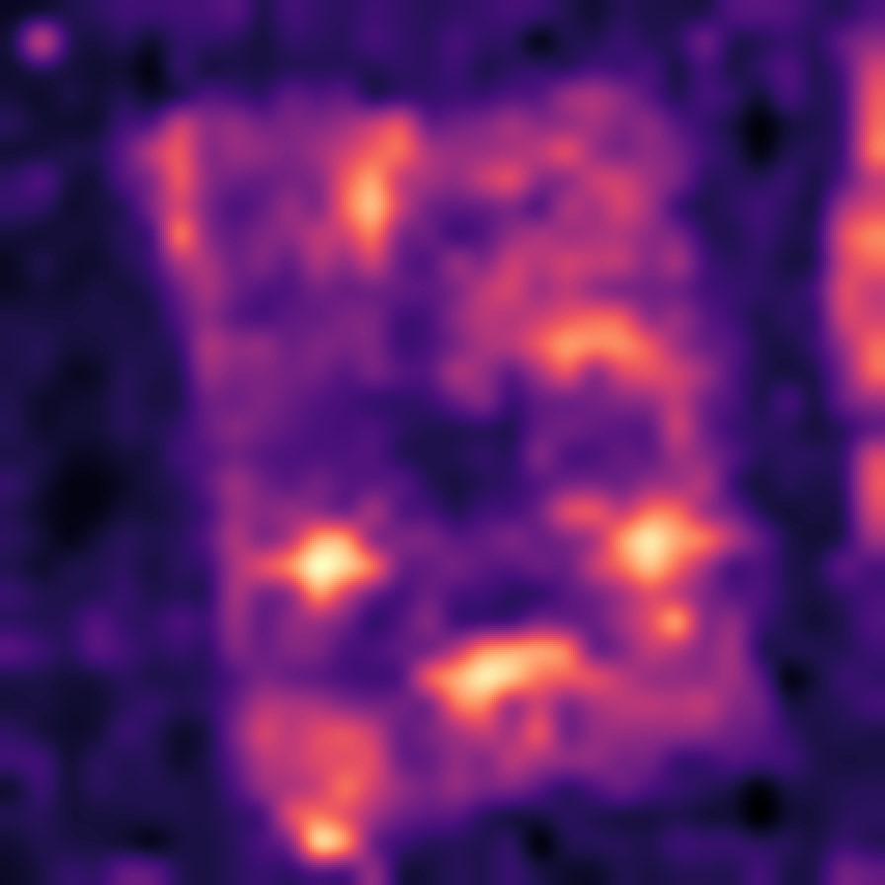
(a) Construct the normal reference bank
Frozen encoders
Align grids
Fixed reference bank
B DINOv2-B
C AnomalyCLIP visual
ℓ₂ unit
Extra descriptor slot
𝒳_{c}
K normal images
Frozen parameters
Unit descriptors
r ∈ ℛ_{c}
All patches
Read only
(b) Score the query using the fixed bank
Reference matching
Output and display
Same frozen
feature path
J(p) = min_{r} ∑_{b} w_{b} d_{b}(p,r)
L(p) = ∑_{b} w_{b} min_{r} d_{b}(p,r)
Query x
Align + normalize
Resize H × W Gaussian σ = 4
A_{t}
Display
Map and image score
J one shared row
L one row per branch
s_{img,t} = max_{u} A_{t,u}
Contour uses τ_{vis} for display only
(c) Separate representation effects from matching effects
A1
DUP
TRI
BAL
B ½ C ½
B ⅓ B copy ⅓ C ⅓
B ⅓ S or D ⅓ C ⅓
B ¼ S or D ¼ C ½
E_{TRI,t} = P(TRI_{t}) − P(DUP_{t})
E_{BAL,t} = P(BAL_{t}) − P(A1_{t})
I_{TRI} = E_{TRI,L} − E_{TRI,J}
I_{BAL} = E_{BAL,L} − E_{BAL,J}
Identical supports and query images within every paired comparison
Notes:
Scientific sources: scripts/manuscript_build_20260914 and docs/manuscript_polished_20260919. Real image assets: D:\STUDY\My_github\sci_project\scripts\figures_reference_matching_20260914\assets. MPDD metal_plate/test/scratches/026.png, A1 joint matching, seed 0 K=1. Score map follows stored resize and Gaussian sigma=4 processing. Red contour uses archived 256-bin Otsu polygons without loading a test mask. Three support thumbnails illustrate the general K-image input; they do not claim the output example used all three. B/C/S/D are upright encoder labels. p is query-patch index, b branch index, r normal-bank candidate. Native model outputs are the continuous anomaly map and its spatial maximum. Contour is display only. Extra encoder is a fixed construction, never a runtime switch. All diagrams and labels are editable native shapes, with real images embedded.

