Slide 1
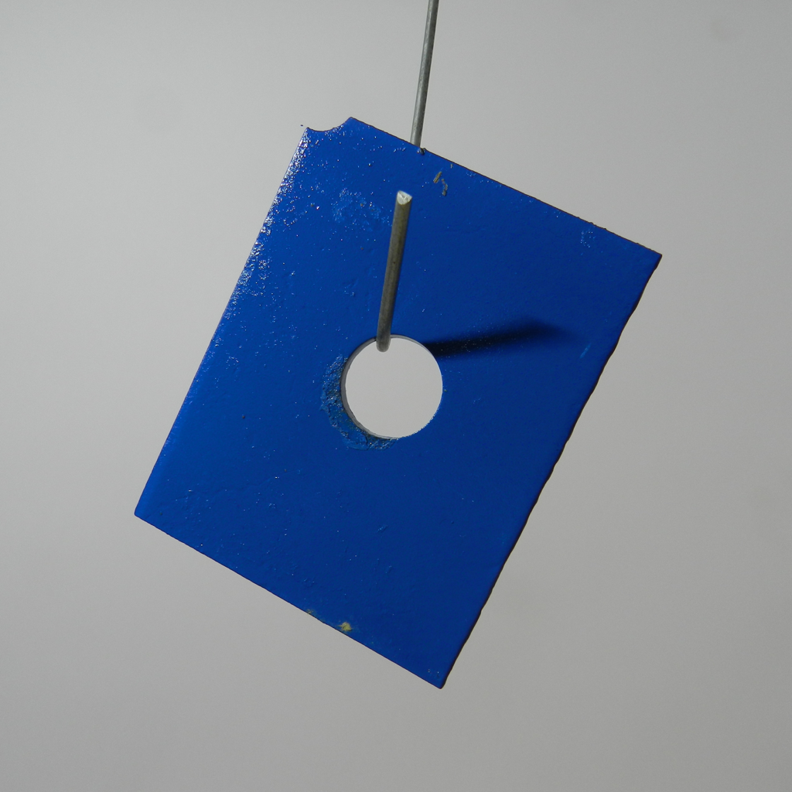
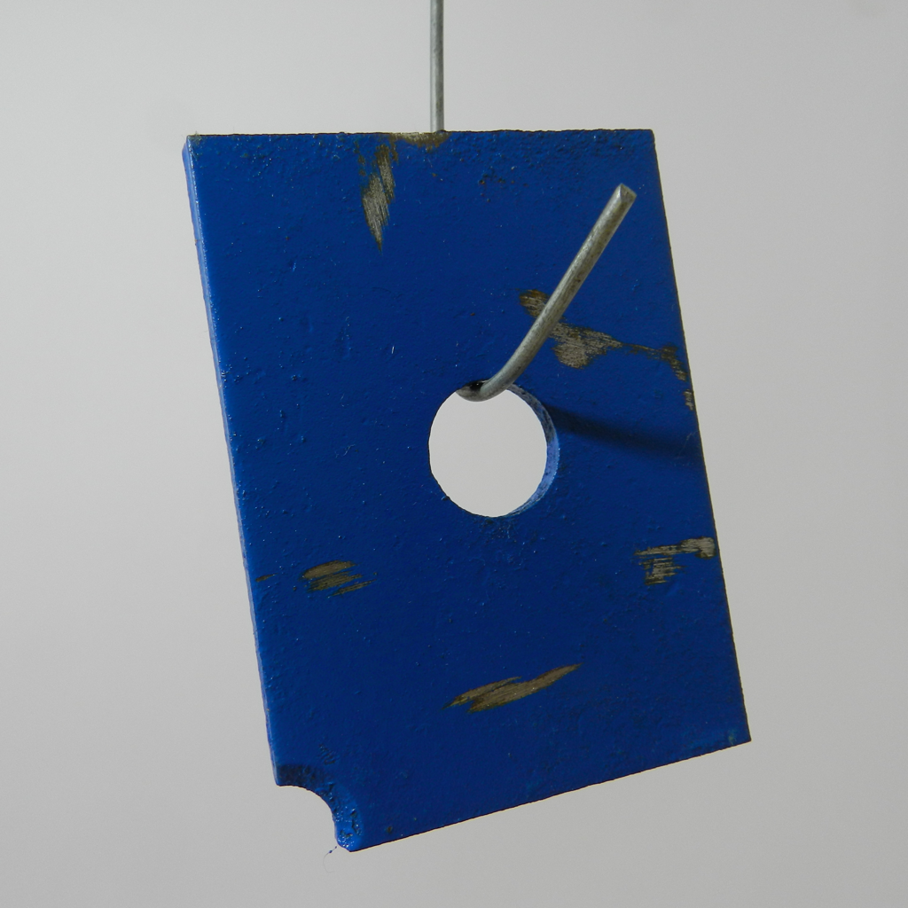
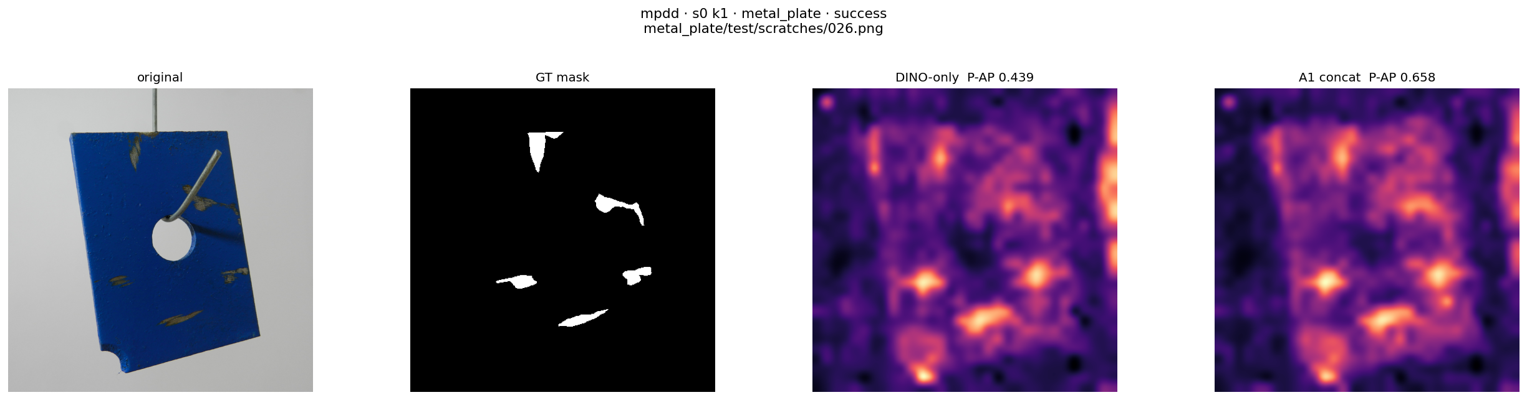
DCFnet
Dual-Encoder Calibrated Fusion Network
Normal-only few-shot industrial anomaly localization
(a) Build the normal reference memory
DINOv2
Align grids
Normalize and concatenate
Normal memory
All support patches
Fixed after construction
CLIP + DPAM
1536-D
R_{c} = {x^{c}_{i}}
Frozen visual encoders
Same feature pipeline as (b)
K ∈ {1, 2, 4}
M_{c}
(b) Localize anomalies in a query image
read only
Per patch
Bilinear resize
Gaussian σ = 4
DINOv2
ViT-B/14
ℓ₂ norm
Concat
h_{D} × w_{D}
Exact 1-NN
Fused space
Short side: 448
target grid
768-D
0.5 / 0.5
CLIP visual
ViT-L/14 + DPAM
Bilinear
grid alignment
ℓ₂ norm
a_{p}
x
Joint ℓ₂ norm
Input: 518 × 518
37 × 37
Anomaly map
768-D
S₄₄₈(x)
f_{A,p} ∈ ℝ¹⁵³⁶
448 × 448
a_{p} = ½ min_{m ∈ Mc} ‖f_{A,p}(x) − m‖₂²
s_{img}(x) = max_{u} S_{448,u}(x)
Notes:
Figure 1. DCFnet overview. (a) Verified normal support images construct a fixed category-specific memory. (b) The query passes through the same frozen encoders and deterministic fusion path. CLIP visual features are bilinearly resized to the DINO lattice; branch-wise L2 normalization, equal scaling, concatenation, and joint normalization yield 1536-dimensional descriptors. Exact nearest-neighbor scoring uses half the squared Euclidean distance in the joint space. Bilinear resizing and Gaussian smoothing (sigma = 4 pixels) produce the 448 x 448 anomaly map, whose spatial maximum is the image-level anomaly score. The query never updates the normal memory.
Blue and ochre grids/vector blocks are editable structural schematics, not measured activations, and their cell count is illustrative. The DINO grid is h_D x w_D, not universally 32 x 32. The CLIP grid is 37 x 37 and retains projected layer-24 patch descriptors with DPAM_layer = 20. The illustration uses MPDD metal_plate train/good/029.png and test/scratches/026.png. The map is the existing A1 inference panel from outputs/p1_b_figures/mpdd_s0_k1_metal_plate_success.png; it is not a ground-truth mask, and no output values were regenerated. Support illustration shows one example, not all K images. Both encoders remain frozen, without target-domain parameter optimization or text-based inference. Norm formula assumes positive branch norms.
Method source: docs/manuscript_english_polished_20260906/English_content.md, sections 3.1–3.5, and DCFnet_Figure_Source_Polished_20260906_final.pptx. Design requirements: docs/lesson_notes_20260905/20260905_SCI论文辅导详细整理与修改清单.md, section 二, classroom 04:26–08:47 and 01:07:48–01:17:17.

Slide 2
Fig. 2 Spatial calibration and fixed feature fusion
Common spatial sampling, normalized branch magnitudes, and a joint descriptor
(a) Align the CLIP grid to the DINO lattice
DINO reference grid
CLIP grid
target size
Same grid location p
Bilinear
resizing
h_{D} × w_{D}
h_{D} × w_{D}
768-D per branch
37 × 37
align_corners = False
(b) Normalize, scale and concatenate each patch pair
f_{D,p}
g_{D,p}
ℓ₂ norm
× 0.5
f_{A,p}
Channel
concatenation
Joint
ℓ₂ norm
ℓ₂ norm
× 0.5
1536-D
f_{C→D,p}
g_{C,p}
f_{A,p} = Norm([0.5 g_{D,p}; 0.5 g_{C,p}]) = [g_{D,p}; g_{C,p}] / √2
Notes:
Figure 2. Deterministic calibration and fixed feature fusion. The CLIP lattice is bilinearly resized to the DINO grid with align_corners=False. At each location p, the aligned branch descriptors are independently L2-normalized, scaled by 0.5, concatenated, and jointly normalized. The DINO grid is unchanged. Matching grid dimensions does not guarantee receptive-field or semantic correspondence. Norm(v)=v/||v||2 assumes positive norms. The complete-metric implementation does not claim an epsilon guard.
Source: docs/manuscript_english_polished_20260906/English_content.md, sections 3.3–3.6. All grids, tokens and vector bars are editable structural schematics rather than measured activations. Cell counts are illustrative.

Slide 3
Fig. 3 Normal reference memory and anomaly scoring
All normal support patches form the fixed memory used for query retrieval
(a) Collect the normal support descriptors
Frozen dual encoders
Calibrated fusion
Collect
1536-D descriptors
R_{c}
Retain every patch
M_{c}: N_{c} × 1536
fixed memory read
FAISS IndexFlatL2
(b) Find the nearest support patch in feature space
Bilinear resize
448 × 448
Gaussian σ = 4
f_{A,p}(x)
a
Exact 1-NN
Patch scores
S₄₄₈(x)
Anomaly map
a_{p} = ½ min_{m ∈ Mc} ‖f_{A,p}(x) − m‖₂²
s_{img}(x) = max_{u} S_{448,u}(x)
Notes:
Figure 3. Normal-memory construction and anomaly scoring. Every fused descriptor from the K normal supports is stored in a category-specific FAISS IndexFlatL2 memory. N_c=KP when all support images have a common P-patch lattice; generally N_c is the sum of their patch counts. Each query patch retrieves one nearest normal descriptor in joint feature space across all support locations. The highlighted candidate is schematic, not a measured nearest-neighbor visualization. Half the squared Euclidean distance yields the raw patch score. Bilinear resizing to 448x448 and Gaussian smoothing with sigma=4 produce the output map. The image score is the map maximum. Query descriptors never update the memory. Existing map: MPDD metal_plate, seed0, K1, scratches/026.png, A1 panel from outputs/p1_b_figures/mpdd_s0_k1_metal_plate_success.png.
Source: docs/manuscript_english_polished_20260906/English_content.md, sections 3.3–3.6. All grids, tokens and vector bars are editable structural schematics rather than measured activations. Cell counts are illustrative.

Slide 4
Fig. S1 Frozen dual-encoder visual representation
Independent image preprocessing produces two 768-dimensional patch representations
(a) DINOv2 visual path
Short side: 448
Patch-compatible crop
DINOv2
ViT-B/14
Local patch tokens
Frozen parameters
F_{D}: h_{D} × w_{D} × 768
Shorter grid dimension: 32
(b) CLIP visual path with DPAM
Support or
query image
Requested layer outputs
Resize to
518 × 518
CLIP ViT-L/14
Visual encoder + DPAM
6
12
18
24
Retain layer 24 only
DPAM_layer = 20
Project to 768-D
Exclude CLS token
F_{C}: 37 × 37 × 768
Frozen visual features for both paths. No text prompts or text encoder at inference.
Notes:
Figure S1. The frozen visual extraction paths shared by support and query images. DINOv2 ViT-B/14 uses short-side 448 preprocessing and patch-compatible cropping. Its shorter grid dimension is 32, with general shape h_D x w_D x 768. CLIP ViT-L/14 receives 518x518 images with DPAM_layer=20. The extractor requests layers 6/12/18/24 but retains only layer 24, projects the local features to 768 dimensions, and excludes the CLS token. Hidden width 1024 is distinct from the 768-D output descriptor. The figure depicts selection of requested outputs, not four-layer concatenation. No text encoder or prompts enter inference. Example input: MPDD metal_plate scratches/026.png.
Source: docs/manuscript_english_polished_20260906/English_content.md, sections 3.3–3.6. All grids, tokens and vector bars are editable structural schematics rather than measured activations. Cell counts are illustrative.

Slide 5
Fig. S2 Matched DINO-only control
Identical support identities, query images and downstream scoring protocol
(a) DCFnet
Separate normal memory
Same DINOv2
support
Calibrated
fixed fusion
CLIP visual + DPAM
1536-D
Exact 1-NN
query
DCFnet map
(b) DINO-only control
Separate normal memory
Same DINOv2
support
ℓ₂ normalization
Single visual branch
768-D
Exact 1-NN
query
DINO-only map
Same scoring and post-processing: squared ℓ₂ / 2, resize, Gaussian σ = 4, spatial maximum
Paired maps: one existing MPDD example, seed 0, K = 1
Notes:
Figure S2. Matched control isolating the calibrated second visual representation. DCFnet retains the same DINOv2 descriptors and adds DPAM-modified CLIP image features, grid alignment and fixed concatenation. DINO-only uses 768-D unit descriptors; DCFnet uses 1536-D unit descriptors. Each method maintains its own normal memory. Support descriptors build that memory and query descriptors read it through exact 1-NN. Support identities, K=1/2/4, seeds=0/1/2, distance convention (squared L2/2), resizing, Gaussian sigma=4, spatial maximum and evaluation resolution are matched. The paired heatmaps are an existing illustrative MPDD metal_plate example (seed0,K1,scratches/026.png) using the DINO-only and A1 panels from outputs/p1_b_figures/mpdd_s0_k1_metal_plate_success.png. No aggregate performance claim is made by this example.
Source: docs/manuscript_english_polished_20260906/English_content.md, sections 3.3–3.6. All grids, tokens and vector bars are editable structural schematics rather than measured activations. Cell counts are illustrative.

