Slide 1
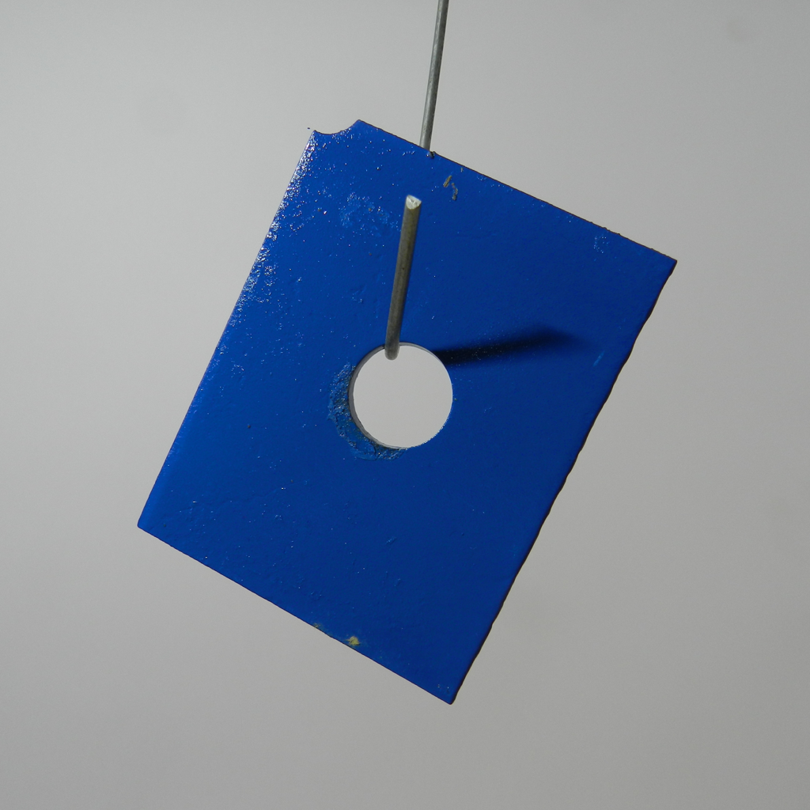
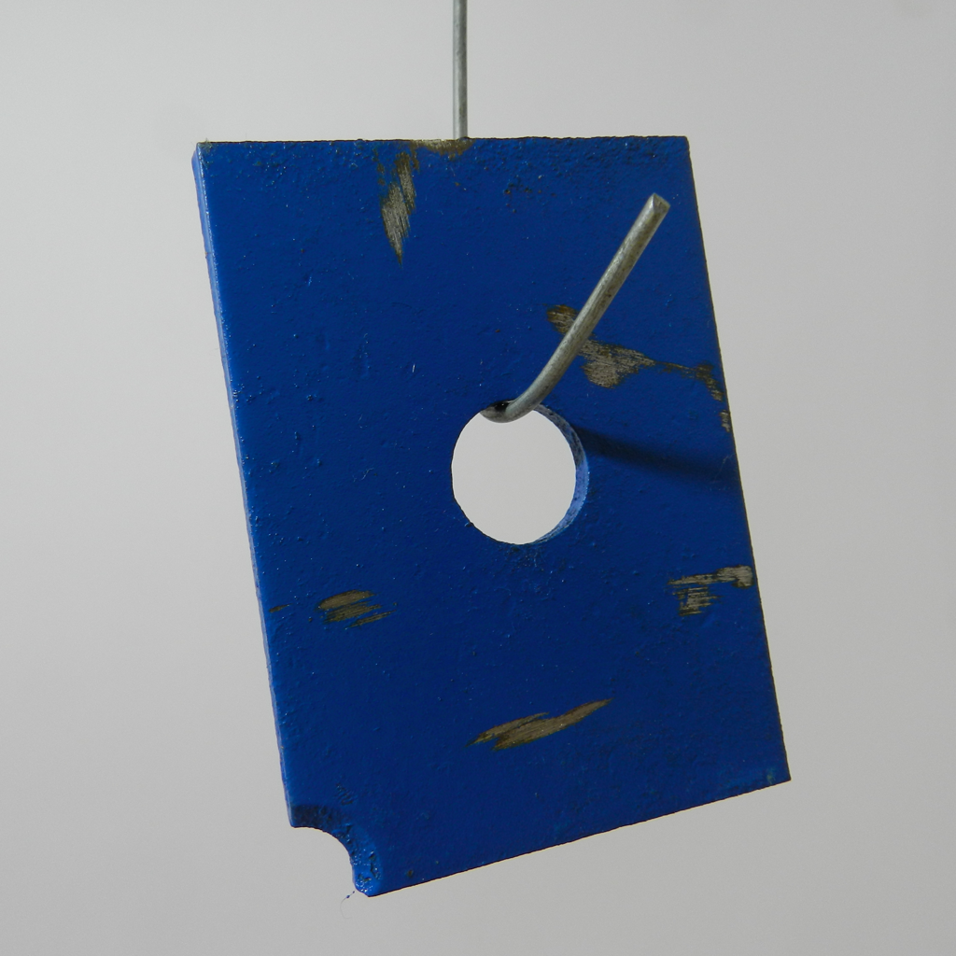
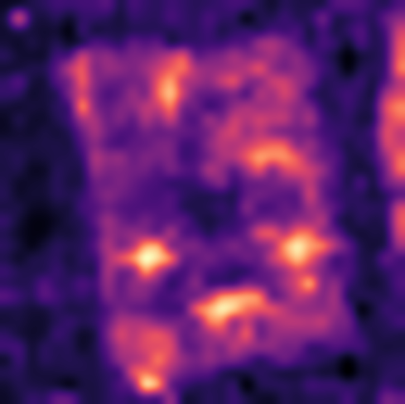
DCFnet
Dual-Encoder Calibrated Fusion Network
Normal-only few-shot industrial anomaly localization
(a) Build the normal reference memory
DINOv2
Align grids
Normalize and concatenate
Normal memory
All support patches
Fixed after construction
CLIP + DPAM
1536-D
R_{c} = {x^{c}_{i}}
Frozen visual encoders
Same feature pipeline as (b)
K ∈ {1, 2, 4}
M_{c}
(b) Localize anomalies in a query image
read only
Per patch
Bilinear resize
Gaussian σ = 4
DINOv2
ViT-B/14
ℓ₂ norm
Concat
h_{D} × w_{D}
Exact 1-NN
Fused space
Short side: 448
target grid
768-D
0.5 / 0.5
CLIP visual
ViT-L/14 + DPAM
Bilinear
grid alignment
ℓ₂ norm
a_{p}
x
Joint ℓ₂ norm
Input: 518 × 518
37 × 37
Anomaly map
768-D
S₄₄₈(x)
f_{A,p} ∈ ℝ¹⁵³⁶
448 × 448
a_{p} = ½ min_{m ∈ Mc} ‖f_{A,p}(x) − m‖₂²
s_{img}(x) = max_{u} S_{448,u}(x)
Notes:
Figure 1. DCFnet overview. (a) Verified normal support images construct a fixed category-specific memory. (b) The query passes through the same frozen encoders and deterministic fusion path. CLIP visual features are bilinearly resized to the DINO lattice; branch-wise L2 normalization, equal scaling, concatenation, and joint normalization yield 1536-dimensional descriptors. Exact nearest-neighbor scoring uses half the squared Euclidean distance in the joint space. Bilinear resizing and Gaussian smoothing (sigma = 4 pixels) produce the 448 x 448 anomaly map, whose spatial maximum is the image-level anomaly score. The query never updates the normal memory.
Blue and ochre grids/vector blocks are editable structural schematics, not measured activations, and their cell count is illustrative. The DINO grid is h_D x w_D, not universally 32 x 32. The CLIP grid is 37 x 37 and retains projected layer-24 patch descriptors with DPAM_layer = 20. The illustration uses MPDD metal_plate train/good/029.png and test/scratches/026.png. The map is the existing A1 inference panel from outputs/p1_b_figures/mpdd_s0_k1_metal_plate_success.png; it is not a ground-truth mask, and no output values were regenerated. Support illustration shows one example, not all K images. Both encoders remain frozen, without target-domain parameter optimization or text-based inference. Norm formula assumes positive branch norms.
Method source: docs/manuscript_english_polished_20260906/English_content.md, sections 3.1–3.5, and DCFnet_Figure_Source_Polished_20260906_final.pptx. Design requirements: docs/lesson_notes_20260905/20260905_SCI论文辅导详细整理与修改清单.md, section 二, classroom 04:26–08:47 and 01:07:48–01:17:17.

