Slide 1
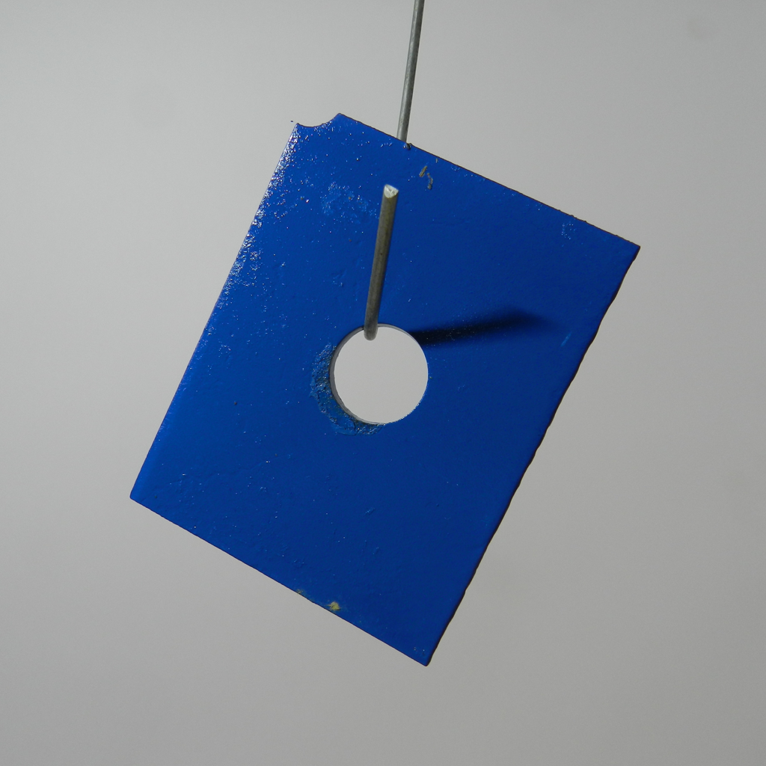
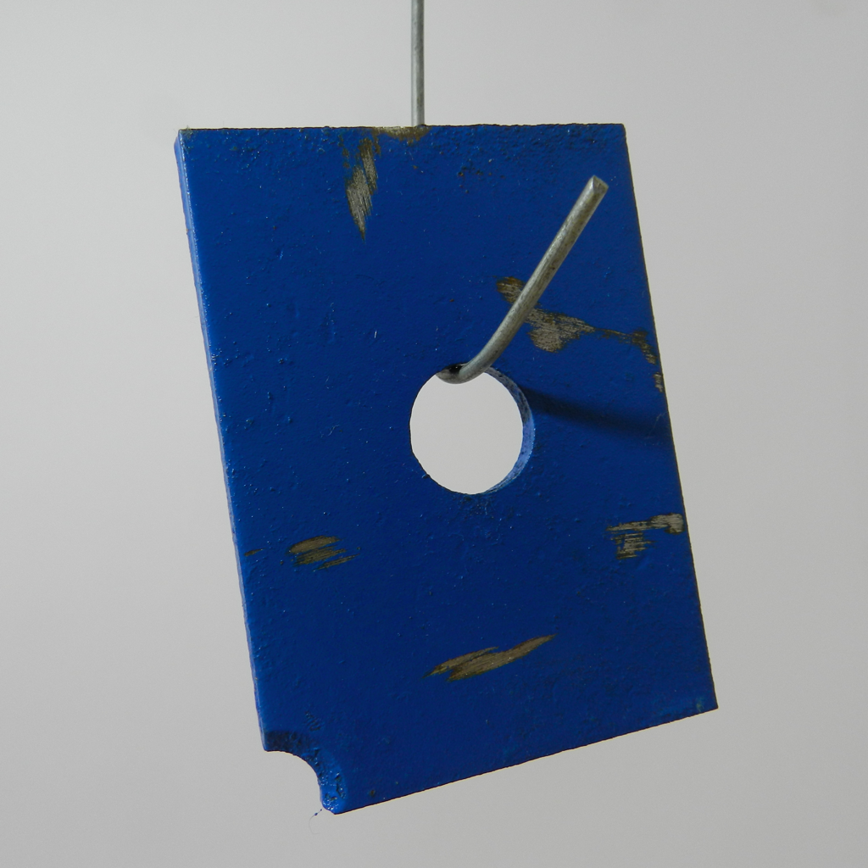
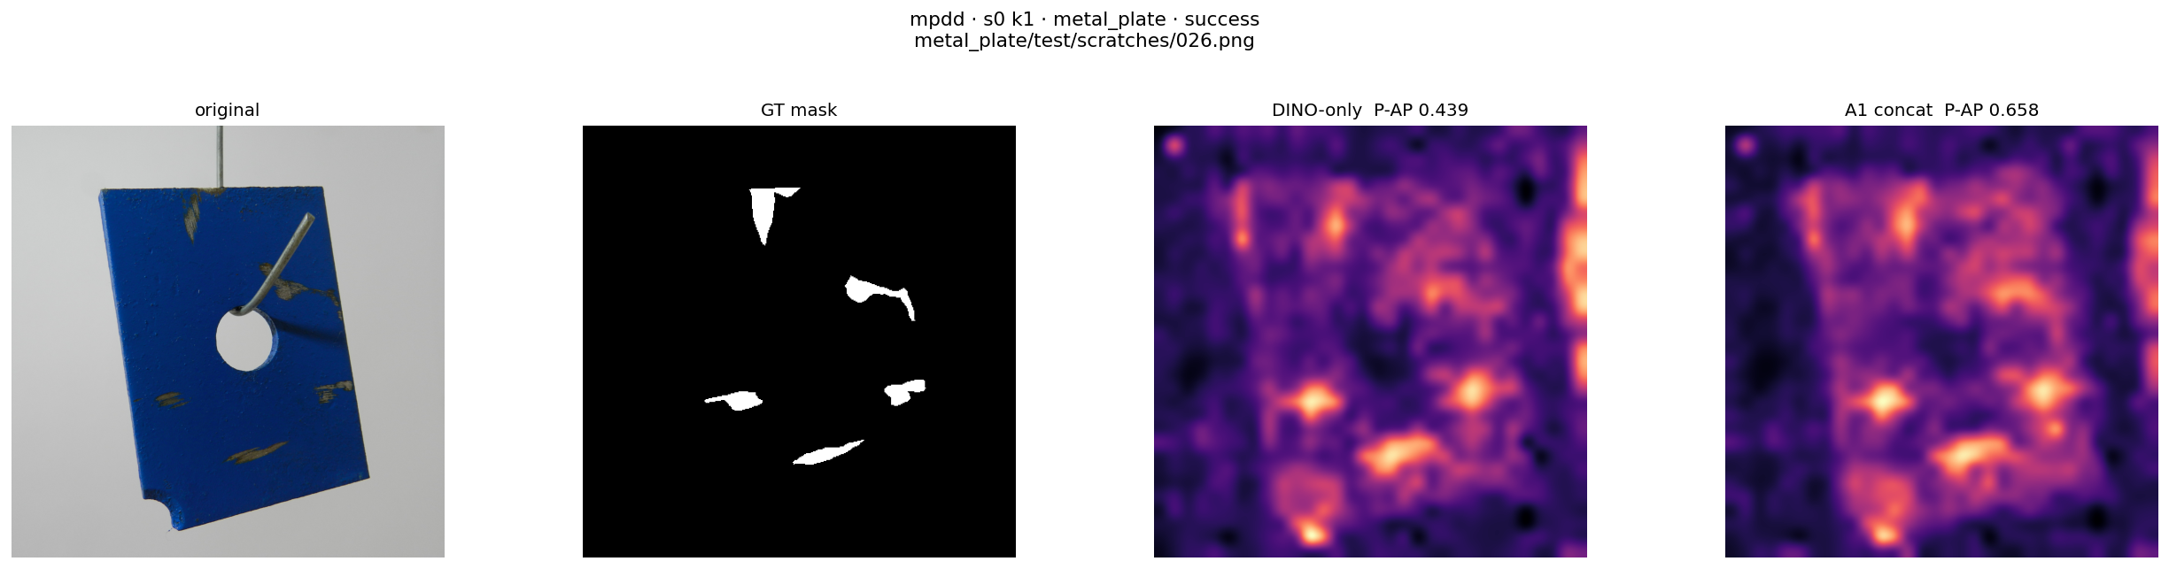
DCFnet overview
(a) Normal support memory construction
DINOv2 ViT-B/14
Calibrated fusion
Normal memory
1536-D
Grid alignment
Branch ℓ₂ norm
0.5 / 0.5 concat
Joint ℓ₂ norm
CLIP visual + DPAM
ViT-L/14@336
M_{c}
R_{c} = {x_{i}}
K ∈ {1, 2, 4}
768-D patches / branch
1536-D patches
Shared frozen encoders and fusion
0 target-domain trainable parameters
fixed
(b) Query inference
Exact 1-NN
Squared ℓ₂ / 2
Anomaly map
DINOv2 ViT-B/14
Calibrated fusion
Grid alignment
Branch ℓ₂ norm
0.5 / 0.5 concat
Joint ℓ₂ norm
CLIP visual + DPAM
ViT-L/14@336
Bilinear resize
Gaussian σ = 4
x
768-D patches / branch
1536-D patches
448 × 448
Image score = max(map)
Notes:
建议作为 Fig. 1，放在 3.2 Overview Structure 首次引用后，双栏通栏。主图保留正常支持集建库与查询评分的完整路径，详细算子见后续分图。
Caption: Overall workflow of DCFnet. Normal support images construct a category-specific memory. Query images use the same frozen visual encoders and calibrated fusion operator, and their descriptors are compared with the fixed memory. Exact nearest-neighbor distances are upsampled and Gaussian-smoothed to obtain the anomaly map. The image score is the spatial maximum of this map.
Illustrative image pair and output: MPDD, metal_plate, seed 0, K=1. Support: train/good/029.png. Query: test/scratches/026.png. Output cropped from existing mpdd_s0_k1_metal_plate_success.png (A1 concat panel), with display scaling inherited from that figure. This single example is a workflow illustration, not an aggregate performance claim.
课堂依据：20260905 SCI论文辅导，https://meeting.tencent.com/crm/2O84onE064。课堂 Word：DCFnet_English_Draft_Through_Method_Revised_20260903(1).docx，第3.2至3.6节。实现核对：scripts/evaluate_a1_feature_fusion.py，scripts/export_anomalyclip_mpdd_features.py，scripts/export_anomalydino_mpdd_features.py，methods/anomalydino/src/utils.py，submission_repro_20260827/config/frozen_a1.json。

Slide 2
Frozen dual-encoder visual representation
The same frozen extractor processes each support or query image
DINO reference grid
Short side: 448
Patch-compatible
crop
DINOv2
ViT-B/14
Support or
query image
F_{D}: h_{D} × w_{D} × 768
Shorter grid dimension: 32
Layer 24 retained
Resize to
518 × 518
CLIP ViT-L/14@336
Visual encoder + DPAM
DPAM_layer = 20
F_{C}: 37 × 37 × 768
Frozen visual encoders. No text prompts or text encoder at inference.
Notes:
建议作为 Fig. 2，置于 3.3 Frozen Dual-Encoder Visual Representation 两个编码器说明后。若篇幅有限，可放补充材料，而保留 Fig. 3 的融合细节。
Caption: Frozen visual feature extraction. DINOv2 produces 768-dimensional patch descriptors on its native grid after aspect-ratio-preserving resizing and patch-compatible cropping. The CLIP visual encoder uses the fixed DPAM configuration and retains layer-24 patch descriptors on a 37 × 37 grid. Both branches process each support or query image independently. Only visual patch descriptors enter fusion.
CLIP implementation requests layers 6,12,18,24 and retains the last returned tensor (layer 24), discarding CLS. It is not four-layer concatenation. DPAM_layer=20. The general DINO grid is h_D × w_D, with shorter dimension 32 for short side 448 and patch size 14.
课堂依据：20260905 SCI论文辅导，https://meeting.tencent.com/crm/2O84onE064。课堂 Word：DCFnet_English_Draft_Through_Method_Revised_20260903(1).docx，第3.2至3.6节。实现核对：scripts/evaluate_a1_feature_fusion.py，scripts/export_anomalyclip_mpdd_features.py，scripts/export_anomalydino_mpdd_features.py，methods/anomalydino/src/utils.py，submission_repro_20260827/config/frozen_a1.json。

Slide 3
Spatial calibration and fixed feature fusion
(a) Spatial calibration
target size
DINO grid
CLIP grid
Aligned patch
positions
Bilinear
resizing
h_{D} × w_{D}
h_{D} × w_{D}
Common DINO grid
37 × 37
align_corners = False
(b) Per-patch magnitude calibration and concatenation
f_{D,p}
g_{D,p}
ℓ₂ norm
× 0.5
f_{A,p}
Channel
concatenation
Joint
ℓ₂ norm
ℓ₂ norm
× 0.5
1536-D
f_{C→D,p}
g_{C,p}
f_{A,p} = norm([0.5 g_{D,p}, 0.5 g_{C,p}])
Notes:
建议作为 Fig. 3，置于 3.4 Spatial Calibration and Fixed Feature Fusion 首次介绍对齐和归一化后，靠近对应公式。该图优先保留在正文。
Caption: Spatial and magnitude calibration before fixed feature concatenation. The CLIP grid is bilinearly resized to the DINO grid. At each aligned location, the two 768-dimensional branch descriptors are independently normalized, scaled equally, concatenated along the channel dimension, and normalized again to obtain a 1536-dimensional descriptor. The coefficients are fixed at 0.5.
All colored grids and vector bars are schematic editable objects, not measured activation maps. Native grid dimensions are written explicitly; the number of drawn cells is illustrative. norm(v)=v/max(||v||₂,ε). align_corners=False. The diagram shows feature concatenation, not averaging two separately searched anomaly maps.
课堂依据：20260905 SCI论文辅导，https://meeting.tencent.com/crm/2O84onE064。课堂 Word：DCFnet_English_Draft_Through_Method_Revised_20260903(1).docx，第3.2至3.6节。实现核对：scripts/evaluate_a1_feature_fusion.py，scripts/export_anomalyclip_mpdd_features.py，scripts/export_anomalydino_mpdd_features.py，methods/anomalydino/src/utils.py，submission_repro_20260827/config/frozen_a1.json。

Slide 4
Normal memory and anomaly scoring
(a) Category-specific memory construction
K normal support images
P patches per image
Collect fused
patch descriptors
M_{c}
Fixed after
construction
KP × 1536
FAISS IndexFlatL2
(b) Query patch scoring
Fused query
patch descriptor
Exact nearest
normal descriptor
Bilinear resize
448 × 448
Gaussian σ = 4
f_{A,p}(x)
Search all support locations
a_{p}
S₄₄₈(x)
a_{p}(x) = ½ min_{m ∈ Mc} ‖f_{A,p}(x) − m‖₂²
s_{img}(x) = max_{u} S_{448,u}(x)
Nearest means closest in feature space
Notes:
建议作为 Fig. 4，置于 3.5 Normal Reference Memory and Anomaly Scoring，紧邻记忆库与评分公式。优先保留正文。
Caption: Construction and use of the normal reference memory. All fused patch descriptors from the K normal support images populate a fixed category-specific FAISS IndexFlatL2 memory. Each query descriptor retrieves its nearest support descriptor in feature space across all stored locations. Half of the squared Euclidean distance produces the patch score. The patch-score grid is resized to 448 × 448 and smoothed with σ=4. The final map supplies both pixel-level scores and the spatial maximum for image-level scoring.
P=h_D w_D assumes a common retained grid. The memory has KP rows for K support images with P retained patches each. Query descriptors are never inserted into the normal memory. Schematic vectors are not actual activations. Example map source and display scaling are the same as Fig. 1.
课堂依据：20260905 SCI论文辅导，https://meeting.tencent.com/crm/2O84onE064。课堂 Word：DCFnet_English_Draft_Through_Method_Revised_20260903(1).docx，第3.2至3.6节。实现核对：scripts/evaluate_a1_feature_fusion.py，scripts/export_anomalyclip_mpdd_features.py，scripts/export_anomalydino_mpdd_features.py，methods/anomalydino/src/utils.py，submission_repro_20260827/config/frozen_a1.json。

Slide 5
Matched DINO-only control
Identical support identities and query images
(a) DCFnet
support
DINOv2 + CLIP/DPAM
Calibrated fixed fusion
1536-D
Unit descriptors
Separate
1536-D memory
Exact 1-NN
Squared ℓ₂ / 2
query
(b) DINO-only control
support
Same frozen
DINOv2 encoder
768-D
Unit descriptors
Separate
768-D memory
Exact 1-NN
Squared ℓ₂ / 2
query
Same bilinear resizing, Gaussian smoothing, image pooling and evaluator
Notes:
建议作为 Fig. S1，放在 3.6 Matched Control 或实验消融小节。若正文空间足够，可改为正文图；编号应随最终全文排序。
Caption: Matched comparison isolating the calibrated second representation. DCFnet and the DINO-only control use the same support-image identities, query images, DINO features, exact nearest-neighbor search, distance convention, post-processing, and evaluation resolution. They maintain separate memories. The DCFnet descriptor has 1536 channels, while the control descriptor has 768 channels.
This is an experimental control diagram, not a third branch of DCFnet. No performance improvement is claimed by the diagram. The DCFnet setting has no PCA, whitening, learned gate, or target-domain optimization.
课堂依据：20260905 SCI论文辅导，https://meeting.tencent.com/crm/2O84onE064。课堂 Word：DCFnet_English_Draft_Through_Method_Revised_20260903(1).docx，第3.2至3.6节。实现核对：scripts/evaluate_a1_feature_fusion.py，scripts/export_anomalyclip_mpdd_features.py，scripts/export_anomalydino_mpdd_features.py，methods/anomalydino/src/utils.py，submission_repro_20260827/config/frozen_a1.json。

Slide 6
图件安排与正文放置建议
PPT 页 | 图件与用途 | 建议位置
1 | Fig. 1 主图：建库与查询的完整流程 | 3.2 Overview 首次引用后，双栏通栏
2 | Fig. 2 双编码器：输入尺寸与保留的特征 | 3.3 编码器说明后，可移入补充材料
3 | Fig. 3 对齐与融合：空间及幅值校准 | 3.4 对齐说明与融合公式附近，优先保留
4 | Fig. 4 记忆与评分：匹配、异常图与图像分数 | 3.5 记忆库和评分公式附近，优先保留
5 | Fig. S1 对照设计：两套独立特征与记忆库 | 3.6 对照说明或消融实验，可用作附图
版式：英文图件统一横向矩形。先引用，再就近放图。
字体：Arial 正文标签，Cambria 数学符号。变量下标保持可编辑。
图注：每页备注附英文图注。图 3、图 4 的细节优先进入正文。
篇幅压缩时：正文保留主图及融合、评分分图，其余作为附图。
Notes:
本页为图件使用规划，不作为论文插图。暂定图号需要随最终正文顺序统一调整。正文图与实验结果图应避免编号冲突。所有图均围绕课堂稿的固定融合版本，不将后续研究候选架构写入已完成的方法。
课堂依据：20260905 SCI论文辅导，https://meeting.tencent.com/crm/2O84onE064。课堂 Word：DCFnet_English_Draft_Through_Method_Revised_20260903(1).docx，第3.2至3.6节。实现核对：scripts/evaluate_a1_feature_fusion.py，scripts/export_anomalyclip_mpdd_features.py，scripts/export_anomalydino_mpdd_features.py，methods/anomalydino/src/utils.py，submission_repro_20260827/config/frozen_a1.json。

