Slide 1

Student Branch Chapter @ USF
SQL Musical Workshop
IEEE CS Backend Lead: Akmal Kurbanov

Slide 2


Check in! Support us

Slide 3




Follow Us
Instagram
LinkedIn
Discord

Slide 4
What is our goal?
We are given a task to store design a persistent storage for storing data about artists and their songs
Where are we going to use to store data?
How many tables are we going to create?
How would we create, read, update, delete data in those tables

Slide 5
By the end of this workshop, you will be familiar with
Why we use database
Postgres SQL and its syntax
Create and Delete tables
Create, Read, Update, Delete Data (CRUD)

Slide 6
Why do we need database?
Persistent Storage
Fast data retrieval
Efficient memory storage
Easy way to work with data

Slide 7
SQL Vocabulary
Database: A collection that holds one or more related tables.
Table: A structured format used to store data in rows and columns.
Column: Defines the structure and type of data in the table (like Name, Age, Genre).
Row: A single entry or record in a table.

Slide 8
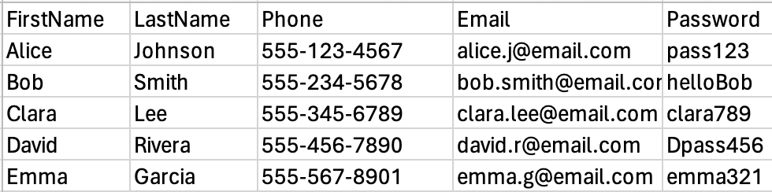
SQL Vocabulary Example User Table

Slide 9
Common Datatypes In SQL
Each column in a table must have a data type. This defines what kind of data it can hold:
INT – Whole numbers (e.g., age, ID)
VARCHAR(n) – Text up to n characters (like string with max length)
BOOL – True or False values
DATE – Calendar dates (e.g., birthday, signup date)
DOUBLE PRECISION – Decimal numbers (e.g., price, rating)
These are the main types we’ll use in this workshop, but SQL supports many more!

Slide 10
Common Constrains
Think of constraints as rules you add on top of data types to make sure your data follows better logic and structure.
Constraint | What It Means | Common Use Example
NULL | The column can be left empty | Optional fields (middle name)
NOT NULL | The column must have a value | Required fields (email)
UNIQUE | No two rows can have the same value in this column | Ensuring usernames are not duplicated
PRIMARY KEY (PK) | Uniquely identifies each row | Usually used on id columns like user_id
FOREIGN KEY (FK) | Links rows in one table to another | Used to connect tables

Slide 11
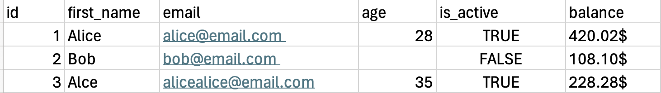
Exercise
What are the datatypes and constrains for each column in this table?

Slide 12

QR CODE FOR SQL TOOL

Slide 13
Writing Our First Table In SQL
Syntax for creating table
CREATE TABLE table_name (
column1_name data_type constraints,
column2_name data_type constraints,
...
);
Syntax for deleting table: DROP TABLE table_name;

Slide 14
Writing Our Artist Table In SQL

Slide 15
CRUD
CRUD operations:
Create (Creating tables and its content)
Read (Reading data from tables)
Update (Updating row/rows from table)
Delete (Removing row/rows from table)
Notes:
Created class to

Slide 16
Create
We created tables but do they store any data?
What we have done so far is called schema
Notes:
The goal of it is just represent each user. As you can see, each user

Slide 17
Fulfilling data with Table
Syntax For Adding One Row
INSERT INTO table_name (column1, column2, ..., columnN)
VALUES (value1, value2, ..., valueN);
Syntax For Adding Multiple Rows at once
INSERT INTO table_name (column1, column2, ..., columnN)
VALUES
(value1a, value2a, ..., valueNa),
(value1b, value2b, ..., valueNb),
...;

Slide 18
Read
Read specific columns:
SELECT column1, column2, ..., columnN
FROM table_name;
Read all columns from a table:
SELECT * FROM table_name;
Add a filter with WHERE:
SELECT *FROM table_name WHERE condition;

Slide 19
Update
UPDATE table_name
SET column1 = value1, column2 = value2, ...
WHERE condition;
Note: the number of rows updated depends on how many match the condition.

Slide 20
‘WHERE’ IS IMPORTANT
What happens if where is dropped?
UPDATE Musician
SET active = FALSE;
All rows are going to be affected

Slide 21
Delete
DELETE FROM table_name
WHERE condition; Note: The number of rows deleted depends on how many match the condition.

Slide 22
‘WHERE’ IS IMPORTANT
DELETE FROM Musician;
All rows are deleted from table if ‘where’ keyword is dropped!

Slide 23
Design Last Table
The table that will store information about songs and their ‘relationship’ with artists

Slide 24
Table Relationships
There are different types of relationship
One to One
Many to Many
One to Many (this is what we are going to work with)
Notes:
It is private readonly because …

Slide 25
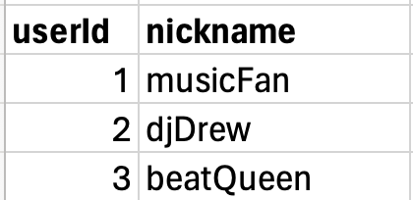
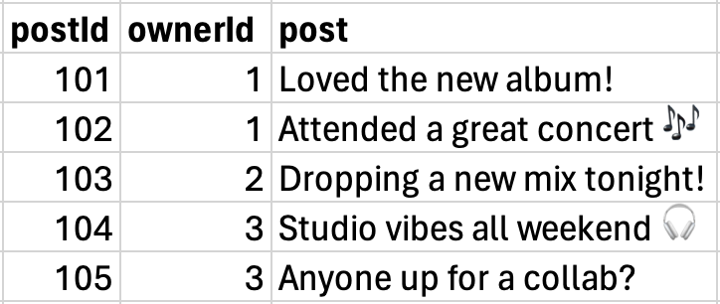
One to Many
Notes:
Explain why list was private

Slide 26
One to Many
Notes:
Explain why list was private

Slide 27
One to Many
Notes:
Explain why list was private

Slide 28
One-to-Many Relationship: Musician and Songs
Our song data is in one table (Song)
Our musician info is in another table (Musician)
We want to see both in the same result and to achieve this we use ’Joins’
Notes:
Explain why list was private

Slide 29
Getting Data from Two Tables Together (Using INNER JOIN)
Syntax:
SELECT column1, column2, ...
FROM table1
JOIN table2
ON table1.common_column = table2.common_column;

Slide 30
Summary
1) Language used to describe databases
2) Creating and Deleting Tables
3) CRUD operations
4) Table relationship (One to Many)
5) Inner Join

