Slide 1
Cybersecurity in the Power Grid
Notes:
Good morning/afternoon, everyone. Welcome to this session on Cybersecurity in the Power Grid. Today, our electrical grids are undergoing unprecedented digital transformation. While digitization brings immense efficiency, automation, and visibility, it also dramatically expands the attack surface of our critical infrastructure. Over the next 45 minutes, we’ll explore the regulatory landscape, examine real-world incidents, and see hands-on how modern energy automation systems like SIPROTEC 5 and SICAM protect the grid by design.

Slide 2
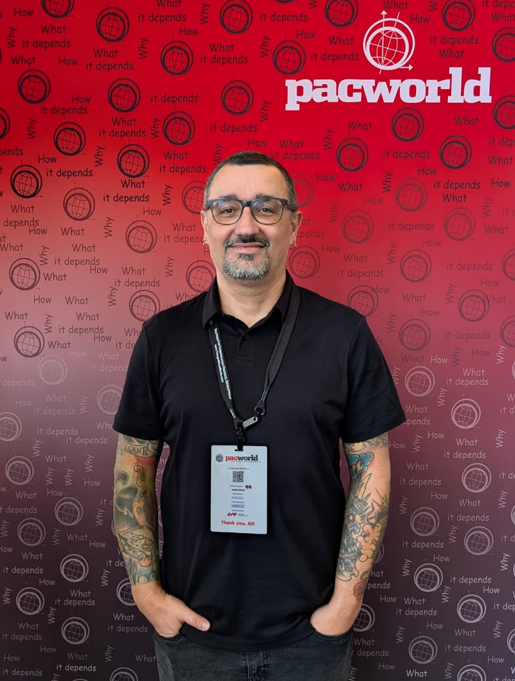
whoami /all
  Brazilian
  26 years of experience in the energy automation sector
  Electrotechnical technician (this is how I started on this field)
  Graduated in Computer Networks
  Postgraduate / Specialization in Cyber Security
  GNU / Linux enthusiast – Debian user
Unrestricted | © Siemens 2026
Notes:
Just talk about me and my experience

Slide 3
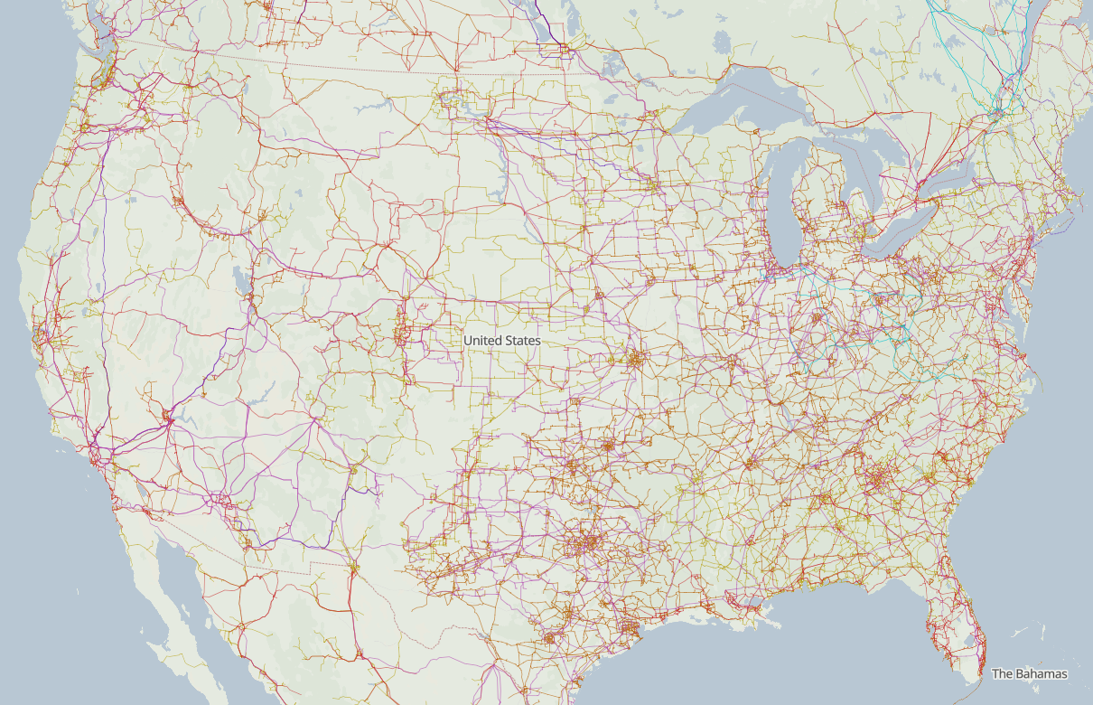
USA Electrical Grid
Unrestricted | © Siemens 2026
Source: openinframap.org -> https://openinframap.org/#4.15/39.29/-99.84
Notes:
To understand the stakes, look at this map of the U.S. power transmission grid. It is arguably the most complex machine ever built by humanity—thousands of generating units, tens of thousands of substations, and hundreds of thousands of miles of high-voltage transmission lines. Historically, we relied on physical isolation and the myth of the 'air gap.' Today, with remote engineering, centralized control centers, DER integration, and IP-based protocols, almost every corner of this map is interconnected. Protecting this physical mesh requires securing its digital nervous system.

Slide 4

USA Electrical Grid
Unrestricted | © Siemens 2026
Source: openinframap.org -> https://openinframap.org/#4.15/39.29/-99.84

Slide 5
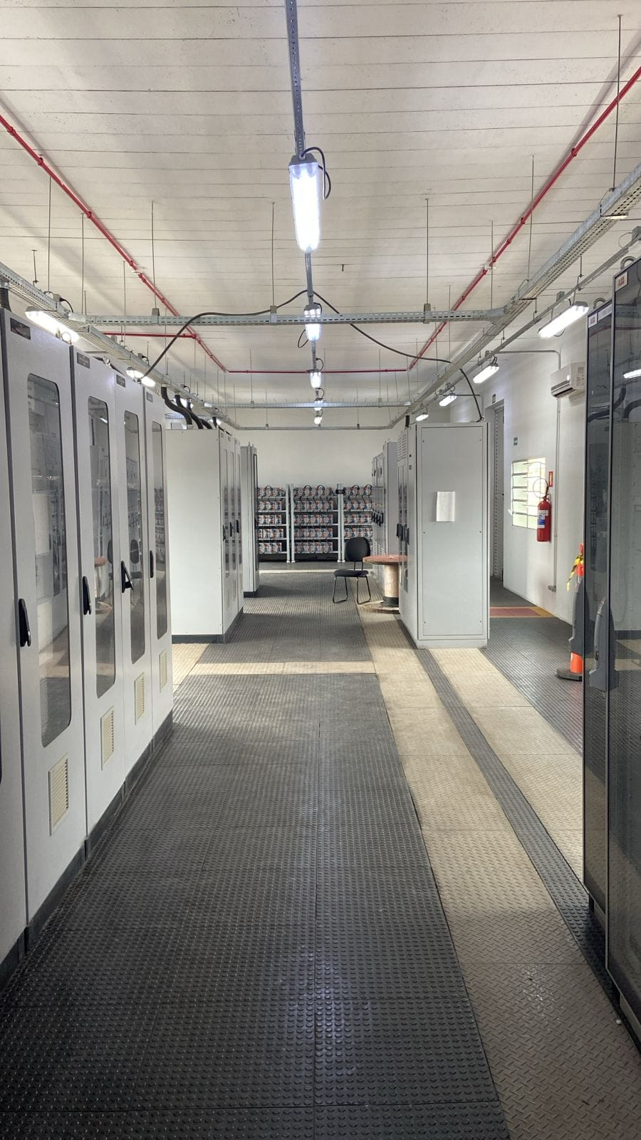
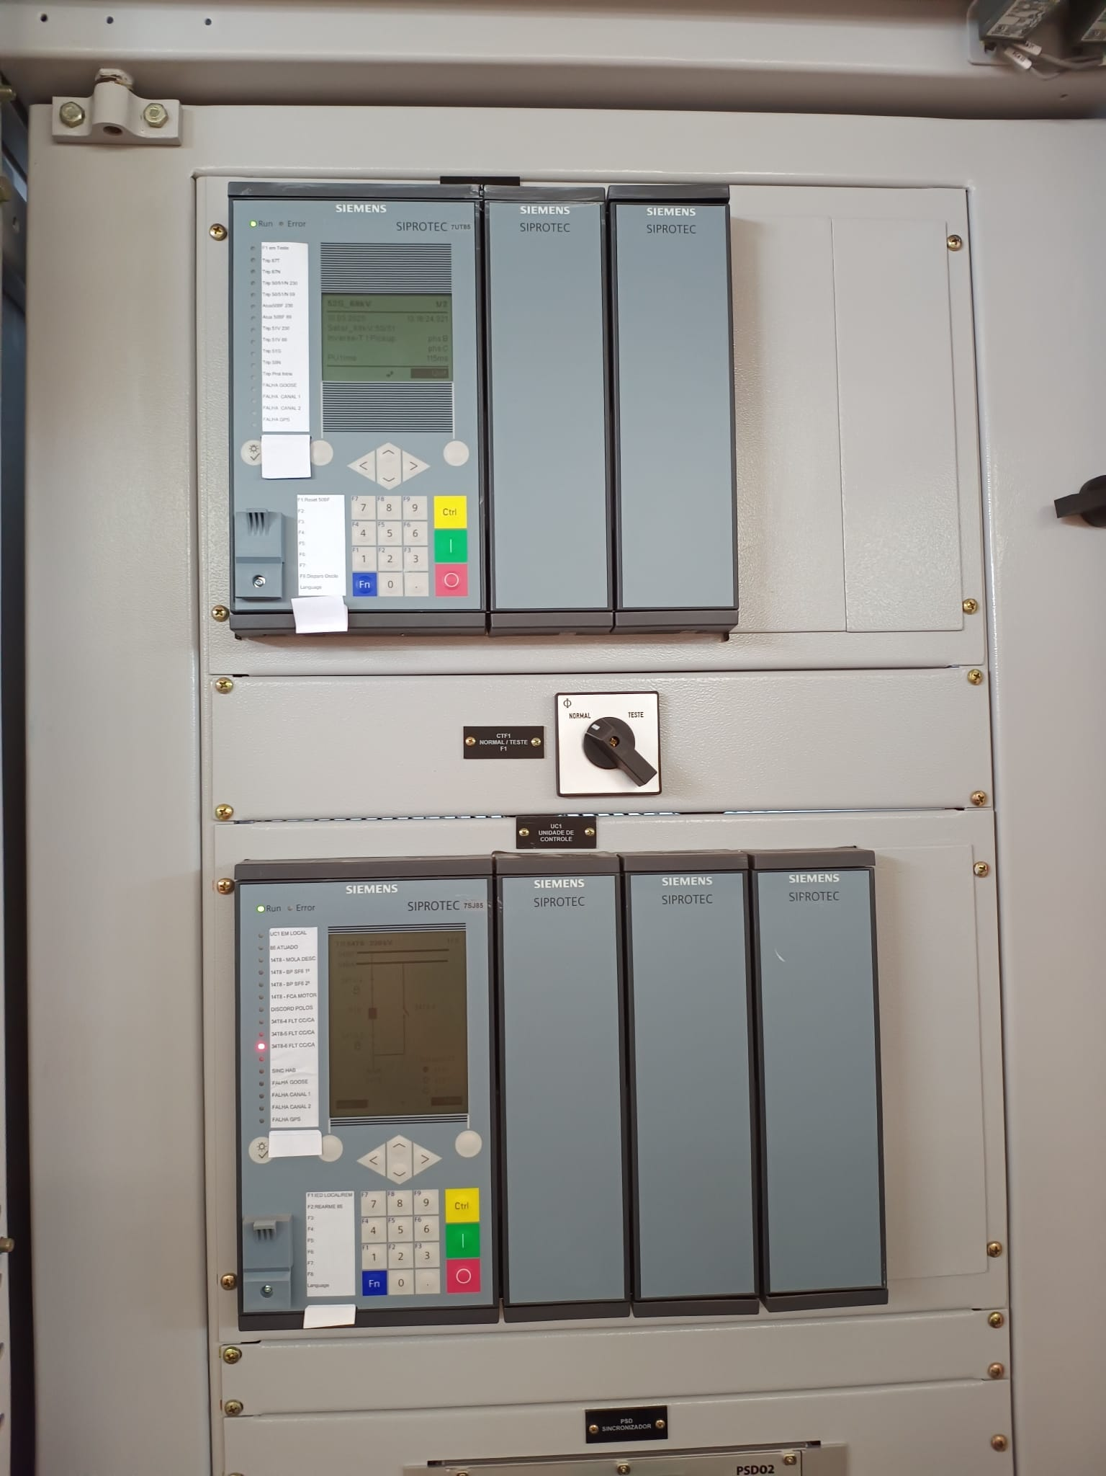
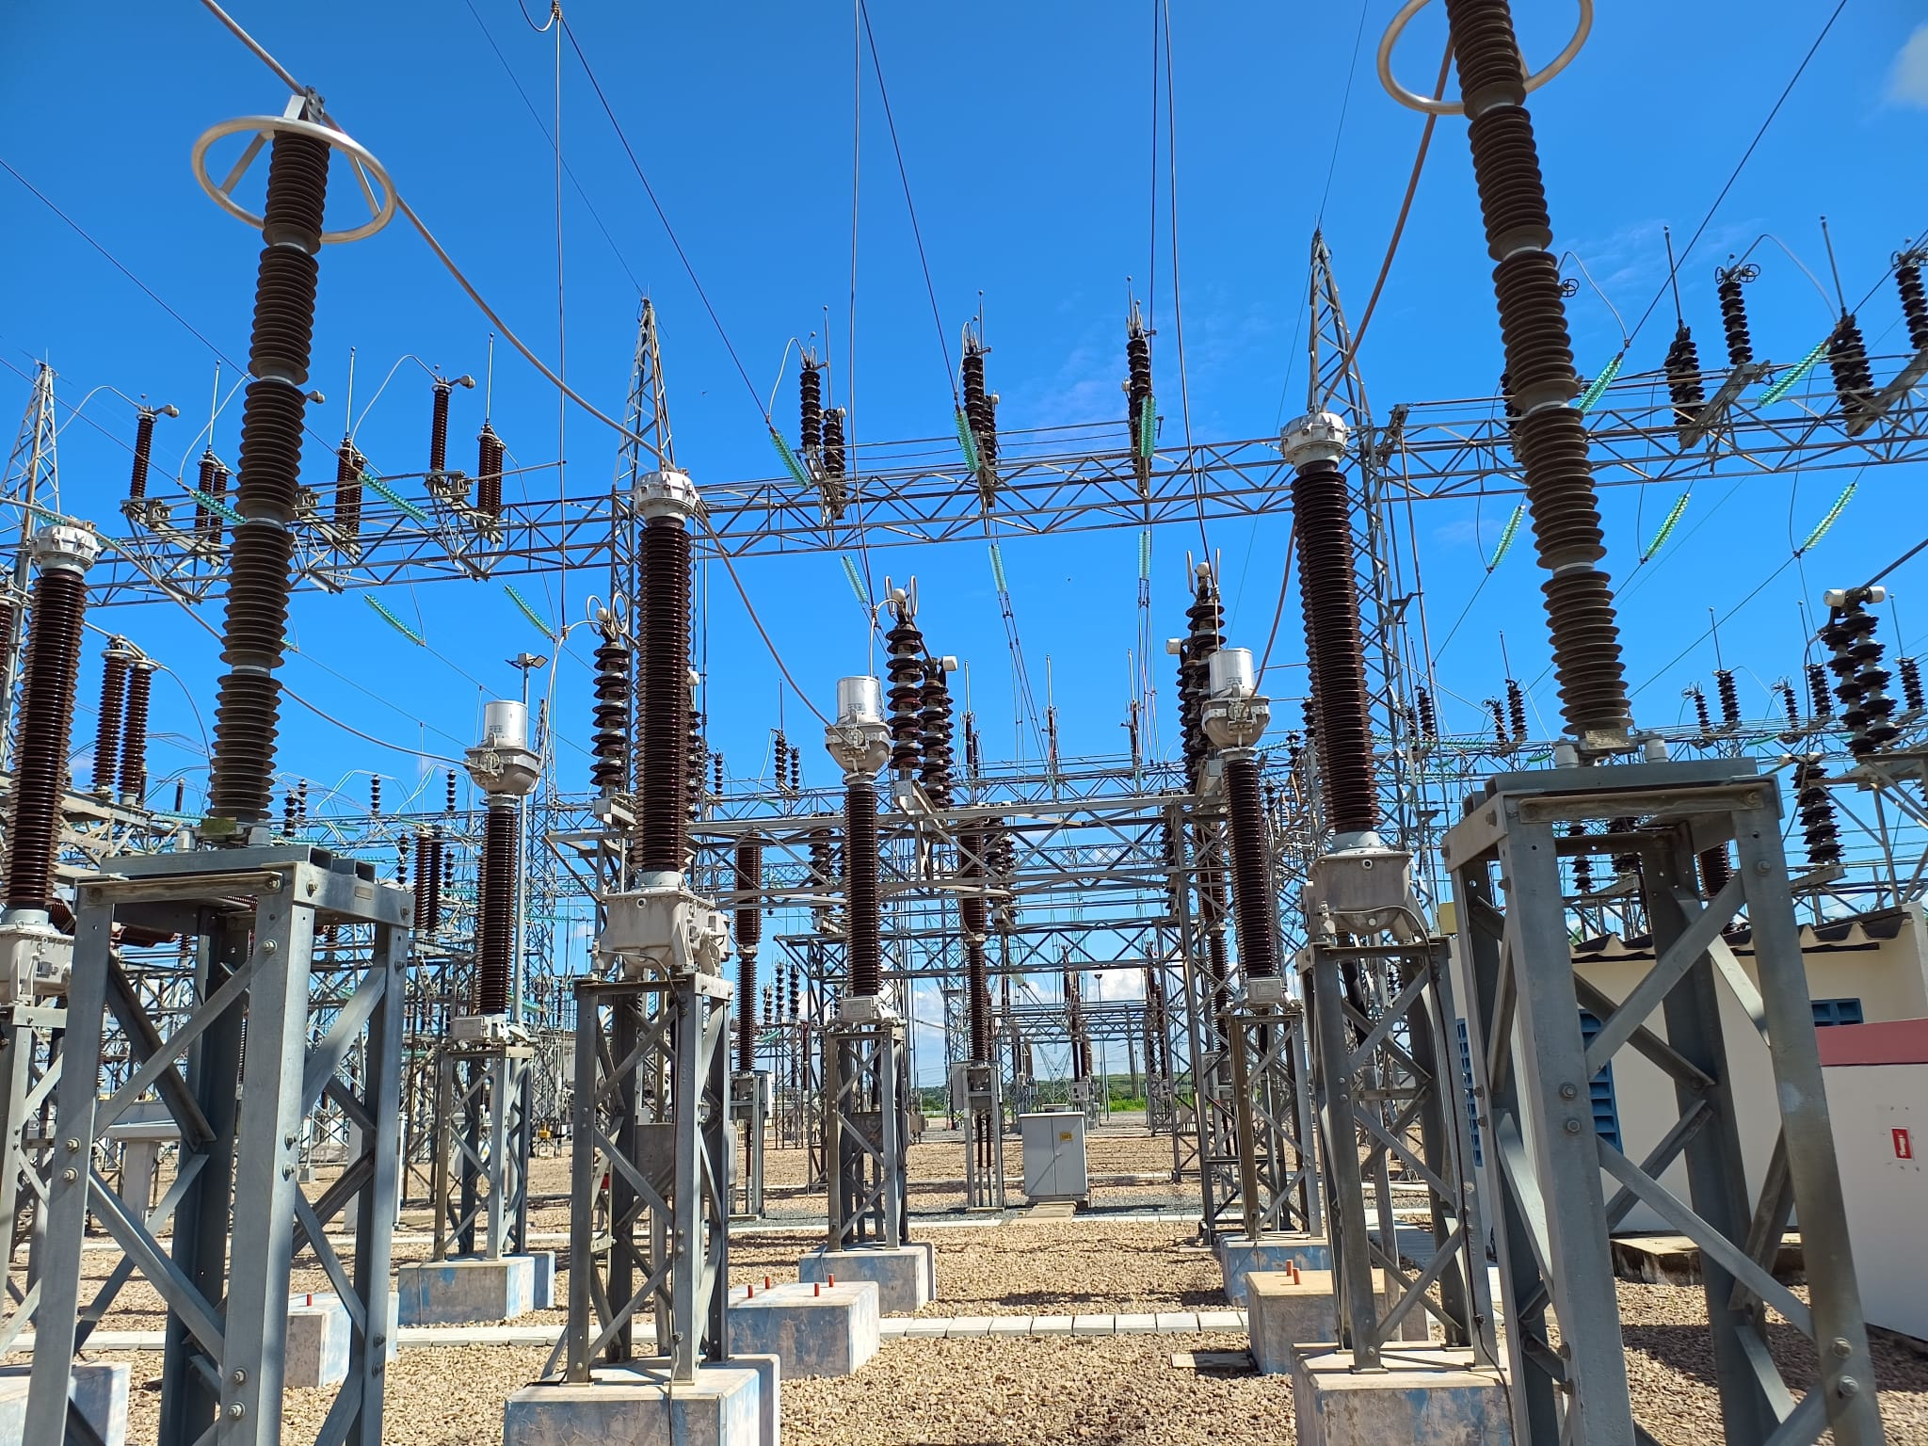
OT (Operational Technology) Infrastructure for power grids – Protection and Automation
Unrestricted | © Siemens 2026
Notes:
Here we see the bridge between the physical and digital worlds: from the high-voltage switchyard on the left, through central operational data centers, to the control panels housing our protection and automation devices. In traditional enterprise IT, confidentiality is king. In power systems OT, the order is reversed: Safety and Availability come first. When a fault occurs on a 500 kV line, our relays must clear it within cycles. That means cybersecurity measures cannot add latency or lock out operators during an emergency. Security must support reliability, not hinder it

Slide 6
NERC CIP
Mandatory cybersecurity standards for the North American grid
  What is NERC CIP?
  The North American Electric Reliability Corporation (NERC) is the Electric Reliability Organization (ERO).
  The Critical Infrastructure Protection (CIP) Reliability Standards define the mandatory, auditable cyber and physical security requirements that protect the Bulk Electric System (BES).
Bulk Electric System (BES)
Who must comply
Transmission elements operated at 100 kV or higher
Generating units > 20 MVA or plants > 75 MVA connected at ≥ 100 kV
Blackstart resources and their cranking paths
Registered entities, e.g. Transmission Owners/Operators, Generator Owners/Operators
Balancing Authorities, Reliability Coordinators, Distribution Providers
Enforcement
Penalties
NERC and six Regional Entities: MRO, NPCC, RF, SERC, Texas RE, WECC
Audits, spot checks, self-reports and self-certifications
Over US$1 million per violation, per day (inflation-adjusted)
Plus mitigation plans and reputational impact
Unrestricted | © Siemens 2026
Source: NERC -> https://www.nerc.com/standards/reliability-standards/cip
Notes:
NERC CIP standards are mandatory and enforceable. NERC and the Regional Entities monitor and enforce compliance. Non-compliance carries severe consequences—audits are rigorous, and fines can exceed one million dollars per day per violation, not to mention the reputational cost

Slide 7
NERC CIP
Mandatory requirements: the CIP standards at a glance
Standard | Topic | Key mandatory requirements
CIP-002 | BES Cyber System Categorization | Identify and categorize BES Cyber Systems as high, medium or low impact; review every 15 months
CIP-003 | Security Management Controls | Cybersecurity policies, CIP Senior Manager, security plan for low impact assets
CIP-004 | Personnel & Training | Security awareness, role-based training, personnel risk assessments, timely access revocation
CIP-005 | Electronic Security Perimeters | ESP with access points, deny-by-default rules, secure Interactive Remote Access with MFA
CIP-006 | Physical Security of BES Cyber Systems | Physical security plan, access control and logging, visitor control
CIP-007 | System Security Management | Ports and services, patch evaluation every 35 days, malware prevention, event logging, account control
CIP-008 | Incident Reporting & Response Planning | Incident response plan, testing every 15 months, reporting to E-ISAC and CISA
CIP-009 | Recovery Plans | Recovery plans, backup and restore of BES Cyber Systems, regular testing
CIP-010 | Configuration Change Mgmt. & Vulnerability Assessments | Baseline configurations, change control, vulnerability assessments, transient cyber assets
CIP-011 | Information Protection | Identify, protect and securely dispose of BES Cyber System Information
CIP-012 | Communications between Control Centers | Protect confidentiality and integrity of real-time assessment and monitoring data
CIP-013 | Supply Chain Risk Management | Supply chain risk management plans for vendor products and services
CIP-014 | Physical Security | Risk assessment and physical security plans for critical transmission stations
CIP-015 | Internal Network Security Monitoring | Monitor traffic inside the ESP to detect anomalous activity (high and medium impact)
Unrestricted | © Siemens 2026
Source: NERC -> https://www.nerc.com/standards/reliability-standards/cip
Notes:
This table summarizes the CIP framework from CIP-002 through CIP-015. Notice how comprehensive it is: CIP-005 mandates strict Electronic Security Perimeters and multi-factor authentication for remote access. CIP-007 requires patch evaluations every 35 days and port lockdown. CIP-010 enforces baseline change management. Most recently, CIP-015 requires internal network monitoring to detect anomalous lateral movement inside the perimeter. Our engineering architectures must be designed from day one to satisfy these specific audit requirements

Slide 8
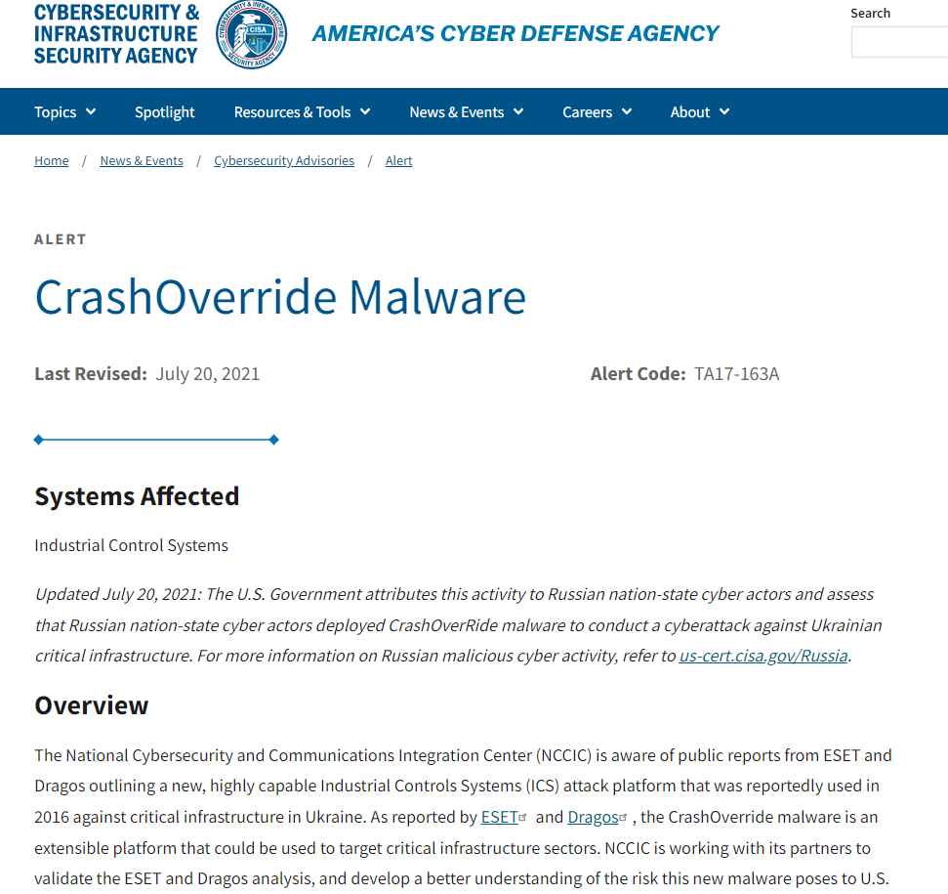
Cybersecurity
  Examples of malware targeting the energy sector.
  Industroyer / Crashoveride
  Campaign happens in Ukraine on December 17th, 2016
  CISA alert about the malware
Unrestricted | © Siemens 2026
Source -> CrashOverride Malware | CISA
Notes:
Regulations exist because threat actors have proven they can disrupt physical power. The most landmark example is Industroyer, also known as Crashoverride, which struck Ukraine's transmission grid in December 2016. As detailed in the CISA advisory shown here, this was not generic ransomware or IT malware that accidentally spilled over—it was the first publicly known malware specifically engineered to speak power system protocols natively and open transmission breakers directly.

Slide 9
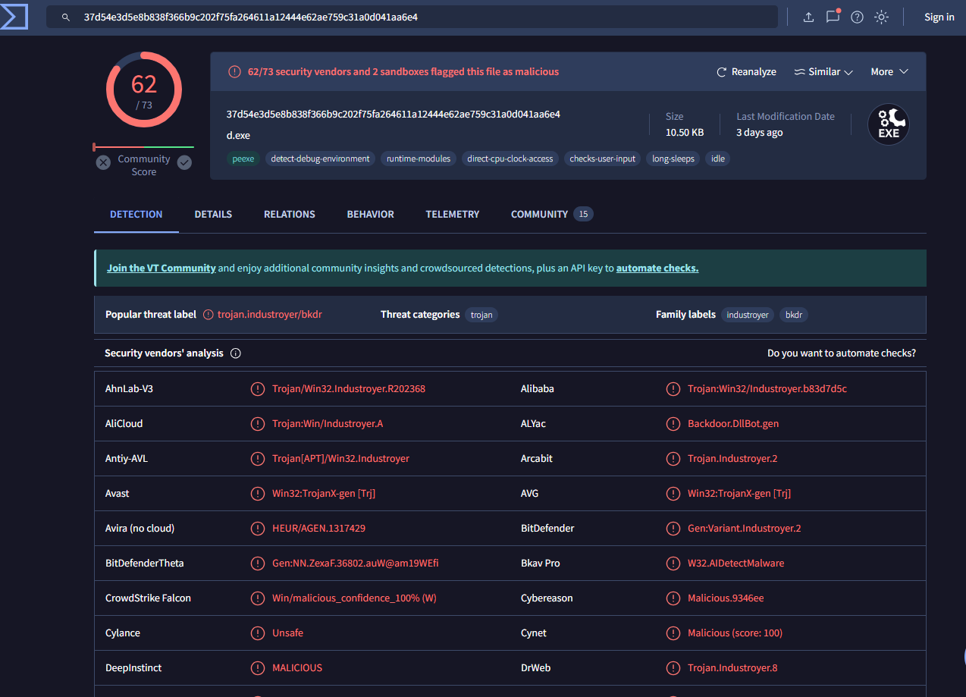

Cybersecurity
  A sample of this malware checked on Virus Total.
Unrestricted | © Siemens 2026
Source -> VirusTotal - File - 37d54e3d5e8b838f366b9c202f75fa264611a12444e62ae759c31a0d041aa6e4
Notes:
When researchers analyzed the binaries on VirusTotal, the findings were chilling. The attacker didn't need to exploit zero-days in the operating system; they used custom protocol modules for IEC 104, IEC 61850, and OPC. The malware legitimately spoke the language of the substation. It issued standard telecontrol commands to trip circuit breakers, then looped indefinitely to re-open them if the operator tried to close them. Historically, our operational protocols assumed trust on the wire. This attack proved that assumption is dead

Slide 10
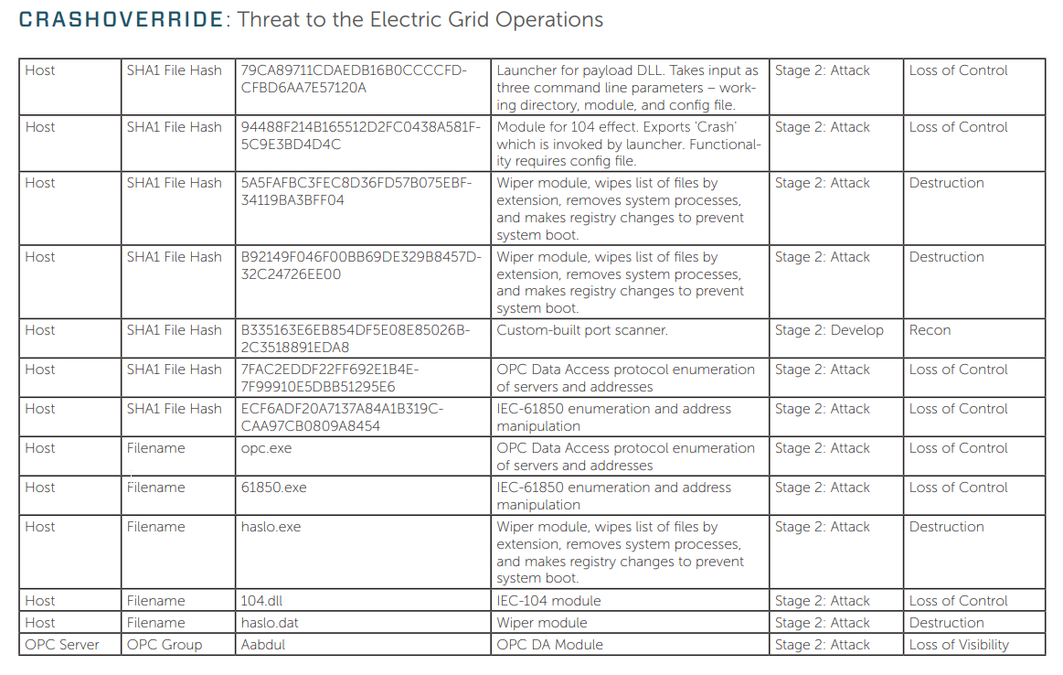
Cybersecurity
  OPC UA - Open Platform Communications Unified Architecture.
  IEC 61850 is a standard with various protocols for energy.
  IEC 608070-4-5-104 is standard for 104 protocol. It’s a telecontrol protocol for long distance, commonly used in Europe.
Unrestricted | © Siemens 2026
Source -> www.dragos.com - Dragos Report – Crashoverride Analysis of the Threat to Electric Grid Operations – version: 2.20170613
Notes:
The Dragos report highlighted on this slide unpacks the modular design of Crashoverride. The adversary paired OT protocol execution with wiper modules that deleted configuration files and corrupted system drives. Their objective was twofold: execute physical de-energization in the field, and simultaneously blind the control center operators so they had no situational awareness to respond. That combination is lethal to grid reliability.

Slide 11
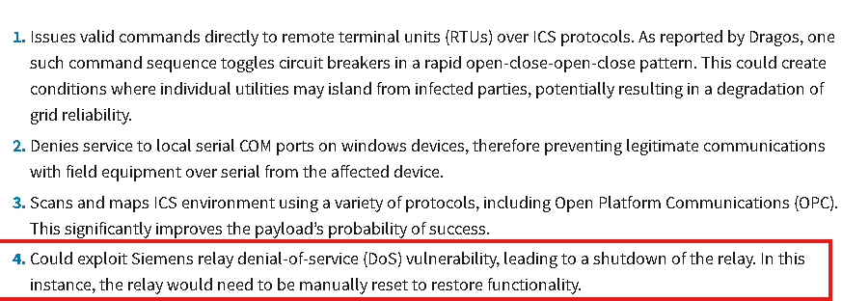
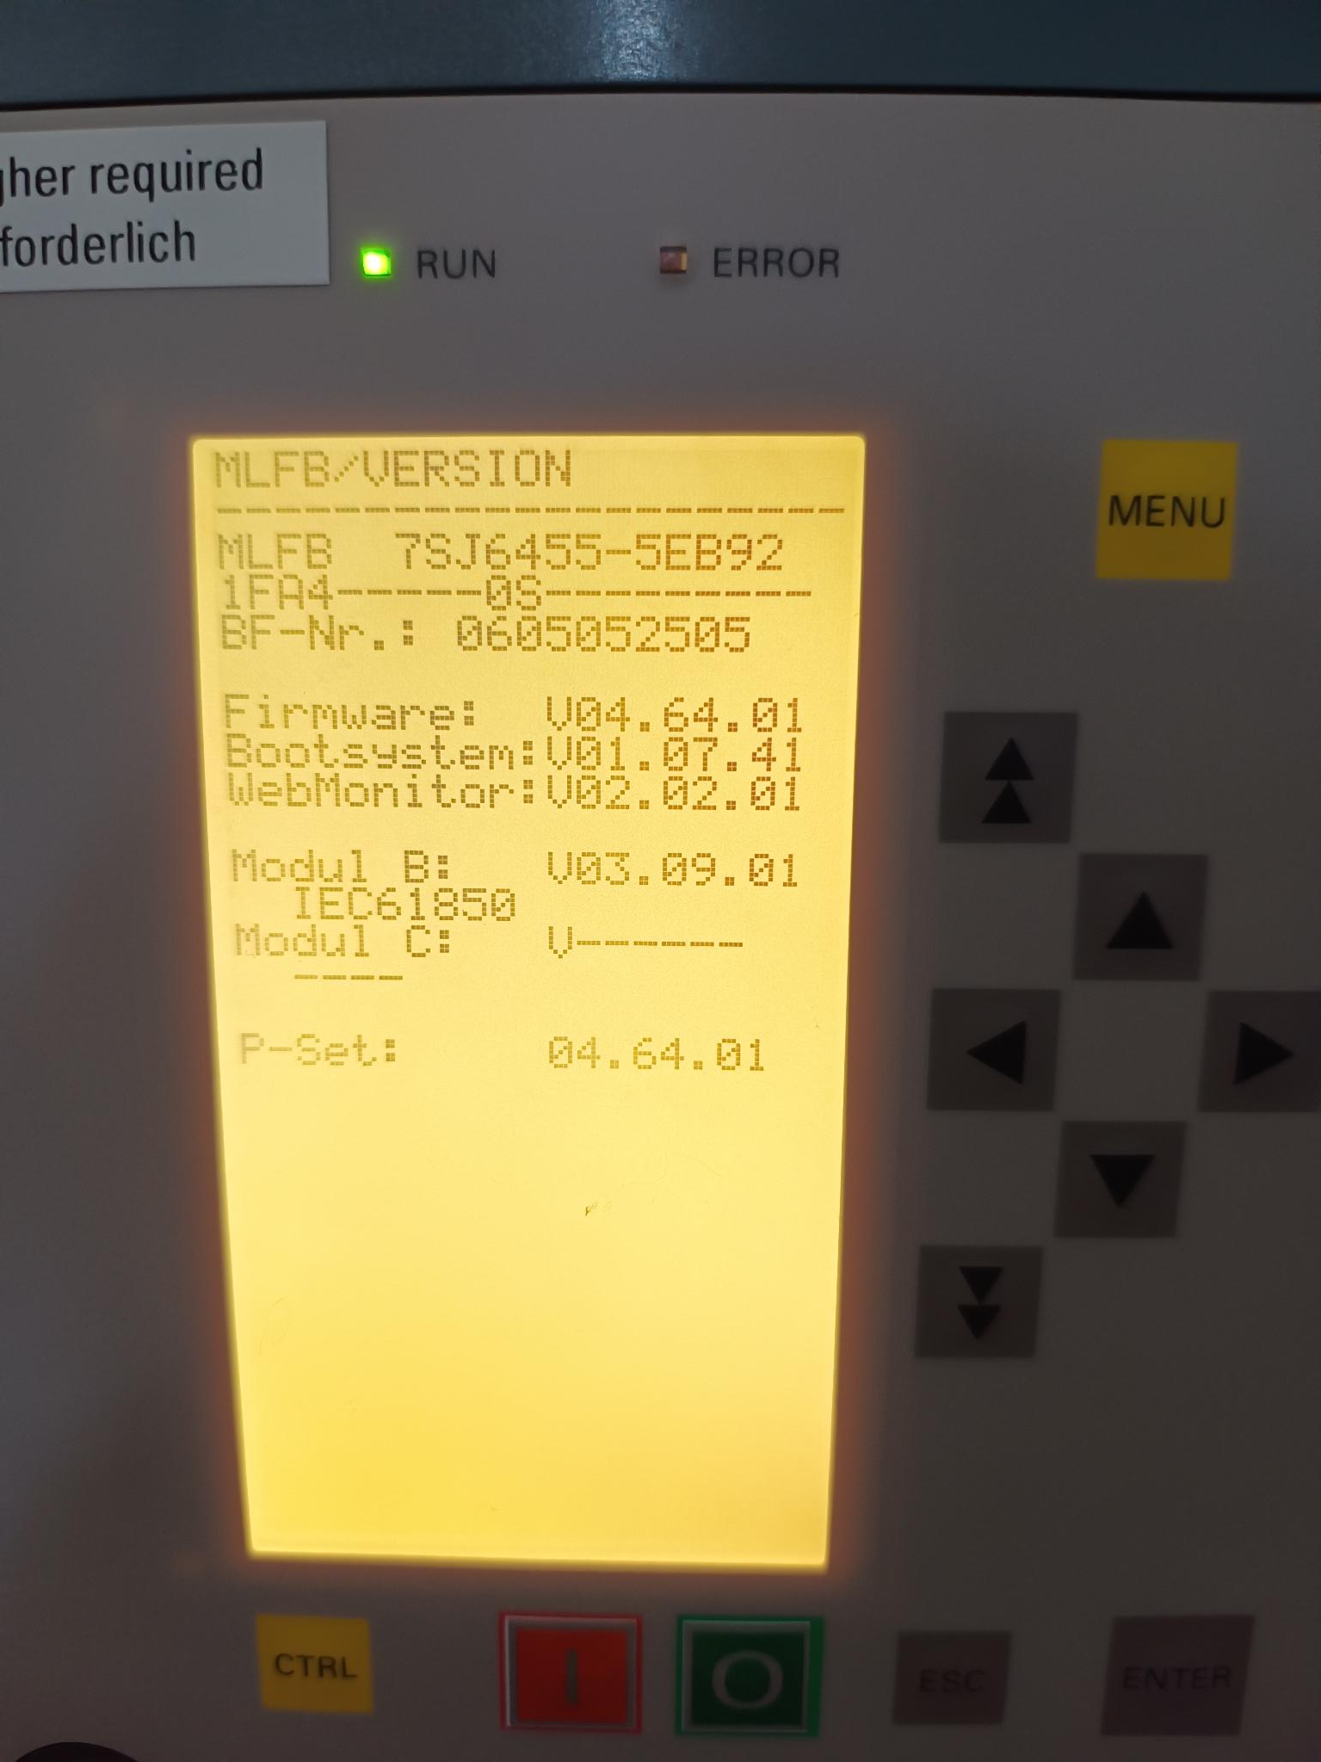
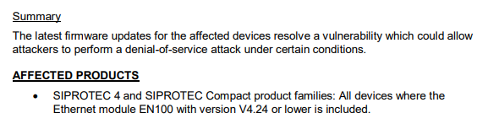
Cybersecurity – Denial of Service “DoS”
Unrestricted | © Siemens 2026
Source -> CrashOverride Malware | CISA
Notes:
CrashOverride, also known as Industroyer, was malware built to interact with power-system protocols. Its capabilities included issuing commands to disrupt grid operations, while destructive components could impair recovery. The CISA advisory shown here is a reminder that threats to operational technology can affect both control and availability.

Slide 12
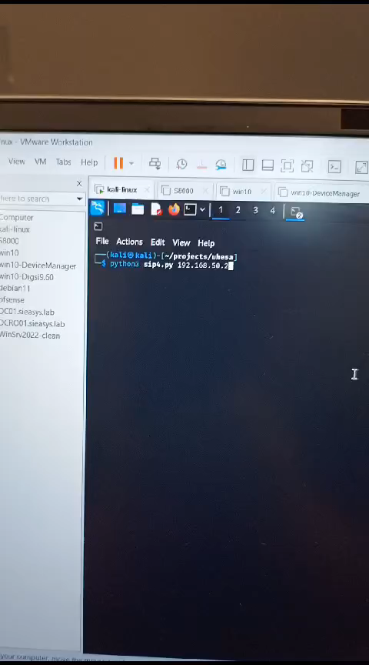
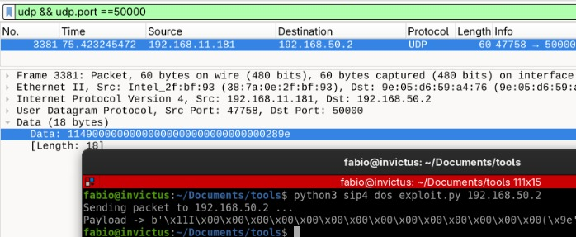
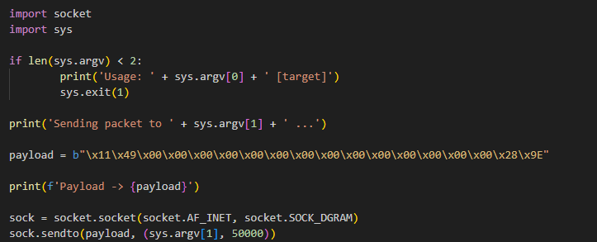
Cybersecurity
Demonstration of an attack on a SIPROTEC 4
Unrestricted | © Siemens 2026
Notes:
This video demonstrates an actual Denial-of-Service exploit against an outdated SIPROTEC 4 EN100 communication module running firmware older than V4.25. By sending specially crafted network packets, an attacker can freeze the communications processor. The relay might still trip locally on an overcurrent curve, but it stops communicating with SCADA, remote tripping fails, and GOOSE messaging halts. Siemens patched this vulnerability years ago, but the patch only protects you if you actually deploy it.

Slide 13
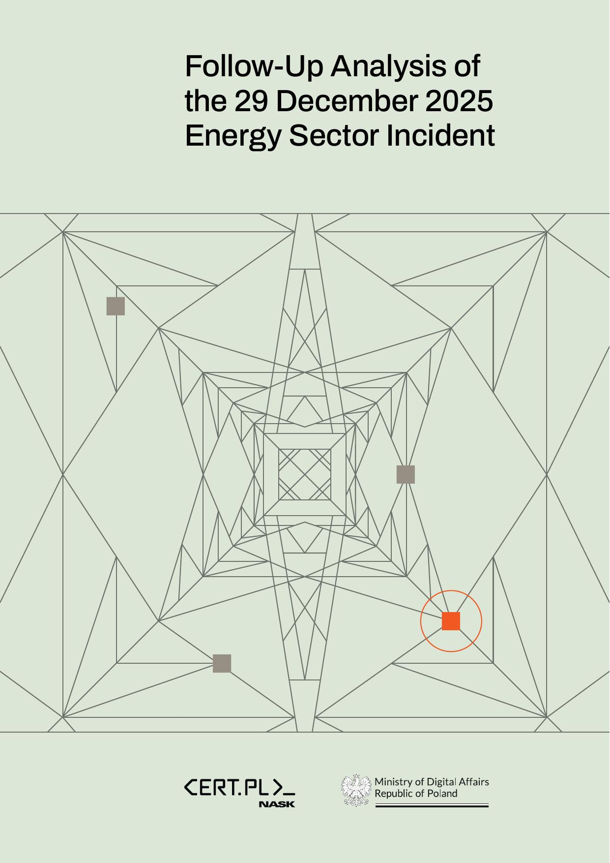
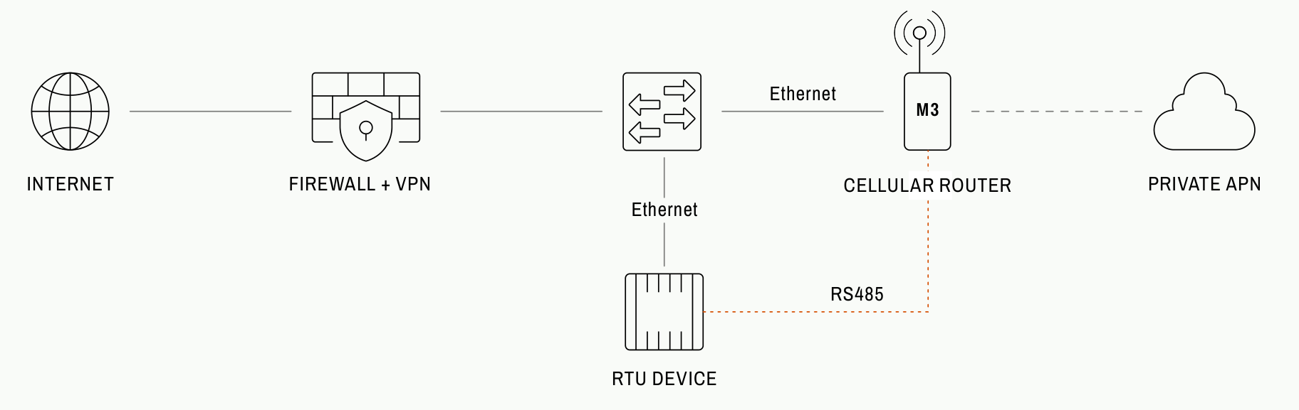
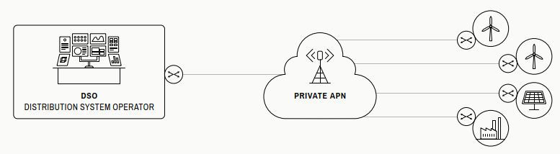
Poland case 2025
Unrestricted | © Siemens 2026
Source -> https://cert.pl/en/posts/2026/01/incident-report-energy-sector-2025/
Notes:
Recent, highly sophisticated real-world incident investigated by CERT Polska in late 2025/early 2026.
Multi-stage attack targeting renewable energy generation (wind/solar) and combined heat and power (CHP) facilities.
Architecture exploited: Internet → Edge Firewall → Cellular Router (APN) → RTU / Field PLCs.
Let's move to a very recent, highly instructive case study: the 2025 attacks on Poland's energy sector, documented by CERT Polska. This was not a theoretical lab exercise—it was a coordinated attack targeting distributed energy resources and cogeneration plants. This diagram shows the entry path: the attackers penetrated an edge perimeter device, pivoted across private APN cellular links, and reached field RTUs and PLCs. Let’s break down the attack chain.

Slide 14
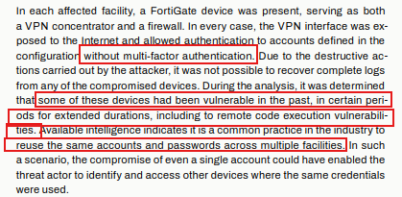
Poland case 2025
Initial Access Firewall
  Internet-accessible FortiGate VPN interface without multi-factor authentication.
  Some devices had known vulnerabilities; CERT did not confirm exploitation in this attack.
  Credential reuse was considered a possible risk; the exact initial credential was not established.
Unrestricted | © Siemens 2026
Source -> https://cert.pl/en/posts/2026/01/incident-report-energy-sector-2025/
Notes:
The VPN interface on the FortiGate firewall was internet-accessible and did not require multi-factor authentication.
Some devices had previously been vulnerable to known issues; CERT did not confirm that a vulnerability was exploited in this attack.
CERT considered credential reuse a possible risk. The report does not establish the exact initial credential or a lack of Active Directory as the cause.

Slide 15
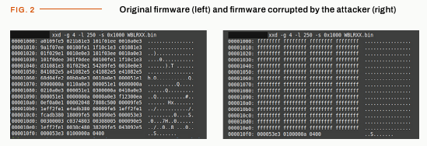


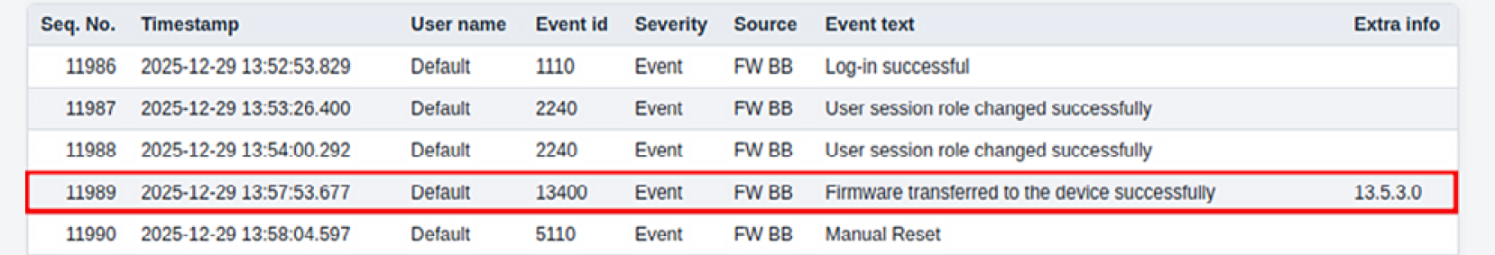
Poland case 2025
Corrupted firmware caused RTU reboot loops
  Affected RTUs were configured with a default account.
  Secure update verification required activation on supported versions; a bypass vulnerability also existed.
  Reboot loops disrupted DSO communications and remote control; ongoing electricity generation continued.
Unrestricted | © Siemens 2026
Source -> https://cert.pl/en/posts/2026/01/incident-report-energy-sector-2025/
Notes:
Hitachi RTU560 controllers at the affected renewable-energy facilities were configured with a default account.
On supported versions, secure update verification required activation; CERT also identified a vulnerability that could bypass it.
Corrupted firmware caused reboot loops and loss of DSO communications and remote control; electricity generation continued.
At the affected renewable-energy sites, attackers logged into Hitachi RTU560 controllers using the configured Default account and uploaded corrupted firmware. On supported versions, secure update signature verification required explicit activation, and CERT noted a vulnerability that could bypass it. The corrupted firmware caused reboot loops and loss of communication and remote control, but did not stop ongoing electricity generation.

Slide 16


Poland case 2025
Detailed reports on these QR codes
  Energy Sector Incident Report - 29 December 2025
Follow-Up Report of the December 2025 Energy Sector Incident
Unrestricted | © Siemens 2026
Notes:
These QR codes link to CERT Polska's initial incident report and its follow-up analysis. Together, they provide the source details behind the case study.

Slide 17
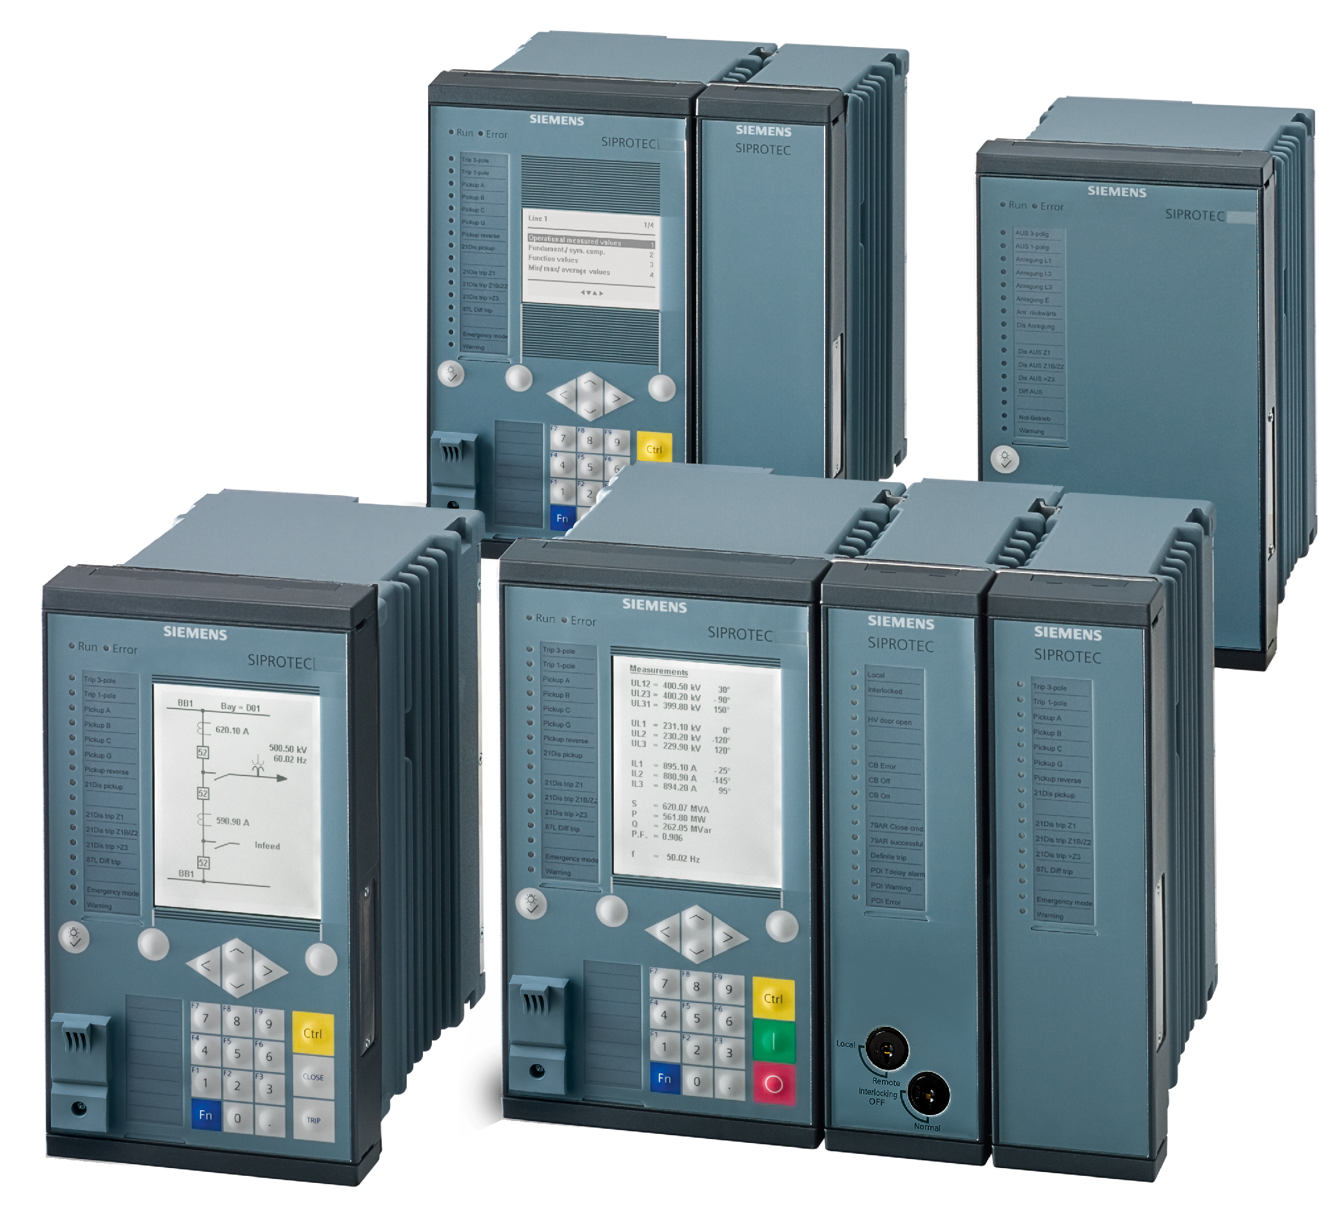
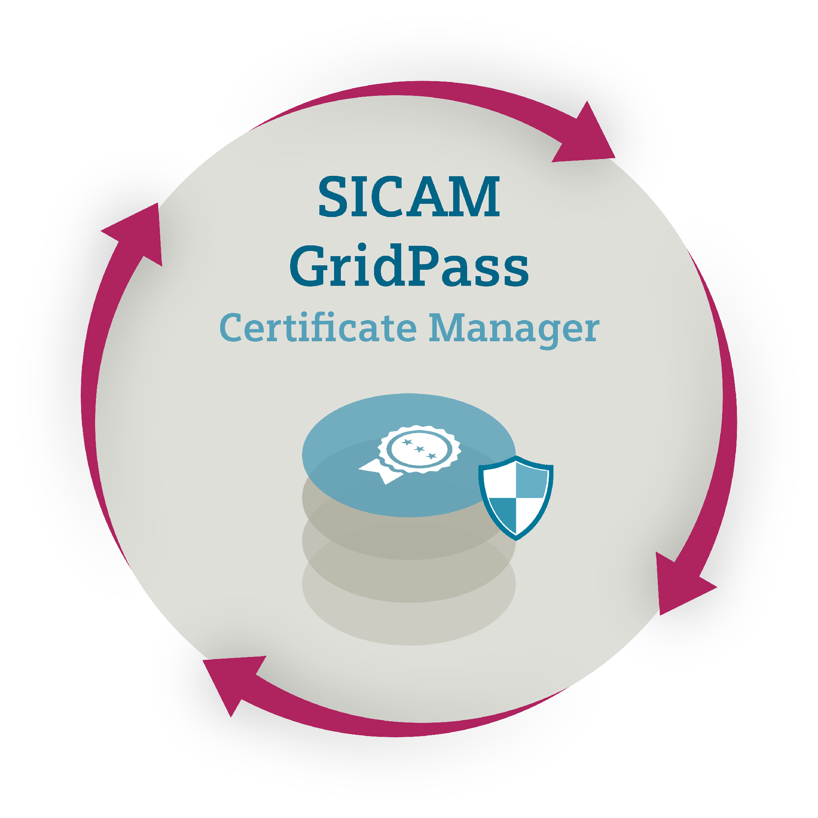
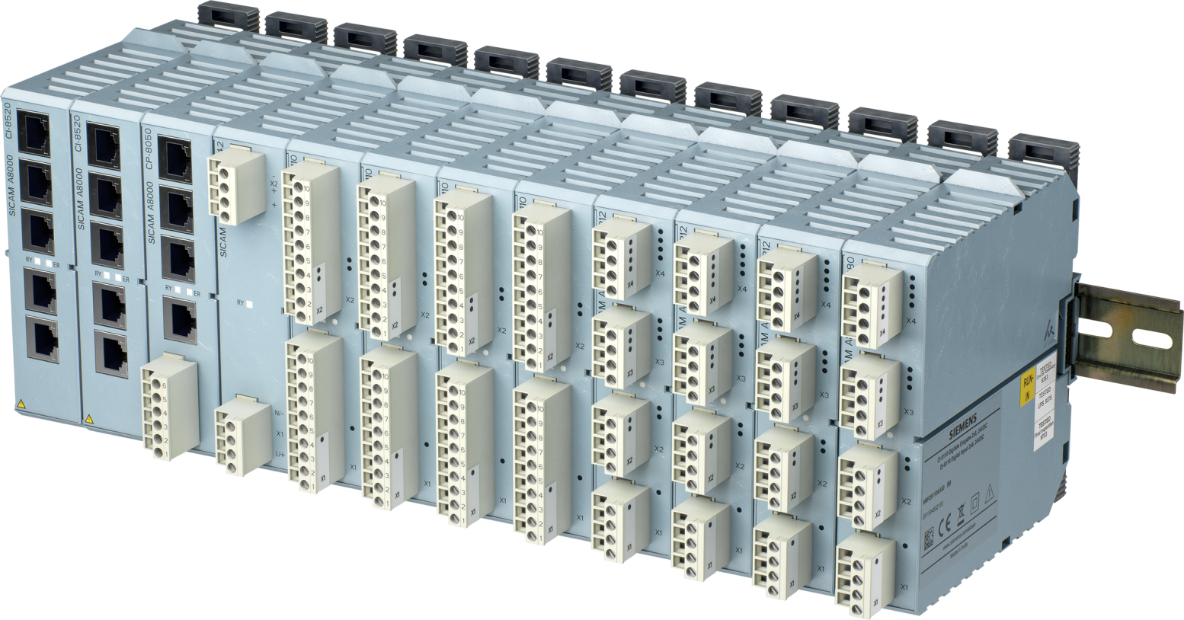
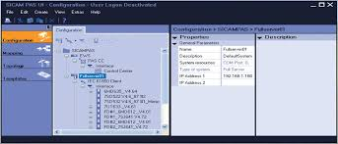
Cybersecurity in Power Systems
Security by default in products
Digitally signed software/firmware
X.509 Certificate Management
Protection against firmware/software tampering
Simplified X.509 certificate management with SICAM GridPass
Firewall & VLAN
SICAM A8000 Gateway Functionalities
Segregation of Ethernet network traffic using VLANs and firewall rules
Security with VPN tunnels & TLS
Secure IEC 60870-5-104,
IEC 61850, DNP3i protocols
Application firewall by default in SICAM A8000
Security logs
RBAC with central user management
BDEW whitepaper and IEEE 1686 compliance
Non-volatile storage of security (audit) logs and log forwarding via Syslog
Central user management and role-based authorization (per IEC 62351-8)
Meets recommendations for the security of control and communication systems
Notes:
<speak>
<prosody rate="90%">
<break time="2s"/>
Siemens has taken a holistic approach for the energy automation portfolio including processes, communication,
employees and technologies.
First, cybersecurity is established in the organization by defined roles, rules and processes;
a governance structure has been implemented according to ISO I E C 27001.
Second, secure product development,
adherent to a secure development lifecycle process such as IEC 6 2 4 4 3 dash 4 dash 1, is part of the product lifecycle management
that satisfies the stringent demands on cybersecurity and incorporates a secure product architecture.
<p/>
The components follow the approach of security by design, and contain essential security functionalities:
<p/> Signed firmware to ensure integrity
<p/> Integrated firewall, where appropriate
<p/> Security logging capabilities
<p/> Role Based Access Control in line with international standards and guidelines
<p/> Conformity to standards and guidelines
<p/> Gateways with TLS based secure communication
<p/> Simple to use interoperable certificate manager as a portfolio element
</prosody>
</speak>

Slide 18
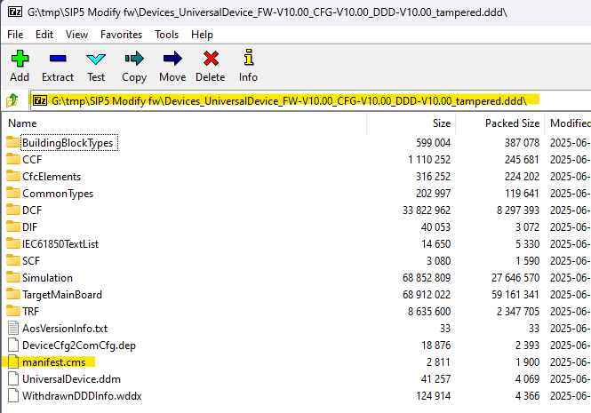

SIPROTEC 5 – Firmware Signature
Signed firmware and integrity protection
  All SIPROTEC 5 firmware is signed by the Siemens Certificate Authority by default. Firmware signature verification is enabled by default and cannot be disabled, so every firmware upload to the device undergoes a signature check to guarantee file integrity.
  The SIP5 firmware is part of the DDD (DIGSI Device Driver) file. This is a ZIP file containing the many files and data required by DIGSI and SIPROTEC 5. The manifest.cms file inside the DDD contains the data about the files and the signature.
Notes:
All SIPROTEC 5 firmware binaries are digitally signed by the Siemens Certificate Authority (CA).
Firmware signature verification is enforced by the device during firmware updates.
Structure of DDD (DIGSI Device Driver) package: A ZIP container housing binaries and a cryptographic manifest (manifest.cms) with PKCS#7 signatures
Unlike the optional secure-update setting described in the Poland case, SIPROTEC 5 firmware is digitally signed and the device checks the signature during firmware updates. A package that fails verification is rejected. This is a product-specific protection against altered firmware, not a claim that every attack path is impossible.

Slide 19
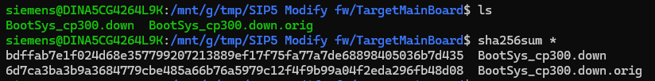
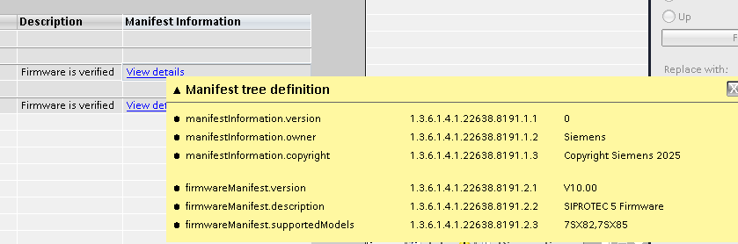
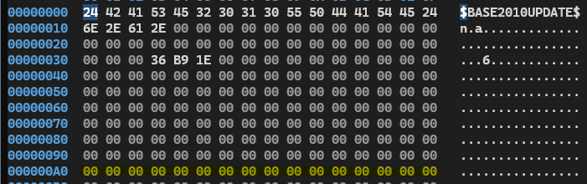
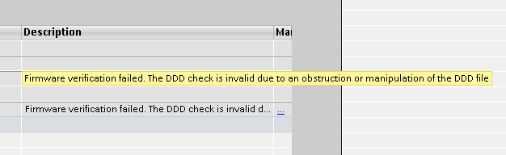
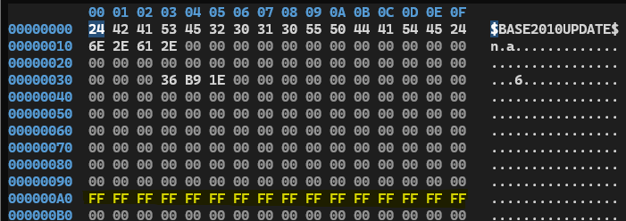
SIPROTEC 5 – Firmware Signature
Tampering test: original vs. manipulated firmware
  BootSys_cp300.down.orig is the original file and BootSys_cp300.down is the tampered file.
Good firmware
Bad firmware (tampered)
Notes:
Laboratory proof-of-concept experiment:
Original file: BootSys_cp300.down.orig
Tampered file: BootSys_cp300.down modified at offset 000000A0 (replacing null bytes with 0xFF).
Repackaged into the DDD file to test whether the device detects byte-level corruption or malicious injection.
"To prove this, we performed a lab tampering test. We took a genuine SIPROTEC 5 bootloader file, opened it in a hex editor, and deliberately changed a handful of zero bytes to FF at offset 000000A0. We repackaged this modified binary back into the DDD driver container and attempted to upload it to a live SIPROTEC 5 relay."

Slide 20
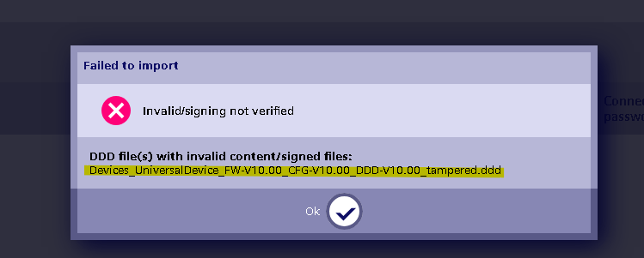
SIPROTEC 5 – Firmware Signature
Signature check rejects altered firmware in this test
Uploading tampered firmware with SIPROTEC Tools
Notes:
In this lab test, the altered firmware package was rejected during upload because signature validation failed. The device did not accept the file. This demonstrates the value of signature validation in this test; it does not mean every possible attack path against the device is impossible.

Slide 21
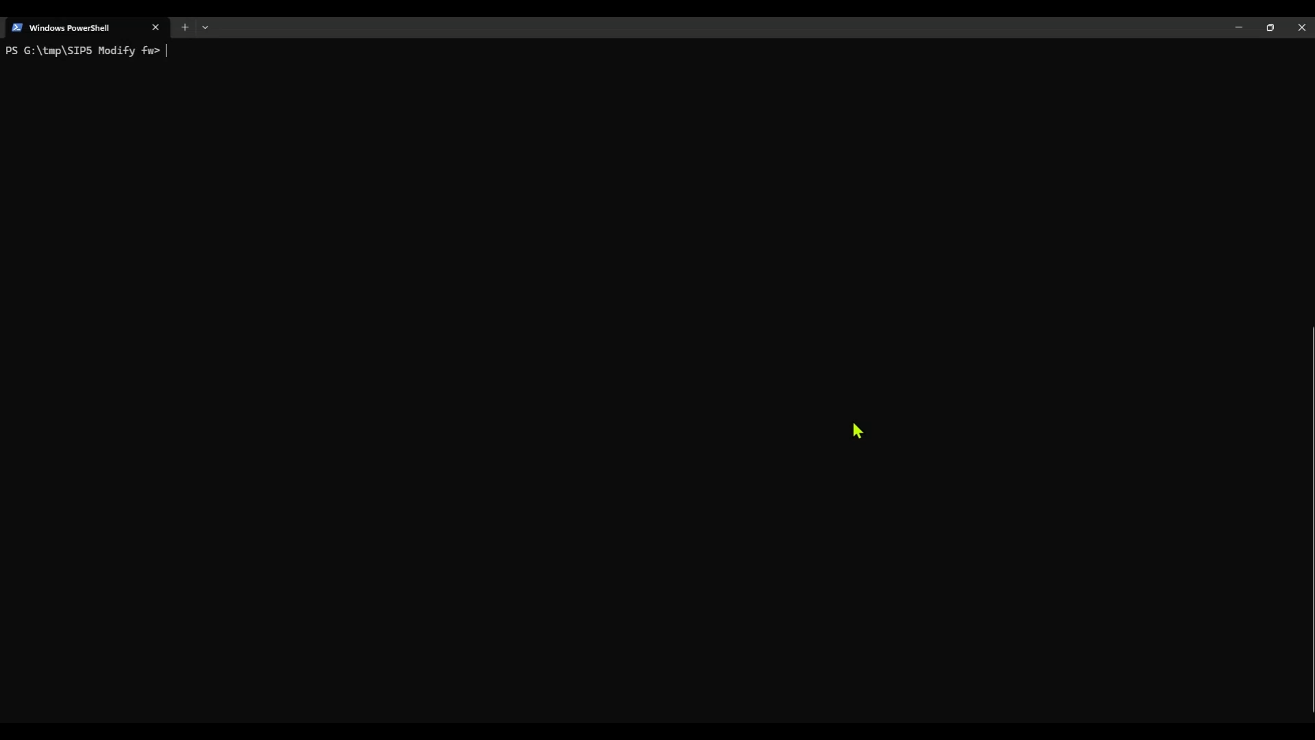

Slide 22
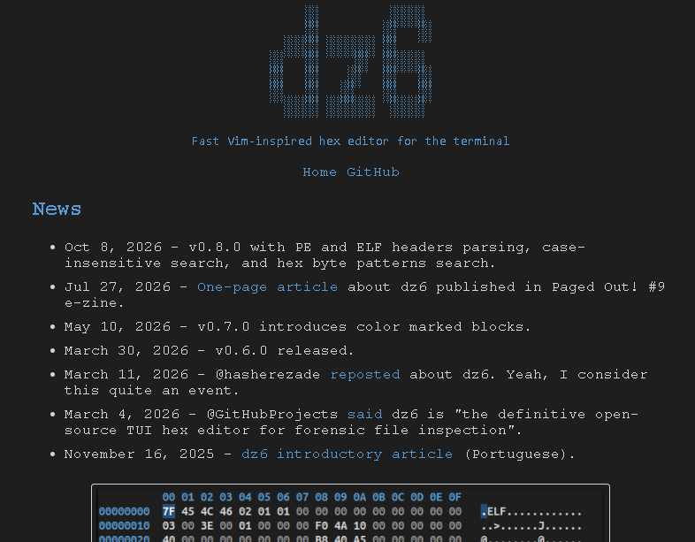

SIPROTEC 5 – Firmware Signature
Hex editor used to manipulate the firmware bootloader
  https://dz6.dev.br/en-us/

Slide 23
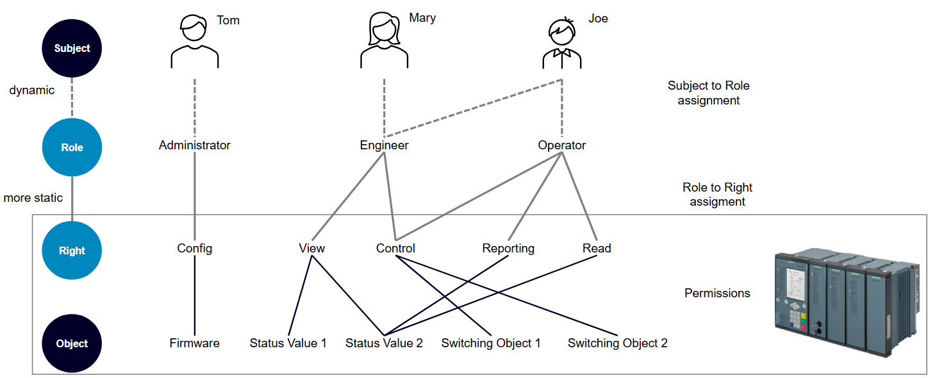
SIPROTEC 5 – RBAC with DIGSI 5
Role-based access control per IEC 62351-8
  Introduction
  Role-based access control (RBAC) is defined by IEC 62351-8. The technology used is Windows Active Directory, widely used in IT networks and increasingly in OT networks.
  The Active Directory Domain Controller (DC) manages users and groups, defining the permissions that each role has on a given service or computer. When the user logs in to the computer, these roles are loaded and DIGSI 5 limits access to the tool, accordingly, ensuring granular, role-based access.
Source: Siemens
Notes:
Standardized under IEC 62351-8 (Role-Based Access Control for power systems).
Implementation utilizes standard Microsoft Windows Active Directory (AD).
Central Domain Controllers manage users, groups, and password policies; DIGSI 5 queries AD upon startup and adjusts user permissions dynamically.
"We didn't invent a proprietary user database. We adopted IEC 62351-8, which defines standard roles for power system management, and built the integration on top of Microsoft Active Directory. Utilities already use Active Directory for their enterprise IT. By extending AD into the OT environment, user provisioning, password rotation, and role assignments are centralized. When an engineer logs into the substation engineering PC, DIGSI 5 dynamically queries the Domain Controller and unlocks only the specific features permitted for their role."

Slide 24
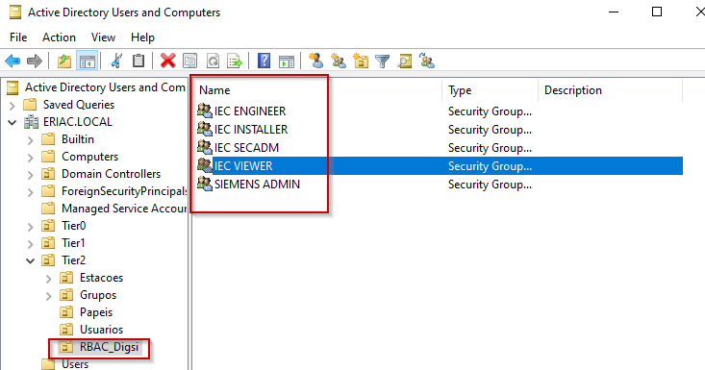
SIPROTEC 5 – RBAC with DIGSI 5
Creating the DIGSI 5 roles in Active Directory
  Create an Organizational Unit (OU) on the DC. Inside this OU, create the roles using the names given in the SIPROTEC 5 Security manual, section “Role-based views in DIGSI 5”.
  The table shows the roles configured on the DC and the equivalent permission level in DIGSI 5.
  A user can have more than one role – for example, Engineer and Viewer at the same time.
Source: Siemens
DIGSI 5 role | Active Directory (AD) group
Administrator | SIEMENS ADMIN
Engineer | IEC ENGINEER
Security Administrator | IEC SECADM
Installer | IEC INSTALLER
Viewer | IEC VIEWER
Source: Siemens
Notes:
Organizational Unit (OU) setup in Active Directory.
Standard security groups mapped directly to DIGSI 5 permission levels:
SIEMENS ADMIN → Administrator (full rights, system configuration)
IEC ENGINEER → Engineer (protection settings, CFC logic)
IEC SECADM → Security Administrator (manage certificates, security logs)
IEC INSTALLER → Installer (firmware updates, hardware upgrades)
IEC VIEWER → Viewer (read-only, oscillography, measurements)
"Setting this up in Active Directory is straightforward. As shown in this table, you create standard AD Security Groups that match the IEC 62351-8 profiles defined in the SIPROTEC 5 Security Manual. For instance, members of 'SIEMENS ADMIN' get full administrator rights, 'IEC ENGINEER' can modify protection parameters and logic, 'IEC SECADM' manages certificates and audit logs, and 'IEC VIEWER' can only view settings and download fault records without modifying anything. A single user can also belong to multiple groups."

Slide 25
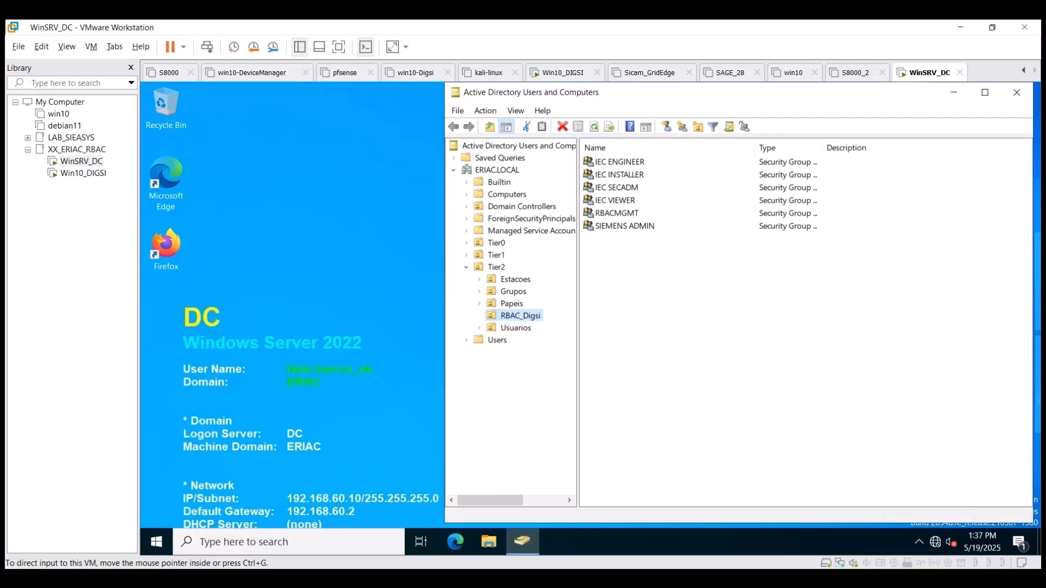

Slide 26
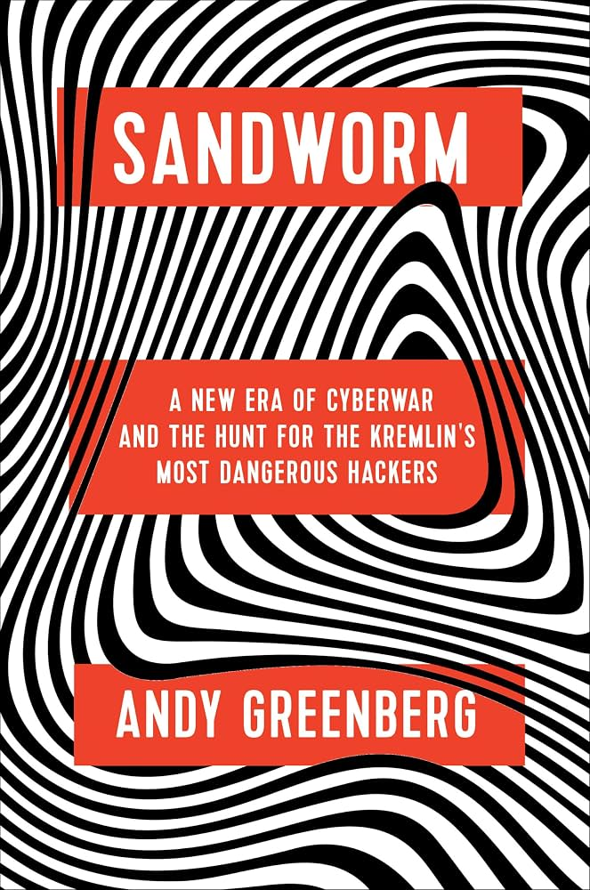
References
Books

Slide 27

Thank You!
Siemens - RC-US SI EA PPA CTP
  Fabio L. P. de Barros
  System Engineer / Customer Technical Partner
  Mobile +1 817 794-0813
  E-mail fabio.de-barros@siemens.com
Notes:
"To wrap up: Cybersecurity in the modern grid is no longer about perimeter firewalls and hope. It is about building resilient systems from the ground up—with signed firmware that cannot be tampered with, rigorous role-based access control, and defense-in-depth architectures certified to IEC 62443. Thank you very much for your time, and I'd be glad to take any questions."

