Slide 1

No Undo: Security for Critical Systems that Need to be Correct
Karthik Pattabiraman
Pritam Dash, Gargi Mitra, Ethan Chan, Chanyuan Liu, Yingao Yao, Alain Zhiyanov, Mehdi Karimibiuki, Guanpeng Li, Aastha Mehta
University of British Columbia (UBC)

Slide 2
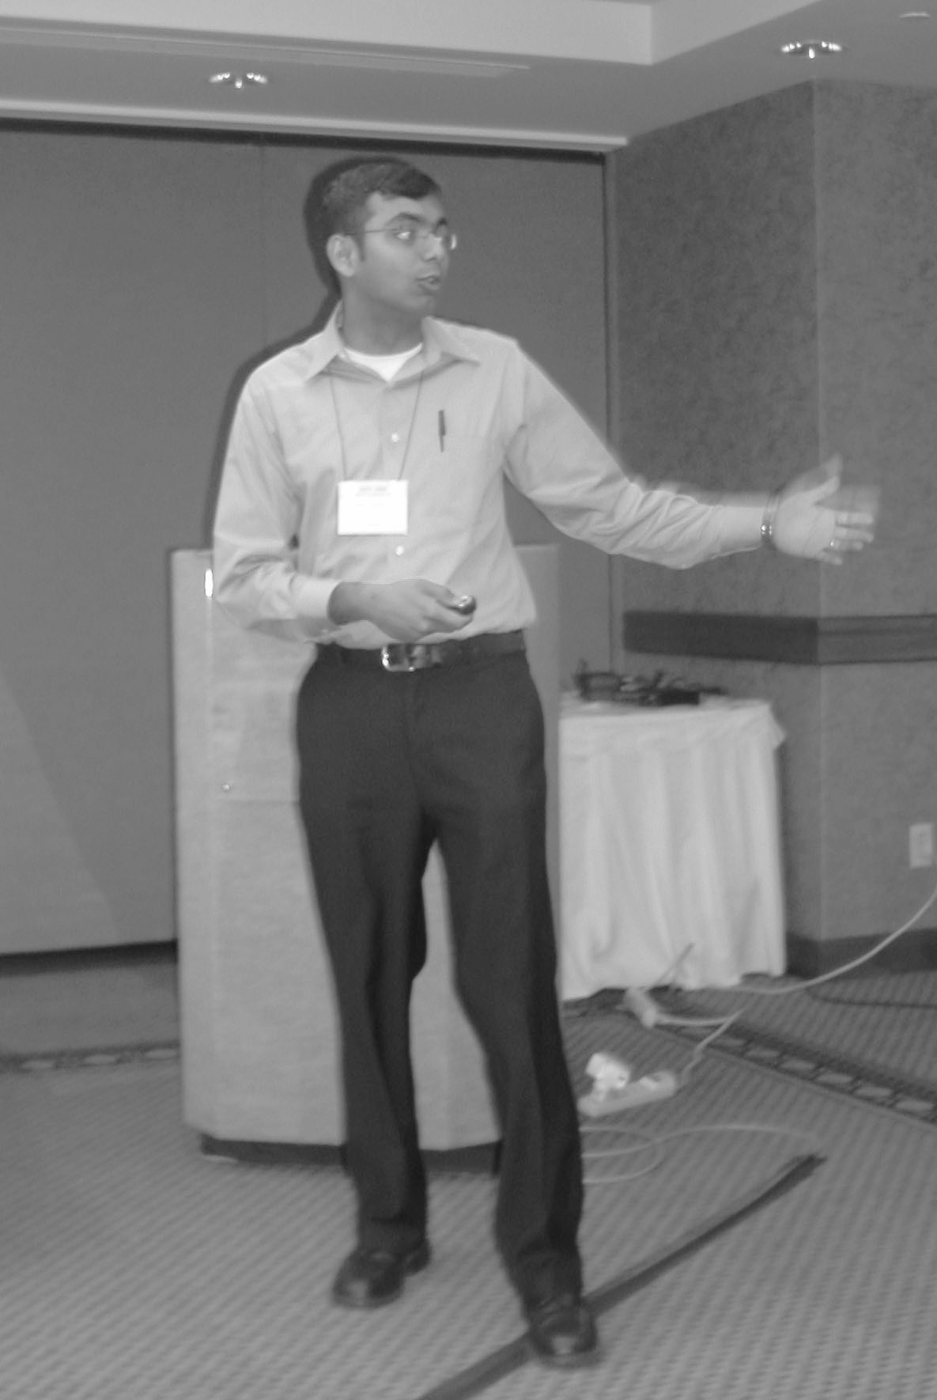
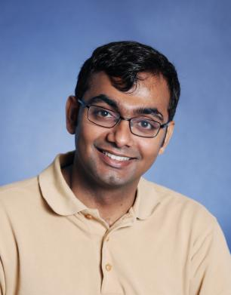
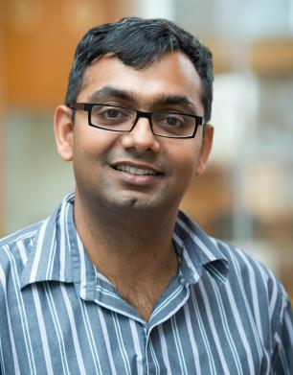
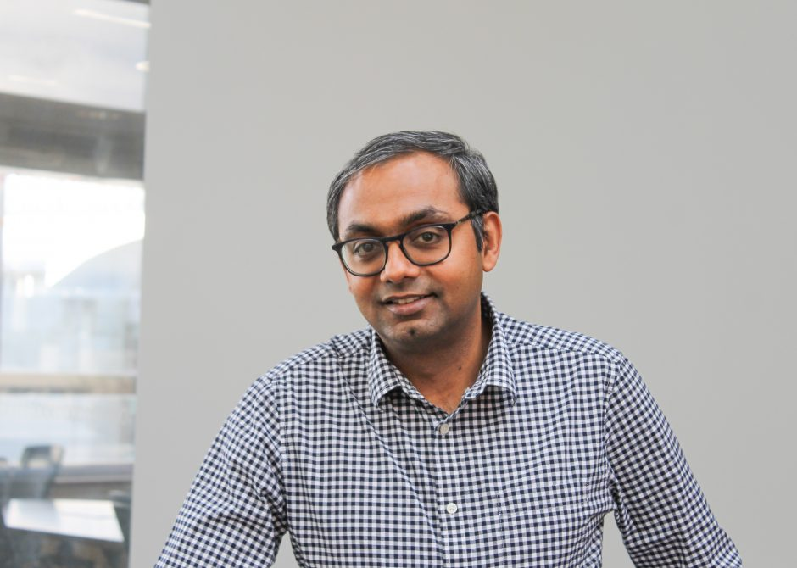
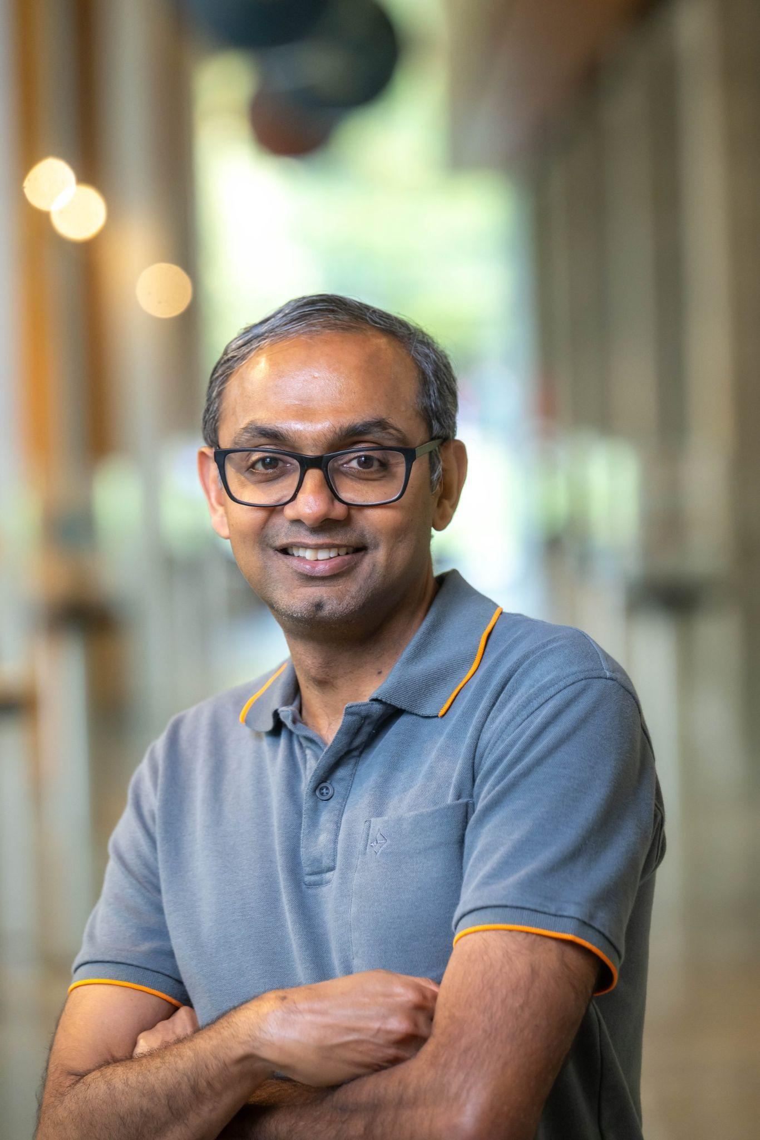


About Me: Karthik Pattabiraman
2001 – 2009
2010 – 2019
2020 – Today
Graduate Student
Assistant Professor → Associate Professor
Professor & Associate Head
B.Tech, Madras Univ. · MS & PhD in Computer Science, U. Illinois (UIUC)
William C. Carter Award, 2008
Electrical & Computer Engineering, UBC
IEEE Rising Star in Dependability, 2020
Jean-Claude Laprie Award, 2025
Joined UBC after a postdoc at Microsoft Research, Redmond
Dependable Systems Lab, UBC
Graduated: 14 PhD, 26 Master’s, 2 postdocs · Currently: 3 PhD, 2 Master’s, 2 postdocs
We build computer systems that keep working when things go wrong — by accident or on purpose.
ACM Distinguished Member · IEEE CS Distinguished Visitor · Vice-Chair, IEEE Technical Committee on Dependable Computing
Lab Website

Slide 3
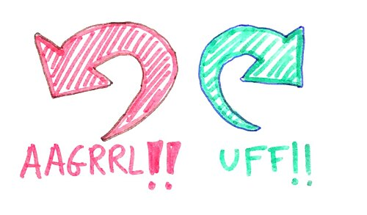
Computing’s Safety Net
Retry the request. Roll back the transaction. Restore from backup.
Nearly everything you are taught about failure assumes the state can be rolled back
Image license: Wikimedia commons

Slide 4
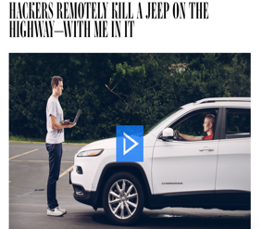
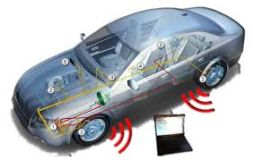
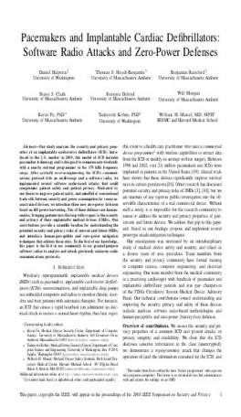
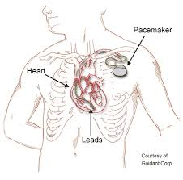
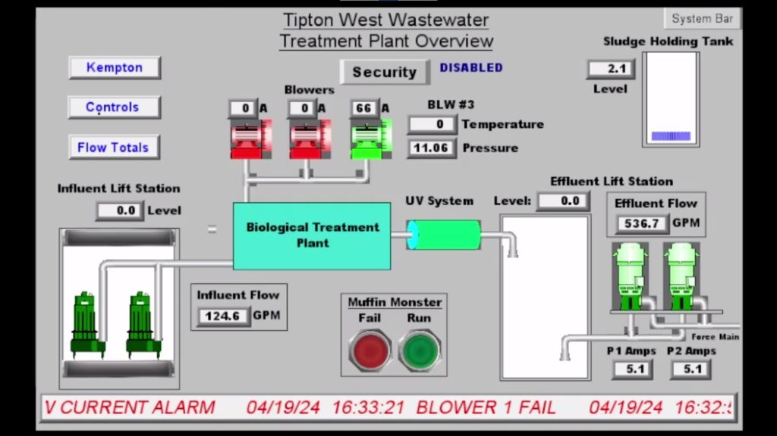

Systems Without the Safety Net
Muleshoe, Texas
January 2024
Attackers breached control interface and overflowed a water tower. Tens of thousands of gallons lost.
Mango Markets
October 2022
~$116M drained by manipulating
a price oracle - money was lost.

Slide 5
The Common Thread: There is No Undo
Vehicle has already crashed
Unsafe dose has been delivered
Water has already been spilled/lost
Money has already been drained

Slide 6
Our Goal
Keep Critical Systems Operating Correctly even While They are Under Attack,
Without Human Intervention

Slide 7
Agenda
Motivation: systems with no undo button
Drones and Rovers — recover [DSN’21, DSN’25]
Industrial Control Systems — discover [NDSS’27]
Future Work and Conclusion

Slide 8
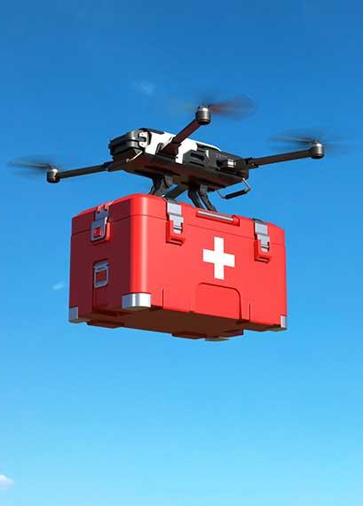
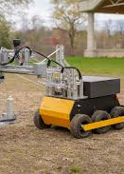
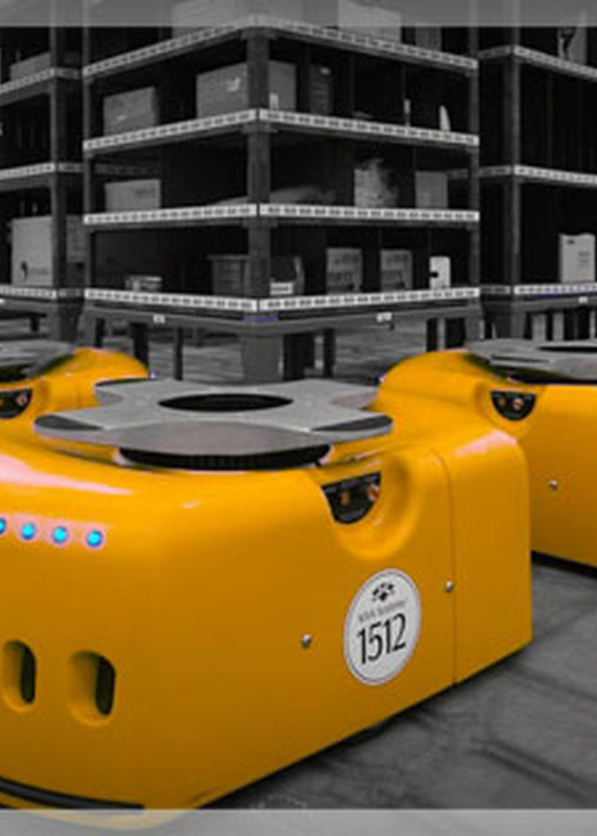
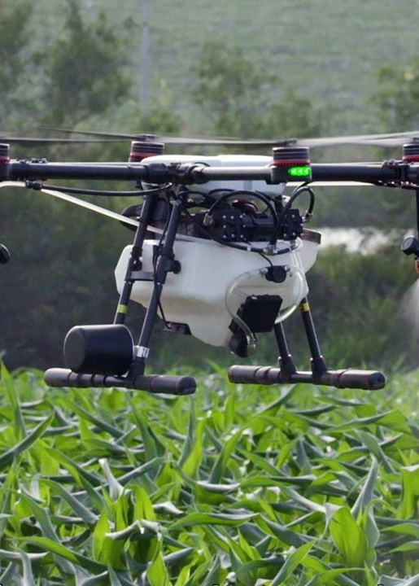
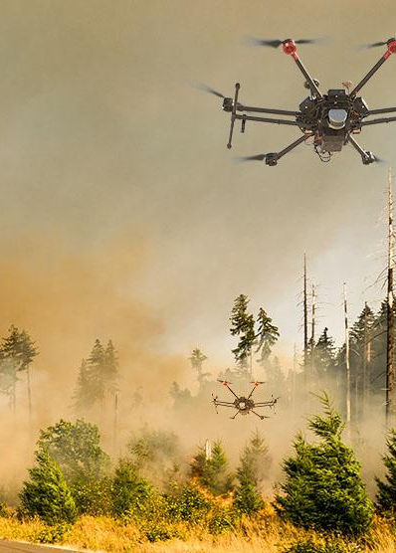
Robotic Autonomous Vehicles (RAVs)
RAVs are being used in many safety-critical applications
Notes:
Autonomous Robotic Vehicles such as drones and rovers are increasingly becoming popular in various industrial sectors including critical tasks such as on demand drug delivery, disaster relief.
They have become an effective means to improve productivity while ensuring safety in many industries such as mining.
The goal of this thesis is to Secure Robotic Vehicles and ensure that they operate safely.

Slide 9

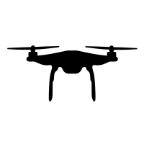
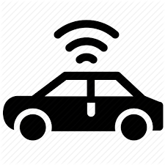
Perception in RAVs
Roll rate = 0.5 rad/s
Turn Right in 50 meters
Notes:
Robotic Autonomous Vehicles, (RAV) in short rely on sensors for perception and use specialized systems and algorithms to operate autonomously.
For example, a ground vehicle relies on GPS to perceive its position and takes appropriate actions to follow the set path, similarly a drone relies on gyroscope and accelerometer sensors to determine its angular orientation and navigates autonomously.
Correctness of sensors is crucial for safe operation in RAVs.

Slide 10


Physical Sensor Attacks: Sensor Spoofing
GPS Spoofing.
Transmit malicious GPS Signals
Erroneous Command
Actual Position
Spoofed Position
Tippenhauer et. al. “On the requirements for successful GPS spoofing attacks”. ACM CCS’11
Nighswander, Tyler, et al. "GPS software attacks." ACM CCS’2012

Slide 11
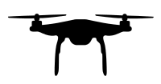


Physical Sensor Attacks: Signal Injection
Signal Injection.
Optical, Magnetic or Acoustic noise
Yaw = 122.45
Roll = 0.20
Pitch =0.72
Erroneous Command
Son et. al. “Rocking Drones with Intentional Sound Noise on Gyroscopic Sensors”. Usenix Security’2015
Davidson, Drew, et al. "Controlling UAVs with sensor input spoofing attacks." WOOT 2016.
Kim, Hyungsub, et al. "A Systematic Study of Physical Sensor Attack Hardness." IEEE S&P 2024
Notes:
Acoustic or Magnetic signal injections are other examples of physical attacks. These attacks manipulate gyroscope and optical sensors resulting in erroneous actions.
These attacks are possible due to the physics behind how these sensors operate.
Physical attacks exploit the underlying operating principles of sensors to distort their measurements

Slide 12
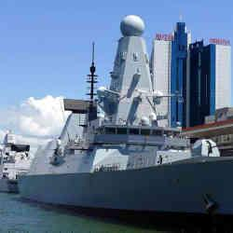
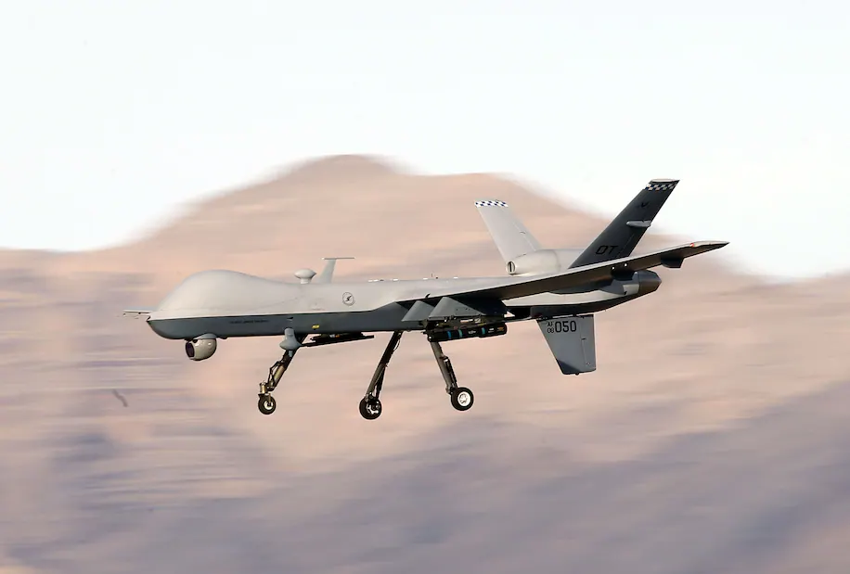
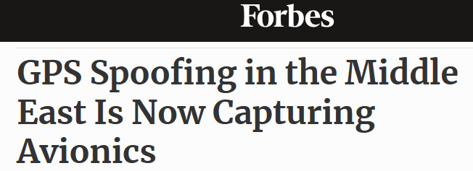

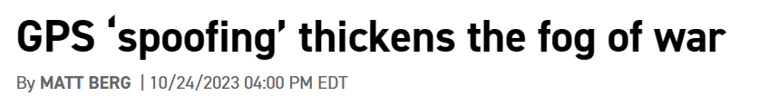
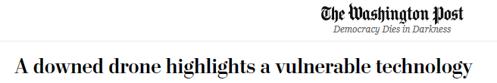


Physical Attacks in the Real World
Notes:
Physical attacks are not limited to academic research. They have been seen in the wild.
GPS spoofing/jamming is perhaps the most prominent physical attack, and increasingly making headlines now more than ever.

Slide 13
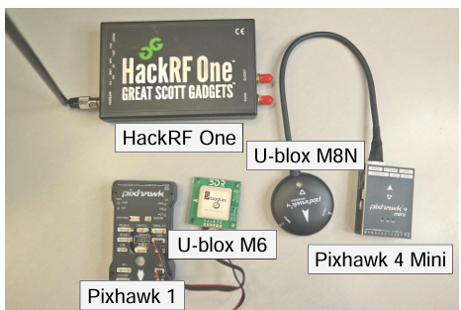
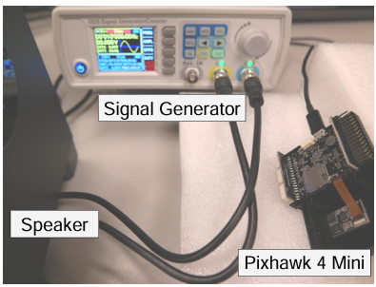
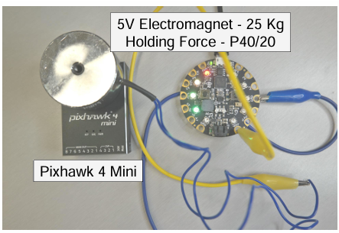
How are Physical Attacks launched?
GPS Spoofing
Acoustic Injection 🡪Gyroscope, Accelerometer
EMI Injection🡪 Magnetometer
Photos from Kim et. al., “A Systematic Study of Physical Sensor Attack Hardness”, IEEE Security and Privacy, 2024.
Notes:
To study the impact of physical attacks on various RAV components and to develop effective defense techniques we first need to be able to launch realistic attacks in a controlled and scalable way.
But that’s easier said than done. Launching physical attacks for experimentation is non-trivial, it requires specialized hardware setups. Let me give you a few examples.
GPS spoofing requires a fake GPS signal emitter.
Acoustic signal injection, used to manipulate gyroscopes and accelerometers, requires a signal generator and speakers to emit precisely modulated sound waves.
EMI attacks require high-strength electromagnets to generate magnetic interference.
These setups are not only hardware-intensive but also require careful calibration.

Slide 14
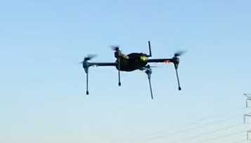
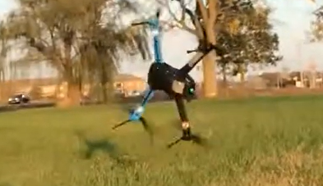
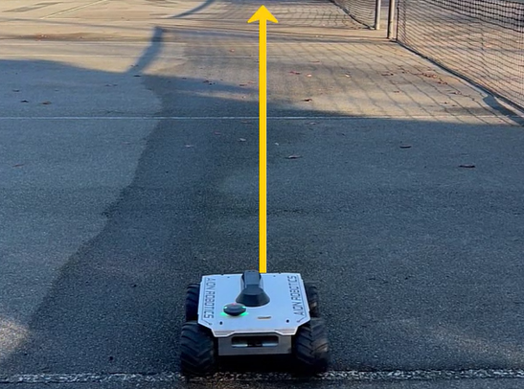
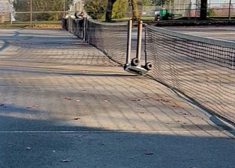
Challenges
Running large scale experiments 🡪 impractical
Crash
Expertise to operate the attack hardware
Risks of physical damages and injuries
Crash
Drone Photos from Choi et. al., CCS’2018
Notes:
Conducting physical attack experiments on RAVs presents several challenges.
Large-scale testing is often impractical,
operating the attack hardware requires specialized expertise,
and there are serious safety risks—including crashes, hardware damage, and potential injuries.
We show a few examples here from both our own experiments and prior work in the field.

Slide 15
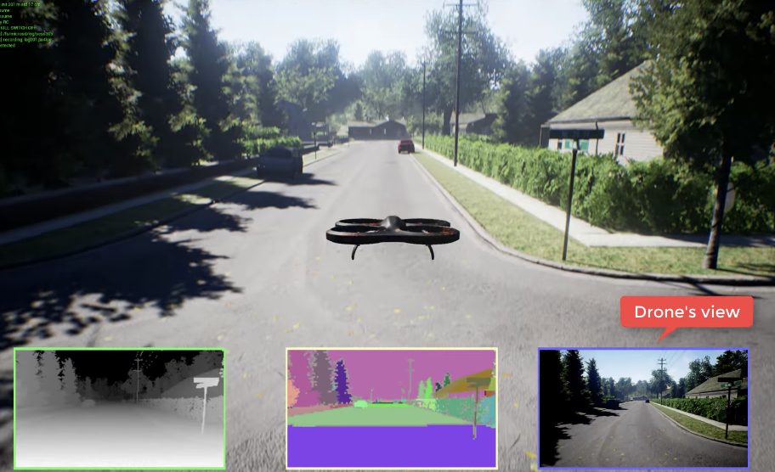
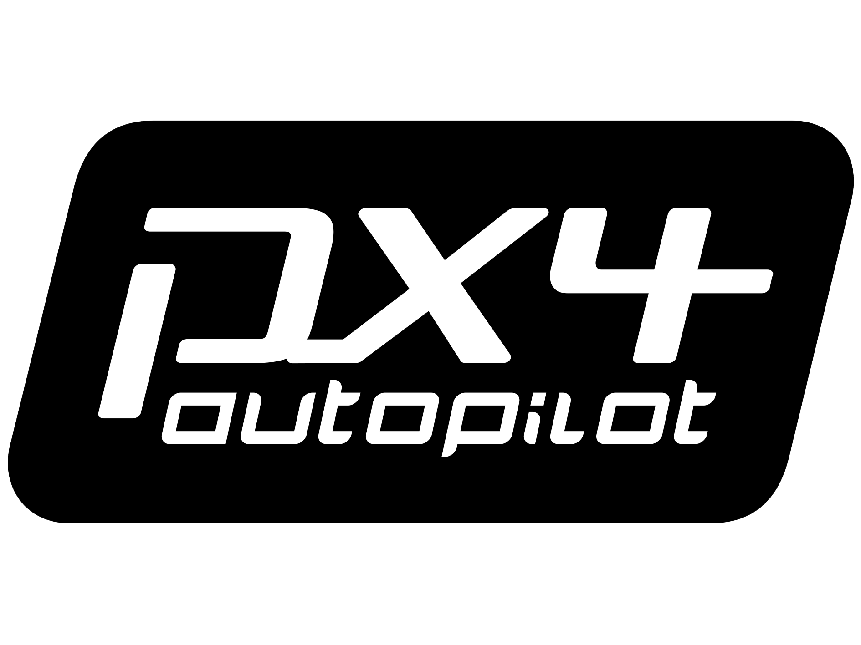

RAVAGE : RAV Attack Generation Engine
Emulate realistic physical attacks through software
External commands and configurations to
launch attacks
Integration with Autopilot Software
Notes:
To make physical attack experiments safer, simpler, and scalable,
we built RAVAGE: a software-based attack generation engine for both virtual and real RAVs.
RAVAGE offers three key features:
It allows researchers and industry partitioners to emulate realistic physical attacks without needing specialized hardware.
It supports external commands to launch attacks, and allow users to configure parameters like attack intensity and duration,
all while integrating seamlessly with widely used autopilot software like PX4 and ArduPilot.

Slide 16
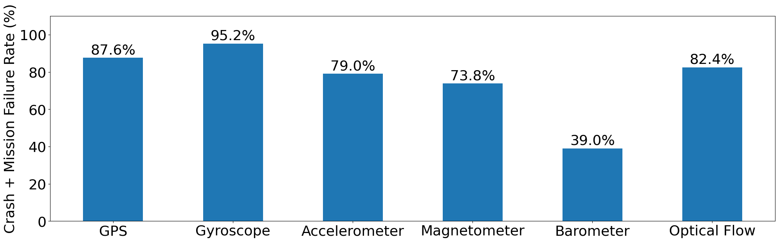
RAVAGE: Key Results
Mission Failure: RAV did not reach the target (i.e., deviated significantly or crashed)
Without protection – RAVs are highly sensitive to attacks
Notes:
This figure shows the impact of attacks on six sensor types, shown on the x-axis.
The y-axis represents the percentage of missions that resulted in a crash or mission failure due to the attack.
A mission is considered a failure if the RAV deviated significantly from its target and could not complete the intended objective.
We found high mission failure rate and crashes across most sensors.
Which shows that without any protection RAVs are highly sensitive to physical attacks.

Slide 17
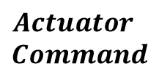

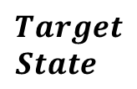

RAVs’ Feedback Control Loop
Cyber
Physical
PID Controller
PID – Proportional Integral Derivative
Notes:
PID Controller adjusts coefficients 𝐾_𝑝, 𝐾_𝑖, 𝐾_𝑑 🡪 actuator signal

Slide 18

Compensation-based Error Correction
Cyber
Physical
PID Controller
E = |target-actual|
Notes:
The PID controller measures the deviation from desired states using the sensors measurements

Slide 19
Compensation-based Error Correction
Cyber
Physical
Measure the error
PID Controller
E = |target-actual|
Command
(Compensate)
Error Correction
✔
Notes:
So, PID controller measures the error and derive appropriate actuator commands to compensate for the incurred error.
And this type of error correction works very well under transient faults and environmental noise.

Slide 20
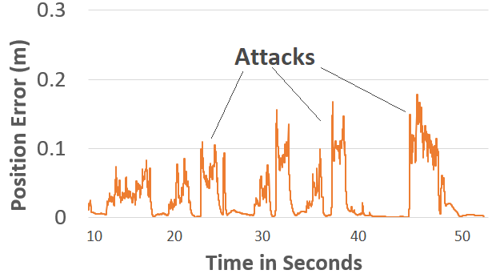
Compensation-based Error Correction under Physical Attacks
Notes:
Now let’s see what happens to the compensation based error correction under an attack. Unlike environmental noise or faults, attacks are not transient in nature.
This figure shows the trajectory error incurred due to GPS spoofing attack during a drone mission, the y-axis shows the trajectory error.
Normally the error will be 0. However, as seen in the figure, the drone incurs persistent and systematic error under attacks. Which prompts the PID controller

Slide 21
Over-Compensation under Physical Attacks
Notes:
to over-compensate

Slide 22
Over-Compensation under Physical Attacks
Notes:
for the attack induced error

Slide 23
Over-Compensation under Physical Attacks
Notes:
Which results in erroneous

Slide 24
Over-Compensation under Physical Attacks
Notes:
actuator signals, that can

Slide 25

Over-Compensation under Physical Attacks
Notes:
Crash the drone.

Slide 26

Over-Compensation under Physical Attacks
Compensation-based Error Correction
Environmental Noise
Attacks
✔
Notes:
Therefore, compensation-based error correction which is effective in handling faults becomes undesirable under attacks.

Slide 27

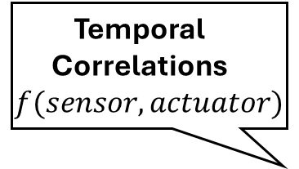




PID-Piper: Feedforward Controller (FFC)
Feedforward Control
Sensor-Actuator history
Proactive error correction
Feedforward
Controller(ML)
✔
error = |target-actual|
Compensation-based error correction
Feedback
Controller (PID)
FFC estimates robust actuator commands even under attack
Notes:
Now that we know the problems with the current control method, how do we address it?
We propose PID-Piper -> an attack recovery technique that is robust under attacks.
The key innovation in PID-Piper is an FFC, the FFC is designed using robust time series estimation.
It learns the temporal correlations between past sensor and actuator values, enabling it to anticipate disturbances and estimate what the actuator command should be—even under attack.
Unlike a feedback controller, the FFC do not measure and compensate for the attack induced errors.
Instead, it performs proactive correction—it anticipates the error based on historical trends and issues actuator commands that mitigate the effect of attacks.
Thus, FFC estimates robust actuator signals even under attacks.

Slide 28





PID-Piper: Attack Recovery Framework
Feedforward Control
FFC (ML)
Feedback Control
-
FBC (PID)
State Estimation
Feedback Control (FBC) 🡪 Fault Tolerance
Feedforward Control (FFC) 🡪 Attack Recovery
Notes:
we switch back to feedback control.
By using both feedback and FFC in tandem PID-Piper offers best of both worlds and protects robots from both environmental noise and attacks

Slide 29
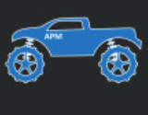
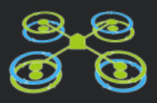
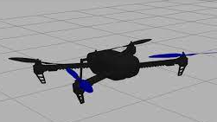
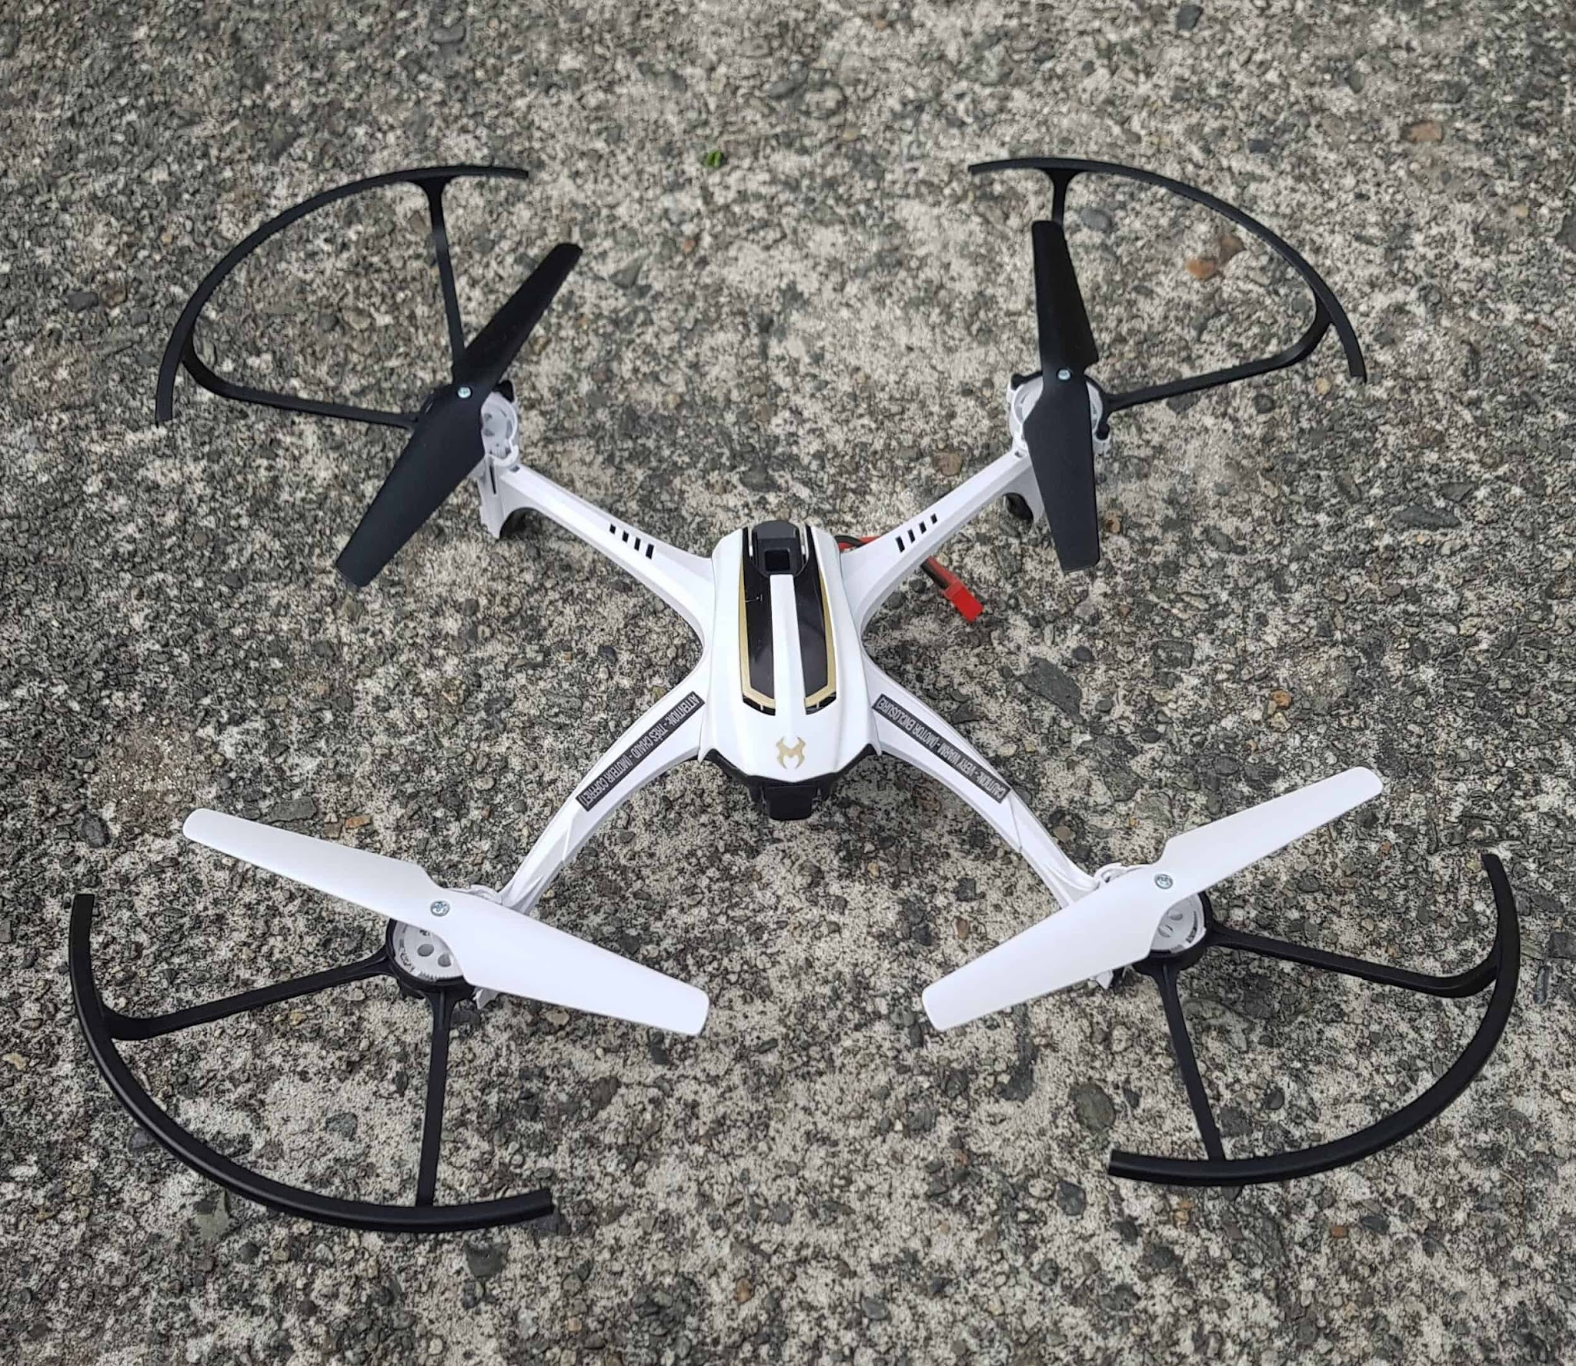
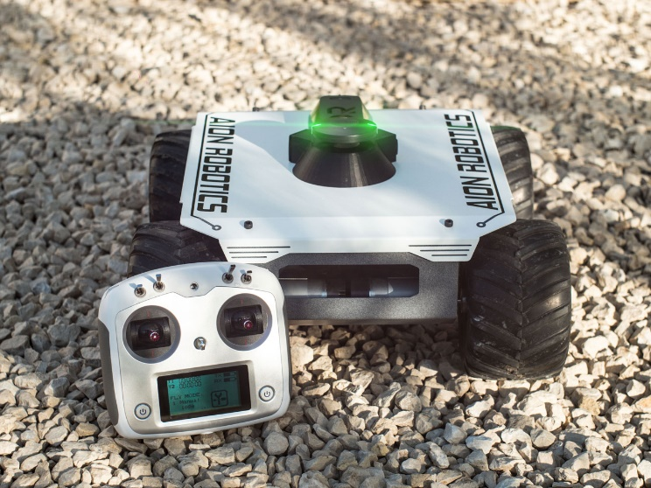
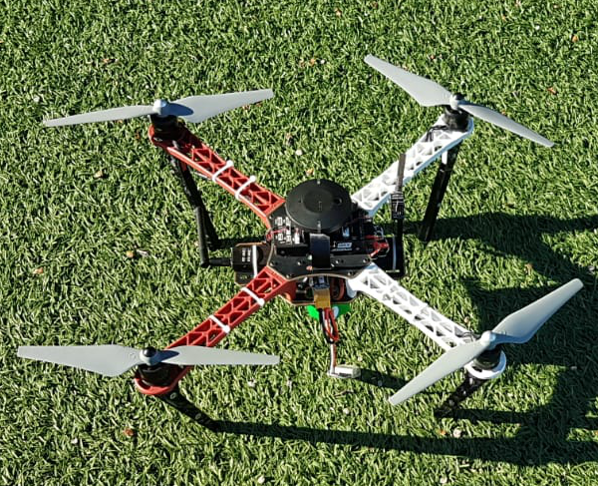
PID-Piper: Key Results
83% Mission Success
0 Crash
Virtual RAVs
PID-Piper
Mission Success Rate
ArduRover
ArduCopter
PXCopter
Real RAVs
SSR
RAID’20
CI, Savior
(CCS’18) (Usenix’20)
Crash/Stall
SkyViper
Aion R1
DIY Pixhawk
Notes:
We evaluate PID-Piper on 3 real and 3 virtual RAV systems – shown here.
And we compare its effectiveness in attack recovery with 3 prior work using two metric –
mission success rate – in how many cases the RAV mission completed successfully despite the attacks, higher is better,
Crash rate - How many cases the attack resulted a crash/stall – lower is better.
We found that, PID-Piper significantly outperformed prior methods, achieving 83% mission success and 0 crashes under attack scenarios — demonstrating robust recovery and mission success across diverse RAV platforms.

Slide 30
Agenda
Motivation: systems with no undo button
Drones and Rovers — recover [DSN’21, DSN’25]
Industrial Control Systems — discover [NDSS’27]
Future Work and Conclusion

Slide 31
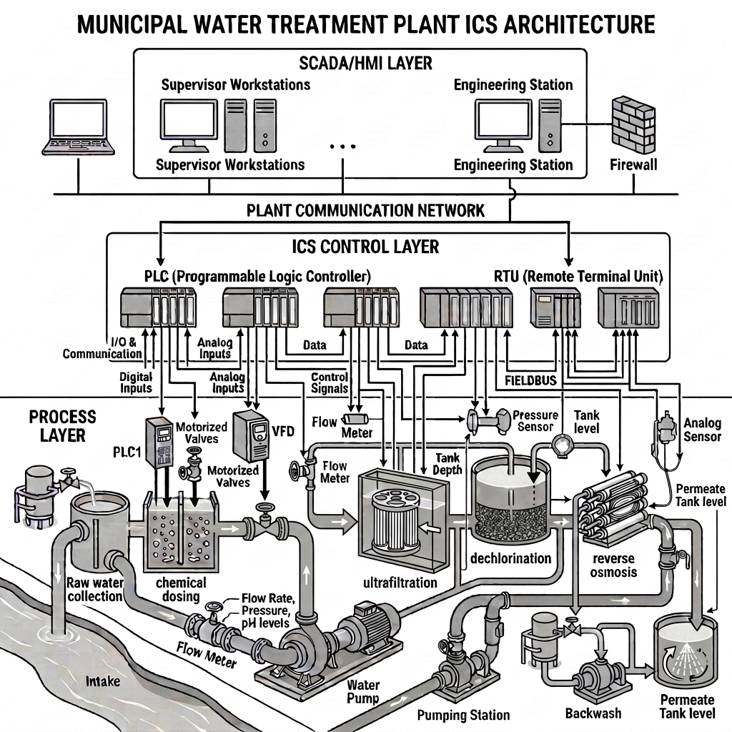


Industrial Control System (ICS): A Primer
Internet
IT Network
Operational Technology (OT) Network
Treated water
Citizen’s home
Other plants
Notes:
Give an example of an ICS with a water treatment plant: what the plant does, the two types of networks, our focus is on the OT network
Adversary’s objective: What happens when an adversary attacks the OT network
Describe how an attacker got access to the OT network in traditional ICS architecture

Slide 32


The OT Network
Internet
IT Network
Treated water
Citizen’s home
Other plants
Notes:
Describe the internal components of the OT network: The process layer, the ICS control layer, and the SCADA
Give a high-level description of the functions of each layer, how the SCADA synchronizes the 6 stages of water treatment

Slide 33
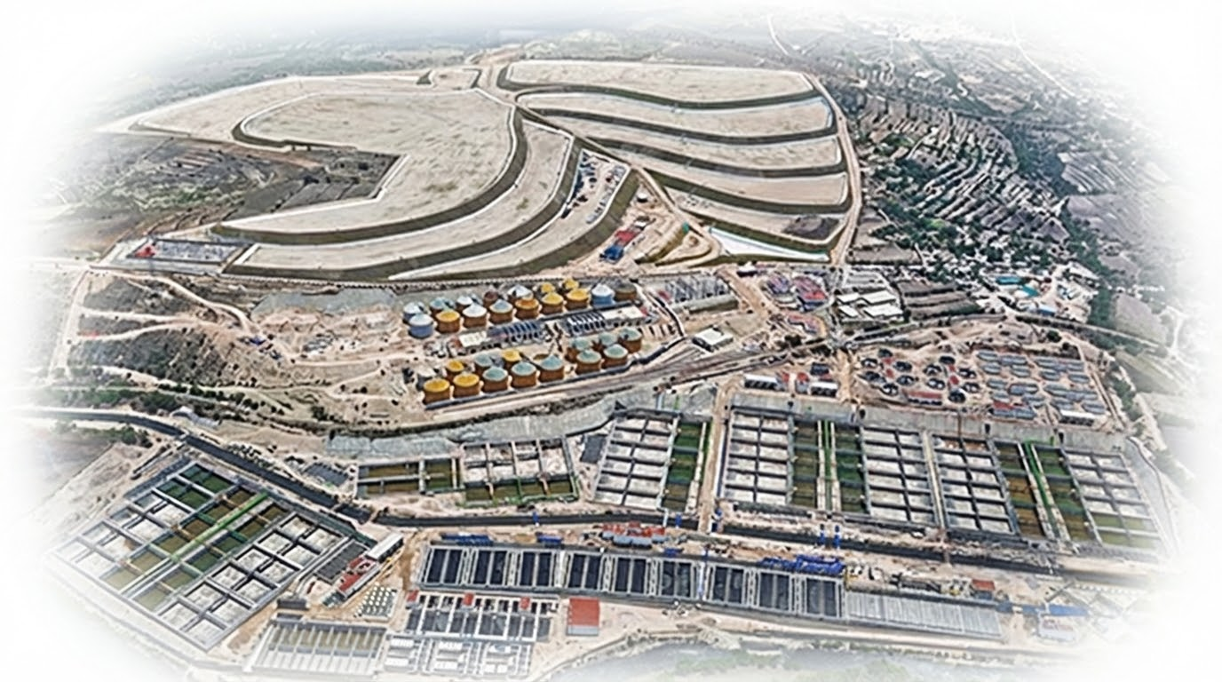
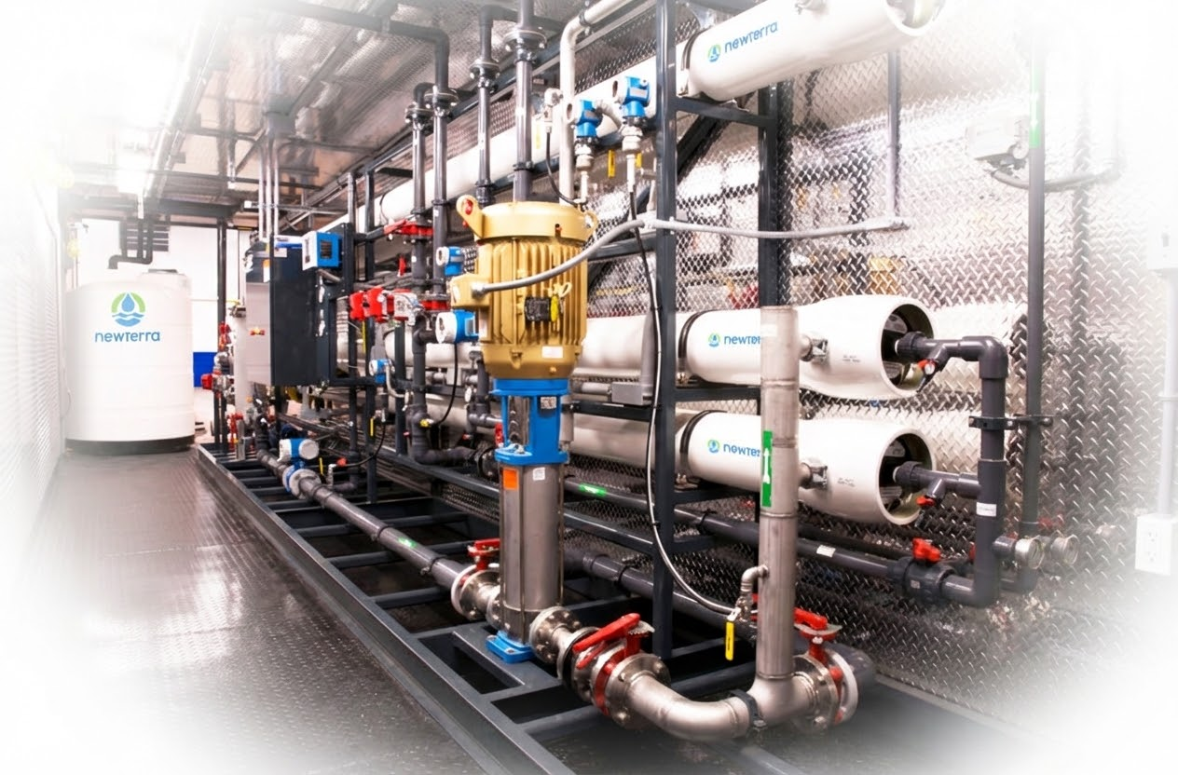

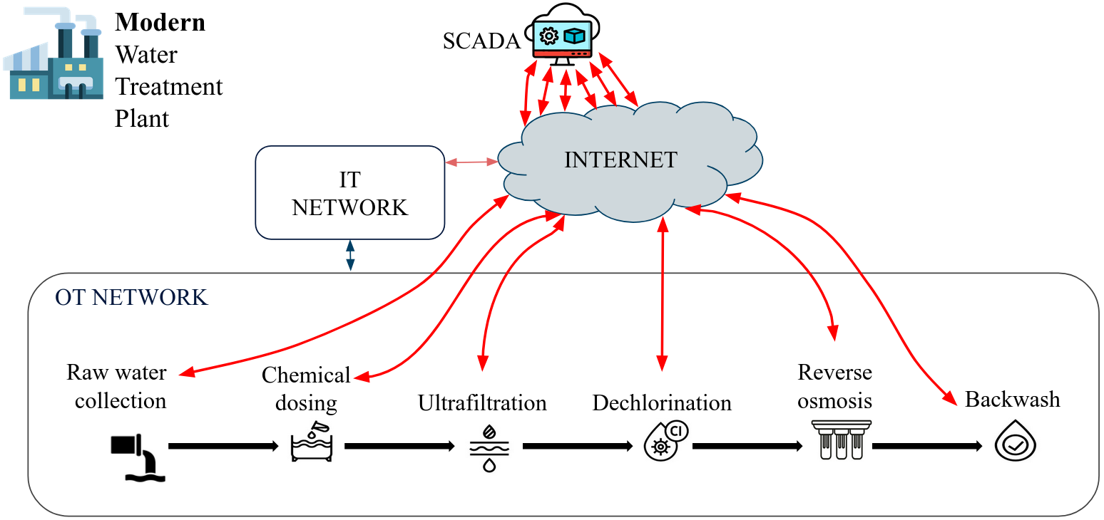
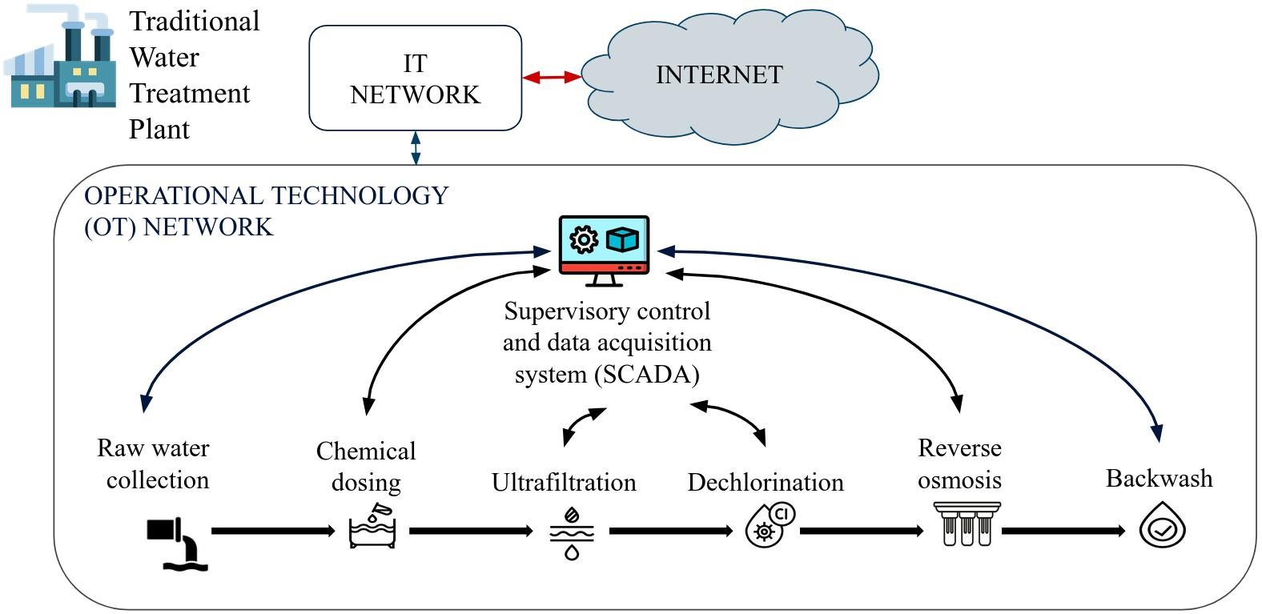
Modern ICS: What’s New?
Traditional ICS
Modern ICS
SCADA
SCADA:
Private network → Cloud-hosted
VPN tunnels

Slide 34





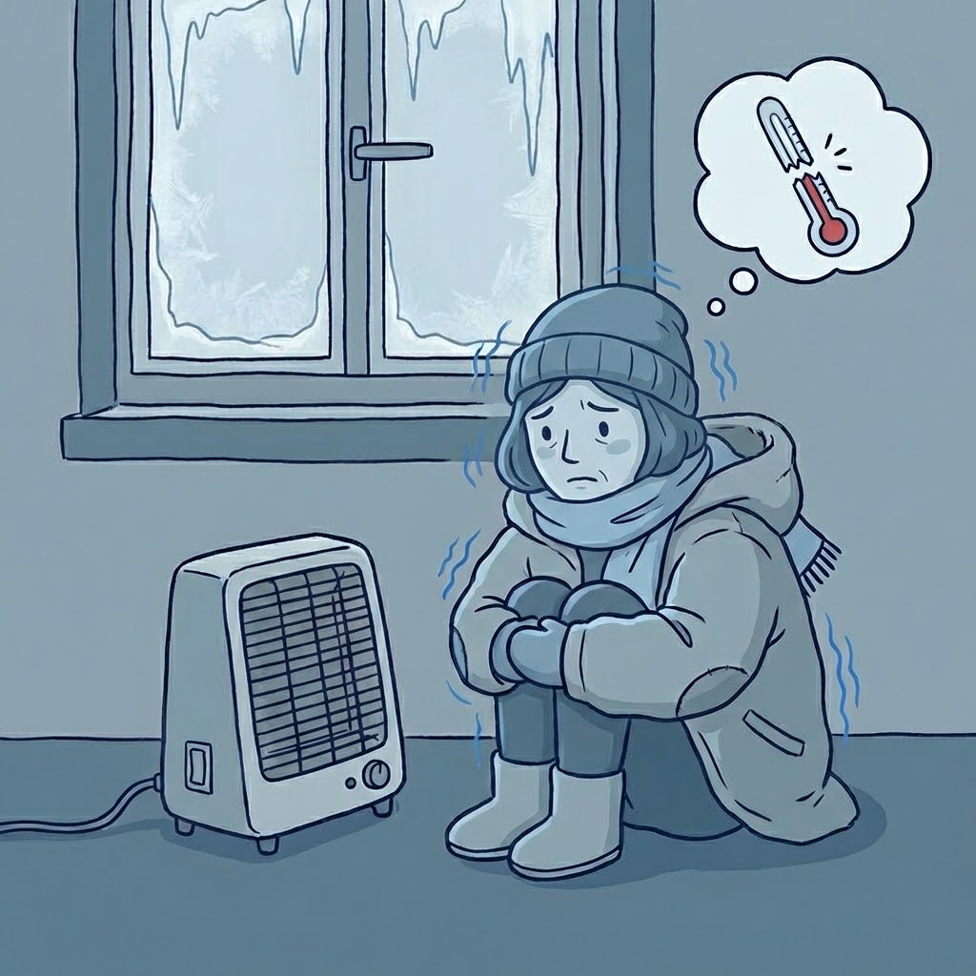

ICS Attacks
Can an adversary compromise a modern ICS?
Sandworm attack on Ukrainian power grids (2022)
Texas (2024) and Quebec (2026) water treatment plant attacks

Slide 35





The Adversary Model
Can observe all packets traversing compromised node
Cannot break encryption or see data.
Lacks knowledge of process details or system design.
Can see traffic metadata (even with VPNs).
SCADA
VPN tunnels
Internet
Raw water
collection
unit
Chemical
dosing unit

Slide 36
ICS-Sniper : A Targeted Black-Hole Attack on ICS
Key idea:
Time-criticality of messages causing change in mechanical components >> Time-criticality of other status update messages
Drop ONLY the highly time-critical messages to cause physical damage
VPN tunnels
SCADA
Internet
Raw water
collection
unit
Chemical
dosing unit

Slide 37

ICS-Sniper : Key Challenge
Attacker goal: To drop the time-critical packets only
Insight: Time critical packets precede network pattern shifts
Key challenge
How to predict network pattern shift
when contents are encrypted?
Is this packet time-critical??
SCADA
VPN tunnels
Internet
Raw water
collection
unit
Chemical
dosing unit

Slide 38

ICS-Sniper : Key Contribution
Attack plan: Drop packets responsible for state transition
Encrypted traffic analysis technique to predict pattern shift from traffic metadata, and thereby packet criticality
Internet
SCADA
Chemical dosing unit
Change ⇒ Network pattern shift
X times
Y times
Site-to-SCADA communications are periodic
Pattern #1
Pattern #1
Pattern #2
t₁
. . .
t₂
. . .
Timeline
Period (T)
Period (T)
Period (T)
Procedure:
Compare encrypted traffic metadata across consecutive periods,
identify critical packets
Drop critical packets in subsequent operational cycle

Slide 39

ICS-Sniper: Evaluation Testbed (Water Treatment Plant Simulation)

Slide 40

ICS-Sniper: Consequences
6-hour operational cycle - selective packet dropping
≅ 4% packets dropped
Attack-1: Valve open for an additional 9 minutes and 11 seconds - product loss
Small Issue: Big Impact
Evaded 9 SOTA Anomaly Detectors

Slide 41

ICS-Sniper: Proposed Countermeasures

Slide 42
Agenda
Motivation: systems with no undo button
Drones and Rovers — recover [DSN’21, DSN’25]
Industrial Control Systems — discover [NDSS’27]
Future Work and Conclusion

Slide 43




Future Challenges
Recovery, not just detection
Agents with actuation authority
Swarms, not single vehicles
Guarantees, not benchmarks
Notes:
Recovery, not just detection: we can recover a drone and still finish the mission. For DeFi we can only detect, and for ICS we are still finding the attacks. What is the SpecGuard equivalent for a plant with no mission plan, or a protocol where finality is the feature?
Agents with actuation authority: an agent that places an order, deploys code or drives a robot has no undo button either. And unlike a drone, nobody has written down its specification — everything in this talk assumed you could state what safe means formally enough to check.
Swarms: recovery that works for one vehicle may not compose when fleets share airspace. The recovering vehicle becomes an obstacle for its neighbours.
Guarantees: 83%, 2x, 3x are measurements, not proofs. Certifiable autonomy needs guarantees about the recovery policy, not benchmark numbers.

Slide 44
Conclusion
Critical systems increasingly have no undo button
Perimeter defenses and after-the-fact detection are not enough
Need systems that stay correct even while under attack
Different Systems, different solutions
Drones and rovers — recover
Industrial control systems — discover
Lab Website
Contact: karthikp@ece.ubc.ca
More Info: https://blogs.ubc.ca/dependablesystemslab/

Slide 45


















Acknowledgements
Notes:
Finally, this work would not have happened without …

