Slide 1

Student Branch Chapter @ USF
Workshop 1
Backend Lead: Akmal Kurbanov

Slide 2

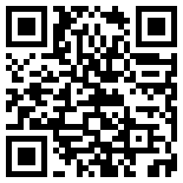
Check in! Support us

Slide 3
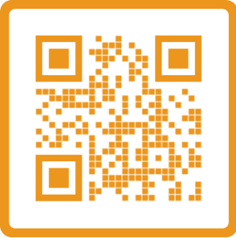
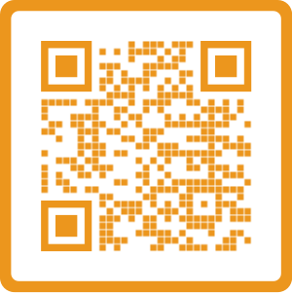
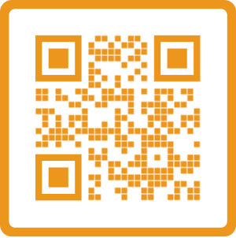
Follow Us
Instagram
LinkedIn
Discord

Slide 4
What are we building today?
RESTful API Endpoints using ASP.NET Core Web API controllers
Database Integration with Entity Framework
Authentication & Authorization powered by JWT tokens

Slide 5
By the end of this workshop, you will be familiar with:
RESTful APIs (what they are and why they matter)
HTTP Requests (methods, status codes, headers)
Database Integration (connecting to and querying a database)
JWT Tokens (token-based authentication flow)
Authentication vs Authorization (what’s the difference and why it’s important)

Slide 6
Backend Vs Frontend
Frontend
User Interface: Everything the user sees and interacts with (HTML, CSS, JavaScript).
Technologies: Frameworks like React, Angular, or Vue.
Role: Handles presentation, user input, and communicates with the backend for data or actions.
Backend
Server-Side Logic: Processes requests, applies business rules, handles database operations.
Technologies: ASP.NET, Node.js, Python (Django/Flask), Java (Spring), etc.
Role: Manages data storage, authentication, security, and provides APIs to the frontend.

Slide 7
Introduction to API
API stands for Application Programming Interface—a contract that defines how different software components interact.
Why API matter?
They let one piece of software request information or functions from another
They standardize communication and reduce complexity for developers.
Notes:
Real world examples first

Slide 8
Rest API
Uses HTTP for communication (GET, POST, PUT, DELETE, etc.).
Typically returns JSON for data sharing
Resource-based URLs (e.g., /users/123, /products/42) make endpoints easy to understand
JSON Data Exchange Responses (and often requests) are in JSON, a lightweight and human-readable format.
Stateless & Simple Each request contains all necessary information; the server doesn’t store client state.
REST is the de-facto standard for most public web APIs due to its simplicity.

Slide 9
HTTP Communication
HTTP Verbs (Methods)
GET (retrieve data)
POST (create data)
PUT (update/replace data)
DELETE (remove data)
An HTTP Request Consists Of
Request Line
Specifies the HTTP method, target URL, and HTTP version
Example: GET /api/users HTTP/1.1
Headers
Metadata about the request
Examples: Content-Type, Authorization, Accept
Body (optional)
Contains data for methods like POST or PUT
Often in JSON format for REST APIs

Slide 10
HTTP Example
POST /api/users/signup Host: example.com
Content-Type: application/json
{ "username": "alice", "email": "alice@example.com" }
GET /api/users/alice Host: example.com
Accept: application/json
DELETE /api/users/1 Host: example.com

Slide 11
Wrap Up
Backend vs Frontend
HTTP Communication
Rest API
HTTP

Slide 12
Handling Request
API Controller
Data annotation
Methods to handle data
Dummy Controller

Slide 13
Our Project
Users
Posts
Admins
Notes:
To handle requests, we need to create api controller

Slide 14
Creating Class for Data Storage
Enable Us
Store user*
Add user
Remove user
Edit user
Also Known as CRUD operations
Notes:
Created class to

Slide 15
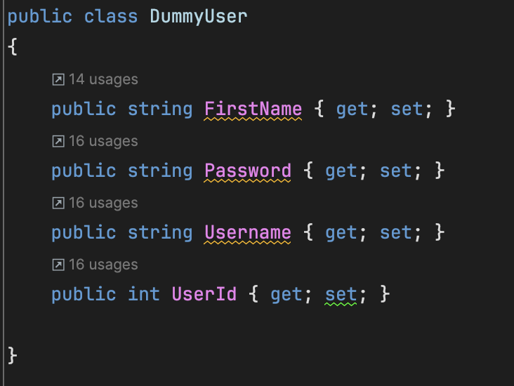
DummyUser
Notes:
The goal of it is just represent each user. As you can see, each user

Slide 16
UserDummyDatabase
Users – list containing all the dummy users
Methods:
UserDummyDatabase
CreateUser
GetUser
UpdateUser
DeleteUser
GetAllUsers
Notes:
UpdateUser(int id, string newFirstName, string newUsername, string newPassword)
Finds a user by ID and updates their details (first name, username, and password).
Returns the updated user or null if the user is not found.
GetAllUsers()
Returns a list of all users in the dummy database.
DeleteUser(int id)
Finds a user by ID and removes them from the list.
Returns the deleted user or null if the user is not found.
CreateUser(string firstName, string username, string password)
Creates a new user with a unique ID, first name, username, and password.
Adds the user to the list and returns the newly created user.
GetUser(string username, string password)
Searches for a user by username.
If the user exists but the password does not match, returns null.
Returns the user if both username and password match.
These methods allow basic CRUD operations (Create, Read, Update, Delete) on the user list. Let me know if you need modifications or enhancements!

Slide 17
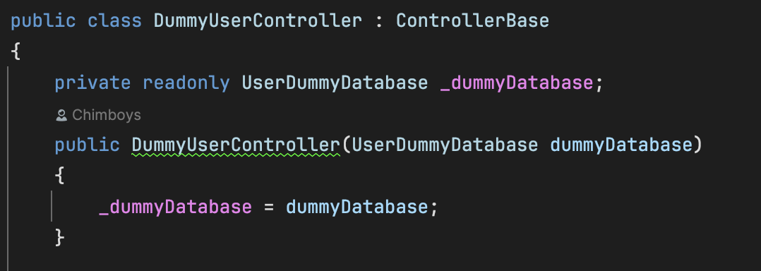
Adding DummyDb in Controllers
Notes:
It is private readonly because …

Slide 18
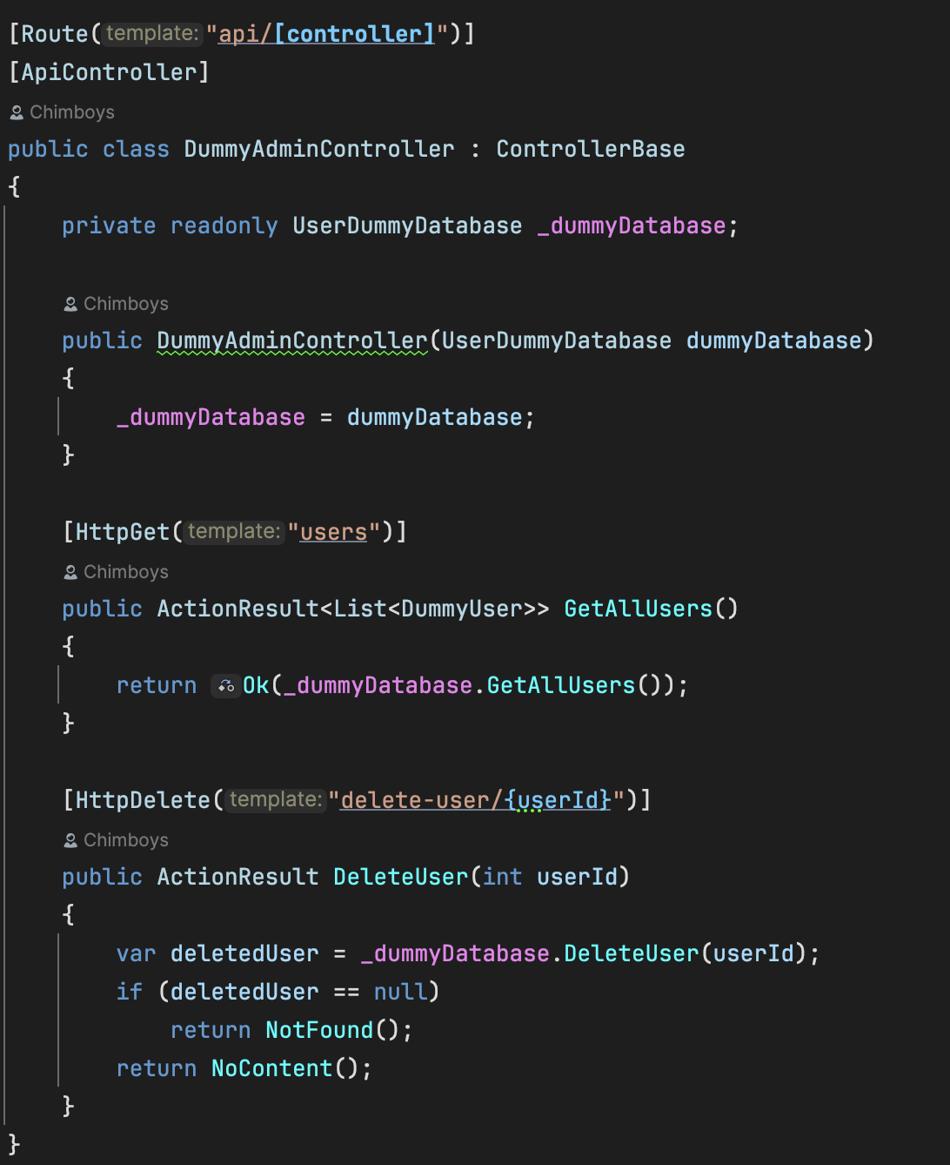
Using DummyDb in Admin Controller
Notes:
It is private readonly because …

Slide 19
Using DummyDb in User Controller
Notes:
Explain why list was private

Slide 20
The Problem
What happens if project is restarted?
Notes:
Explain why list was private

Slide 21
How to solve the problem?
Enjoy free food
Integrate Database
PREPARE QUESTIONS IF YOU HAVE ANY, I PROMISE I WILL NOT BITE BECAUSE I WILL GO AHEAD AND HAVE SOME FOOD

Slide 22
Integrate DB with EF
3 portions
For each SQL table (Users, Admins, Posts), write a C# class that represents one row in that table.
2) Write a class that inherits from DbContext and includes DbSet<T> properties for each entity class.
3) Register DB as the service.

Slide 23
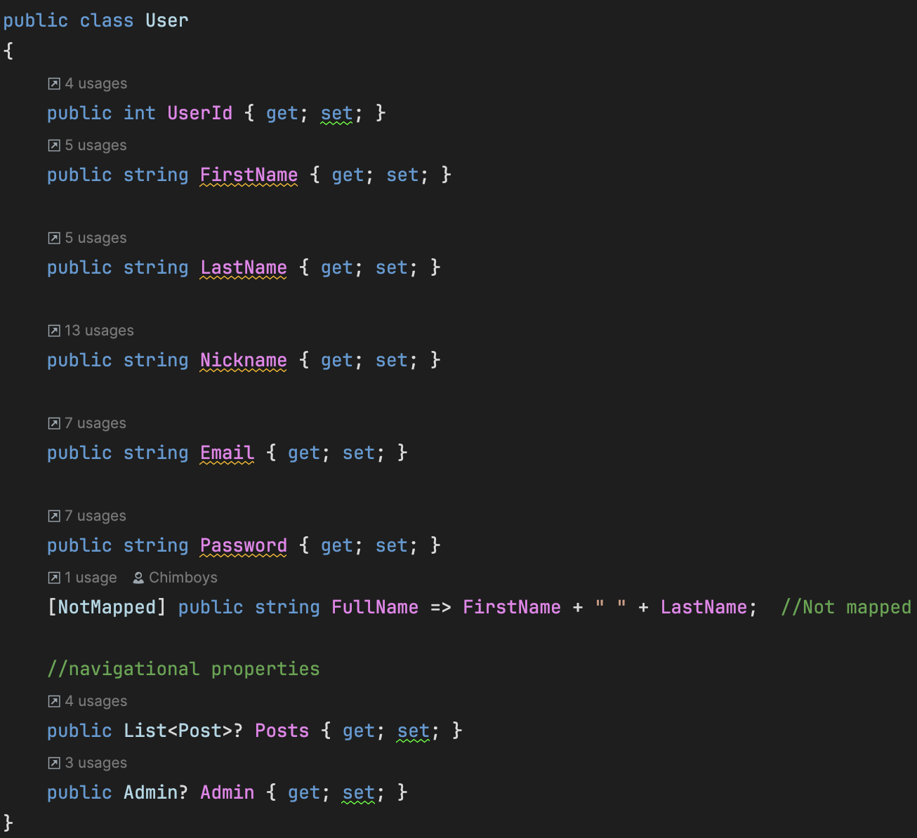
Integrate DB with EF (1step)

Slide 24
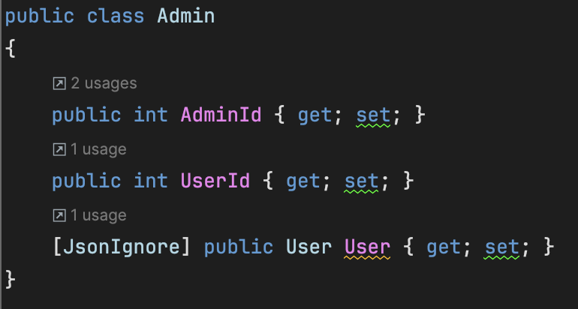
Integrate DB with EF (1step)

Slide 25
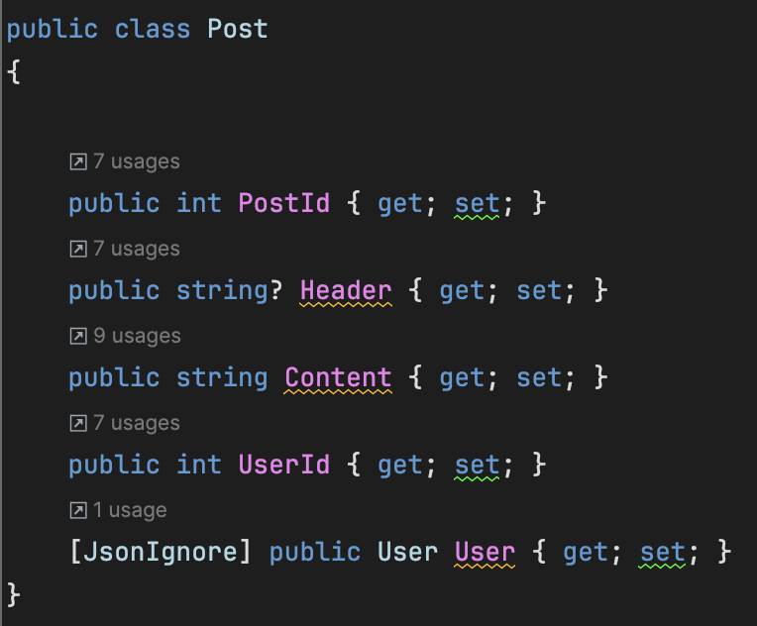
Integrate DB with EF (1Step)

Slide 26
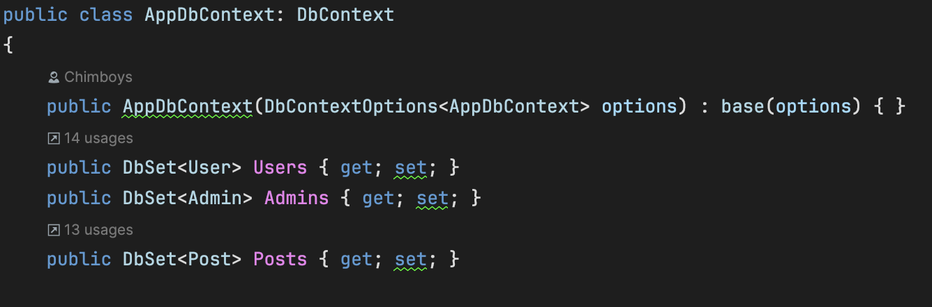
Integrate DB with EF (2Step)

Slide 27
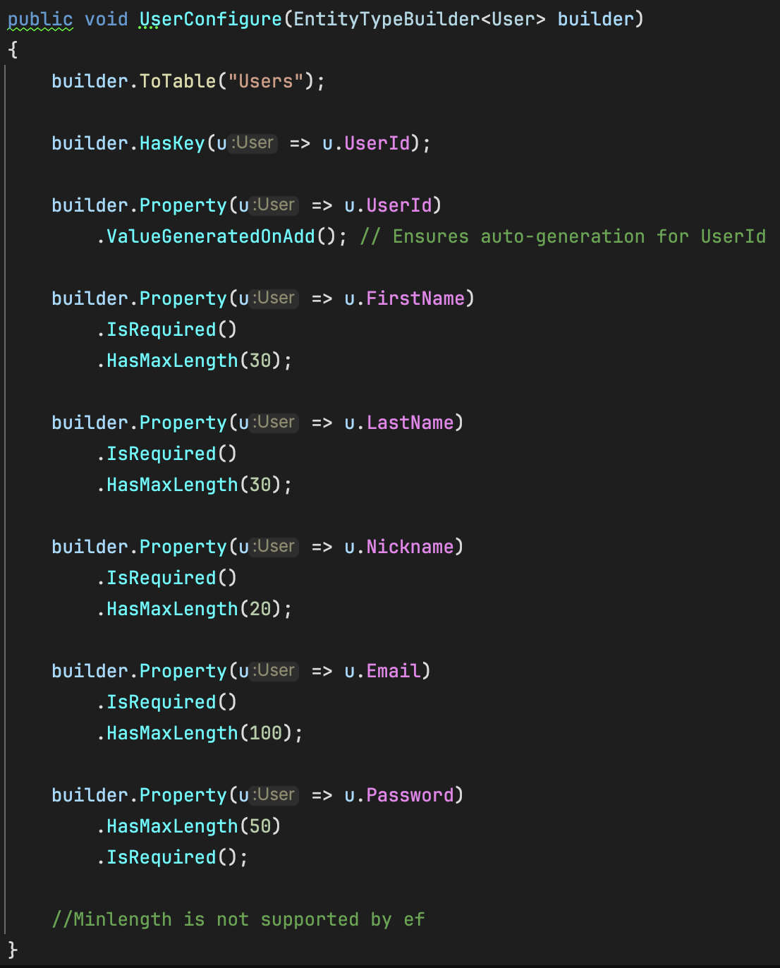
Integrate DB with EF (2Step)

Slide 28
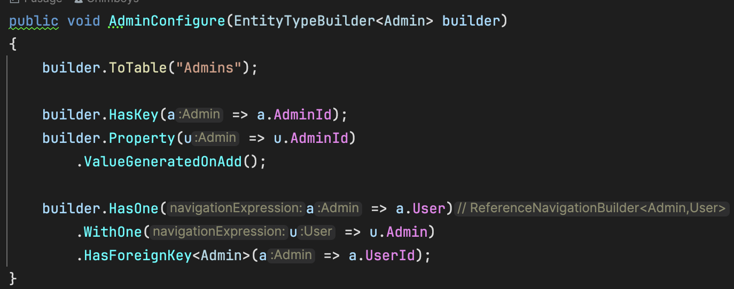
Integrate DB with EF (2Step)

Slide 29
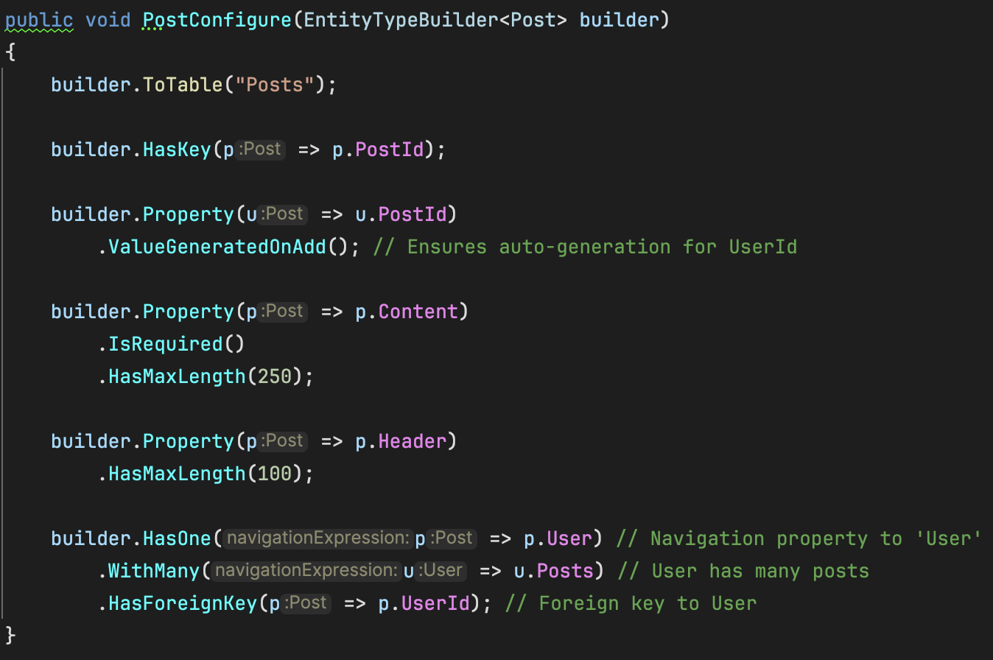
Integrate DB with EF (2Step)

Slide 30
Integrate DB with EF (3 Step)
In program.cs add the following
In appsettings.json

Slide 31
Let’s have a look at controllers

Slide 32
Authentication & Authorization
Authentication
What is it?
The process of verifying who a user is.
Typically done with credentials like username & password, or multifactor methods.
Authorization
What is it?
The process of determining what resources or actions a user is allowed to access.
Usually enforced through roles or permissions.

Slide 33
JWT Tokens
Consists of
Header: Includes the token type (JWT) and the hashing algorithm (e.g., HS256).
Payload: Contains “claims” about the user or any other data (e.g., nickname, fullname)
Signature: Verifies the token’s integrity using a secret or public/private key.
Debugging tokens https://jwt.io/

Slide 34
JWT Tokens and Authentication
Workflow Overview
Sign Up
User registers with a username/nickname and password.
On successful registration, server generates a JWT token and sends it back.
Log In
User logs in with their credentials (nickname & password).
If valid, server issues a JWT token.
Subsequent Requests
Client includes token in the Authorization header (Bearer <token>) for protected endpoints.
Server verifies the token’s signature and checks expiration before granting access.
Token Validity
Tokens can be configured to expire after a specific time (e.g., 15 minutes, 1 hour, or 1 day).
Refresh tokens can be used to obtain a new JWT without re-entering credentials.
Key Points
Stateless: No session data is stored on the server; the token carries user claims.

Slide 35
Tokens Based Authorization
Key Idea
Use claims in the JWT to decide which policy (e.g., UserPolicy or AdminPolicy) applies.
Each policy grants different levels of access to your application’s endpoints.
Base Policy
A user with a valid token is initially assigned to UserPolicy by default.
Check Admin Claim
If the token’s isAdmin claim indicates potential admin status (e.g., "adminFrFr"), the server verifies in the database if the user is truly an admin.
If confirmed, the user is assigned AdminPolicy.
Otherwise, they remain on UserPolicy.
Enforce Policies
UserPolicy grants standard user-level access (e.g., view personal data).
AdminPolicy grants additional privileges (e.g., manage users or system settings).

Slide 36
Testing Controllers

Slide 37
Your action items + Next workshop ☺ !
Actions Items:
Upload your learnings today on LinkedIn and resume
Drop your suggestions in the poll
Make sure to network with folks around you
And join us in our next workshop

