Slide 1
Searching
Terence Parr University of San Francisco

Slide 2
Common searching/membership strategies
O(mn)
linear: scan data structure looking for element(s)
binary search: if in array and sorted, split recursively in half
binary search tree: subtree to left has elements less than current node and subtree to right has elements greater than
hash table: function maps key to bucket, linear search in bucket; recall search index project from MSDS692; for word search, not arbitrary string search in document(s)
state machines (graphs)
O(mlog(n))
O(mlog(n))
O(m)
O(m)
m = length of search string, n vocab size, unit of work = character comparison

Slide 3
Binary search (review sort of)
If we know data is sorted, we can search much faster than linearly
Means we don’t have to examine every element even worst-case
def binsearch(a,x):
left = 0; right = len(a)-1
while left<=right:
mid = (left + right)//2
if a[mid]==x: return mid
if x < a[mid]: right = mid-1
else: left = mid+1
return -1
See http://interactivepython.org/runestone/static/pythonds/SortSearch/TheBinarySearch.html

Slide 4
Compare to (tail-)recursive version
def binsearch(a,x,left,right):
if left > right: return -1
mid = (left + right)//2
if a[mid]==x: return mid
if x < a[mid]:
return binsearch(a,x,left,mid-1)
else:
return binsearch(a,x,mid+1,right)
left = 0; right = len(a)-1
while left<=right:
mid = (left + right)//2
if a[mid]==x: return mid
if x < a[mid]: right = mid-1
else: left = mid+1
Bracket region with element

Slide 5
String matching
Problem: Given a document of length n characters and a string of length m, find an occurrence or all occurrences
Brute force algorithm is O(nm)
Theoretical best-case algorithm exists for O(n + m)
Exercise: Describe brute force algorithm; why is it ”slow”?

Slide 6
Hash searches
First, note that two equal strings have same hash code so we can compare int codes quickly even for huge strings
Rabin-Karp* algorithm uses hash function to speed up but is still O(nm) worst-case; works for any substring not just words
Idea: h = hash search string s We move i from 0 to n-m compute hash for doc[i:i+m] and compare to h if same and doc[i:i+m]==s then return i else i = i + 1
Idea is to avoid comparing strings unless the hash codes match, but usually hash computation costs same as comparing strings
*https://en.wikipedia.org/wiki/Rabin%E2%80%93Karp_algorithm

Slide 7
Rabin-Karp (almost)
def search(doc, s) -> int:
n = len(doc); m = len(s)
hs = hash(s)
for i in range(0,n-m+1):
hdoc = hash(doc[i:i+m]) # slow O(m)
if hdoc==hs: # fast
if s==doc[i:i+m]: # slow
return i
return -1
def hash(s:str)->int:
return sum(ord(c) for c in s)
Additive hashcode is important here
See https://github.com/parrt/msds689/blob/master/notes/searching.ipynb

Slide 8
More details
Find "and"
Naïve hash(doc[i:i+m]) is O(m) for each i=1..n, so use rolling hash to reuse partial hash function computations:
next hash is old hash minus doc[i] plus doc[i+m]
drop old one off, add in new char (see improved search() in notebook): hdoc = hdoc - ord(doc[i]) + ord(doc[i+m]) # roll it!
What about finding all occurrences of s in doc?
Algorithm is O(nm) since a weak hash function could cause us to compare s at each position

Slide 9
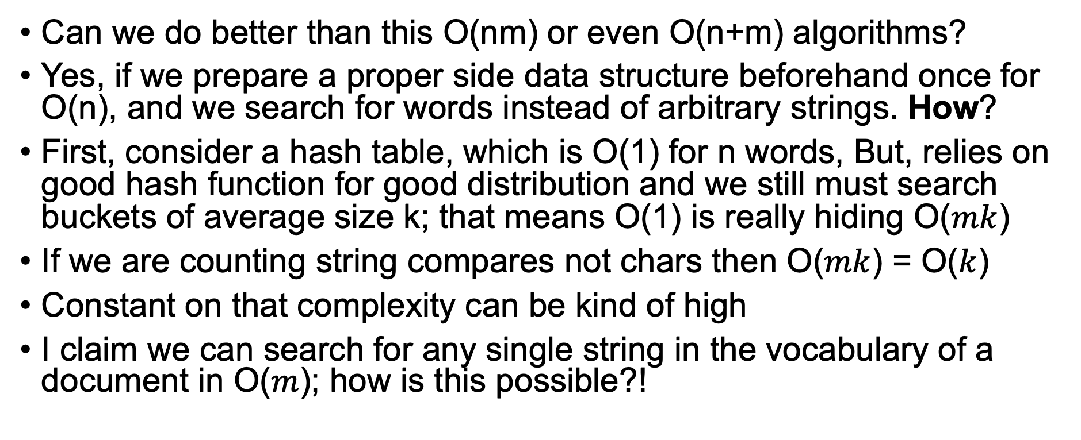
Is this the best we can do?
Can we do better than this O(nm) or even O(n+m) algorithms?
Yes, if we prepare a proper side data structure beforehand once for O(n), and we search for words instead of arbitrary strings. How?
First, consider a hash table, which is O(1) for n words, But, relies on good hash function for good distribution and we still must search buckets of average size k; that means O(1) is really hiding O($mk$)
If we are counting string compares not chars then O($mk$) = O($k$)
Constant on that complexity can be kind of high
I claim we can search for any single string in the vocabulary of a document in O($m$); how is this possible?!

Slide 10
Revisit recursive bucket sort
Break up doc into words, make nested bucket structure as we saw before
Add deeper buckets until just one max of k words per bucket
To find word s, use char s[i] to navigate and find final “leaf” with list of words w/same prefix
Navigate with index to bucket
How long does it take to find s for n=len(vocab), m=len(s), k= max bucket size? T(n,m,k) =
m+k*avgwordsize
Can we do better than that?

Slide 11
Introducing “Tries” or Prefix Trees
First step, convert buckets to nodes and rotate: we get a tree! Don’t need buckets anymore
Words are edge labels on path from root to leaves
(was in a “big internet company” interview)

Slide 12
Adding string s to TRIE
class TrieNode:
def __init__(self):
self.edges = {}
TRIE can hold a big set of words and we can search for a word superfast
Like bucket sort but add nested buckets for entire length of each string: pigeonhole! Like having max bucket size k = 1
Note: We’re not sorting so order of edges is not important; can use dict()
Starting at the root, add edge labeled with s[0] pointing to new node
Traverse edge root.edges[s[0]] to child and add subtree for s[1:] to that child
Recurse until out of chars in string s
Adding one s is O(m) since we must add edge for each char

Slide 13
Implementation
class TrieNode:
def __init__(self):
self.edges = {}
add(root, “ape”)
def add(p:TrieNode, s:str, i=0) -> None:
if i>=len(s): return
if s[i] not in p.edges:
p.edges[s[i]] = TrieNode()
add(p.edges[s[i]], s, i+1)
Note that nodes have no values, edges contain the letters
Edge field is a dictionary mapping a char to a node

Slide 14
Words that are prefixes of other words
What about when we have two words “ape” and “apex”?
“ape” stops before being a leaf, so we must mark as accept state, which is sometimes called a stop state
class TrieNode:
def __init__(self):
self.isword = False # set to true if accept state
self.edges = {}
def add(p:TrieNode, s:str, i=0) -> None:
if i>=len(s): p.isword=True; return
if s[i] not in p.edges:
p.edges[s[i]] = TrieNode()
add(p.edges[s[i]], s, i+1)

Slide 15
Searching a Trie (with analogies)
choose door
based upon
current letter
Return true if s is prefix of word in Trie or full word in Trie
Note that the search depends on len(s) NOT num words n in the vocabulary!!!
def search(root:TrieNode, s:str, i=0) -> bool:
p = root
while p is not None:
if i>=len(s): return True
if s[i] not in p.edges: return False
p = p.edges[s[i]]
i += 1
return True

Slide 16
Can search for word sequences too
TRIE remembers set of sentences not words, in this case
Tokenize document into words then add sentence sequence to TRIE or just bigrams, trigrams etc…

Slide 17
Edge dictionaries are O(1) but…
self.edges = {} using general hashtable; can we do faster version of self.edges['x']?
Yes, use array access via perfect hash function f(c) = ord(c) - ord(‘a’)
But we use 26 slots even for one edge
How can we reduce memory costs?
Many nodes will have just one outgoing edge so we can optimize for that case with single pointer instead of an array
Switch to 26-element edge array if we need more than one edge

Slide 18
Exercise: find all words starting with prefix
Create a trie again from the word list
Write a function that prints all words in trie that begin with a specific prefix like “app”; it should get “apple”, “application”, …
How would this work?
Trace prefix into trie, reaching specific non-leaf node p; find all reachable leaves; track string as recursion parameter for each path; print the string when you reach a leaf

Slide 19
Exercise: How to build a suffix tree?
Simple: create trie from reversed strings or modify add() method to walk backwards through string

Slide 20
Exercise: Given misspelled words off by 1 letter only, find all possible words
Trace word into trie until no edge exists for s[i]; this is node p
Get list of words reachable from each node targeted by p starting with s[i+1]
E.g., “cxt” would get to p=root.edges[‘c’] target and fail
Find “t” from p.edges[‘a’] and p.edges[‘i’]
We find only “t” matches via ‘a’ to get “cat”

Slide 21
Summary
Lots of ways to search beyond linear and binary search
String searching has some really efficient solutions such as Rabin-Karp; idea is to compare hash codes before doing string comparisons and do a rolling hash for the document substrings
If we are willing to build a graph data structure in O(nm), the TRIE is pretty hard to beat in terms of complexity / performance; looking up a word in the TRIE is O(m) for m-character string!
TRIE is just a nested pigeonhole sort turned into a graph
Useful as prefix and suffix trees; can find misspelled words
Coding exercises next…

Slide 22
Exercise: Brute force dictionary search
Load words from /usr/share/dict/words file (one per line) into list
Search for each word in list of words; what is complexity?
This takes almost 5 minutes on my fast computer. Ugh
For just 50k words, takes 13s (still brutally slow)
A
a
aa
aal
aalii
aam
Aani
aardvark
aardwolf
Aaron
Aaronic
Aaronical
…
See solution https://github.com/parrt/msds689/blob/master/notes/code/trie.py

Slide 23
Exercise: Build Trie from dictionary of words
From searching notebook, get Trie implementation
Add each word to a trie, which takes about 7s on my machine
Search the trie for each of 235,886 words; takes 0.70s for me!!
Rejoice in your new super powers
Cool interview question/task: How can you do fast spell checking on big documents?
See solution https://github.com/parrt/msds689/blob/master/notes/code/trie.py

