Slide 1
Object-oriented programming
Terence Parr
MSDS program University of San Francisco
See notebook https://github.com/parrt/msds501/blob/master/notes/OO.ipynb

Slide 2
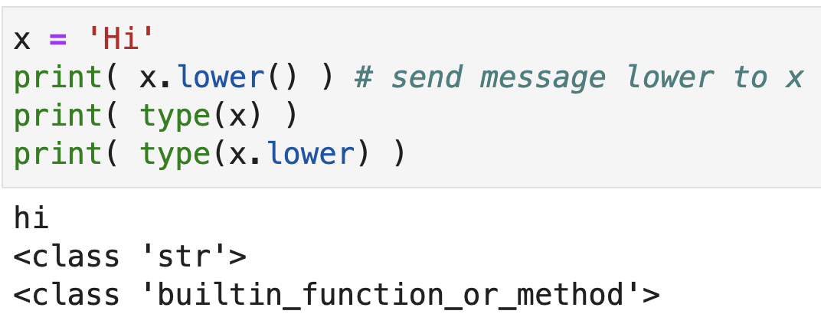
The big reveal
We've been working with functions and modules with functions, as well as defining our own functions
It turns out, though, that we've also been working with objects all along, we just haven't recognized them as such

Slide 3
Classes and objects
An object represents a (potentially) real-world entity and encapsulates its state (fields) and behavior (methods)
An object is called an instance of the class
A class is the blueprint for an object and is the name of the type
In common speech, we often use the terms interchangeably
Methods are just functions associated with classes (behavior)
Python has both functions and methods for object programming, which is why there is both x.lower() and len(x)
x.lower() is implemented as str.lower(x)
Objects were added after-the-fact to Python and the syntax is a bit awkward compared to other OO languages

Slide 4
Why OO programming?
Our hunter-gatherer brain views the world as a collection of objects that interact by sending messages
An OO programming paradigm maps well to real-world problems that we try to solve or simulate via computer
We are at our best when programming the way our minds are hardwired to think
OO lets us map real-world entities onto programming constructs; nouns become objects and verbs become methods

Slide 5
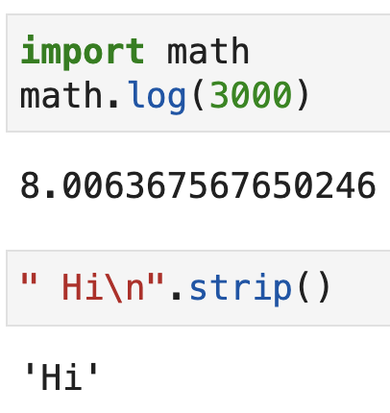
Attention: Module versus object members
The dot ’.’ operator is overloaded in Python to mean both module/package member access and object member access
When we see a.f(), we don't know whether f is a member of the package identified by a or a method in the object referred to by a

Slide 6
Exercise
What kind of things are the various words and subexpressions here?
np.log(3)
np.linalg.norm(v)
from sklearn.ensemble import RandomForestRegressor
pd.read_csv("foo.csv")
pd.read_csv
'hi'.lower()
'hi'.lower
df_train.columns
np.pi
img = img.convert("L")
df["saledate"].dt.year
df_train.isnull().any().head(60)

Slide 7
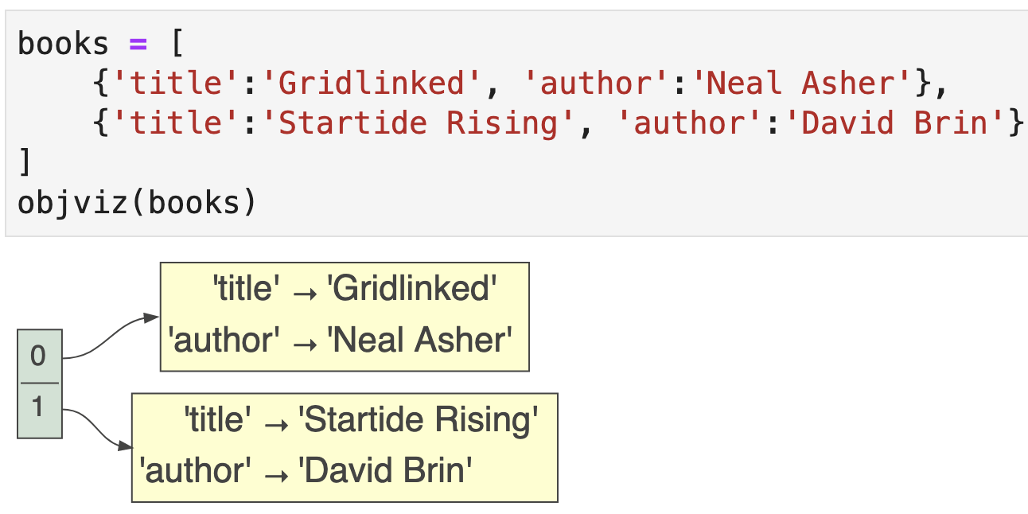
Objects group related values
Let’s baby step into the object-oriented world by associating an author and title for a few books; easiest way is with a dictionary
Acts like an object

Slide 8
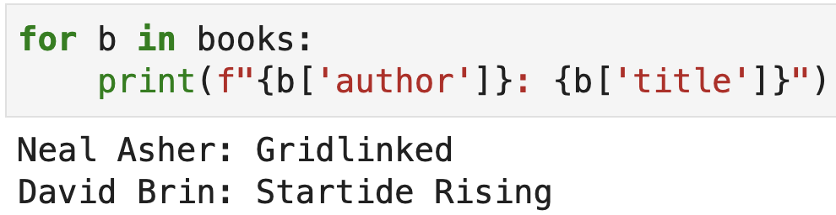
Accessing “fields” with dictionary approach
Using a small dictionary to group related values works, but has a number of significant disadvantages
There’s no template that ensures each dictionary has the right key/value pairs (actually, Python syntax has no way to do this)
The notation is a bit awkward: b[‘author’] instead of b.author
There’s no way to associate functions with these dictionaries

Slide 9
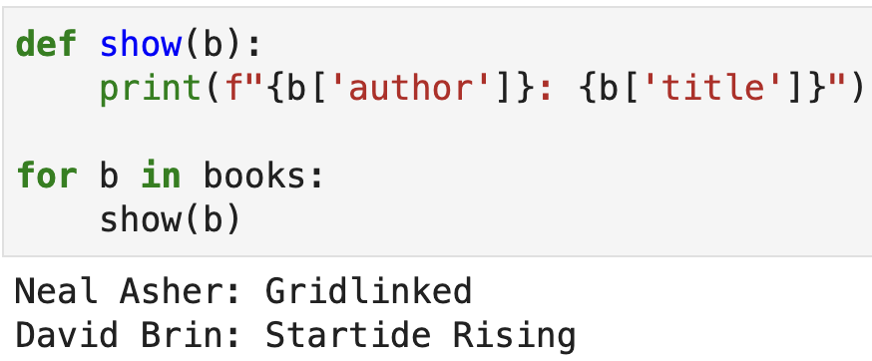
Calling functions with dictionary approach
We can obviously define a function to print out a book represented by dictionary, but there's nothing about that function that indicates it's associated with our book dictionaries
Could try to add “:dict” but doesn’t help much

Slide 10
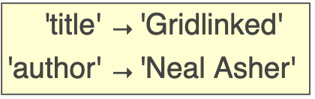
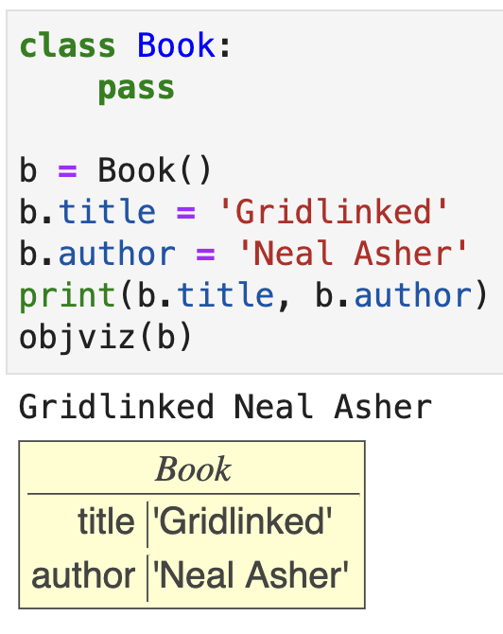
A basic Python class version of Book
Compare the dictionary version to the minimal formal class version
("pass" just means there's nothing inside)
We create a Book object/instance using the class name and parentheses
Here, we explicitly create new fields for a Book object by assignment
Notice: b.title vs b['title'] notation
There is one Book definition but there can be many instances

Slide 11
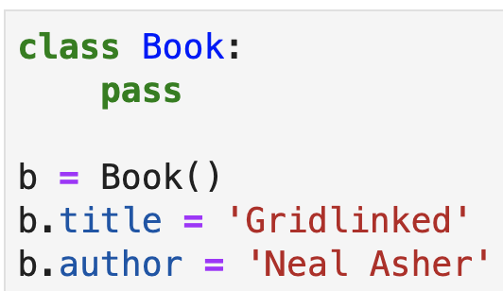
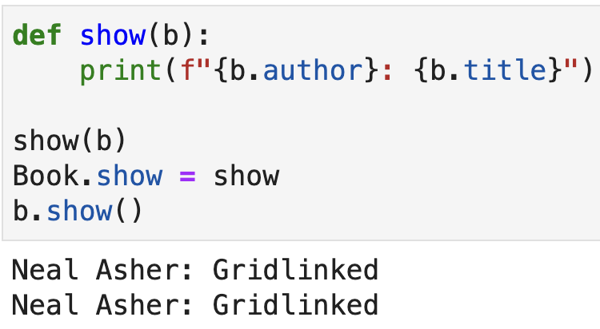
Attaching a function to a class
As with fields for a specific instance, we can attach a function to the class definition using an assignment
Then we can use OO notation b.show() instead of show(b)

Slide 12

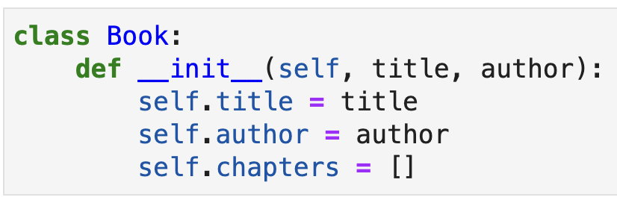
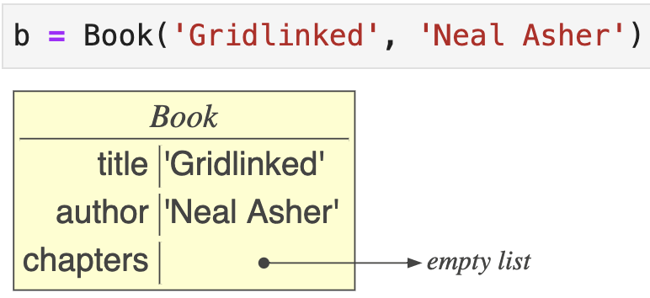
Defining a constructor method
🚫
Associating fields & functions to objects & classes with assignments is awkward; better to embed methods within classes
Let's start by defining a constructor that sets initial and default field values based upon the arguments (a func nested inside class)
Python creates an object and passes it to constructor
Yes, __init__ is a convention (and super weird)

Slide 13
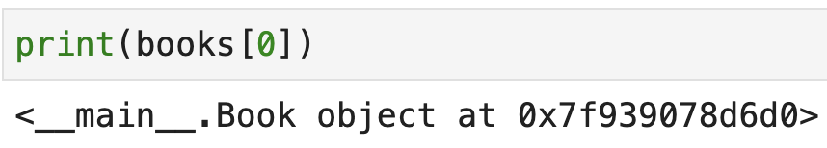
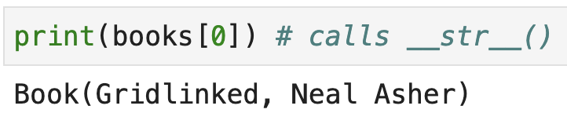
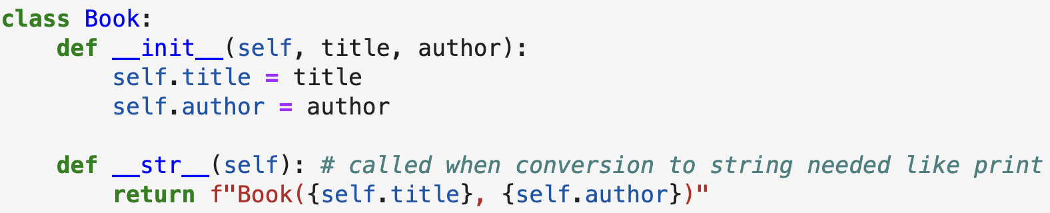
Another common method to implement
Objects don't know how to display themselves by default:
We have to define a method

Slide 14
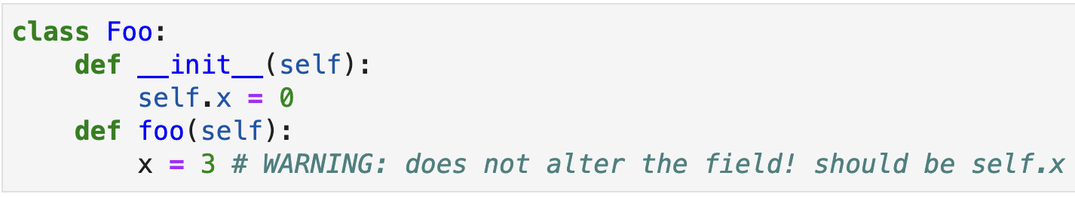
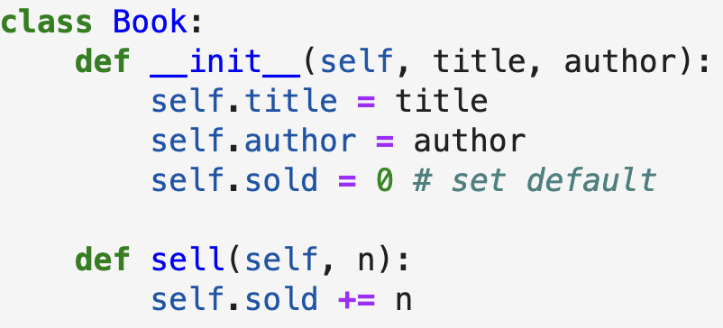
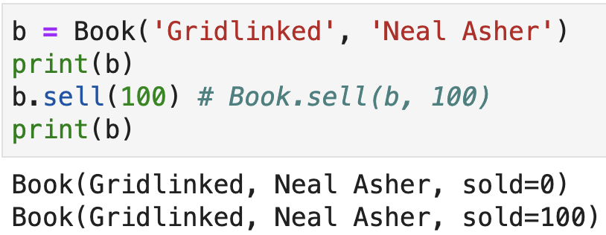
Focus on your "self"
In methods, you must refer to fields and other methods by prefixing them with "self."

Slide 15
Understanding methods versus functions
b.sell(100) method call is translated and executed by the Python interpreter as function call Book.sell(b,100)
b becomes parameter self and so the sell() function is updating book b
Why we prefer b.sell(100) over Book.sell(b,100):
Instead of just functions, we send messages back and forth
Instead of bark(dog) we say dog.bark() or instead of inflate(ball) we say ball.inflate()

Slide 16
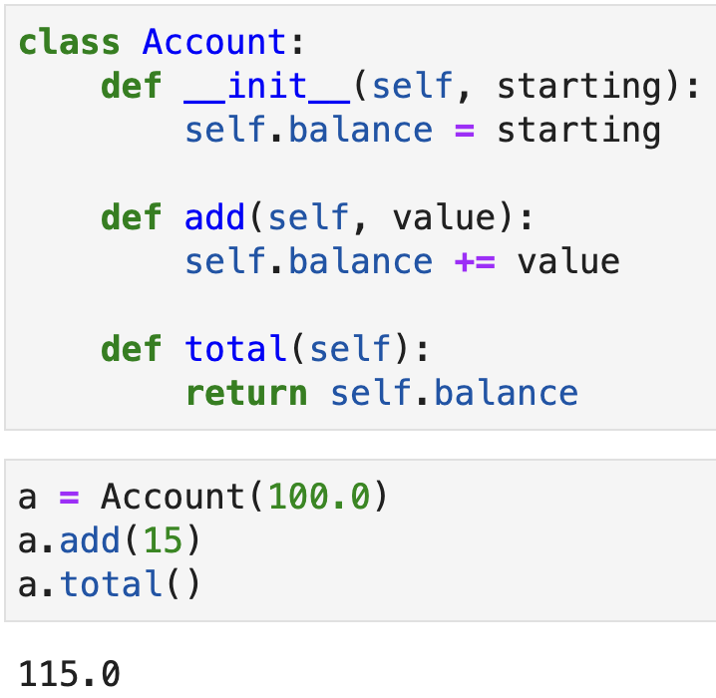
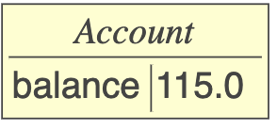
Inheritance
Defining something new as it relates to something we already understand is usually a lot easier than starting from scratch; same is true in programming
A subclass inherits from a superclass
Let's start our demonstration of this by defining a simple class representing account balances
Experiment in pythontutor

Slide 17
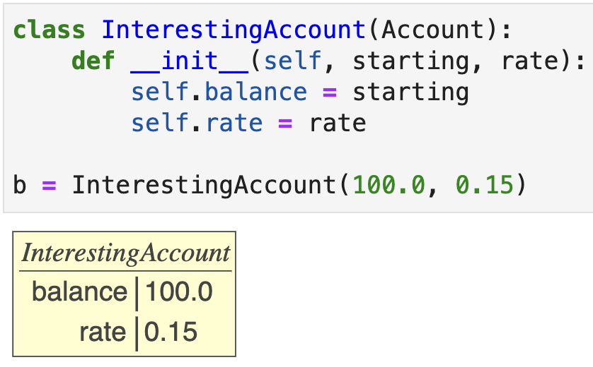
Inheriting fields (conceptually but not really)
Inheritance behaves like an import or include operation from another class into a new class (not exactly true)
Either call superclass constructor or manually set fields; technically, we are not inheriting fields but we consider subclasses to always inherit the fields of their superclass
Experiment in pythontutor

Slide 18
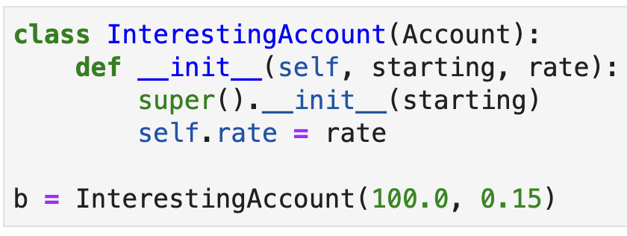
Inheriting fields continued
We can also refer to the superclass constructor instead of manually assigning fields associated with the superclass; it's useful but a bit awkward
I mention this because you will see this notation

Slide 19
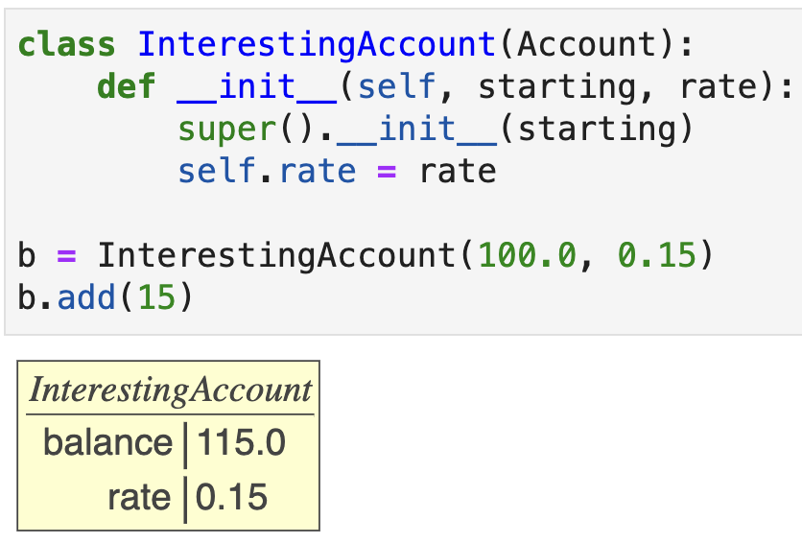
Inheriting methods
A class inherits all methods defined in the superclass(es) so, in this case, InterestingAccount inherits method add()
Calls Account.add()
Experiment in pythontutor

Slide 20
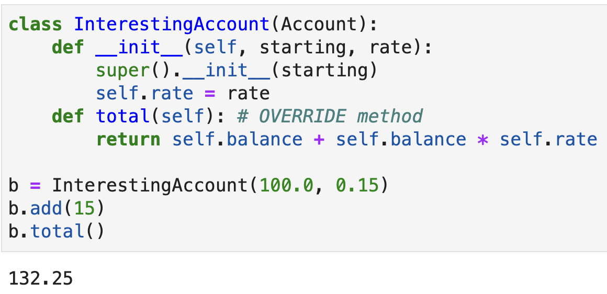
Overriding methods
We can also override a method defined above; by defining method total() in the subclass, it hides the superclass definition
We have reused and refined previous functionality
Experiment in pythontutor

Slide 21
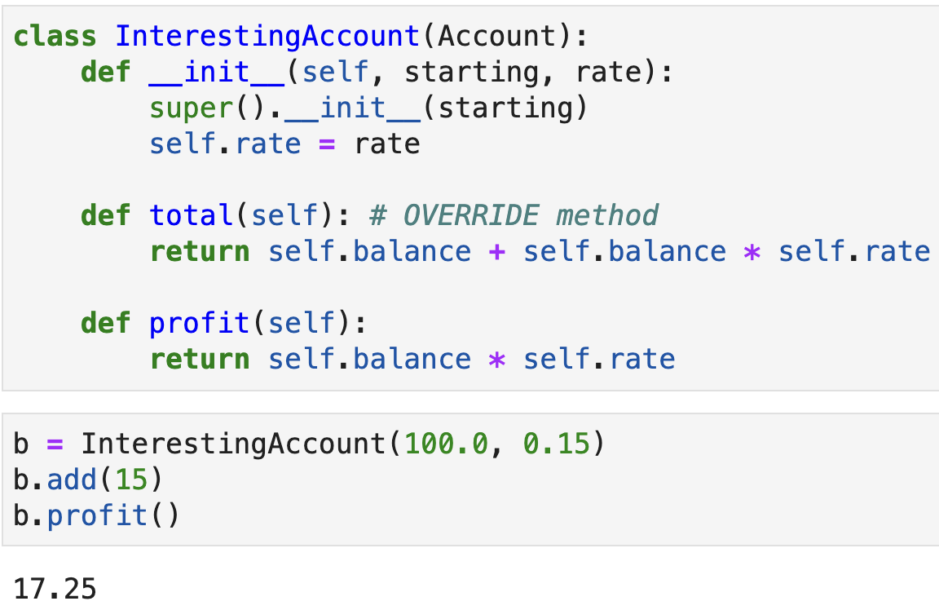
Extending functionality
We can also extend the functionality by adding a method that is not in the superclass
Experiment in pythontutor

