Slide 1
Reading, writing files
Terence Parr
MSDS program University of San Francisco
See notebook https://github.com/parrt/msds501/blob/master/notes/files.ipynb

Slide 2
What are files?
Both the disk and RAM are forms of memory
RAM is much faster (but smaller) than the disk and RAM data disappears when the power goes out
Disks, in contrast, are persistent / non-volatile
A file is simply a chunk of data on the disk identified by a filename and living within a specific directory
File data is less convenient to access because we have to explicitly load the file into working memory before operating on it
If a file is too big to fit into memory all at once, we have to process the data in chunks, typically line by line if text format data

Slide 3
File state
Files must be opened and then closed when we're done
Files are opened for reading or for writing (or appending)
Files are opened with a mode: text or binary
f is a file descriptor
f = open(‘foo.txt’, mode=‘r’) # open for read text mode
read from f
f.close() # ok, we're done

Slide 4
Avoiding confusion
The filename is a string that identifies a file on the disk. It can include path information or can be just the name of the file itself
A path (specifying a directory or file) can be fully-qualified (absolute) or relative to the current working directory
A file descriptor object is not the filename and is also not the file contents itself on the disk. It's really just a descriptor that lets a program refer to and operate on the file
The content of the file is different than the filename and the file (descriptor) object that Python gives us when we open it

Slide 5
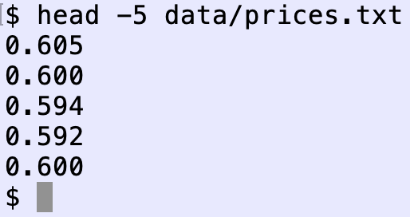
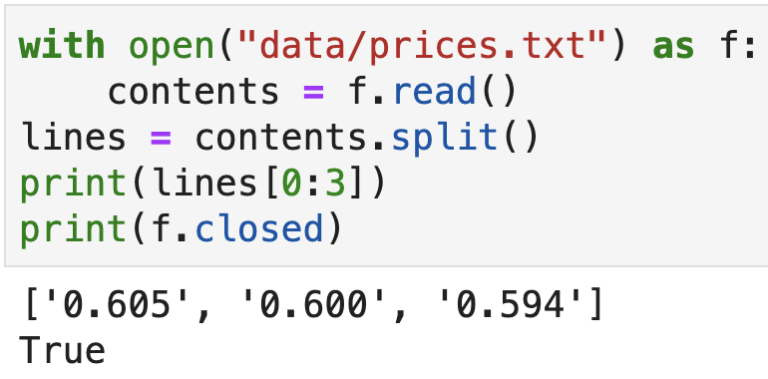
The WITH statement
The with statement helps us to automatically close files

Slide 6
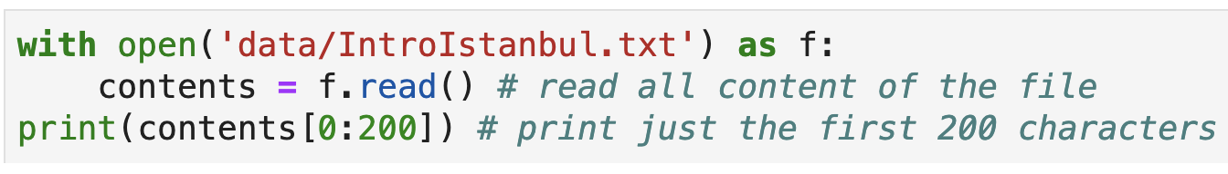

Most common programming pattern
Load all file contents into a string

Slide 7
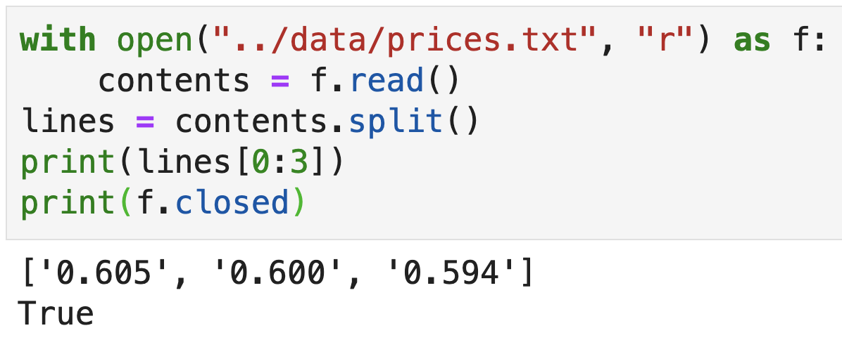
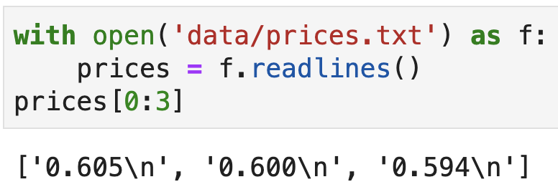
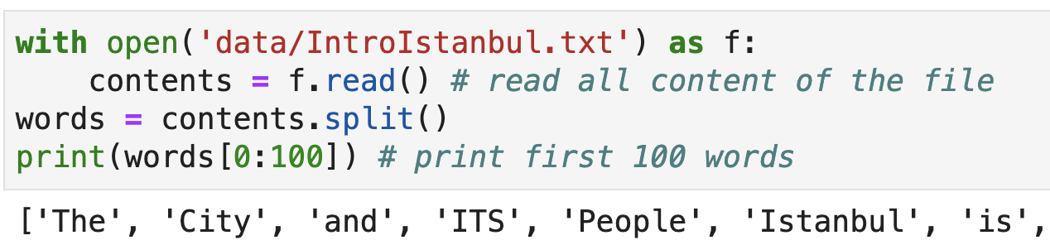
2nd most common programming pattern
Load all lines of a file or words of a file into a list

Slide 8
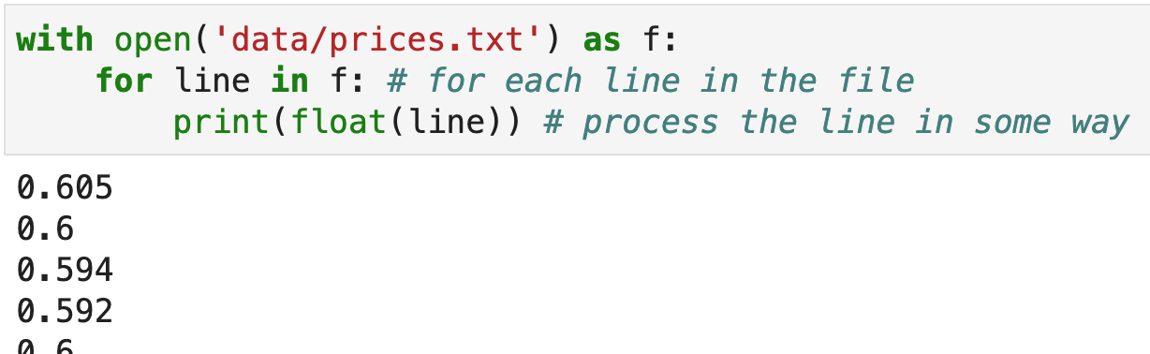
Processing files line by line
Loading everything into memory all at once doesn't work if a file is bigger than available RAM
That limits the size of the data we can process with that method
Instead, we can use a for-each loop iterating on the file descriptor:
or use f.readlines()

Slide 9
Efficiency tip
Python optimizes use of f.readlines() in a loop so that it only loads one line at a time
This is very efficient:
But this loads all into memory and is much slower
for line in f.readlines():
print(line)
lines = f.readlines()
for i in range(len(lines)):
line = lines[i]
print(line)

Slide 10
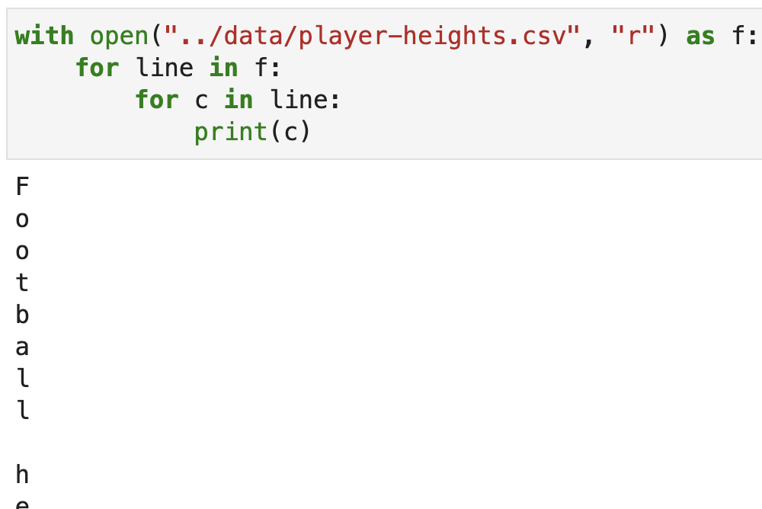
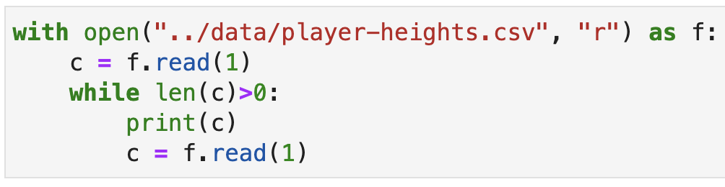
Process a file char-by-char
Or, read 1 char at a time in a while loop
(read() gives empty string at EOF)

Slide 11
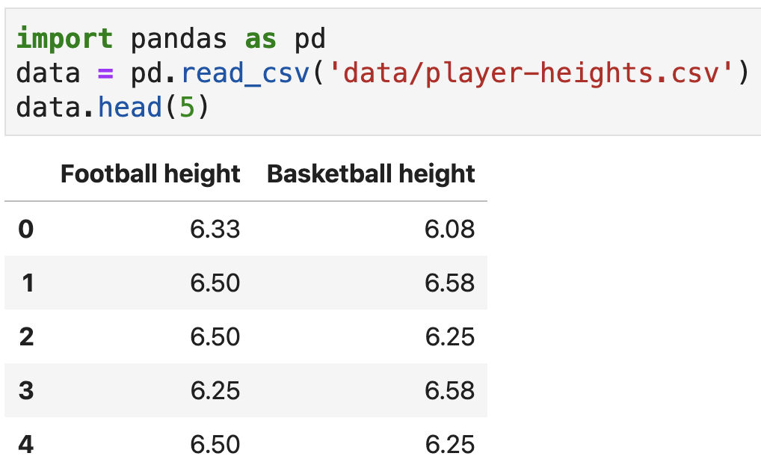
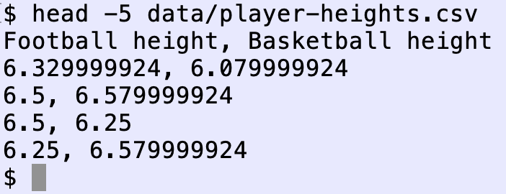
Using Pandas to load CSV files
If the text file is a comma separated value file (CSV), the easiest way to load the data is with Pandas

Slide 12
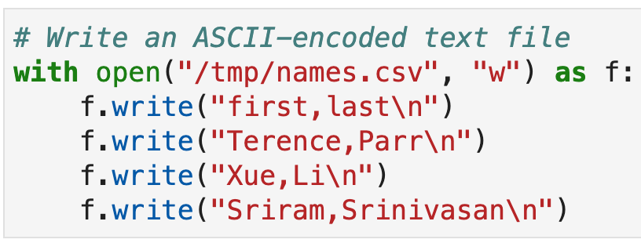
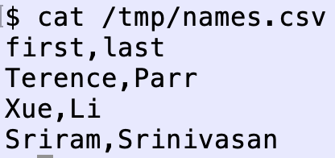
Pattern: Save strings into a text file
(The way we encode strings for storage in a file is a complication we can ignore until MSDS692)
Save a few lines representing a CSV file to /tmp dir
The two-char \n sequence represents a single newline character

Slide 13
We’ll study more about text formats and binary formats in data acquisition (MSDS692)

