Slide 1
Organizing your code with functions
Terence Parr
MSDS program University of San Francisco
See notebook: https://github.com/parrt/msds501/blob/master/notes/functions.ipynb

Slide 2
What’s a function?
def pi():
return 3.14159
We’re already familiar with functions from mathematics like sin, cos, max, etc…
A function is just a sequence of operations grouped into a single, named entity that we can invoke to perform a task
Functions are like mini programs or subprograms that we can build just like full programs
Just like a book is organized into multiple chapters, programs are best organized into multiple functions; the main program can then just call the appropriate functions

Slide 3
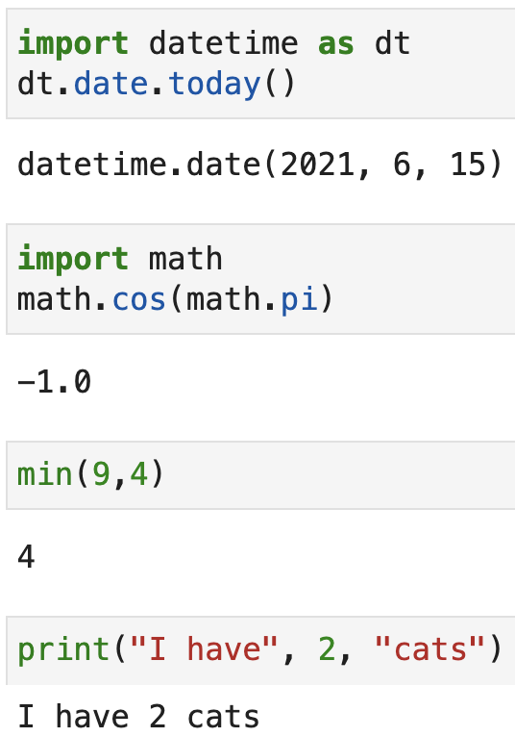
Black boxes
no args
Think of functions as black boxes that:
perform some task
possibly taking some input
possibly returning output
possibly causing side effects
Don’t worry about their guts, just worry about how to call them
Reduce cognitive load
one arg
multiple args
arbitrary number of args

Slide 4
A cooking analogy to functions
A pasta recipe might have several high level tasks:
Chop veggies
Create sauce
Cook pasta
As we proceed through the recipe we have to go off and perform the indicated task, come back, and continue to the next task
We jump from the main path to the subtask and back just like the computer processor in code

Slide 5
Data science example
The overall program is often a sequence of function calls that perform the subtasks; you might have something like:
Acquire data
Clean data
Compute statistics
Visualize results
Top-down design: solve overall problem with high-level tasks, then design those subtasks
Subtasks might be broken into subsubtasks etc…

Slide 6
The motivation to define functions
Helps organize our programs, which really helps readability
Fosters code reuse, thus, increasing productivity
Lets us focus on just the behavior inside the function, which helps reduce what we have to think about at once (this is also the motivation to avoid side-effects)
Functions have well-established input and output (arguments and return values), which can make debugging easier and improves reusability

Slide 7
How to plan out a function
First, identify:
a descriptive function name
the kind of value(s) it operates on (parameter types)
the kind of value(s) it returns (return type)
what the function does and the value(s) it returns
If we can't specify exactly what goes in and out of the function, there's no hope of determining the processing steps, let alone Python code, to implement that function
Write some sample function invocations to show what data goes in and what data comes out
Then try to work out the steps, possibly working from the return value backwards
Then write the code that implements the steps
pow2(3) ☞ 8
pow2(8) ☞ 64

Slide 8
Coding a function
The code template for a function with no arguments is:
Recall: we associate statements with a function by indentation
The function definition does not execute the code inside; it just defines the function for our use
def funcname(): statement 1 statement 2 ... return expression
def pi():
return 3.14159

Slide 9
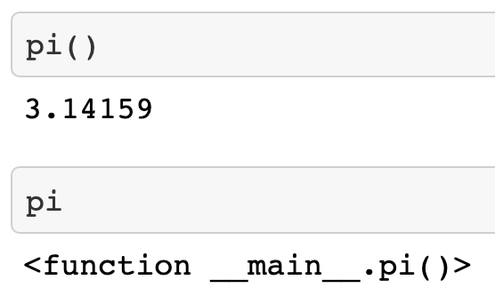
Calling a function
def pi():
return 3.14159
The definition of a function is different than calling a function
Calling a function requires the function name and any argument values; here, we don't have any arguments so we can do this:
(We don't need a print statement here to see the value because we are executing inside a notebook)

Slide 10
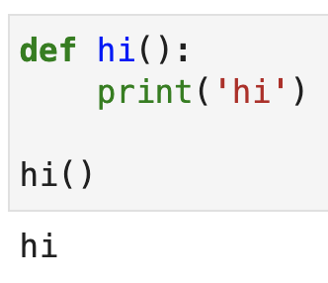
Functions with side effects
Some functions don't have return values; e.g., they might update a GUI, alter a database, delete records from a data frame, or simply print
Such functions have side effects
The return statement is omitted if the function does not return a value
The value of a function w/o a return is None
Experiment in pythontutor

Slide 11
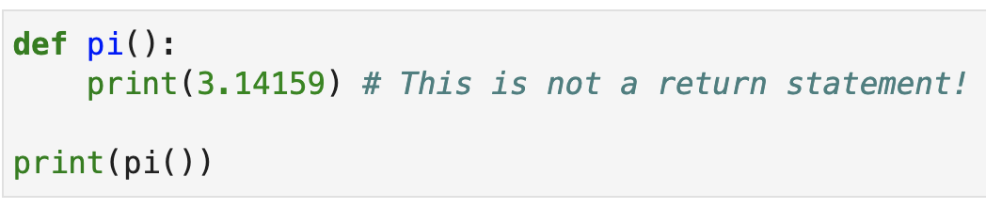

Return values versus printing
Functions compute and return values to their callers
Functions do NOT print anything unless explicitly asked to do so with a print statement
What does this print?
Experiment in pythontutor

Slide 12
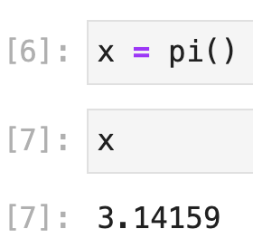
Saving return values
Every invocation of function pi evaluates to the value 3.14159
We can save the return value in a variable like x = pi()
Or even use it in an expression like x = pi() * 4
Note: Jupyter notebooks do not print results for assignments (just for expressions)
The pi function returns a value but prints nothing; e.g., even in a notebook, there is no output if we save the return value
Confusion point!

Slide 13
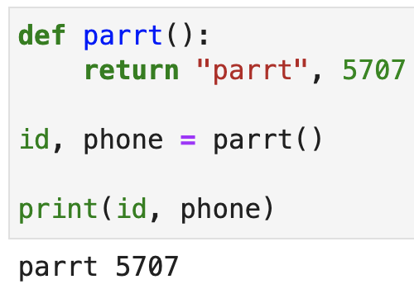
Functions with multiple return values
We can return any Python object, not just numbers
We can also return multiple values
Multiple return values are assigned to multiple variables

Slide 14
Functions with arguments
Here is a function template with N arguments
Function calls look like: funcname(expr1,expr2,expr3,…,exprN)
The order of the arguments matters, matching expr_i to arg_i
def funcname(arg1, arg2, arg3, …, argN): statement 1 statement 2 ... return expression

Slide 15
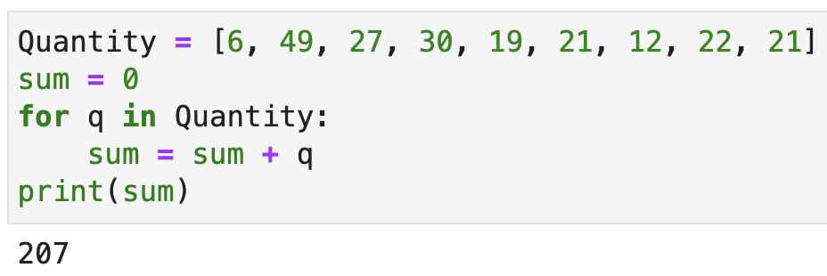
Example: summation of numbers in list
Here’s a code snippet to sum the numbers in a list
This works, but there’s an issue here; any ideas?
The code is not reusable as-is (must copy/paste/tweak)

Slide 16
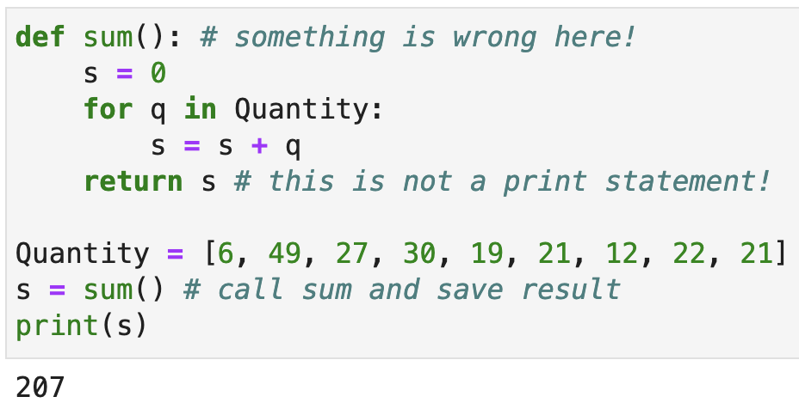
Encapsulating in a function; version 1
By wrapping in a function, we strive for a reusable ”recipe”
Add the function header, shift the statements to the right and add a return statement:
What’s wrong with this version?
Experiment in pythontutor

Slide 17
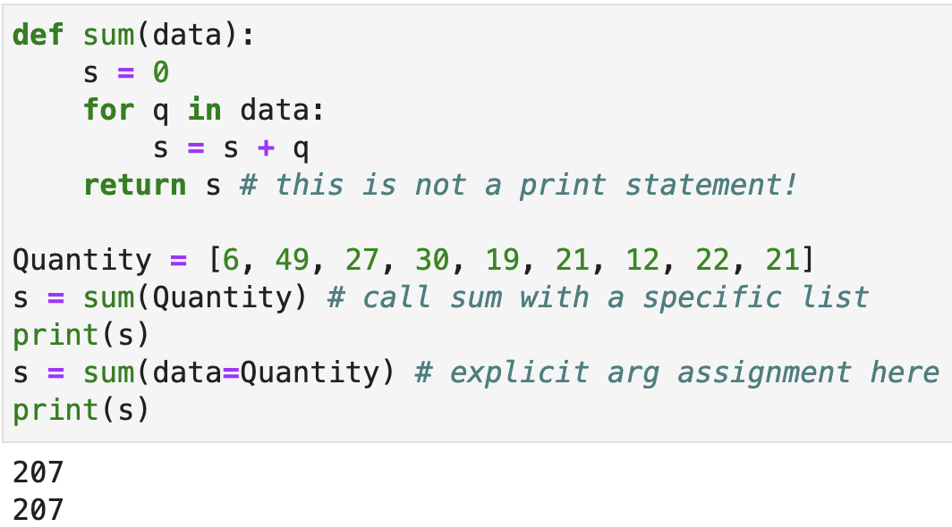
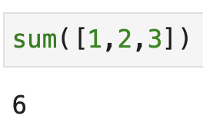
Encapsulating in a function; version 2
Functions should focus on the parameters and avoid global variables if possible
This version now works with any list of numbers, not just Quantity:
Experiment in pythontutor

Slide 18
Example: search function
Here’s a hardcoded non-function search example
The problem is that it is restricted to work with a list called first
first=['Xue', 'Mary', 'Robert'] # our given input
target = 'Mary' # searching for Mary
index = -1
for i in range(len(first)): # i is in range [0..n-1]
if first[i]==target:
index = i
break

Slide 19
Example: search function version 1
Wrap in a function header with two arguments
def search(x, data):
index = -1
for i in range(len(data)):
if data[i]==x:
index = i
break
print(index)
first=['Xue', 'Mary', 'Robert']
search('Mary', first) # invoke search with 2 parameters
What’s wrong with this function?

Slide 20
Example: search function version 2
Wrap in a function header with two arguments
def search(x, data):
for i in range(len(data)): # i is in range [0..n-1]
if data[i]==x:
return i # found, return current index i
return -1 # failure; we didn’t find x
print(search('Mary', first))
print(search('Xue', first))
print(search('foo', first))
The return statement forces Python to immediately exit the function and return the specified value
Experiment in pythontutor

Slide 21
Restricting data accessed by functions
Optimally, functions should be purely a function of the data passed to them as parameters---functions should be completely ignorant of any other data
That is, functions should not access global variables
Good
Bad
def sum(data):
s = 0
for x in data:
s += x
return s
def sum():
s = 0
for x in data:
s += x
return s
argument
global
Experiment in pythontutor

Slide 22
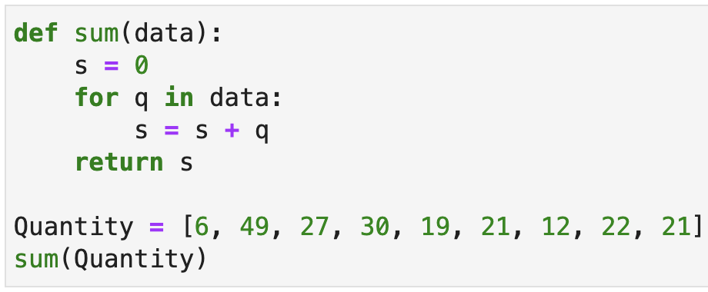
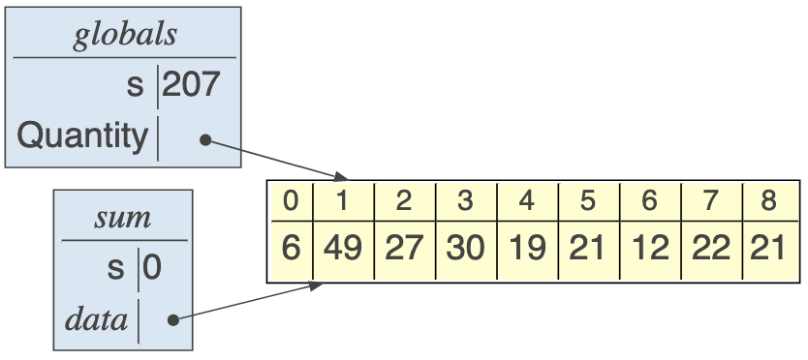
Aliasing through argument passing (review)
Aliasing of data happens a great deal when we pass lists or other data structures to functions
E.g., passing list Quantity to a function whose argument is called data means that the two are aliased

Slide 23
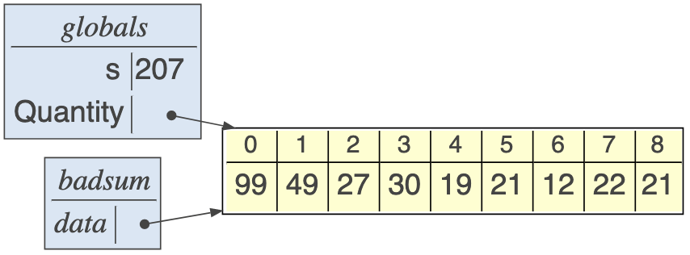
Watch out for functions that modify data structure arguments (review)
A list argument is a reference to the list past in and so modifying the list contents modifies the caller’s perspective as well
def badsum(data):
data[0] = 99 # alters global variable as well
s = 0
for q in data:
s = s + q
return s
Experiment in pythontutor

Slide 24
Visibility rules
Main programs cannot see variables and arguments inside functions; just because a main program can call a function, doesn't mean it can see the inner workings (Information hiding is a key concept for large projects)
Functions can technically see global variables but don't do this as a rule; instead, pass the global variables that you need to each function as arguments

Slide 25
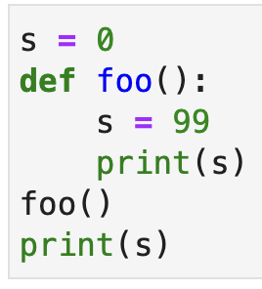
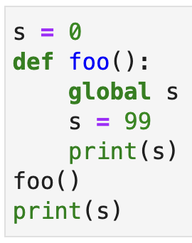
Global vs local variables
Assigning to a variable for the first time creates that variable (almost always, that is)
Creates global
Creates local or sets global?
What's the output?
What's the output?
99
0
99
99

Slide 26
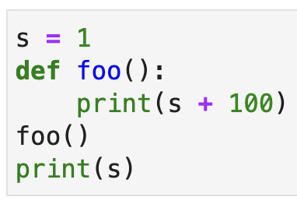
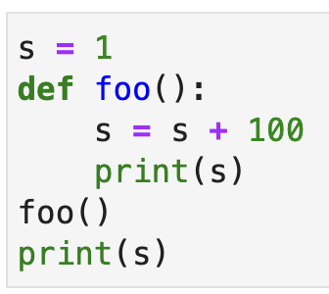
More variable references in functions
Assigning to a variable for the first time creates that variable (almost always, that is)
global or local?
What's the output?
What's the output?
101
1

Slide 27
How functions return to invocation sites
Calling a function not only jumps to the function code, it remembers the call site so it can continue where it left off
We remember call site by pushing return address onto a stack

Slide 28
Nested function calls
Here’s a simple program with two functions, where the main program calls f and f calls g
1 def f():
2 g()
3 def g():
4 print(‘hi’)
6 f()
Experiment in pythontutor

Slide 29
Code organization is important
Programs quickly become an incomprehensible rat's nest if we are not strict about style and organization
Here’s a general structure for Python programs:
import any libraries define any constants, simple data values define any functions main program body

