Slide 1
Iterative computing pattern: approximating square root
How to compute values iteratively instead of symbolically
Terence Parr
MSDS program University of San Francisco

Slide 2
Iterative computing
There are lots of useful functions with no closed form solution, meaning we can't just do a computation and return the value
Instead, we approximate function values with iterative methods
Examples include:
sine (with Taylor series expansion)
square root (as we'll do in this lecture)
optimize a cost or error function (e.g., gradient descent in the introduction to machine learning course)

Slide 3
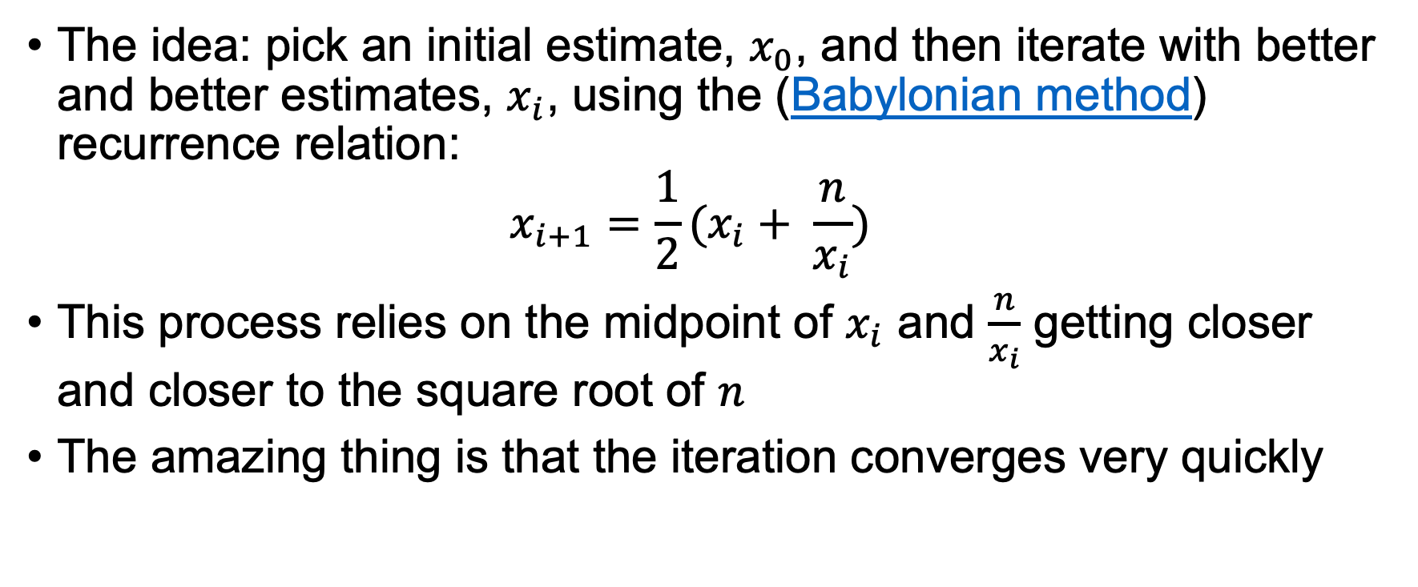
Babylonian method for sqrt
The idea: pick an initial estimate, $x_{0}$, and then iterate with better and better estimates, $x_{i}$, using the (Babylonian method) recurrence relation: $x_{i+1}=\frac{1}{2}(x_{i}+ \frac{n}{x_{i}})$
This process relies on the midpoint of $x_{i}$ and $\frac{n}{x_{i}}$ getting closer and closer to the square root of $n$
The amazing thing is that the iteration converges very quickly

Slide 4
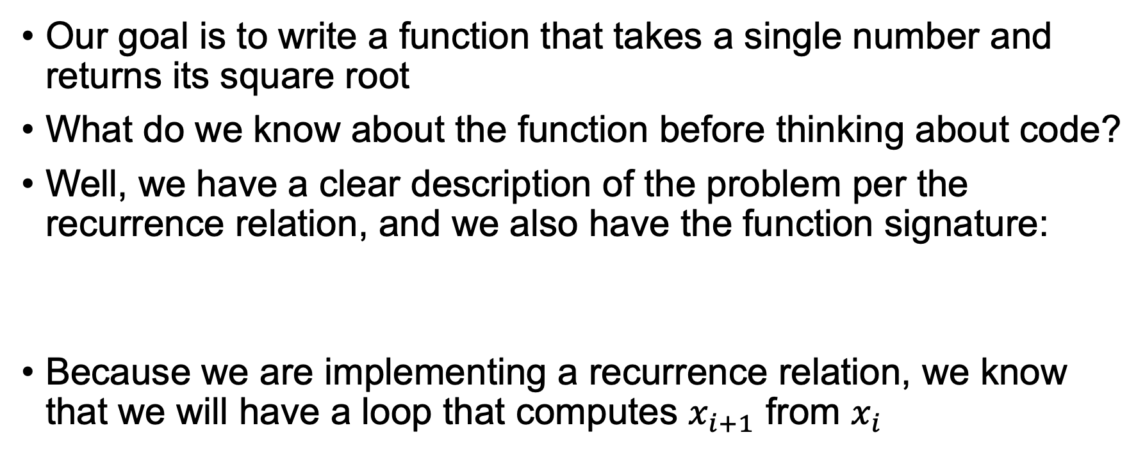
The goal
Our goal is to write a function that takes a single number and returns its square root
What do we know about the function before thinking about code?
Well, we have a clear description of the problem per the recurrence relation, and we also have the function signature:
Because we are implementing a recurrence relation, we know that we will have a loop that computes $x_{i+1}$ from $x_{i}$
def sqrt(n): ...

Slide 5
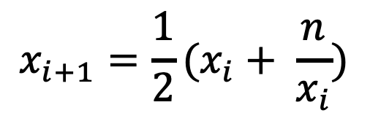
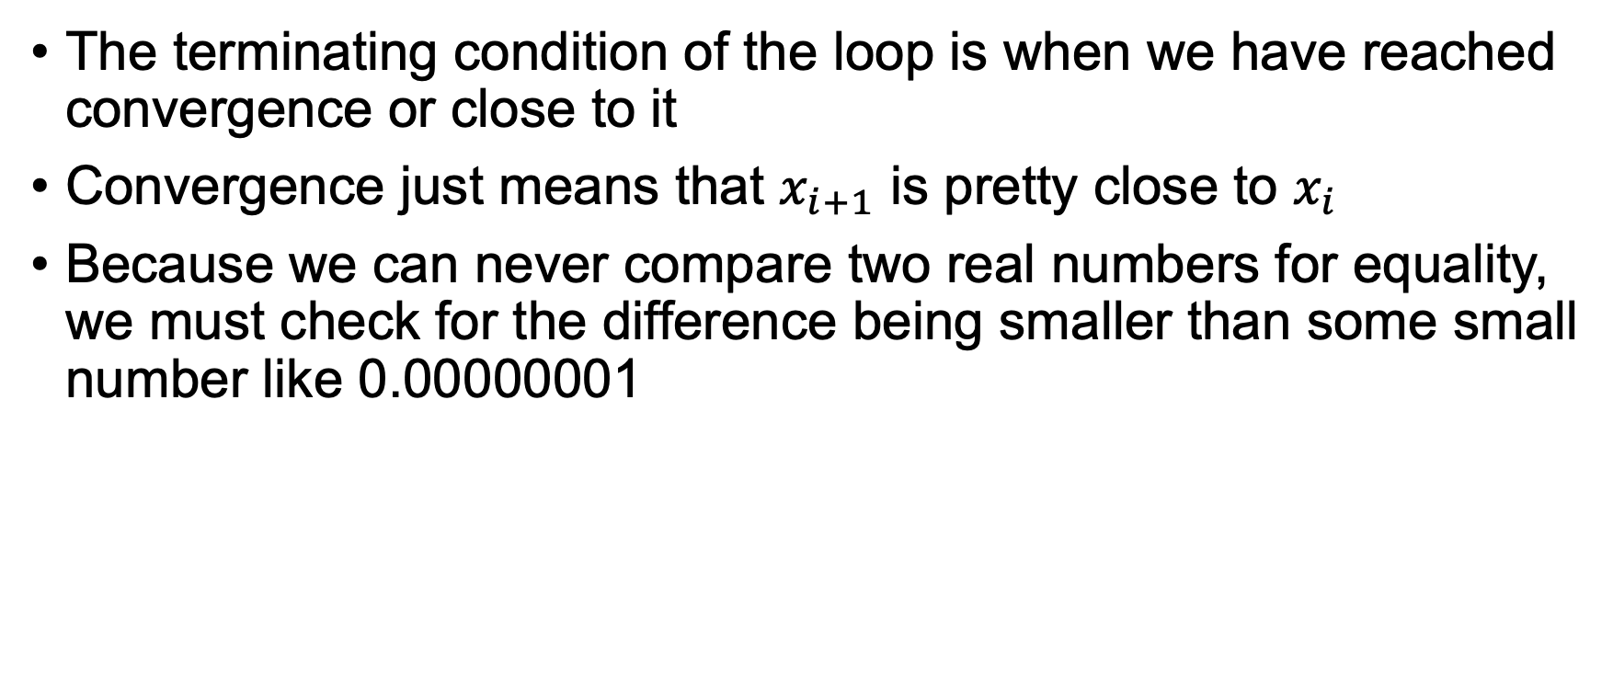
Convergence
$$x_{i+1}=\frac{1}{2}(x_{i}+ \frac{n}{x_{i}})$$
The terminating condition of the loop is when we have reached convergence or close to it
Convergence just means that $x_{i+1}$ is pretty close to $x_{i}$
Because we can never compare two real numbers for equality, we must check for the difference being smaller than some small number like 0.00000001

Slide 6
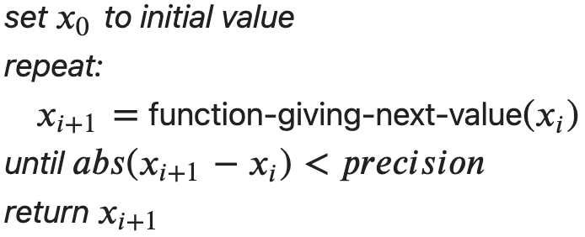
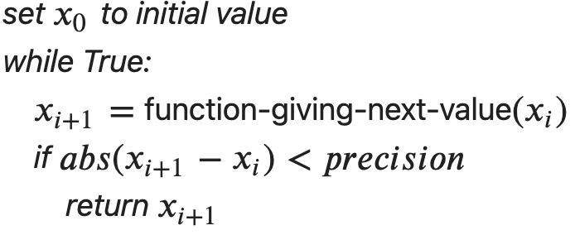
Algorithm
Iterative methods all share the same basic outline
Python does not have a repeat-until loop so we fake it with an infinite loop containing a conditional that breaks out upon convergence

Slide 7
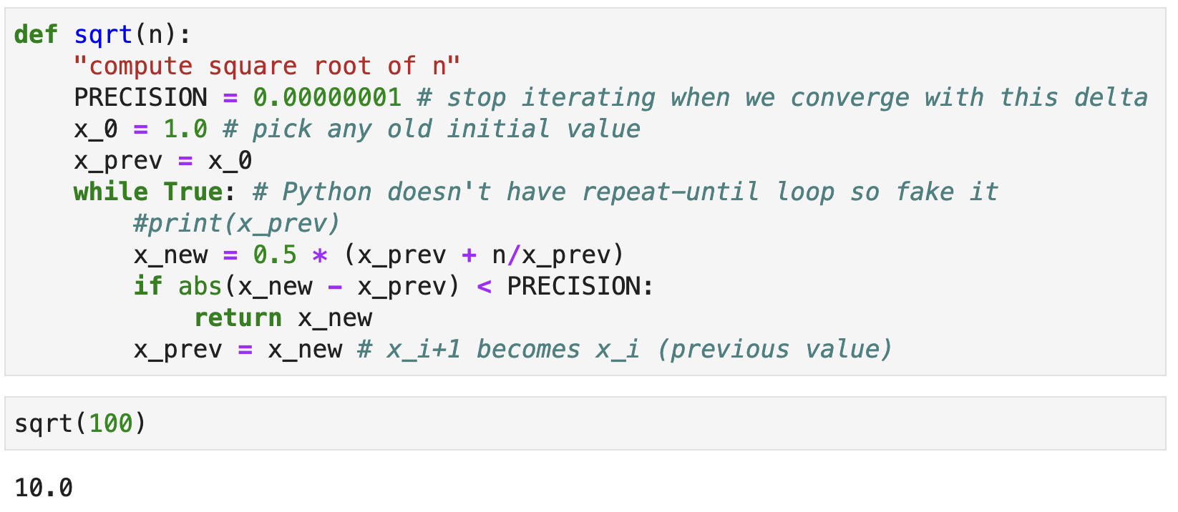

Implementation
The translation to Python is straightforward but notice that we don't need to track all $x_{i}$; we just need the previous/current

Slide 8
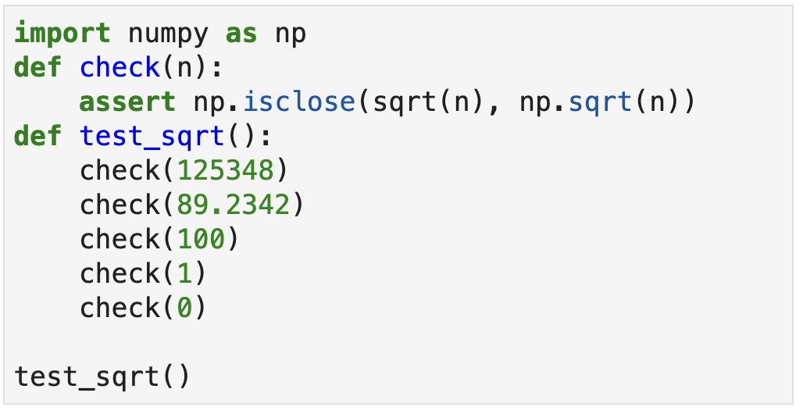
Testing our implementation
To test our square root approximation, we can compare it to math.sqrt() and use numpy's isclose() to do the comparison
The associated lab has an expanded version of these tests

Slide 9
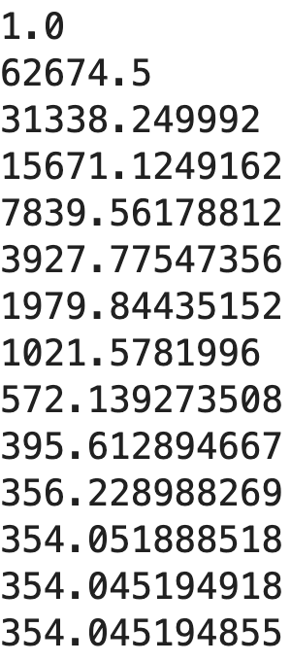
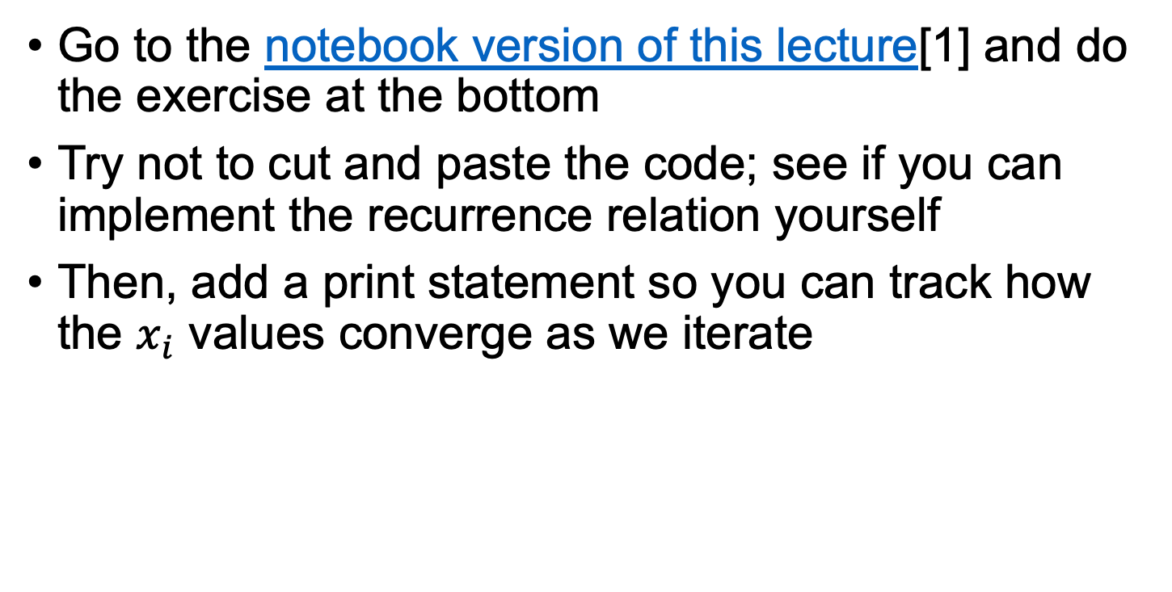
Exercise
sqrt(125348.0)
Go to the notebook version of this lecture[1] and do the exercise at the bottom
Try not to cut and paste the code; see if you can implement the recurrence relation yourself
Then, add a print statement so you can track how the $x_{i}$ values converge as we iterate
[1] https://github.com/parrt/msds501/blob/master/labs/sqrt.ipynb

