Slide 1
Algorithm Complexity
“How long is this gonna take?”
Mustafa Hajij
MSDS program University of San Francisco

Slide 2


Reasons to study algorithm complexity
Get a feel for algorithm time and space performance to operate on a specific data structure or structures
Be able to meaningfully compare multiple algorithms’ performance across a wide variety of input sizes
Analyze best, typical, and worst-case behavior
Reducing algorithm complexity is by far the most effective strategy for improving program performance; Aside: For my PhD, I discovered an approximation to a useful algorithm that dropped complexity from O($n^{k}$) to O($nk$)

Slide 3
Why can’t we just time program execution?
Execution time is a single snapshot that includes:
Choice of specific data structure(s) and algorithm(s)
Machine processor speed, memory bandwidth, possibly disk speed
Implementation language (in)efficiency (e.g., Python vs C)
One possible input (is it the best or worst-case scenario?)
One possible input size
And, we have to actually implement an algorithm in order to time it
(Measuring exec time is still useful)

Slide 4
Algorithm complexity to the rescue
Complexity analysis encapsulates an algorithm’s performance across a wide variety of inputs and input sizes, n.
In a sense, complexity analysis predicts future performance of your algorithm as, say, your company grows and the number of users on your website gets larger (be afraid of non-linear alg’s)
We can compare performance of two algorithms without having to implement them
Comparisons are independent of machine speed, implementation language, and any optimization work done by the programmer

Slide 5
Space vs time complexity
Space complexity measures the amount of storage necessary to execute an algorithm as a function of input size
Time complexity measures the amount of work ("time") necessary to execute an algorithm as a function of input size
There is often a trade-off between using more memory and increasing speed
Be aware that space complexity is a thing, but we will focus on time complexity in this class

Slide 6
If not exec time, what do we measure?
We count fundamental operations of work; e.g., comparisons, floating-point operations, visiting nodes, traversing edges, swapping array elements, …
For example, in sorting, we (usually) count the number of comparisons required to sort n elements
Of primary interest is growth: how many more operations are required for each increase in input size
If it takes 2 operations for input of size 2, how many operations are needed for input of size 3? Is it 2, 3, 4, 8, or worse?
Define T(n) = total operations required to operate on size n

Slide 7
Array sum example
Let's count memory acccess and floating point addition.
We will consider the operation addition/assignment: s = s + a[i] to have a constant time c
s = 0.0
n = len(a)
for i in range(n):
s = s + a[i]
Total running time T(n)= n*c+2 c

Slide 8
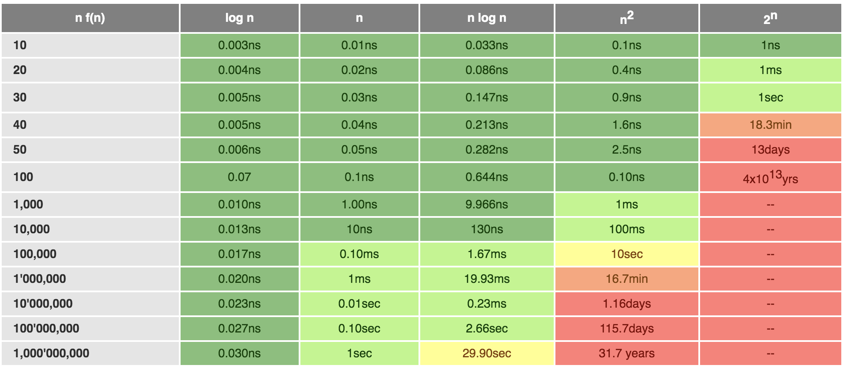
Sample execution times for T(n)
From http://cooervo.github.io/Algorithms-DataStructures-BigONotation/index.html

Slide 9
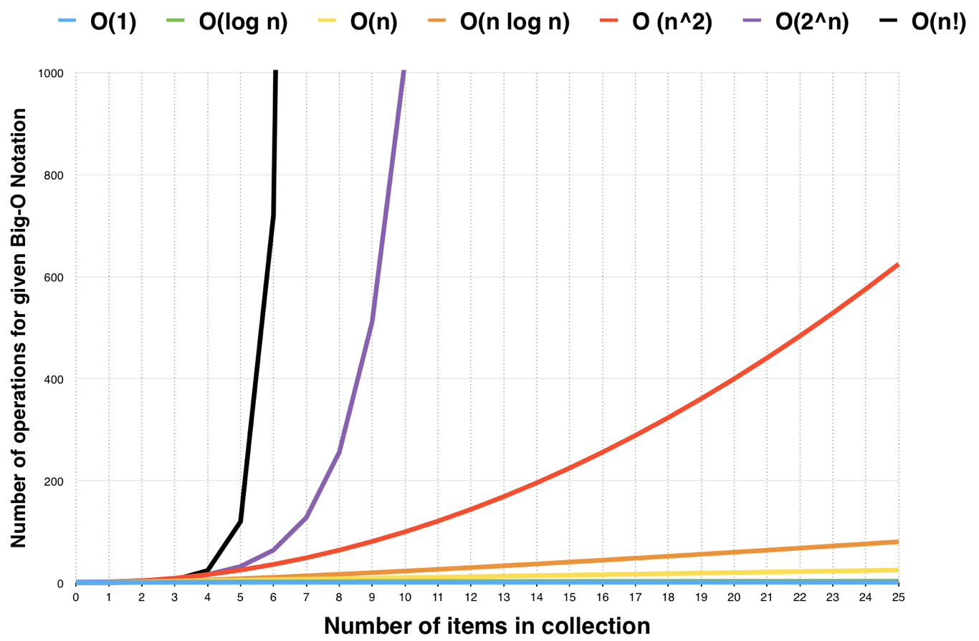
Graphical view of growth
Should keep
your complexity
at or below O(n log n)
Plot from https://medium.freecodecamp.org/my-first-foray-into-technology-c5b6e83fe8f1

Slide 10
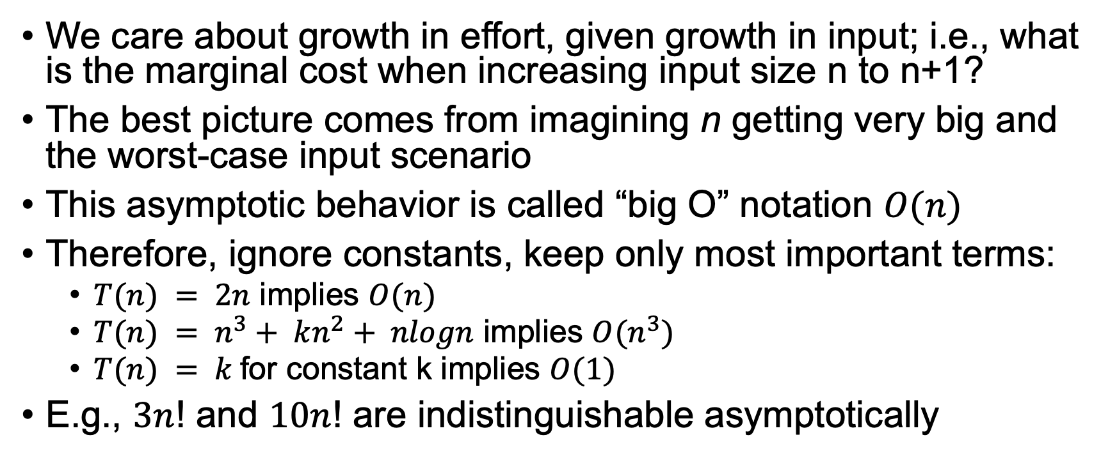
We care about asymptotic behavior
We care about growth in effort, given growth in input; i.e., what is the marginal cost when increasing input size n to n+1?
The best picture comes from imagining n getting very big and the worst-case input scenario
This asymptotic behavior is called “big O” notation $O(n)$
Therefore, ignore constants, keep only most important terms:
$T(n) = 2n$ implies $O(n)$
$T(n) = n^{3}+ kn^{2}+ nlogn$ implies $O(n^{3})$
$T(n) = k$for constant k implies $O(1)$
E.g., $3n$! and $10n$! are indistinguishable asymptotically

Slide 11
Process
Identify what we are counting as a unit of work
Identify the key indicator(s) of problem size
Usually just some size n, but could be n and m if n x m matrix, etc…
Even for n x m, you could claim in worst-case that n is bigger, so n x n is input size but we usually compute complexity as a function of n
Define T(n) = … then solve sum or recurrence for closed form
Define O(n) as asymptotic behavior of T(n)

Slide 12
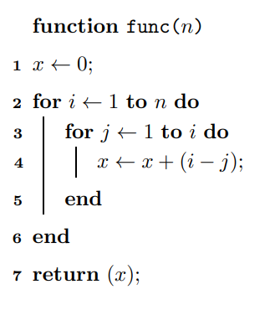
Example

Slide 13
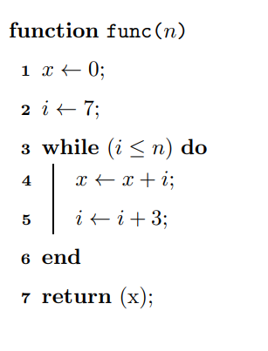
Example

Slide 14
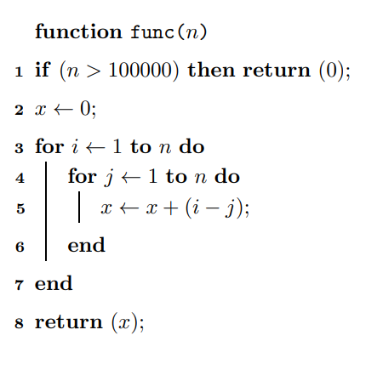
Example

Slide 15
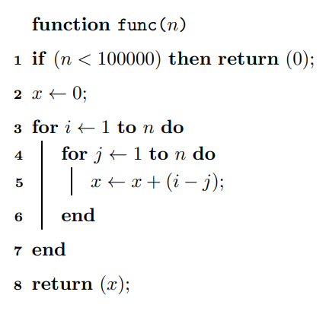
Example

Slide 16
Tips
With experience, you’ll be able to go from algorithm description straight to O(n) by looking at max loop iterations etc…
Look for loops and recursion
Verify loops step by constant amount like 1 or k (not i *= 2)
Look for patterns you know like binary search, sorting, traversing tree, etc…

Slide 17
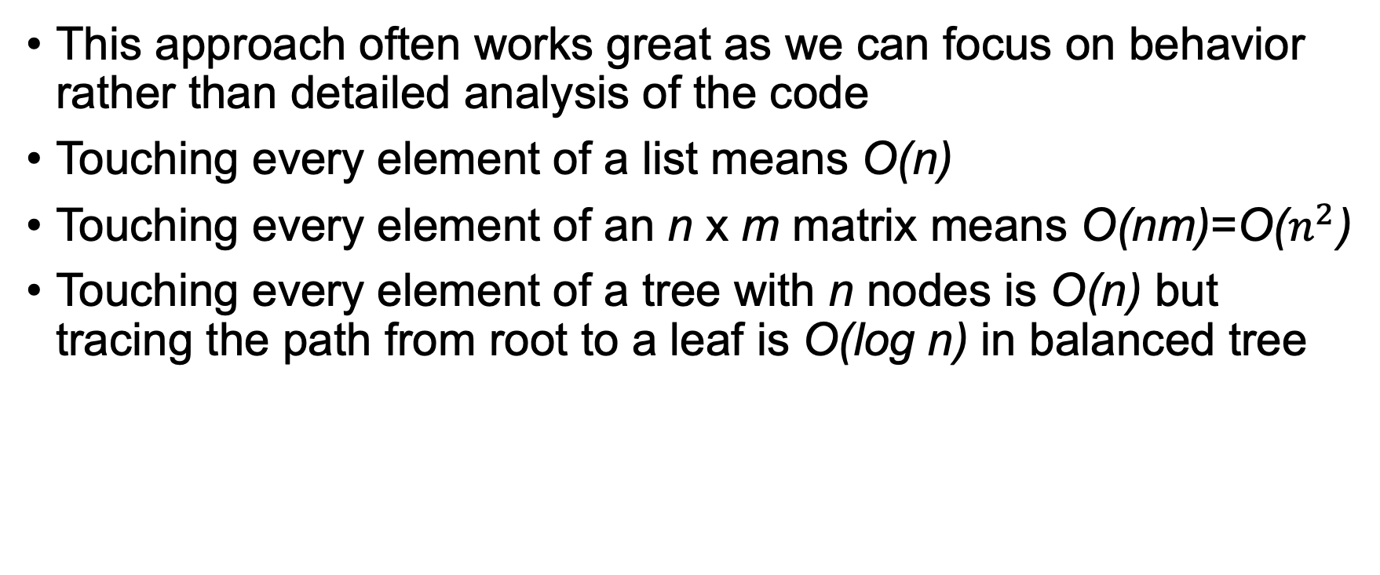
Ask: What is the maximum amount of work?
This approach often works great as we can focus on behavior rather than detailed analysis of the code
Touching every element of a list means O(n)
Touching every element of an n x m matrix means O(nm)=O($n^{2}$)
Touching every element of a tree with n nodes is O(n) but tracing the path from root to a leaf is O(log n) in balanced tree
Does it matter if tree is binary or trinary?

Slide 18

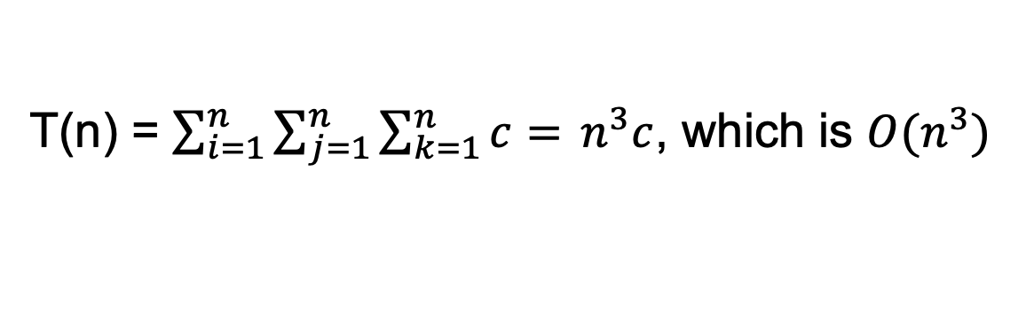
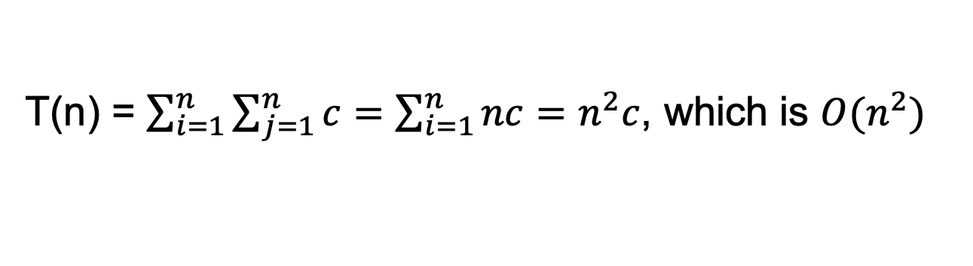
Nested loop examples
Loops nested $m$ deep, going around $n$ times, are often O($n^{m}$)
for i in range(n):
for j in range(n):
a = …
for i in range(n):
for j in range(n):
for k in range(n):
a = …
What is cost of these loops assuming “a=…” costs $c$ operations?
T(n) = $\sum_{i=1}^{n}{\sum_{j=1}^{n}{c=\sum_{i=1}^{n}{nc=n^{2}c}}}$, which is $O(n^{2})$
T(n) = $\sum_{i=1}^{n}{\sum_{j=1}^{n}{\sum_{k=1}^{n}{c=} n^{3}c}}$, which is $O(n^{3})$

Slide 19
Recursive algorithms are trickier
Define initial condition, such as T(0) = 0
Define recurrence relation for recursion then turn the crank T(n) = 1 + T(n-1) T(n) = 1 + 1 + T(n-2) T(n) = 1 + 1 + 1 + T(n-3) = n + T(n-n) = n + T(0) = n + 0 = n
3
def sum(a): # recursive sum array
if len(a)==0:
return 0
return a[0] + sum(a[1:])
Assumption: a[1:] takes constant time (not true in Python)

Slide 20
Linear search
def find(a,x): # find x in a
n = len(a)
for i in range(n):
if a[i]==x: return i
return -1
Count comparisons
Charge 1 comparison per loop iteration to each element
T(n) is sum of n ones or n, giving O(n), same as sum(a)
The intuition is that we have to touch every element of the input array once in the worst case
What is complexity of max or argmax for array of size n?
What is complexity to zero out an array of size n?

Slide 21
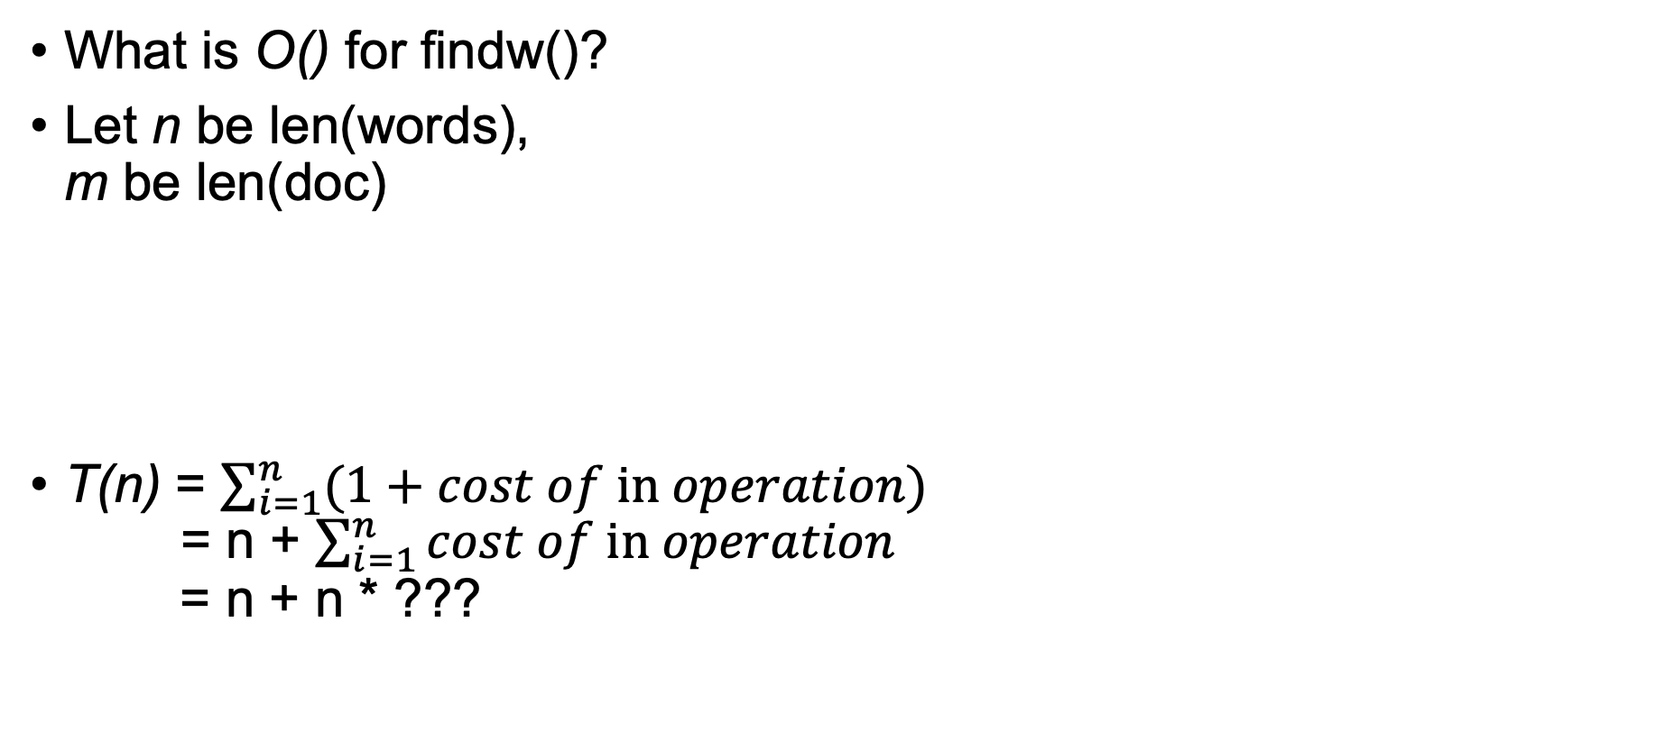
Don’t count lines of code, count operations
What is O() for findw()?
Let n be len(words), m be len(doc)
T(n) = $\sum_{i=1}^{n}{(1+cost of in operation)}$ = n + $\sum_{i=1}^{n}{cost of in operation}$ = n + n * ???
def findw(words, doc):
c = 0
for i in range(len(words)):
if words[i] in doc:
c += 1
return c

Slide 22
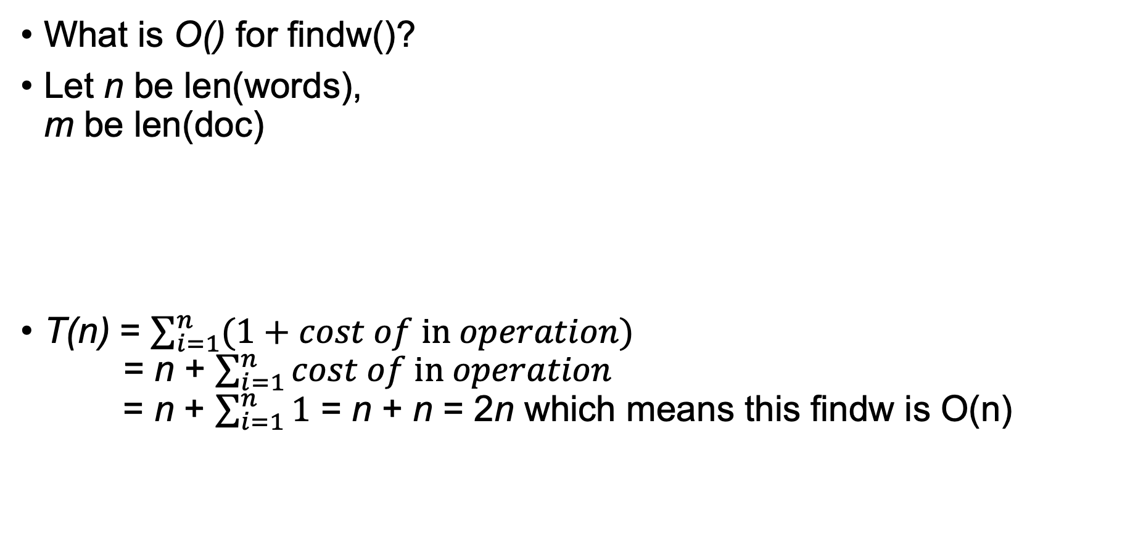
Don’t count lines of code
What is O() for findw()?
Let n be len(words), m be len(doc)
T(n) = $\sum_{i=1}^{n}{(1+cost of in operation)}$ = n + $\sum_{i=1}^{n}{cost of in operation}$ = n + $\sum_{i=1}^{n}{1}$ = n + n = 2n which means this findw is O(n)
def findw(words:list, doc:set):
c = 0
for i in range(len(words)):
if words[i] in doc:
c += 1
return c

Slide 23
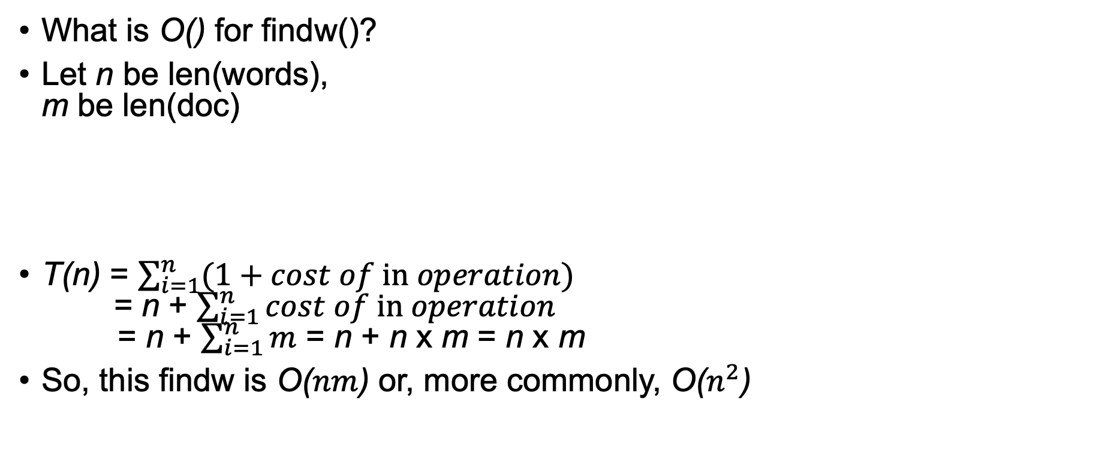
Don’t count lines of code
What is O() for findw()?
Let n be len(words), m be len(doc)
T(n) = $\sum_{i=1}^{n}{(1+cost of in operation)}$ = n + $\sum_{i=1}^{n}{cost of in operation}$ = n + $\sum_{i=1}^{n}{m}$ = n + n x m = n x m
So, this findw is O($nm$) or, more commonly, O($n^{2}$)
def findw(words:list, doc:list):
c = 0
for i in range(len(words)):
if words[i] in doc:
c += 1
return c

Slide 24
List operation | Worst Case
Copy | O(n)
Append[1] | O(1)
Pop last | O(1)
Pop intermediate | O(k)
Insert | O(n)
Get Item | O(1)
Set Item | O(1)
Delete Item | O(n)
Iteration | O(n)
Get Slice | O(k)
Set Slice | O(k+n)
Sort | O(n log n)
Multiply | O(nk)
x in s | O(n)
min(s), max(s) | O(n)
Get Length | O(1)
Set operation | Average Case | Worst Case
Copy | O(n) | O(n)
Get Item | O(1) | O(n)
Set Item | O(1) | O(n)
Delete Item | O(1) | O(n)
Iteration | O(n) | O(n)
From https://wiki.python.org/moin/TimeComplexity

Slide 25

Careful of loop iteration step size
Let n be the input size
Let’s count math ops
Charge 2 ops per iteration
How many iterations?
T(1) = 0 T(n) = 2 + T(n/2) = 2 + 2 + T(n/4) = 2 + 2 + 2 + T(n/$2^{3}$) stop when $2^{i}$ reaches n, at T(n/n)=T(1)
def intlog2(n): # for n>=1
if n == 1: return 0
count = 0
while n > 0:
n = n // 2
count += 1
return count-1
Sum of log n twos = 2 log n, giving O(log n)
3
Ask how many times you can divide n by 2? log(n) times

Slide 26
Complexity of binary search trees (BST)
BST: Nodes to left < current node, nodes to right are >
Let n be num of nodes/values, count comparisons
Charge 2 comparisons to each iteration
How many iterations is key question?
What is average height? What is max height? (Use “what is max work” technique)
p = root
while p is not None:
if p.value==x: return p
if x < p.value: p = p.left
else: p = p.right

Slide 27
USUALLY faster than linear search
Common case: T(n) = 2 + T(n/2), which we just saw is O(log n)
Worst case: the tree is actually a linked list, which is O(n)
O(log n)
O(n)
p = root
while p is not None:
if p.value==x: return p
if x < p.value: p = p.left
else: p = p.right

Slide 28
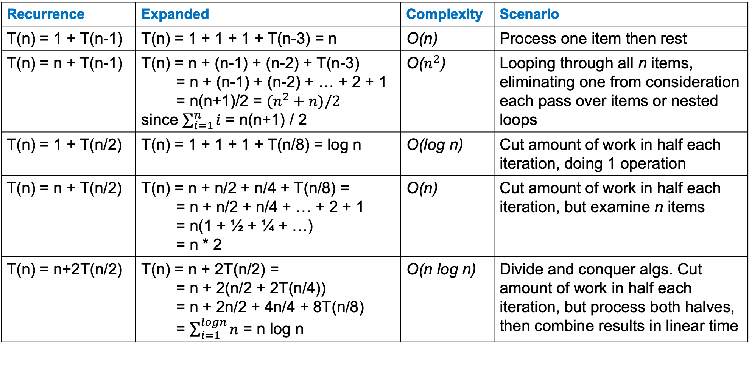
Common recurrence relations / big O
Recurrence | Expanded | Complexity | Scenario
T(n) = 1 + T(n-1) | T(n) = 1 + 1 + 1 + T(n-3) = n | O(n) | Process one item then rest
T(n) = n + T(n-1) | T(n) = n + (n-1) + (n-2) + T(n-3) = n + (n-1) + (n-2) + … + 2 + 1 = n(n+1)/2 = $(n^{2}+n)/2$ since $\sum_{i=1}^{n}{i}$ = n(n+1) / 2 | O($n^{2}$) | Looping through all n items, eliminating one from consideration each pass over items or nested loops
T(n) = 1 + T(n/2) | T(n) = 1 + 1 + 1 + T(n/8) = log n | O(log n) | Cut amount of work in half each iteration, doing 1 operation
T(n) = n + T(n/2) | T(n) = n + n/2 + n/4 + T(n/8) = = n + n/2 + n/4 + … + 2 + 1 = n(1 + ½ + ¼ + …) = n * 2 | O(n) | Cut amount of work in half each iteration, but examine n items
T(n) = n+2T(n/2) | T(n) = n + 2T(n/2) = = n + 2(n/2 + 2T(n/4)) = n + 2n/2 + 4n/4 + 8T(n/8) = $\sum_{i=1}^{logn}{n}$ = n log n | O(n log n) | Divide and conquer algs. Cut amount of work in half each iteration, but process both halves, then combine results in linear time

Slide 29
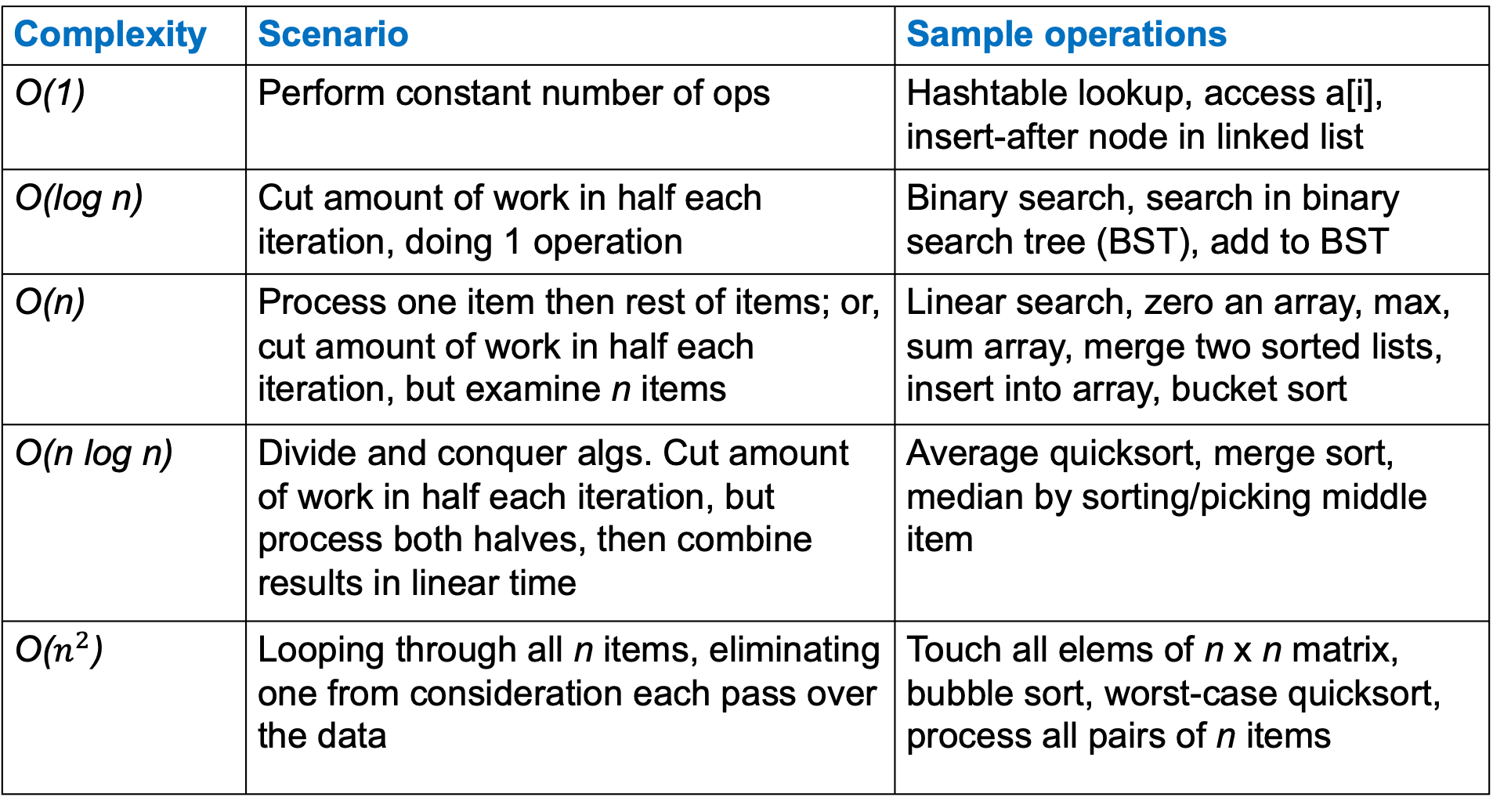
Complexity | Scenario | Sample operations
O(1) | Perform constant number of ops | Hashtable lookup, access a[i], insert-after node in linked list
O(log n) | Cut amount of work in half each iteration, doing 1 operation | Binary search, search in binary search tree (BST), add to BST
O(n) | Process one item then rest of items; or, cut amount of work in half each iteration, but examine n items | Linear search, zero an array, max, sum array, merge two sorted lists, insert into array, bucket sort
O(n log n) | Divide and conquer algs. Cut amount of work in half each iteration, but process both halves, then combine results in linear time | Average quicksort, merge sort, median by sorting/picking middle item
O($n^{2}$) | Looping through all n items, eliminating one from consideration each pass over the data | Touch all elems of n x n matrix, bubble sort, worst-case quicksort, process all pairs of n items

Slide 30
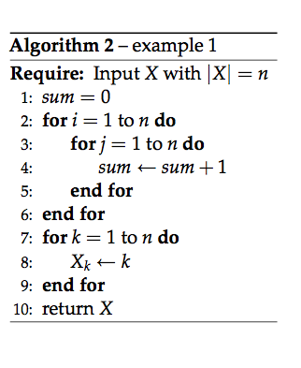
Compute complexity following our process
Identify unit of work
Identify key size indicator
Define T(n) = …
Reduce T(n) to closed form
O(n) is asymptotic behavior of T(n)

Slide 31

Compute complexity following our process
unit of work: assignment, addition
Identify key size indicator: n
T(n) = $\sum_{i=1}^{n}{\sum_{j=1}^{n}{2}}$ + $\sum_{k=1}^{n}{1}$
T(n) = $2n^{2} + n$(closed form)
O($n^{2}$) asymptotic behavior

Slide 32
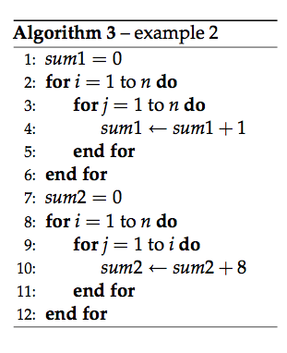
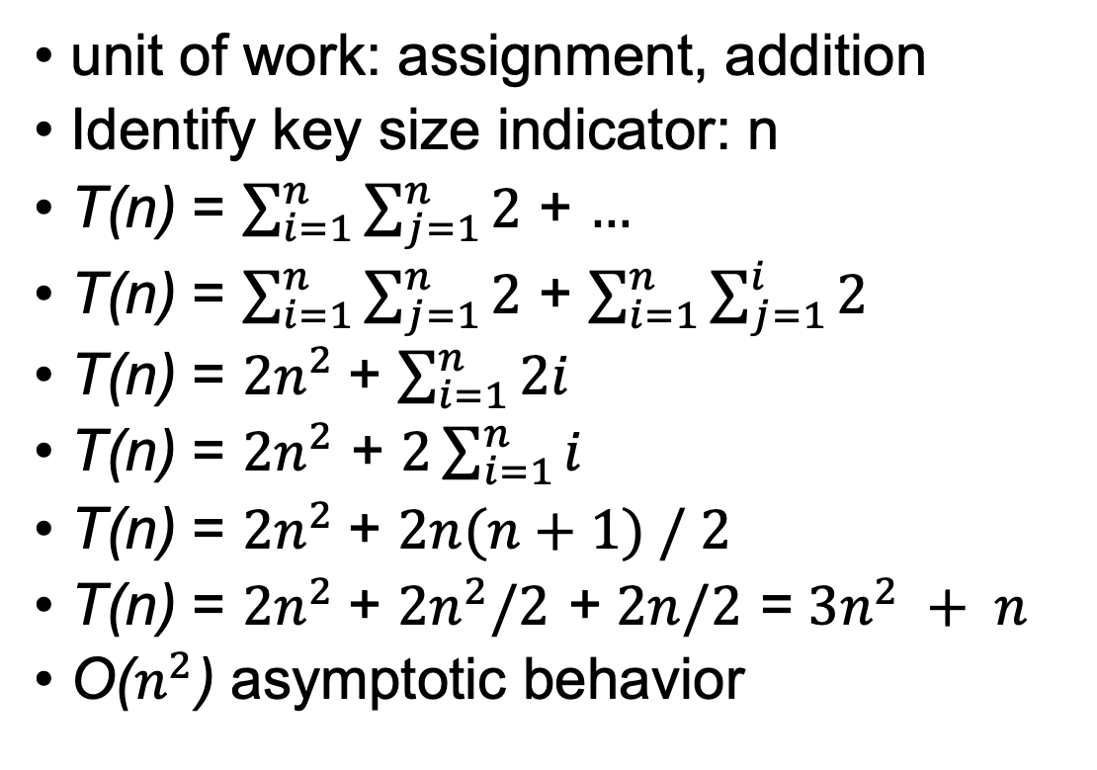
Compute complexities for these too
unit of work: assignment, addition
Identify key size indicator: n
T(n) = $\sum_{i=1}^{n}{\sum_{j=1}^{n}{2}}$ + $…$
T(n) = $\sum_{i=1}^{n}{\sum_{j=1}^{n}{2}}$ + $\sum_{i=1}^{n}{\sum_{j=1}^{i}{2}}$
T(n) = $2n^{2}$+ $\sum_{i=1}^{n}{2i}$
T(n) = $2n^{2}$ + $2\sum_{i=1}^{n}{i}$
T(n) = $2n^{2}$+ $2n(n+1) / 2$
T(n) = $2n^{2}$+ $2n^{2}/2$ + $2n/2$ = $3n^{2} + n$
O($n^{2}$) asymptotic behavior
lines 8, 9 are hallmark of matrix upper/lower triangle iteration

Slide 33
Summary
O(…) is (tight) upper-bound on work done for given input size
Independent of machine, language, algorithm details
Process:
Identify unit of work, key size indicator
Define T(n) = … then find closed form
Take asymptotic behavior of T(n) to get complexity

