Slide 1
COT 4521: Introduction to Computational Geometry
Preliminaries

Slide 2
Basic Objects of CG
Point—Specified by two coordinates (x, y)
Line—Extends to infinity in both directions
Line segment—Specified by 2 endpoints
Ray—Extends to infinity in 1 direction

Slide 3
Basic Objects of CG
Polygon
We assume edges do not cross
Convex polygon
Every interior angle is at most 180 degrees
Precise definition of convex: For any 2 points inside the polygon, the line segment joining them lies entirely inside the polygon (we’ll cover this later)
vertex
edge

Slide 4


2D Points
What’s the distance between these points?
Choice 1: difference between the point locations
Choice 2: Euclidean distance
Choice 3: Commute time distance
Choice 4: Ill-defined question
$$P_{2}(x_{2},y_{2})$$
$$P_{1}(x_{1},y_{1})$$

Slide 5
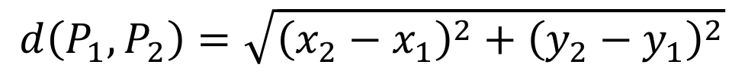
Euclidean Distance
$$d\left(P_{1},P_{2}\right)=\sqrt{{\left(x_{2}−x_{1}\right)}^{2}+{\left(y_{2}−y_{1}\right)}^{2}}$$
$$P_{2}(x_{2},y_{2})$$
$$P_{1}(x_{1},y_{1})$$

Slide 6
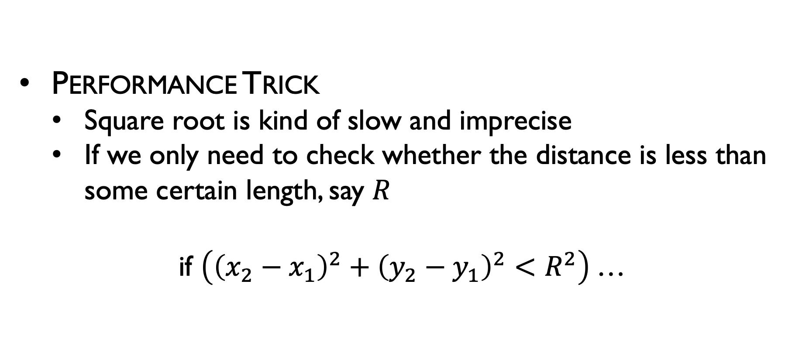
Euclidean Distance
Performance Trick
Square root is kind of slow and imprecise
If we only need to check whether the distance is less than some certain length, say $R$
if $\left({\left(x_{2}−x_{1}\right)}^{2}+{\left(y_{2}−y_{1}\right)}^{2}<R^{2}\right)$…

Slide 7



Vectors
$$\vec{v_{12}}$$
$$=P_{2}−P_{1}$$
$$=<x_{2}−x_{1},y_{2}−y_{1}>$$
$$P_{2}(x_{2},y_{2})$$
$$P_{1}(x_{1},y_{1})$$

Slide 8
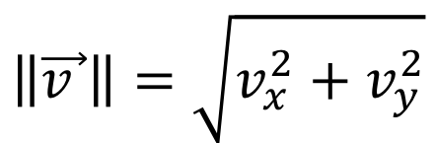
Vector Length/Magnitude
$$\left\|\vec{v }\right\|=\sqrt{v_{x}^{2}+v_{y}^{2}}$$

Slide 9
Vector Length/Magnitude
$$\left\|\vec{v }\right\|=\sqrt{v_{x}^{2}+v_{y}^{2}}$$
Equivalent to Euclidean distance…

Slide 10

Vector Angle
$$α$$

Slide 11

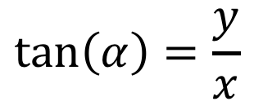


Vector Angle
$$α$$
$$y$$
$$α$$
$$x$$
$$\tan\left(α\right)=\frac{y}{x}$$

Slide 12

Vector Angle
$$α=\tan^{−1}{\frac{y}{x}}$$
or
$$α=\operatorname{atan}\left(\frac{y}{x}\right)$$
(results in radians, not degrees)
Problems?

Slide 13

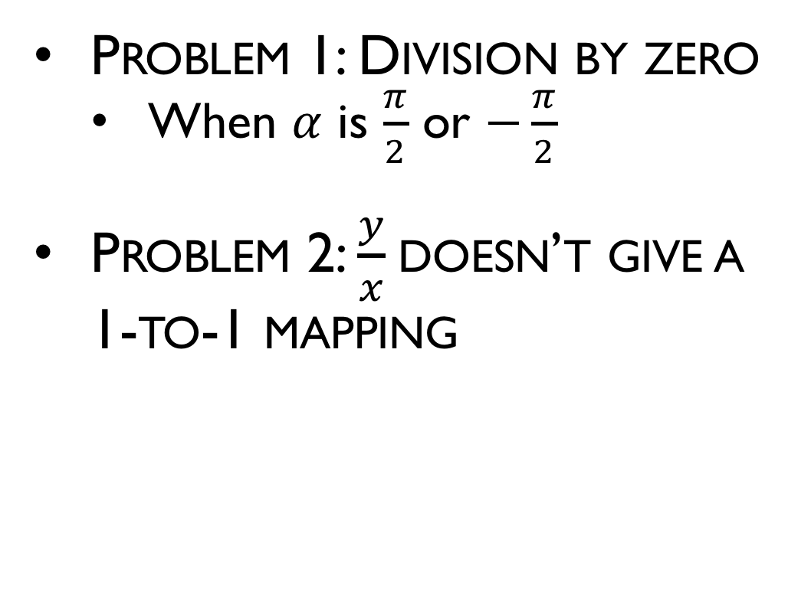



Vector Angle
Problem 1: Division by zero
When $α$ is $\frac{π}{2}$ or $−\frac{π}{2}$
Problem 2: $\frac{y}{x}$doesn’t give a 1-to-1 mapping
$$−x,+y→−\frac{y}{x}$$
$$+x,+y→+\frac{y}{x}$$
$$−x,−y→+\frac{y}{x}$$
$$+x,−y→−\frac{y}{x}$$

Slide 14
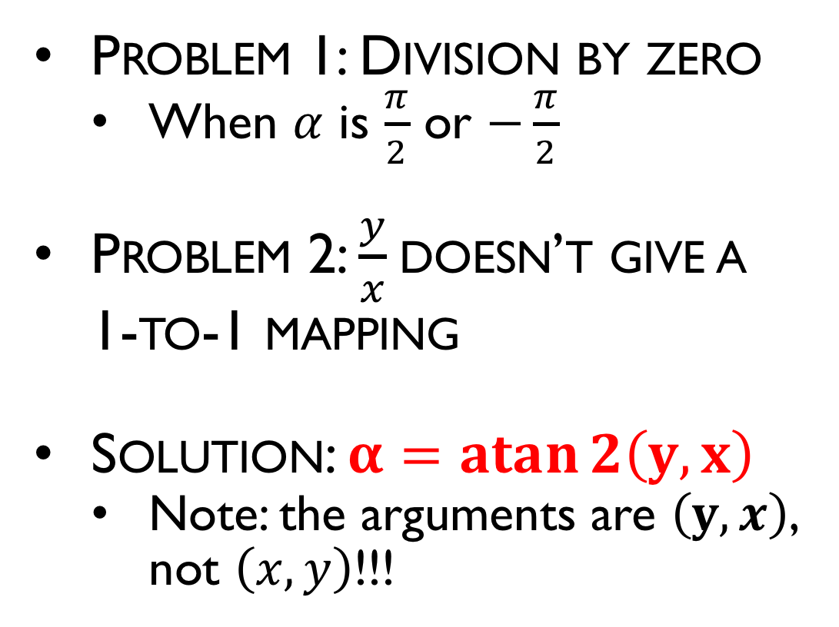
Vector Angle
Problem 1: Division by zero
When $α$ is $\frac{π}{2}$ or $−\frac{π}{2}$
Problem 2: $\frac{y}{x}$doesn’t give a 1-to-1 mapping
Solution: $α=\operatorname{atan}{2\left(y,x\right)}$
Note: the arguments are $\left(y,x\right)$, not $\left(x,y\right)$!!!
$$−x,+y→−\frac{y}{x}$$
$$+x,+y→+\frac{y}{x}$$
$$−x,−y→+\frac{y}{x}$$
$$+x,−y→−\frac{y}{x}$$

Slide 15



Angle Between 2 Vectors
$$\vec{b }$$
$$α$$
$$\vec{a }$$

Slide 16




Angle Between 2 Vectors
$$\vec{b }$$
$$α$$
$$α_{b}$$
$$\vec{a }$$
$$α_{a}$$
$${α=α}_{b}−α_{a}$$

Slide 17

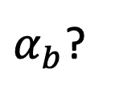
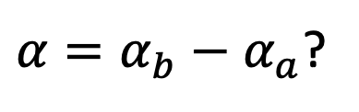
Angle Between 2 Vectors
$$\vec{a }$$
$$α_{a}$$
$α_{b}$?
${α=α}_{b}−α_{a}$?
$$\vec{b }$$

Slide 18
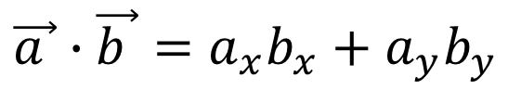
Dot Product
$$\vec{b }$$
$$\vec{a }$$
$$\vec{a }∙\vec{b }=a_{x}b_{x}+a_{y}b_{y}$$

Slide 19
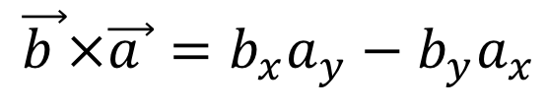
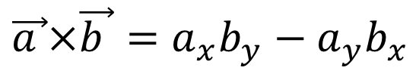
Cross Product
$$\vec{b }$$
$$\vec{a }×\vec{b }=a_{x}b_{y}−a_{y}b_{x}$$
$$\vec{a }$$
$$\vec{b }×\vec{a }=b_{x}a_{y}−b_{y}a_{x}$$

Slide 20
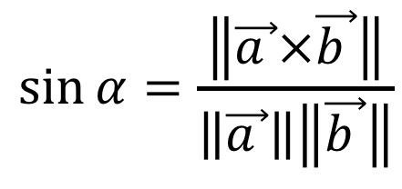
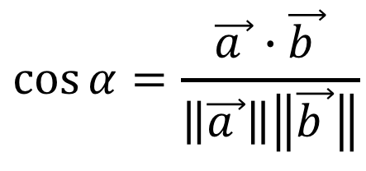
Angle Between 2 Vectors
$$\vec{b }$$
$$α$$
$$\vec{a }$$
$$\cos{α}=\frac{\vec{a }∙\vec{b }}{\left\|\vec{a }\right\|\left\|\vec{b }\right\|}$$
$$\sin{α}=\frac{\left\|\vec{a }×\vec{b }\right\|}{\left\|\vec{a }\right\|\left\|\vec{b }\right\|}$$

Slide 21



Orientation of Triangles
How do you use the tools just discussed to determine orientation?
$$P_{3}(x_{3},y_{3})$$
$$P_{2}(x_{2},y_{2})$$
$$P_{1}(x_{1},y_{1})$$

Slide 22


Orientation of Triangles
How do you use the tools just discussed to determine orientation?
Choice 1: difference in angles
Choice 2: dot product
Choice 3: cross product
$$P_{3}(x_{3},y_{3})$$
$$\vec{b }$$
$$\vec{a }$$
$$P_{2}(x_{2},y_{2})$$
$$P_{1}(x_{1},y_{1})$$

Slide 23
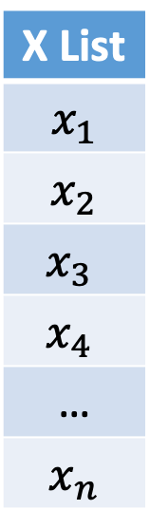
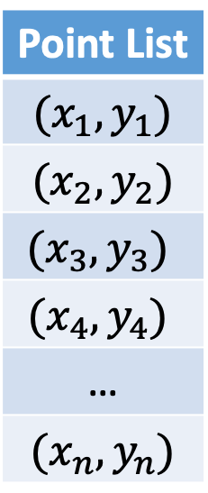




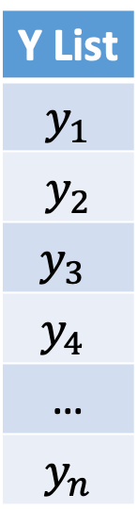
Storing Points
Point List
$$(x_{1},y_{1})$$
$$(x_{2},y_{2})$$
$$(x_{3},y_{3})$$
$$(x_{4},y_{4})$$
…
$$(x_{n},y_{n})$$
X List
$$x_{1}$$
$$x_{2}$$
$$x_{3}$$
$$x_{4}$$
…
$$x_{n}$$
Y List
$$y_{1}$$
$$y_{2}$$
$$y_{3}$$
$$y_{4}$$
…
$$y_{n}$$
$$P_{4}(x_{4},y_{4})$$
$$P_{2}(x_{2},y_{2})$$
$$P_{1}(x_{1},y_{1})$$
$$P_{3}(x_{3},y_{3})$$

Slide 24
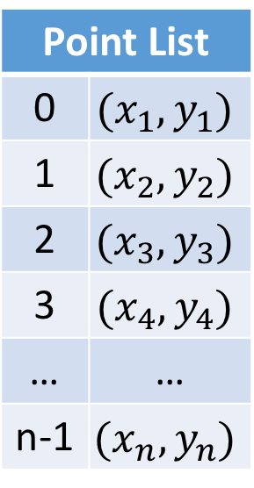
Storing Edges as Indices
Edge List
0 | 3
1 | 3
2 | 3
0 | 1
…
Point List
0 | $$(x_{1},y_{1})$$
1 | $$(x_{2},y_{2})$$
2 | $$(x_{3},y_{3})$$
3 | $$(x_{4},y_{4})$$
… | …
n-1 | $$(x_{n},y_{n})$$
$$P_{4}(x_{4},y_{4})$$
$$P_{2}(x_{2},y_{2})$$
$$P_{1}(x_{1},y_{1})$$
$$P_{3}(x_{3},y_{3})$$

Slide 25
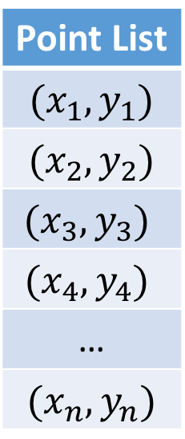
Storing Points as Pointers
Edge List
…
Point List
$$(x_{1},y_{1})$$
$$(x_{2},y_{2})$$
$$(x_{3},y_{3})$$
$$(x_{4},y_{4})$$
…
$$(x_{n},y_{n})$$
$$P_{4}(x_{4},y_{4})$$
$$P_{2}(x_{2},y_{2})$$
$$P_{1}(x_{1},y_{1})$$
$$P_{3}(x_{3},y_{3})$$

Slide 26
Storing Triangles with Indices
Triangle List
0 | 1 | 2
0 | 1 | 3
…
Point List
0 | $$(x_{1},y_{1})$$
1 | $$(x_{2},y_{2})$$
2 | $$(x_{3},y_{3})$$
3 | $$(x_{4},y_{4})$$
… | …
n-1 | $$(x_{n},y_{n})$$
$$P_{4}(x_{4},y_{4})$$
$$P_{2}(x_{2},y_{2})$$
$$P_{1}(x_{1},y_{1})$$
$$P_{3}(x_{3},y_{3})$$

Slide 27
Storing Triangles with Indices
clockwise
Triangle List
0 | 1 | 2
0 | 1 | 3
…
Point List
0 | $$(x_{1},y_{1})$$
1 | $$(x_{2},y_{2})$$
2 | $$(x_{3},y_{3})$$
3 | $$(x_{4},y_{4})$$
… | …
n-1 | $$(x_{n},y_{n})$$
$$P_{4}(x_{4},y_{4})$$
$$P_{2}(x_{2},y_{2})$$
counterclockwise
$$P_{1}(x_{1},y_{1})$$
$$P_{3}(x_{3},y_{3})$$

Slide 28
Storing Polygons with Indices
Polygon List
0 | 2 | 1 | 3
…
Point List
0 | $$(x_{1},y_{1})$$
1 | $$(x_{2},y_{2})$$
2 | $$(x_{3},y_{3})$$
3 | $$(x_{4},y_{4})$$
… | …
n-1 | $$(x_{n},y_{n})$$
$$P_{4}(x_{4},y_{4})$$
$$P_{2}(x_{2},y_{2})$$
$$P_{1}(x_{1},y_{1})$$
$$P_{3}(x_{3},y_{3})$$

Slide 29
Storing Polygons with Indices
Polygon List
0 | 2 | 1 | 3
…
Point List
0 | $$(x_{1},y_{1})$$
1 | $$(x_{2},y_{2})$$
2 | $$(x_{3},y_{3})$$
3 | $$(x_{4},y_{4})$$
… | …
n-1 | $$(x_{n},y_{n})$$
$$P_{4}(x_{4},y_{4})$$
$$P_{2}(x_{2},y_{2})$$
$$P_{1}(x_{1},y_{1})$$
$$P_{3}(x_{3},y_{3})$$

Slide 30
Storing Polygons with Indices
Polygon List
0 | 1 | 2 | 3
…
Point List
0 | $$(x_{1},y_{1})$$
1 | $$(x_{2},y_{2})$$
2 | $$(x_{3},y_{3})$$
3 | $$(x_{4},y_{4})$$
… | …
n-1 | $$(x_{n},y_{n})$$
$$P_{4}(x_{4},y_{4})$$
$$P_{2}(x_{2},y_{2})$$
Take care with order
$$P_{1}(x_{1},y_{1})$$
$$P_{3}(x_{3},y_{3})$$

Slide 31
Linear Interpolation
$$P_{2}(x_{2},y_{2})$$
$$P_{1}(x_{1},y_{1})$$

Slide 32

Linear Interpolation
$$P_{2}(x_{2},y_{2})$$
$$P_{1}(x_{1},y_{1})$$
$$lerp\left(P_{1},P_{2},a\right)=P_{1}(1−a)+P_{2}a$$

Slide 33




Linear Interpolation
$$lerp(P_{0},P_{1},1)$$
$$lerp(P_{0},P_{1},0.8)$$
$$P_{2}(x_{2},y_{2})$$
$$lerp(P_{0},P_{1},0.4)$$
$$lerp(P_{0},P_{1},0)$$
$$P_{1}(x_{1},y_{1})$$
$$lerp\left(P_{1},P_{2},a\right)=P_{1}(1−a)+P_{2}a$$

Slide 34



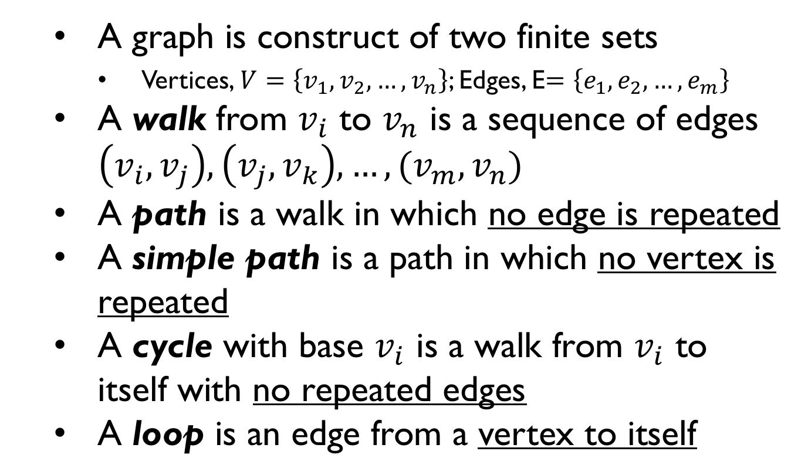




Graphs and trees
A graph is construct of two finite sets
Vertices, $V=\left\{v_{1},v_{2},…,v_{n}\right\}$; Edges, E$=\left\{e_{1},e_{2},…,e_{m}\right\}$
A walk from $v_{i}$ to $v_{n}$ is a sequence of edges $\left(v_{i},v_{j}\right), \left(v_{j},v_{k}\right),…, (v_{m},v_{n})$
A path is a walk in which no edge is repeated
A simple path is a path in which no vertex is repeated
A cycle with base $v_{i}$ is a walk from $v_{i}$ to itself with no repeated edges
A loop is an edge from a vertex to itself
$$v_{1}$$
$$e_{1}$$
$$e_{3}$$
$$e_{2}$$
$$v_{2}$$
$$e_{4}$$
$$v_{3}$$

Slide 35
Trees
A tree is a directed graph that has no cycles, and that has one distinct vertex (the root)
Root
Parent
Height
Node
Child
Leaf

Slide 36
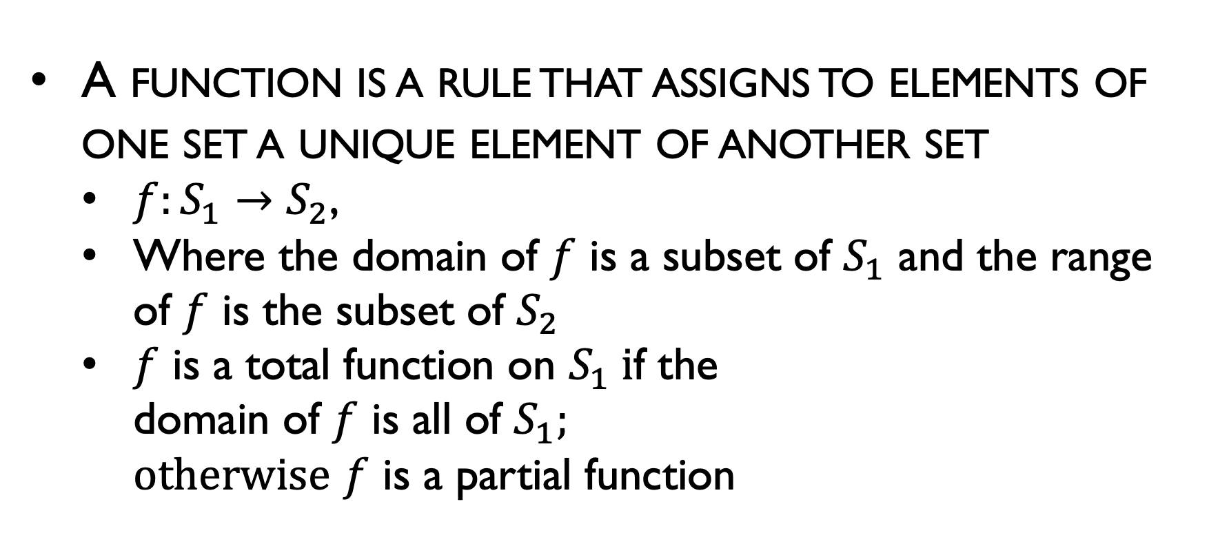



Functions
A function is a rule that assigns to elements of one set a unique element of another set
$f:S_{1}→S_{2}$,
Where the domain of $f$ is a subset of $S_{1}$ and the range of $f$ is the subset of $S_{2}$
$f$ is a total function on $S_{1} i$f the domain of $f$ is all of $S_{1};$ $otherwise$ $f$ is a partial function
$$S_{1}$$
$$f$$
$$S_{2}$$
2
4
6
1
3
5
Notes:
$Ω$ big omega
$Θ$ big theta

Slide 37

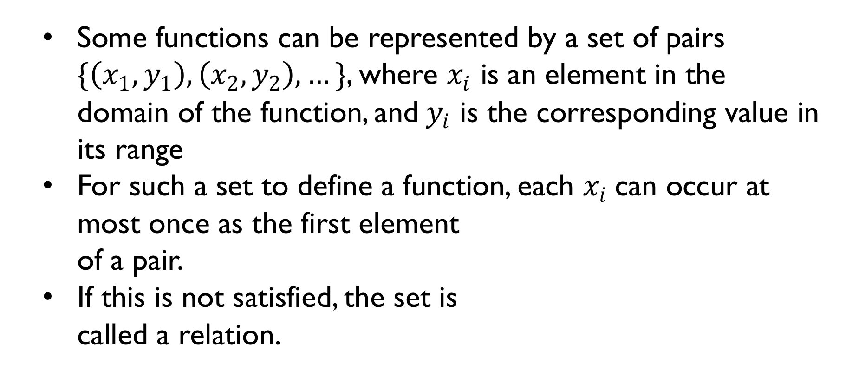
Relations
Some functions can be represented by a set of pairs $\{\left(x_{1},y_{1}\right),\left(x_{2},y_{2}\right),…\}$, where $x_{i}$ is an element in the domain of the function, and${ y}_{i}$ is the corresponding value in its range
For such a set to define a function, each $x_{i}$can occur at most once as the first element of a pair.
If this is not satisfied, the set is called a relation.
$$S_{1}$$
$$R$$
$$S_{2}$$
2
4
6
1
3
5

Slide 38
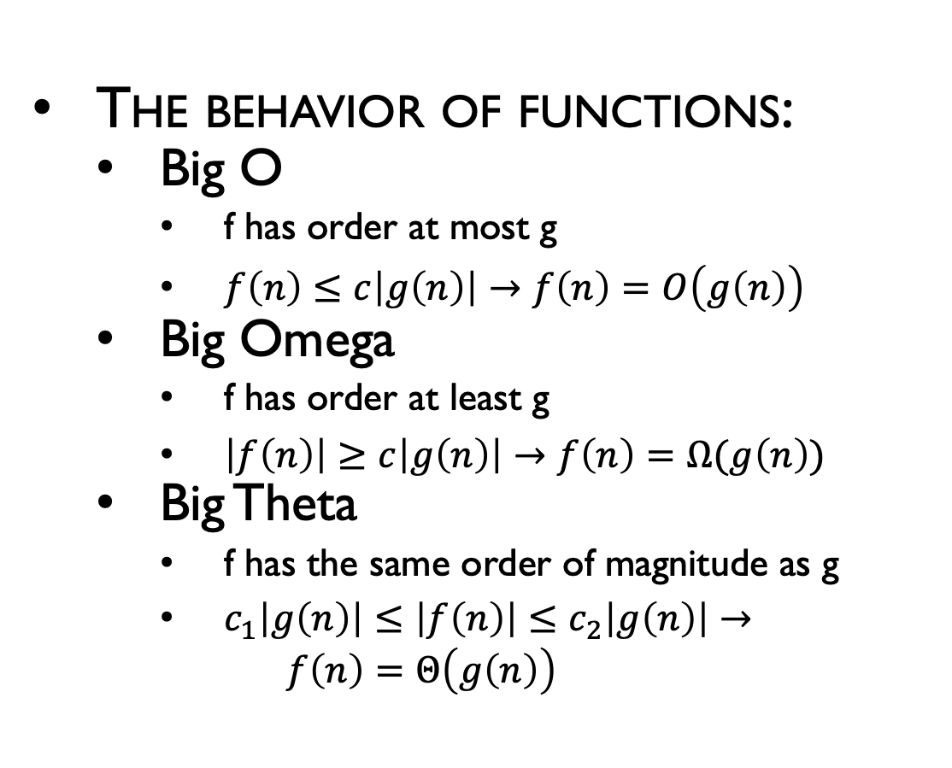
Functions
The behavior of functions:
Big O
f has order at most g
$f\left(n\right)≤c\left|g\left(n\right)\right|→f\left(n\right)=O\left(g\left(n\right)\right)$
Big Omega
f has order at least g
$\left|f\left(n\right)\right|≥c\left|g\left(n\right)\right|→f\left(n\right)=Ω(g\left(n\right))$
Big Theta
f has the same order of magnitude as g
$c_{1}\left|g\left(n\right)\right|≤\left|f\left(n\right)\right|≤c_{2}\left|g\left(n\right)\right|→$ $f\left(n\right)=Θ\left(g\left(n\right)\right)$
Notes:
$Ω$ big omega
$Θ$ big theta

Slide 39
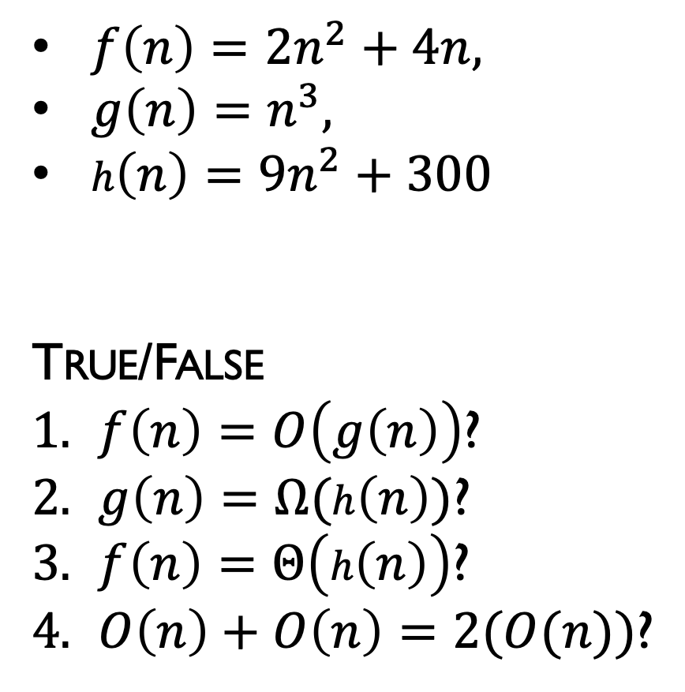
Function Examples
The behavior of functions:
Big O
f has order at most g
$f\left(n\right)≤c\left|g\left(n\right)\right|→f\left(n\right)=O\left(g\left(n\right)\right)$
Big Omega
f has order at least g
$\left|f\left(n\right)\right|≥c\left|g\left(n\right)\right|→f\left(n\right)=Ω(g\left(n\right))$
Big Theta
f has the same order of magnitude as g
$c_{1}\left|g\left(n\right)\right|≤\left|f\left(n\right)\right|≤c_{2}\left|g\left(n\right)\right|→$ $f\left(n\right)=Θ\left(g\left(n\right)\right)$
$f\left(n\right)=2n^{2}+4n,$
$g\left(n\right)=n^{3},$
$h\left(n\right)=9n^{2}+300$
True/False
$f\left(n\right)=O\left(g\left(n\right)\right)$?
$g\left(n\right)=Ω(h\left(n\right))$?
$f\left(n\right)=Θ\left(h\left(n\right)\right)$?
$O\left(n\right)+O\left(n\right)=2(O(n))$?
Notes:
$Ω$ big omega
$Θ$ big theta

Slide 40
Proof techniques
A proof is a sequence of steps that lead from some known facts to the desired conclusion; each step must be obviously correct

Slide 41
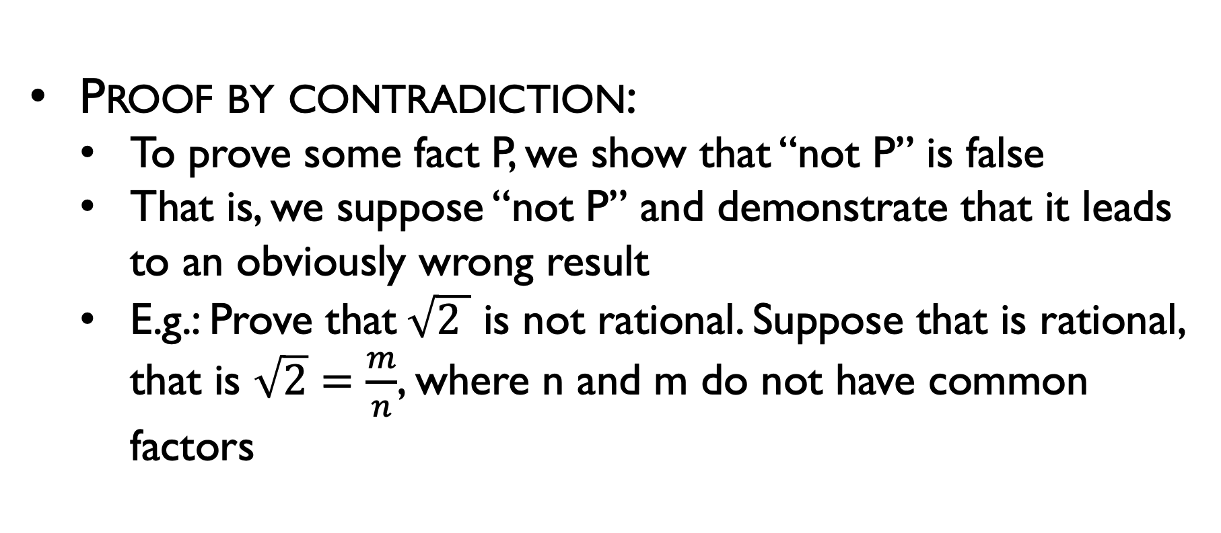
Proof techniques
Proof by contradiction:
To prove some fact P, we show that “not P” is false
That is, we suppose “not P” and demonstrate that it leads to an obviously wrong result
E.g.: Prove that$\sqrt{2 }$ is not rational. Suppose that is rational, that is $\sqrt{2}=\frac{m}{n}$, where n and m do not have common factors

Slide 42
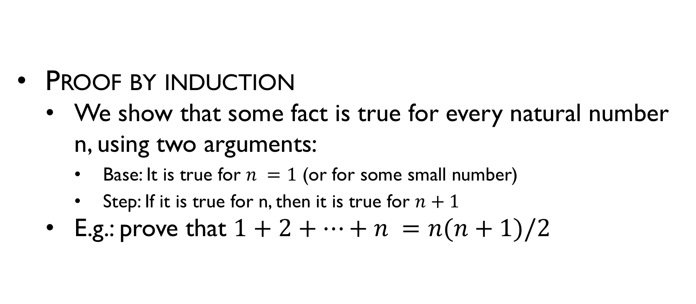
Proof techniques
Proof by induction
We show that some fact is true for every natural number n, using two arguments:
Base: It is true for $n =1$ (or for some small number)
Step: If it is true for n, then it is true for $n+1$
E.g.: prove that $1+2+…+n =n(n+1)/2$

