Slide 1
COT 4521: Introduction to Computational Geometry
INTRODUCTION TO PROCESSING

Slide 2
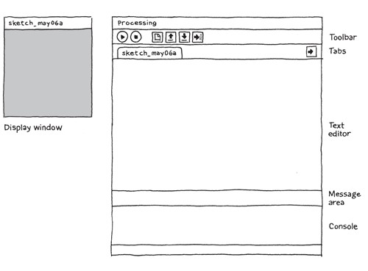
what is it?
Processing Development Environment (PDE)

Slide 3
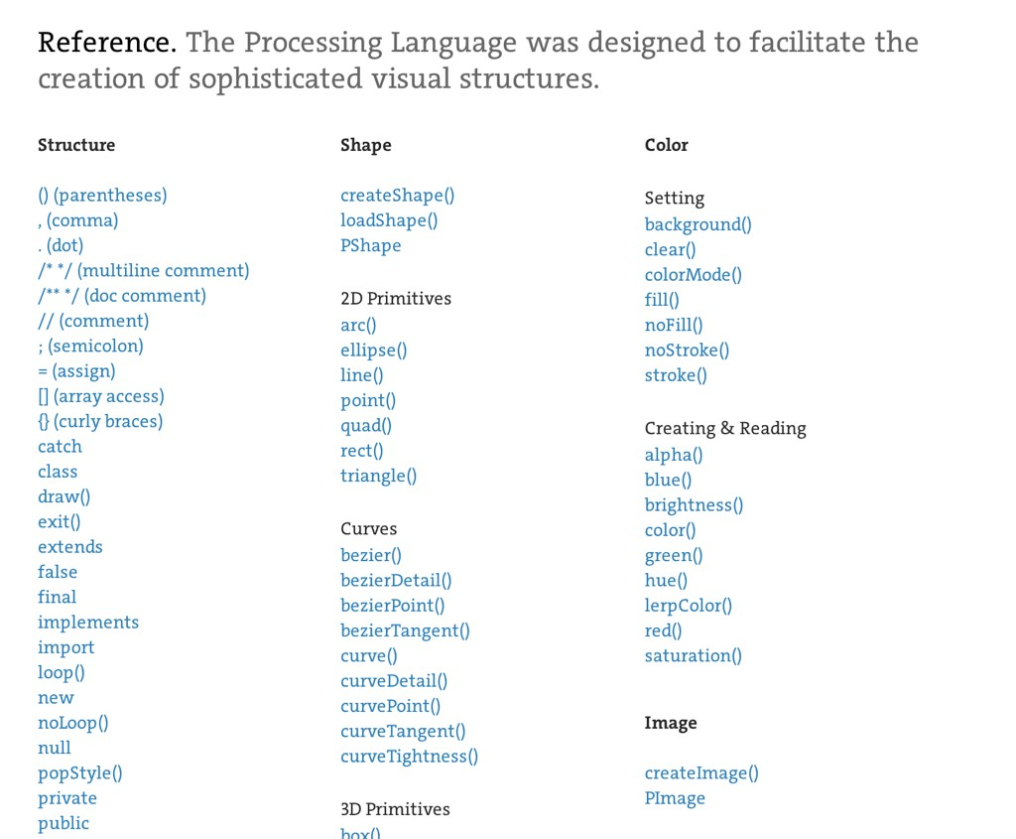
what is it?
Processing API

Slide 4
what is it?
open-source, online community
https://processing.org/
http://forum.processing.org/
https://github.com/processing

Slide 5
why not other languages?
difficulty to sketch with other languages
complicated setup
portability challenging
not easy to learn

Slide 6
why Processing?
+/- Java-based
- complexity
+ big standard library
+ similar syntax & portability
+ lots of user-contributed libraries
+ fast to startup

Slide 7

why Processing?
program = sketch

Slide 8
why Processing?
programming syntax
void setup() { size(480, 120);
}
void draw() {
if (mousePressed) {
fill(0);
} else { fill(255);
}
ellipse(mouseX, mouseY, 80, 80);
}

Slide 9

why Processing?
public class Hello
{
public static void main (String args[])
{
System.out.println("Hello, world!");
}
}
javac Hello.java
java Hello

Slide 10
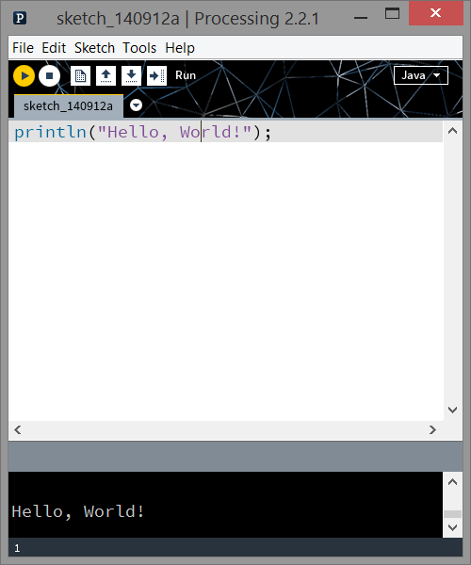
why Processing?
println(“Hello, World!”);

Slide 11
Graphics

Slide 12
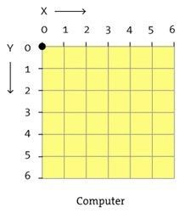
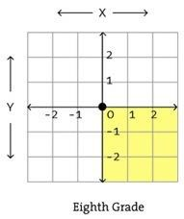
Monitors
grid of pixels
Right Hand Coordinate System
Monitor Coordinate System
(Left Hand Coordinate System)

Slide 13
Right Hand (RHC) vs Left Hand (LHC) Coordinate Systems
Everything we do in this class assumes RHC (not in processing)
I’ve included some code in the skeleton to convert Processing into a RHC

Slide 14
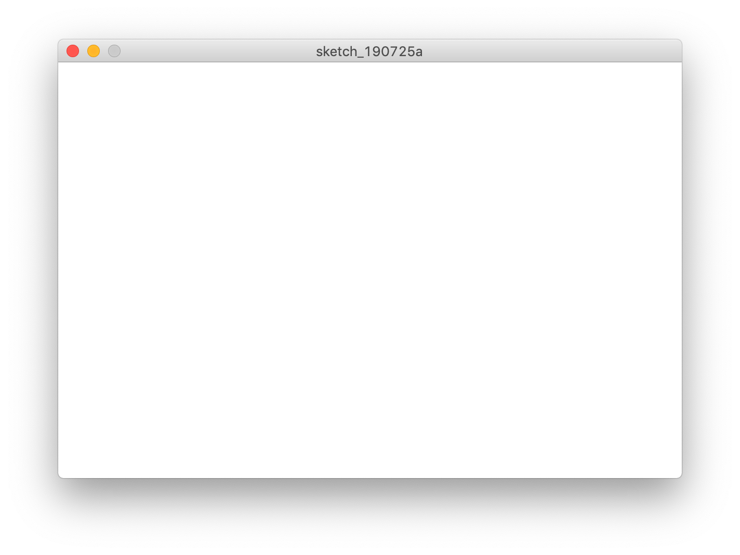
LHC System (Processing default)
(0,0)
(width,0)
(0,height)
(width,height)

Slide 15
RHC System (provided modification)
(0,height)
(width,height)
(0,0)
(width,0)

Slide 16
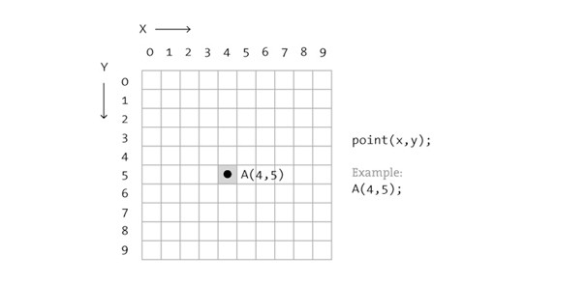
shape
point(x, y);

Slide 17
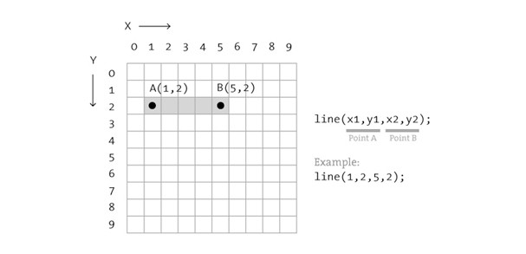
shape
line(x1, y1, x2, y2);

Slide 18
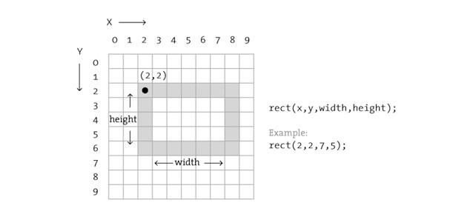
shape
rect(x, y, width, height);

Slide 19
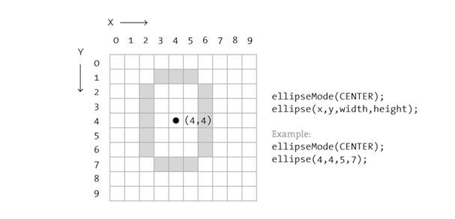
Shape
ellipseMode(CENTER);
ellipse(x, y, width, height);

Slide 20
Shape
triangle(x1, y1, x2, y2, x3, y3);
quad(x1, y1, x2, y2, x3, y3, x4, y4);
arc(x, y, width, height, start, stop);

Slide 21
Shape
More complex shapes (convex polygons) available with:
beginShape() / vertex() / endShape()

Slide 22
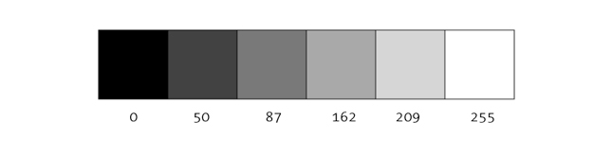
Color
luminance (black & white; grayscale)
background(255); // clear background

Slide 23
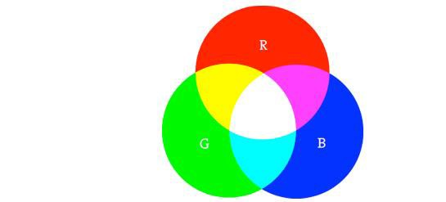
Color
RGB (default)
color c1 = color(r, g, b);
color c2 = #RRGGBB;

Slide 24
Color
RGBA
a = alpha / transparency / opacity
0 = transparent; 255 = opaque (solid)
color c1 = color(r, g, b, a);

Slide 25

properties
noStroke(); fill(c1); rect(...);
fill(c2); stroke(c3); ellipse(...);

Slide 26
properties
noFill();
noStroke(); ellipse(...);
rect(...);

Slide 27
Properties
Graphics is a STATE MACHINE.
When you set a state (no matter where in the code), that state will remain until changed
This is particularly noticeable with color

Slide 28
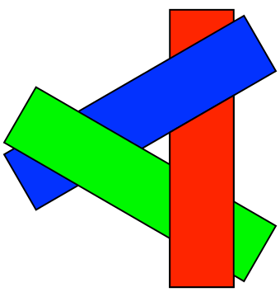
Order
shapes are painted one at a time
overlap can occur
some shapes are not supported

Slide 29
animation
runs once
void setup(){
...
}
void draw(){
...
}
Cycles (automatically)

Slide 30
text
// in setup()
PFont myFont;
myFont
= createFont("Georgia",
32);
// in draw() textFont(myFont); textAlign(CENTER,
CENTER);
text("Hello, World!",
width/2,
height/2);
There is some extra code provided for RHC

Slide 31
programming

Slide 32
Structure
comments, variables, arrays, loops

Slide 33
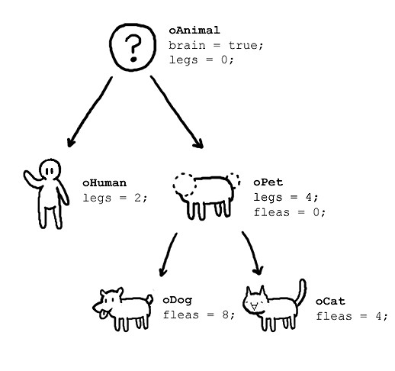

object-oriented
with classes
class oAnimal{ boolean brain; int legs;
oAnimal(){
brain = true;
legs = 0;
}
}

Slide 34
Built-in Trigonometry Functions
acos() / asin() / atan() / atan2()
degrees() / radians()
cos() / sin() / tan()

Slide 35
Built-in Calculation Functions
Calculation
max() / min()
abs() / ceil() / constrain() / floor() / round()
lerp() / map() / norm()
dist() / mag()
exp() / log() / pow() / sq() / sqrt()

Slide 36
Pvector
Container for points and vectors
Variety of functionalities—vector arithmetic, dot/cross products, angles, normalization, and interpolation
https://processing.org/reference/PVector.html
http://processing.github.io/processing-javadocs/core/processing/core/PVector.html
STUDY AND USE THIS CLASS!

Slide 37
Object Storage
ArrayList (also FloatList, IntList, StringList)
HashMap (dict: also FloatDict, IntDict, StringDict)
Table, XML, JSON
(and anything else Java!)

Slide 38

Interaction: mouse
void
mousePressed()
void
mouseReleased()
void mouseClicked(){
if(mouseButton == LEFT)
fill(0);
else if(mouseButton == RIGHT) fill(255);
else
fill(126);
}
void
mouseClicked()
void
mouseDragged()
void
mouseMoved()
void
mouseWheel()
mouseX mouseY pmouseX pmouseY

Slide 39

Interaction: keyboard
void keyTyped(){
if(key == 'b')
fill(0);
else if(key == 'w') fill(255);
else
fill(126);
}
void
keyPressed()
void
keyReleased()
void
keyTyped()
keyPressed key keyCode

Slide 40

folder structure
folder [NAME] & [NAME].pde must match
optional data folder (for images, input)

Slide 41
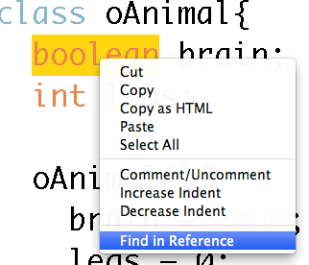
Documentation
available online
also in the PDE
http://processing.org/reference/

Slide 42
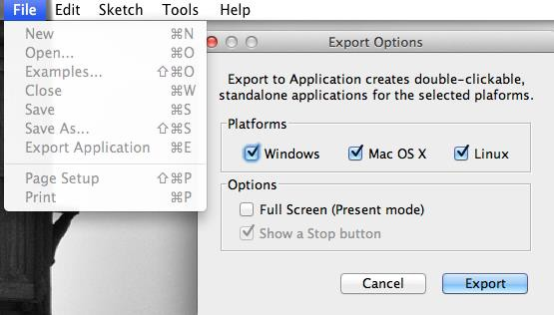
Exporting
creating applications is simple

Slide 43

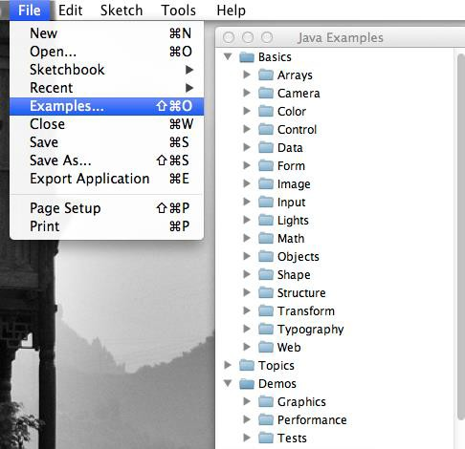
Examples
variety of samples

Slide 44
Demo

