Slide 1
COT 4521: Introduction to Computational Geometry
Segment Intersection

Slide 2
Problem Statement

Slide 3
Problem Statement

Slide 4
Representing Curves
Curves often represented by a polynomial or polynomial spline
Bezier, NURBS, etc.
Tesselate Curve into many small line segments

Slide 5
Representing Curves
Curves usually represented by a polynomial or polynomial spline
Bezier, NURBS, etc.
Tesselate Curve into many small line segments

Slide 6
Representing Curves
Curves usually represented by a polynomial or polynomial spline
Bezier, NURBS, etc.
Tesselate Curve into many small line segments

Slide 7
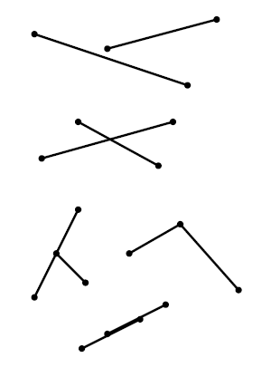
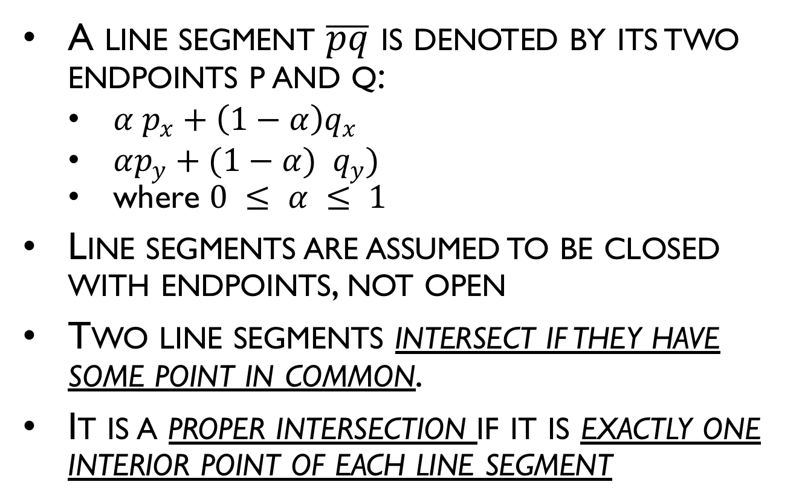
Segment-Segment Intersection
A line segment $\overline{pq}$ is denoted by its two endpoints p and q:
$α p_{x}+\left(1−α\right)q_{x}$
$αp_{y}+(1−α) q_{y})$
where $0 ≤ α ≤ 1$
Line segments are assumed to be closed with endpoints, not open
Two line segments intersect if they have some point in common.
It is a proper intersection if it is exactly one interior point of each line segment

Slide 8




Do they intersect?
Observation: If the two segments intersect, the two red points must lie on different sides of the black line (or lie exactly on it)
The same holds with black/red switched
$$P_{4}$$
$$P_{1}$$
$$P_{3}$$
$$P_{2}$$

Slide 9




Do they intersect?
What does “different sides” mean?
Use the cross product to determine sidedness
$$P_{4}$$
$$P_{1}$$
$$P_{3}$$
$$P_{2}$$

Slide 10
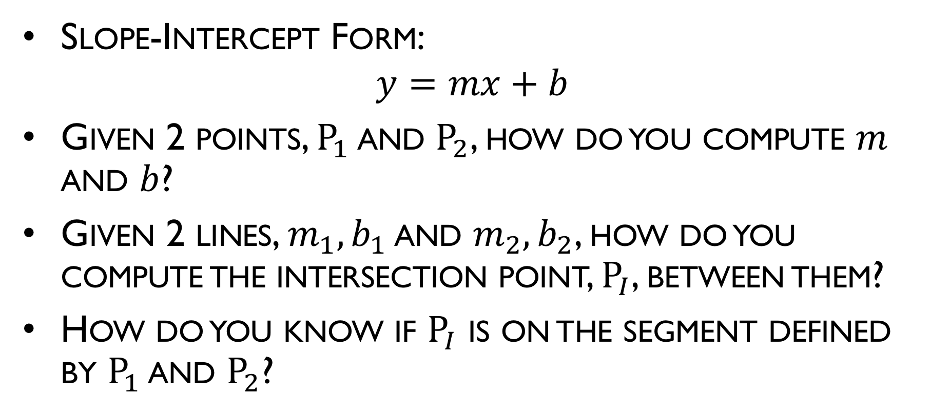
Representing a Line
Slope-Intercept Form:
$$y=mx+b$$
Given 2 points, $P_{1}$ and $P_{2}$, how do you compute $m$ and $b$?
Given 2 lines, $m_{1},b_{1}$ and $m_{2},b_{2}$, how do you compute the intersection point, $P_{I}$, between them?
How do you know if $P_{I}$ is on the segment defined by $P_{1}$ and $P_{2}$?
Notes:
M = (y2-y1)/(x2-x1)
Y1 = m*x1 + b -> b = y1 / (m*x1)
Y = m1 x + b1
Y = m2 x + b2
M1 x + b1 = m2 x + b2
(m1 – m2 ) x = (b2 – b1)
X = (b2 – b1) / (m1 – m2 )
Y = m1 x + b1
Min(X1,X2) <= XI <= max(x1,X2)
Min(Y1,y2) <= YI <= max(y1,Y2)

Slide 11
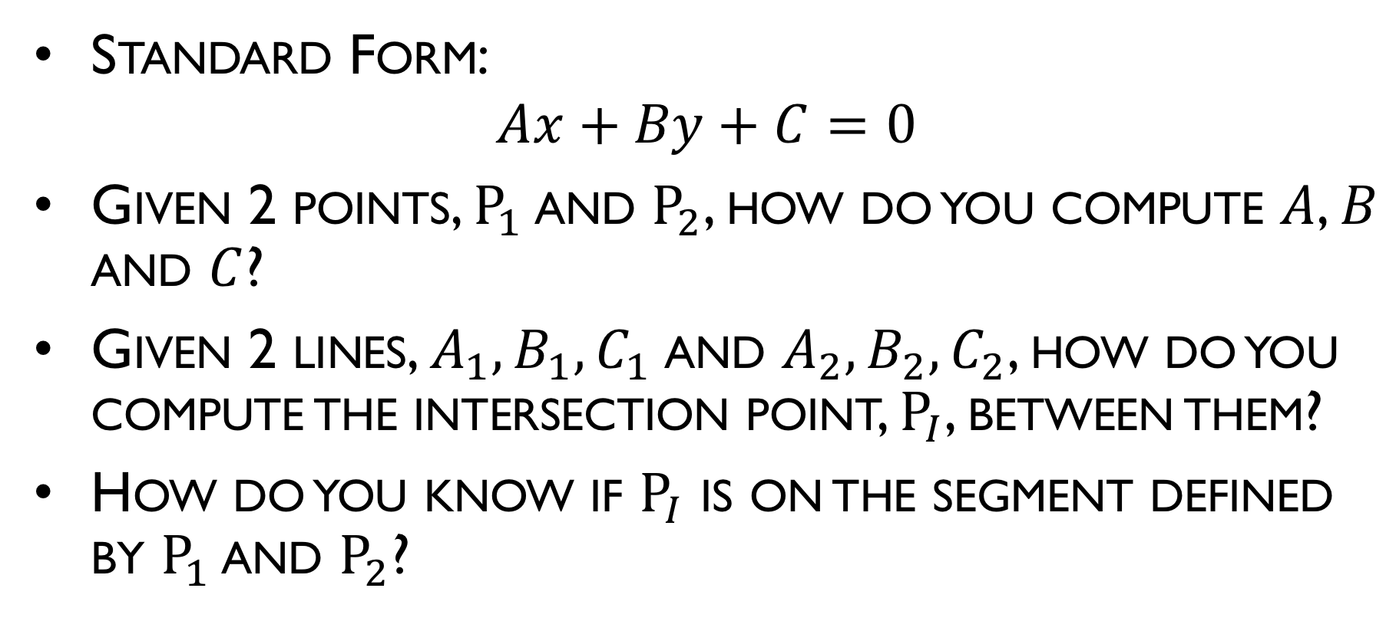
Representing a Line
Standard Form:
$$Ax+By+C=0$$
Given 2 points, $P_{1}$ and $P_{2}$, how do you compute $A$, $B$ and $C$?
Given 2 lines, $A_{1},B_{1},C_{1}$and $A_{2},B_{2},C_{2}$, how do you compute the intersection point, $P_{I}$, between them?
How do you know if $P_{I}$ is on the segment defined by $P_{1}$ and $P_{2}$?
Notes:
A = (y2-y1)
B = (x2-x1)
C = -( A x1 + B y1 )
A1 x + B1 y + C1 = 0
A2 x + B2 y + C2 = 0
Min(X1,X2) <= XI <= max(x1,X2)
Min(Y1,y2) <= YI <= max(y1,Y2)

Slide 12
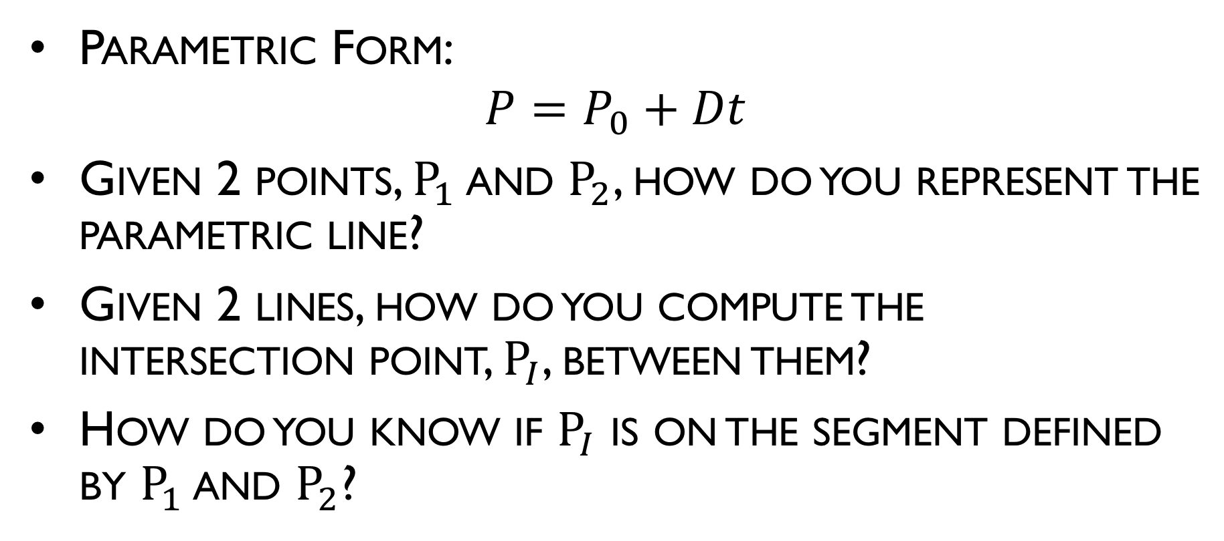
Representing a Line
Parametric Form:
$$P=P_{0}+Dt$$
Given 2 points, $P_{1}$ and $P_{2}$, how do you represent the parametric line?
Given 2 lines, how do you compute the intersection point, $P_{I}$, between them?
How do you know if $P_{I}$ is on the segment defined by $P_{1}$ and $P_{2}$?
Notes:
A = (y2-y1)
B = (x2-x1)
C = -( A x1 + B y1 )
A1 x + B1 y + C1 = 0
A2 x + B2 y + C2 = 0
Min(X1,X2) <= XI <= max(x1,X2)
Min(Y1,y2) <= YI <= max(y1,Y2)

