Slide 1
COT 4521: Introduction to Computational Geometry
Segment Intersection AABB Algorithm

Slide 2
Intersection of >2 Line Segments

Slide 3
Intersection of >2 Line Segments

Slide 4
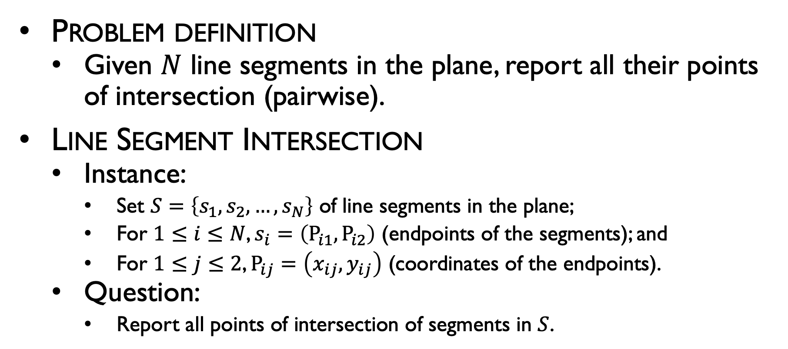
Intersection of line segments
Problem definition
Given $N$ line segments in the plane, report all their points of intersection (pairwise).
Line Segment Intersection
Instance:
Set $S=\left\{s_{1},s_{2},…,s_{N}\right\}$ of line segments in the plane;
For $1≤i≤N$, $s_{i}=\left(P_{i1},P_{i2}\right)$ (endpoints of the segments); and
For $1≤j≤2$, $P_{ij}=\left(x_{ij},y_{ij}\right)$ (coordinates of the endpoints).
Question:
Report all points of intersection of segments in $S$.

Slide 5
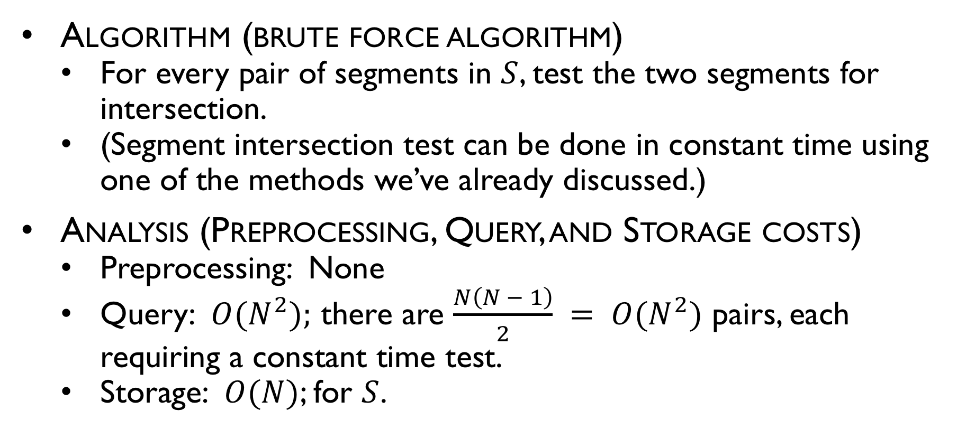
Intersection of line segments
Algorithm (brute force algorithm)
For every pair of segments in $S$, test the two segments for intersection.
(Segment intersection test can be done in constant time using one of the methods we’ve already discussed.)
Analysis (Preprocessing, Query, and Storage costs)
Preprocessing: None
Query: $O(N^{2});$ there are $\frac{N\left(N − 1\right)}{2} = O(N^{2})$ pairs, each requiring a constant time test.
Storage: $O(N)$; for $S$.

Slide 6
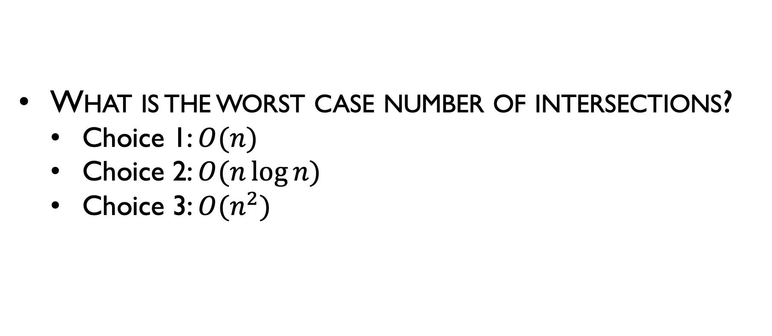
Naïve Intersection of >2 Line Segments
What is the worst case number of intersections?
Choice 1: $O(n)$
Choice 2: $O(n\log{n})$
Choice 3: $O(n^{2})$

Slide 7
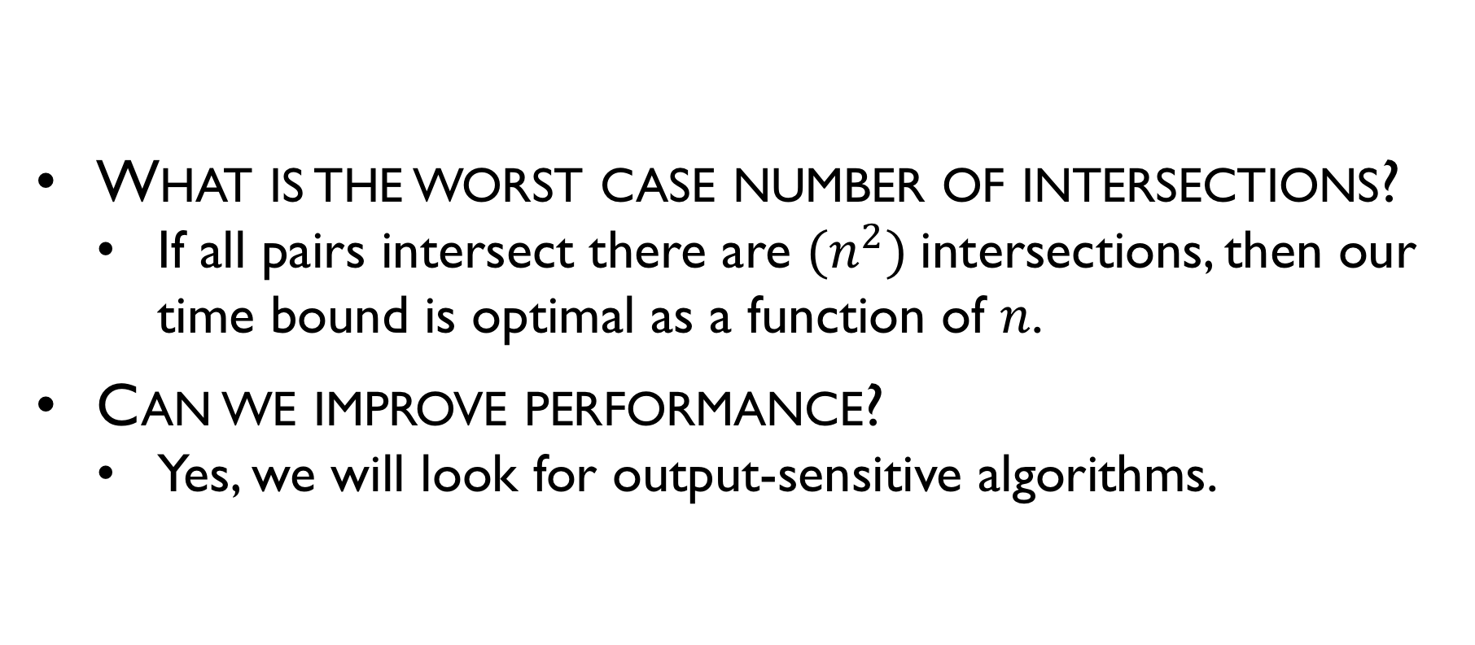
Naïve Intersection of >2 Line Segments
What is the worst case number of intersections?
If all pairs intersect there are $(n^{2})$intersections, then our time bound is optimal as a function of $n$.
Can we improve performance?
Yes, we will look for output-sensitive algorithms.

Slide 8
Observations?

Slide 9
Axis Aligned Bounding Boxes (AABB)

Slide 10

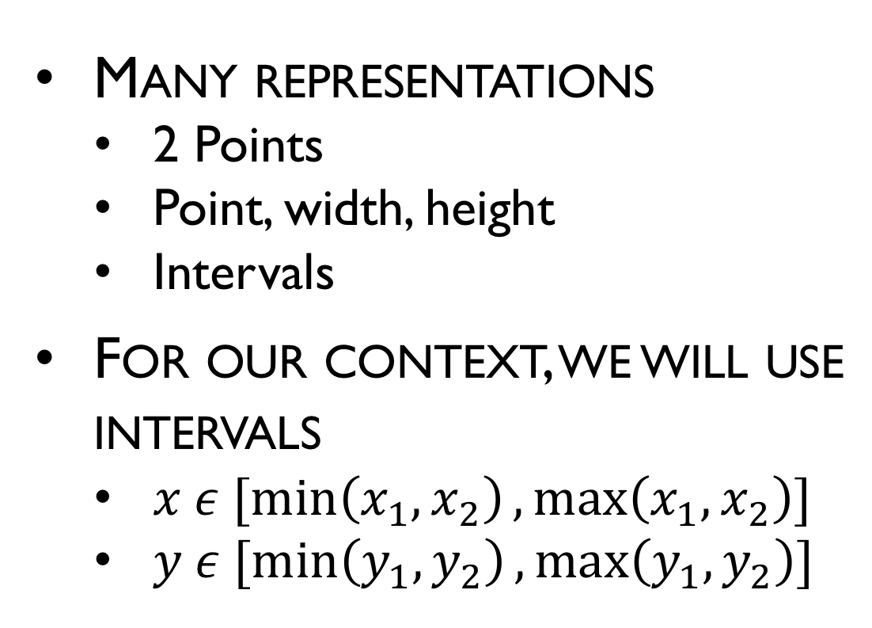

Axis Aligned Bounding Boxes (AABB)
Many representations
2 Points
Point, width, height
Intervals
For our context, we will use intervals
$x ε [\min\left(x_{1},x_{2}\right),\max\left(x_{1},x_{2}\right)]$
$y ε [\min\left(y_{1},y_{2}\right),\max\left(y_{1},y_{2}\right)]$
$$P_{2}(x_{2},y_{2})$$
$$P_{1}(x_{1},y_{1})$$

Slide 11

AABB Intersection
Given a set of $N$ axis-parallel rectangles in the plane, report all intersecting pairs
Intersect $≡$ share at least one point
r₆
r₇
r₅
r₄
r₈
r₃
r₁
r₂
Answer: (r₁, r₂) (r₁, r₃) (r₁, r₈) (r₃, r₄) (r₃, r₅) (r₄, r₅) (r₇, r₈)

Slide 12


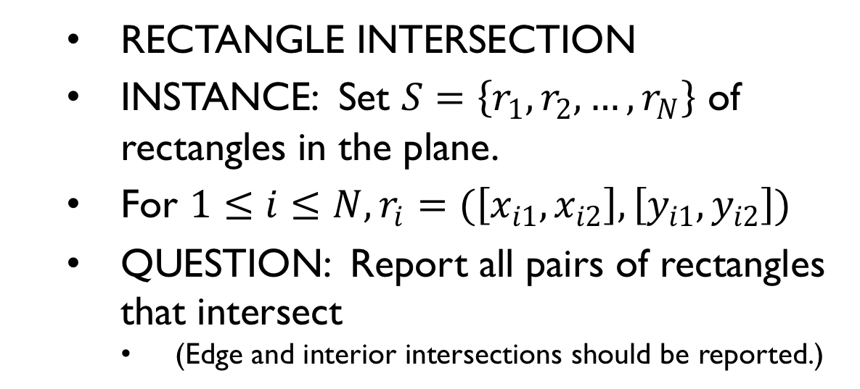



Intersection of rectangles Problem definition
RECTANGLE INTERSECTION
INSTANCE: Set $S=\left\{r_{1},r_{2},…,r_{N}\right\}$ of rectangles in the plane.
For $1≤i≤N, r_{i}=(\left[x_{i1},x_{i2}\right],\left[y_{i1},y_{i2}\right])$
QUESTION: Report all pairs of rectangles that intersect
(Edge and interior intersections should be reported.)
$$y_{i2}$$
$$r_{i}$$
$$y_{i1}$$
$$x_{i1}$$
$$x_{i2}$$
Considered to intersect.

Slide 13

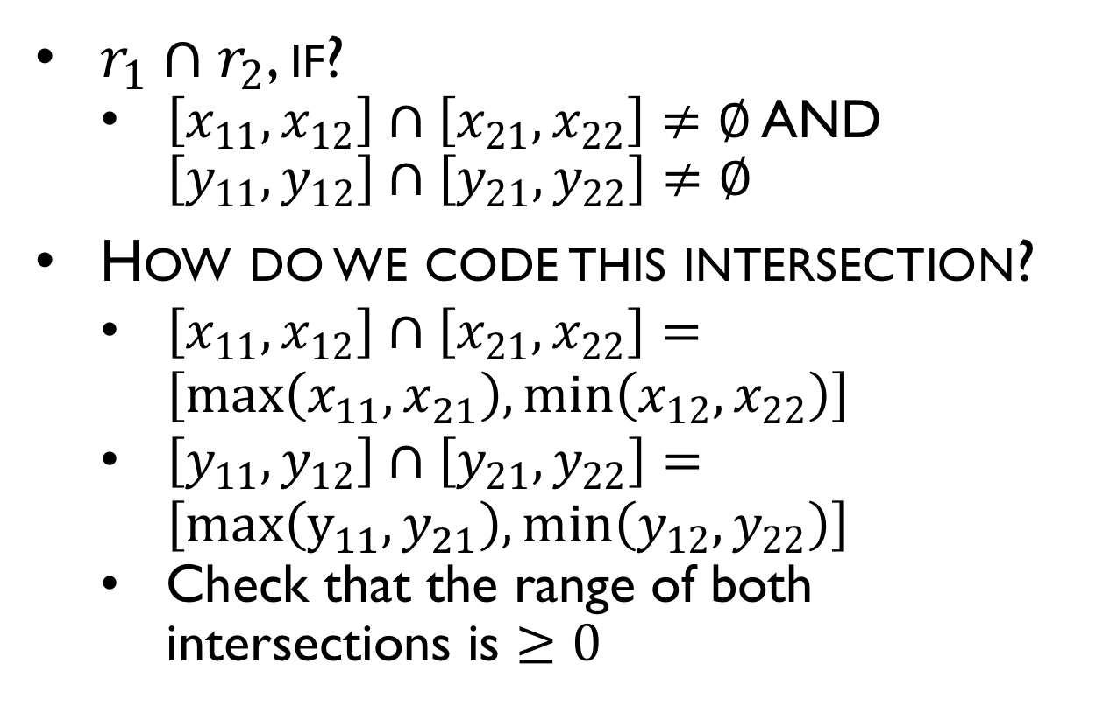

Checking if 2 Rectangles Intersect
$r_{1}∩r_{2}$, if?
$\left[x_{11},x_{12}\right]∩\left[x_{21},x_{22}\right]≠∅$ AND $\left[y_{11},y_{12}\right]∩\left[y_{21},y_{22}\right]≠∅$
How do we code this intersection?
$\left[x_{11},x_{12}\right]∩\left[x_{21},x_{22}\right]=\left[max\left(x_{11},x_{21}\right),min\left(x_{12},x_{22}\right)\right]$
$\left[y_{11},y_{12}\right]∩\left[y_{21},y_{22}\right]=\left[max\left(y_{11},y_{21}\right),min\left(y_{12},y_{22}\right)\right]$
Check that the range of both intersections is $≥0$
$$r_{2}$$
$$r_{1}$$

Slide 14
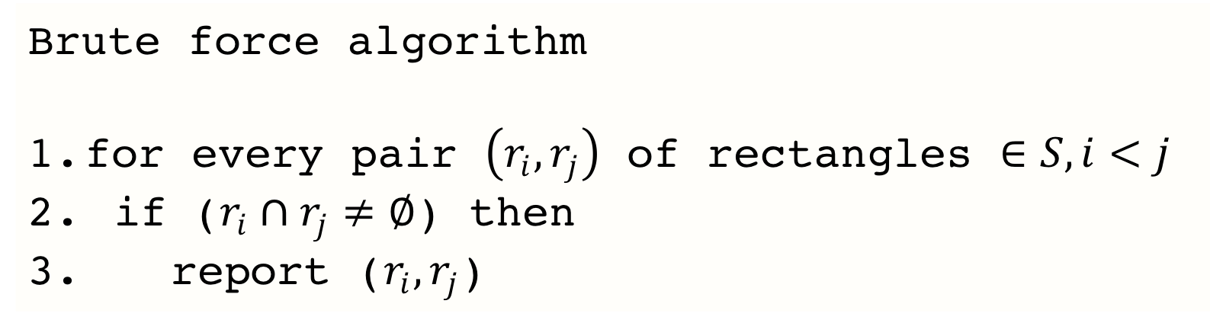
Intersection of a set of rectangles
Brute force algorithm
for every pair $\left(r_{i},r_{j}\right)$ of rectangles $∈S,i<j$
if ($r_{i}∩r_{j}≠∅$) then
report ($r_{i},r_{j}$)
r₆
r₇
r₅
r₄
r₈
r₃
r₁
r₂
Answer: (r1, r2) (r1, r3) (r1, r8) (r3, r4) (r3, r5) (r4, r5) (r7, r8)

Slide 15
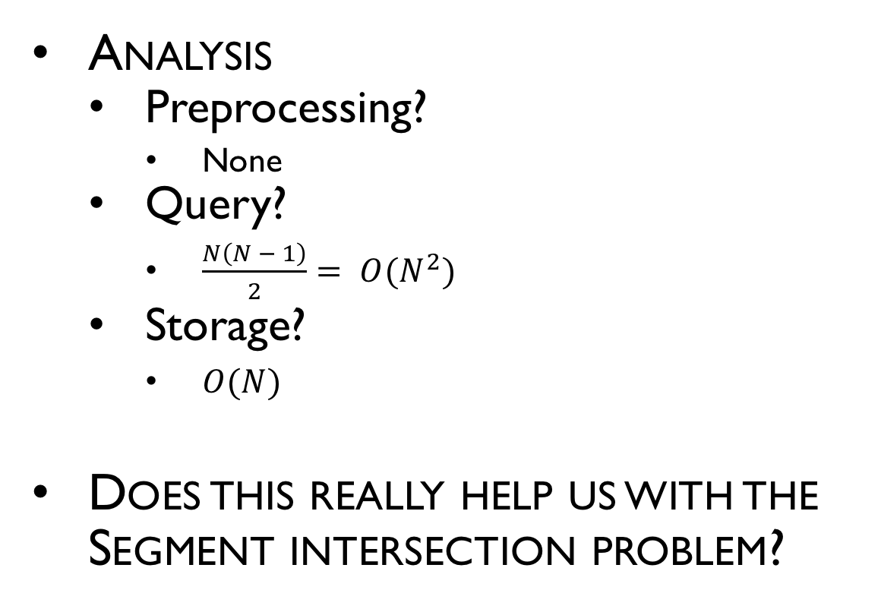
Intersection of rectangles
Analysis
Preprocessing?
None
Query?
$\frac{N\left(N − 1\right)}{2}= O(N^{2})$
Storage?
$O(N)$
Does this really help us with the Segment intersection problem?

Slide 16
Intersection of rectangles
Algorithm using interval trees
Plane sweep algorithm, vertical (top-to-bottom) sweep Event points are Beginning and end of rectangle intervals
At the starting interval:
Compare rectangle x-interval to active set for overlap.
Add rectangle x-interval to active set.
At the ending interval remove rectangle X-interval from active set.

Slide 17
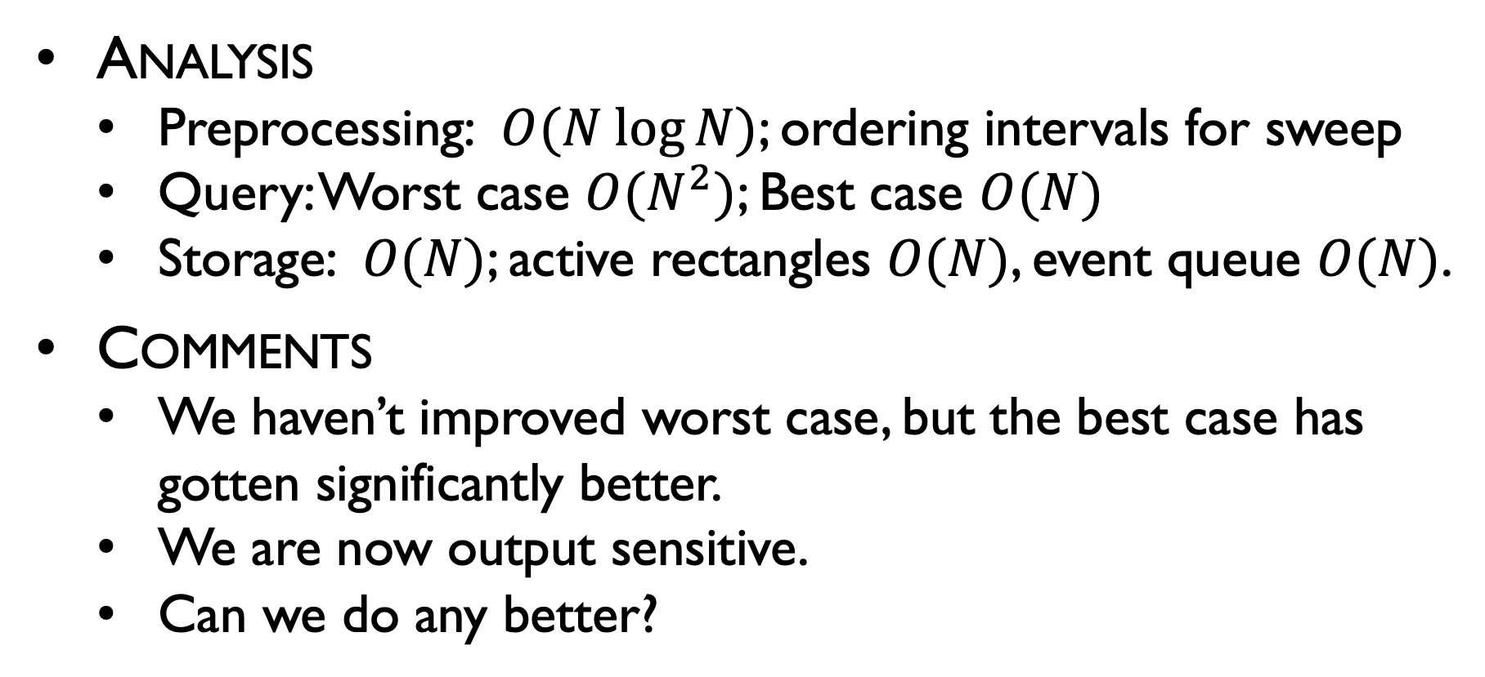
Intersection of rectangles
Analysis
Preprocessing: $O(N log⁡N)$; ordering intervals for sweep
Query: Worst case $O(N^{2})$; Best case $O(N)$
Storage: $O(N)$; active rectangles $O(N)$, event queue $O(N)$.
Comments
We haven’t improved worst case, but the best case has gotten significantly better.
We are now output sensitive.
Can we do any better?

Slide 18
1D Centered Interval Trees
Tree-based Data structure
Each node stores a center point
Intervals are placed into 3 group,
Left of center—placed in left subtree
Right of center—placed in right subtree
Covering center—placed in a specialized list*

Slide 19
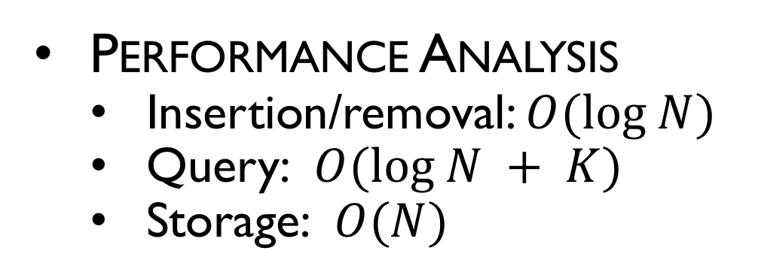
1D Centered Interval Trees
[0,4]
[6,11]
[14,22]
12
[13,16]
[19,24]
Performance Analysis
Insertion/removal: $O(log N)$
Query: $O(log N + K)$
Storage: $O(N)$
5.5
18.5
[14,22]
[0,4]
[6,11]
[13,16]
[19,24]

Slide 20
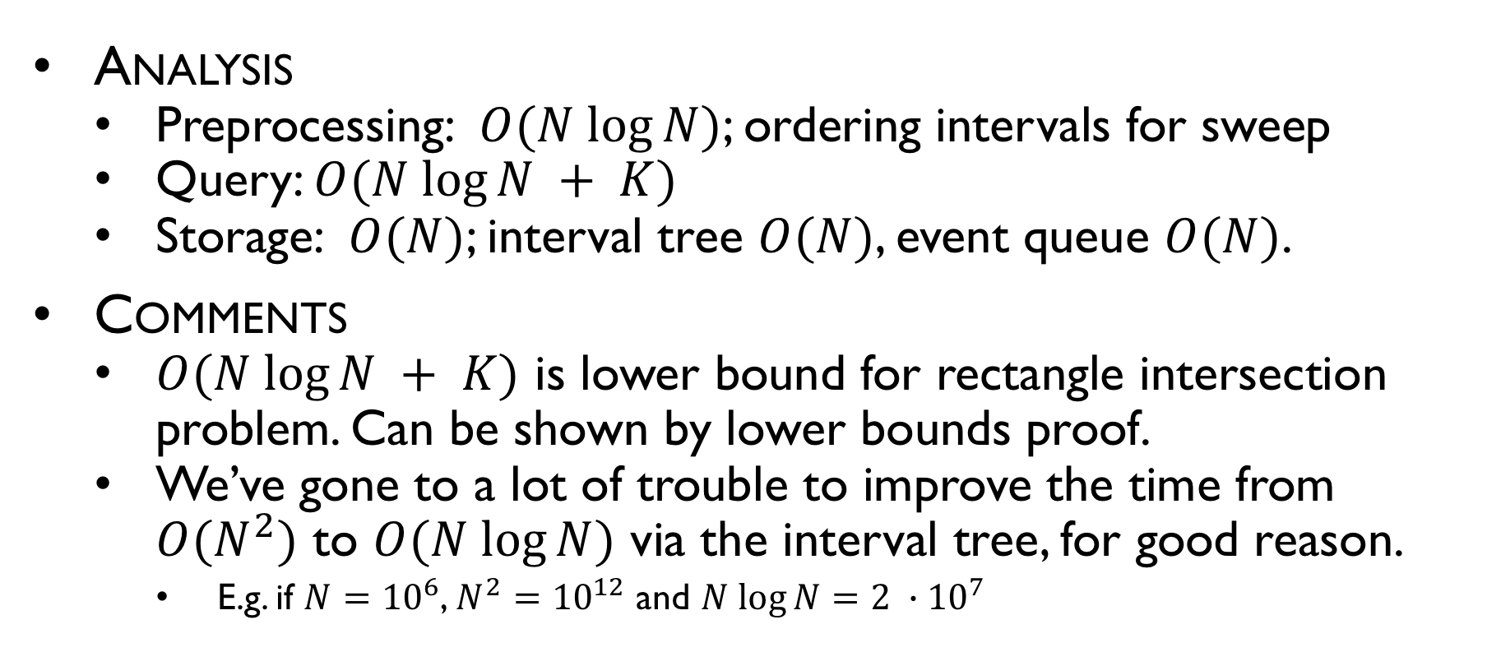
Intersection of rectangles
Analysis
Preprocessing: $O(N log⁡N)$; ordering intervals for sweep
Query: $O(N log⁡N + K)$
Storage: $O(N)$; interval tree $O(N)$, event queue $O(N)$.
Comments
$O(N log⁡N + K)$ is lower bound for rectangle intersection problem. Can be shown by lower bounds proof.
We’ve gone to a lot of trouble to improve the time from $O(N^{2})$ to $O(N log⁡N)$ via the interval tree, for good reason.
E.g. if $N={10}^{6}$, $N^{2}={10}^{12}$ and $N log⁡N=2 ∙{10}^{7}$

Slide 21
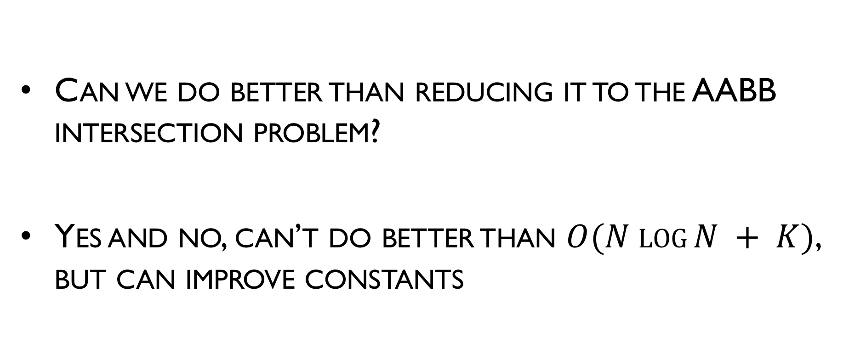
Back to the Segment Intersection Problem
Can we do better than reducing it to the AABB intersection problem?
Yes and no, can’t do better than $O(N log⁡N + K)$, but can improve constants

